Slide 1
How did supporters of slavery in Britain respond to the enslaved rebellion in Saint-Domingue?
Fear
Prejudice
Debate
The Haitian Revolution

Slide 2
Responses of British anti-abolition groups to the slave rebellion in Saint-Domingue (modern-day Haiti)
Identify key anti-abolition groups in Britain and their motivations.
Explain how anti abolitionists responded to the slave rebellion in Saint- Domingue
  economic fears
  political arguments
  racial prejudices
Enquiry Question: How did supporters of slavery in Britain respond to the enslaved rebellion in Saint-Domingue (with fear, prejudice & debate)?

Slide 3

Rebellions by the Enslaved?
Usually, Anti-Abolitionists would think these were a very:
  Good thing
  Bad thing

Slide 4
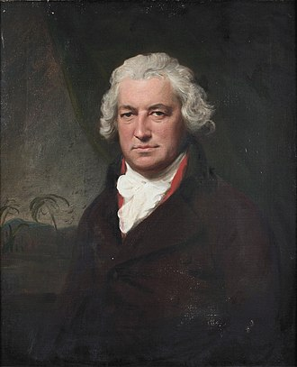
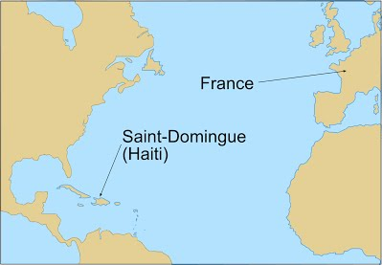
Case Study 1
We will read a short extract from the memoirs of MP Bryan Edwards
(1743–1800).
Edwards is a supporter of slavery
and is giving his views on a rebellion
by enslaved people in the French
colony of Saint-Domingue (Haiti).
WARNING:
He uses racist language
which has been obscured
and we won’t read aloud…
Enquiry Question: How did supporters of slavery in Britain respond to the enslaved rebellion in Saint-Domingue?
Bryan Edwards, MP, portrait
by Lemuel Francis Abbott © https://creativecommons.org/publicdomain/mark/1.0/
Notes:
Starter activity is a memoir entry from pro slavery advocate and MP Bryan Edwards
Hand out on slide 5 for pupils

Slide 5
“I might here expatiate upon the wonderful dispensations of Divine Providence in raising up enslaved Africans…the revolting n***oes of
St. Domingo have been eye-witnesses of the benefits of civilised life among the whites; have seen in what manner and to what extent social order, sober industry, and submission to the laws, contribute to individual and general prosperity…
…Some superior spirits may hereafter rise up among them, by whose encouragement and example they may be taught, in due time, to discard the ferocious and sordid manners and pursuits of savage life; to correct their vices, and be led progressively on to civilisation and gentleness, to the knowledge of trust, and the practice of virtue”.
Bryan Edwards 1797
Expatiate: speak or write in detail about.
Dispensations: gifts
Divine Providence: God's kind and loving guidance and care for the world
St. Domingo: Old name for the French colonial island where Haiti is today
Progressively: Improving or getting better at something
Can you find any words or phrases that show the writer is biased (unfair) against African people?
What does the writer mean by "Divine Providence," and how does he suggest it has helped enslaved Africans?
How does the writer try to make slavery seem acceptable, and how might enslaved people or those against slavery have disagreed?
Challenge Question: How does this source reflect the racist attitudes and beliefs of Europeans in the 18th century?
Notes:
Print me – starter (Pupils to work on the starter and answer the questions on the sheet or in their jotters)
Bryan Edwards, An Historical Survey of the French Colony in the Island of St. Domingo
(Cambridge: Cambridge University Press, 2010 [1797]), 190–91.

Slide 6
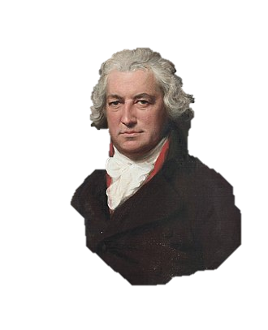
Anti-Abolitionist Response to the Haitian Revolution
time to discard the ferocious and sordid manners and pursuits of savage life
Which reaction best describes anti abolitionist Bryan Edwards’ response to the slave rebellion in Saint- Domingue?
  economic fears
  political arguments
  racial prejudices

Slide 7
Activity questions debrief
Can you find any words or phrases that show the writer is biased (unfair) against African people?
What does the writer mean by "Divine Providence," and how does he suggest it has helped enslaved Africans?
How does the writer try to make slavery seem acceptable, and how might enslaved people or those against slavery have disagreed?
Challenge Question: How does this source reflect the racist attitudes and beliefs of Europeans in the 18th century?
Enquiry Question: How did supporters of slavery in Britain respond to the enslaved rebellion in Saint-Domingue?
Bryan Edwards, MP, portrait
by Lemuel Francis Abbott © https://creativecommons.org/publicdomain/mark/1.0/
Notes:
What does the writer mean by "Divine Providence," and how does he suggest it has helped enslaved Africans?
The writer refers to "Divine Providence" as God's will or intervention. He implies that God has allowed Africans to be enslaved so that they can be "raised up" by exposure to white civilization. He suggests that slavery has provided them with the opportunity to learn from white society.
How does the writer describe white civilization, and what does he assume about African people and their way of life?
The writer describes white civilization as advanced, orderly, and prosperous, associating it with "social order, sober industry, and submission to the laws." He assumes that African people live in a savage and uncivilized manner, needing guidance and correction to become more "civilized and gentle."
Can you find any words or phrases that show the writer is biased (unfair) against African people?
Words and phrases such as "ferocious and sordid manners," "savage life," "correct their vices," and "led progressively on to civilization" show the writer’s bias. These suggest that African people are inherently inferior and need to be "improved" by white people.
How does the writer try to make slavery seem acceptable, and how might enslaved people or those against slavery have disagreed?
The writer tries to justify slavery by portraying it as a way for African people to be "civilized" and learn "virtue." He suggests that white society is helping them improve. However, enslaved people and abolitionists would argue that slavery was cruel, inhumane, and unjustifiable, violating fundamental human rights rather than benefiting those enslaved.
How does this source reflect the racist attitudes and beliefs of Europeans in the 18th century?
This source reflects 18th-century European racism by promoting the idea that African people were inferior and in need of white guidance. It reinforces the belief that European civilization was superior and that Africans could only improve through exposure to white culture. This mindset was often used to justify slavery and colonialism

Slide 8
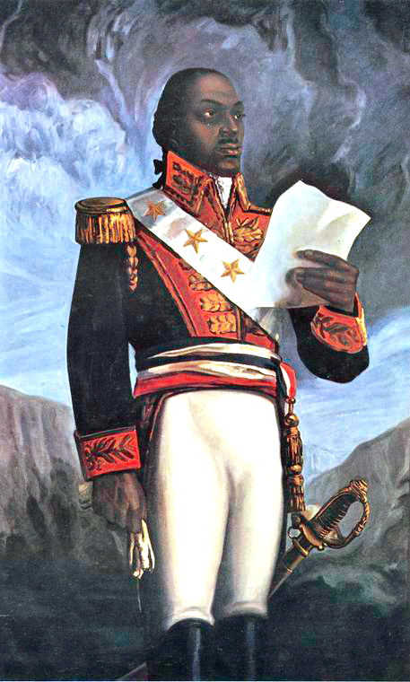

What do you already know about the Saint-Domingue rebellion?
Have you heard of the Haitian
Revolution?
60
Sec
In 60 seconds make list of questions / or guesses / or facts from the sources we have available (this painting, Edwards’ writings)

Slide 9
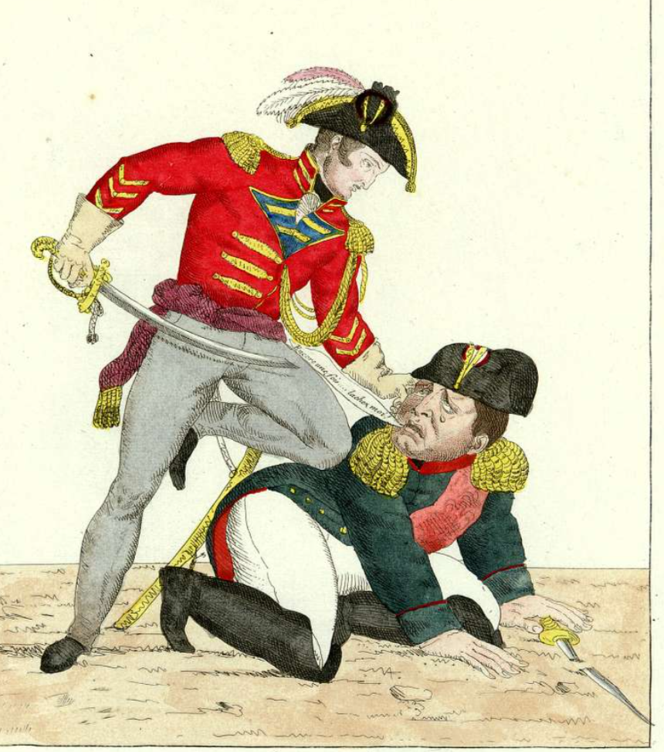

Rebellions by the Enslaved in the French Caribbean?
This was much less clear-cut, so the reaction of the Anti-Abolitionists was mixed
  Good thing
  Bad thing
Notes:
Image: Tenez-le bien, Napoléon! Paris, France, A satirical print depicting Napoleon Bonaparte being held down, CC Creative Commons

Slide 10
Dilemma
Why did the Saint-Domingue rebellion/Haitian Revolution pose such a dilemma for the British slave owning ruling class?

Slide 11

The French Revolution and Saint-Domingue
In France, the French Revolution of 1789 overthrew the French Monarchy. The revolutionaries who did this were guided by new ideas about human rights, that all humans were equal.
These ideas were also heard by enslaved people in the French colonies in the Caribbean.
Both the ideas & the regime change caused by the revolution created an opportunity for enslaved people to seek their freedom.
Enquiry Question: How did supporters of slavery in Britain respond to the slave rebellion in Saint-Domingue?
A propaganda poster, 1793 slogan "Unity and Indivisibility of the Republic. Liberty, Equality, Fraternity or Death"
https://en.wikipedia.org/wiki/Libert%C3%A9,_%C3%A9galit%C3%A9,_fraternit%C3%A9#/media/File:Unit%C3%A9_Indivisibilit%C3%A9_de_la_R%C3%A9publique.jpg
Notes:
Recap of Haitian Revolution: This lesson could be a follow up to lessons on the French and Haitian Revolutions.
The French Revolution (1789–1799) played a crucial role in inspiring the Haitian Revolution by introducing radical ideas about human rights and governance. The revolution’s core principles—liberty, equality, and fraternity—challenged the traditional structures of monarchy, aristocracy, and slavery. The Declaration of the Rights of Man and Citizen, adopted in 1789, asserted that all men were born free and equal, directly contradicting the institution of slavery that sustained France’s Caribbean colonies. These revolutionary ideas spread to Saint-Domingue (now Haiti), where they resonated with the island’s enslaved and free Black populations. As political turmoil in France led to the weakening of colonial authority, enslaved people saw an opportunity to fight for their freedom, ultimately sparking the largest and most successful slave revolt in history.
Image: A propaganda poster, 1793 slogan "Unity and Indivisibility of the Republic. Liberty, Equality, Fraternity or Death"
https://en.wikipedia.org/wiki/Libert%C3%A9,_%C3%A9galit%C3%A9,_fraternit%C3%A9#/media/File:Unit%C3%A9_Indivisibilit%C3%A9_de_la_R%C3%A9publique.jpg

Slide 12
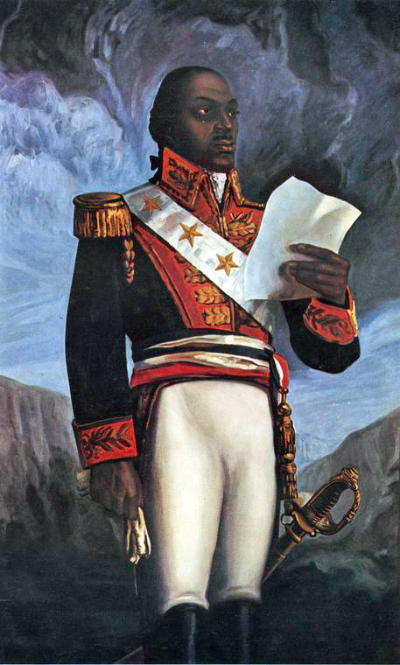
The French Revolution and Saint-Domingue
In Saint Domingue, Toussaint Louverture seized this opportunity. Previously enslaved and self-educated, he led the revolt.
The revolt became a revolution when its Black leaders successfully defeated the French,
ended slavery and ended colonialism.
Saint Domingue became a new country under Black leadership which they renamed: Haiti.
Enquiry Question: How did supporters of slavery in Britain respond to the enslaved rebellion in Saint-Domingue?
Général Toussaint Louverture https://digitalcollections.nypl.org/items/510d47dc-8fbd-a3d9-e040-e00a18064a99
Notes:
The Haitian Revolution (1791–1804) was one of the deadliest conflicts in the Americas. Estimates suggest that: 200,000+ enslaved and free Black Haitians died due to warfare, massacres, and disease. Approximately 75,000 French soldiers and colonists perished, including troops sent by Napoleon. Tens of thousands of Spanish and British soldiers also died, as both nations attempted to seize the colony. In total, the death toll likely exceeded 300,000, making it one of the most devastating uprisings in history.
Haiti – inspired by the Indigenous word for: "land of mountains" in the indigenous Taíno language.
Image: Schomburg Center for Research in Black Culture, Photographs and Prints Division, The New York Public Library Copyright

Slide 13

Who were the Anti Abolitionists?
The Haitian Revolution terrified supporters of slavery in Britain because it showed that enslaved people could seize their own freedom.
Many important people supported slavery because they were making a lot of money from it, including shipbuilders, bankers and plantation owners. These people joined together in The West India Committee.
The committee had influence over other influential people such as Prime Minister William Pitt, prominent politician Henry Dundas along with
King George III and his son the Duke of Clarence
Enquiry Question: How did supporters of slavery in Britain respond to the enslaved rebellion in Saint-Domingue?
Notes:
https://www.bbc.co.uk/bitesize/topics/zgc4jxs/watch/z3ttsbk - BBC Bitesize video should work by clicking the play video icon
All these groups had vest interest in the continuation of the slave trade – The West Indian Committee in particular were a group of plantation owners, businessmen and MPS who all had their money tied up in some area of the trade. Be it in Britain, the Caribbean, Africa or the ships that transported the captives, cash crops etc from each point of the triangular trade.

Slide 14
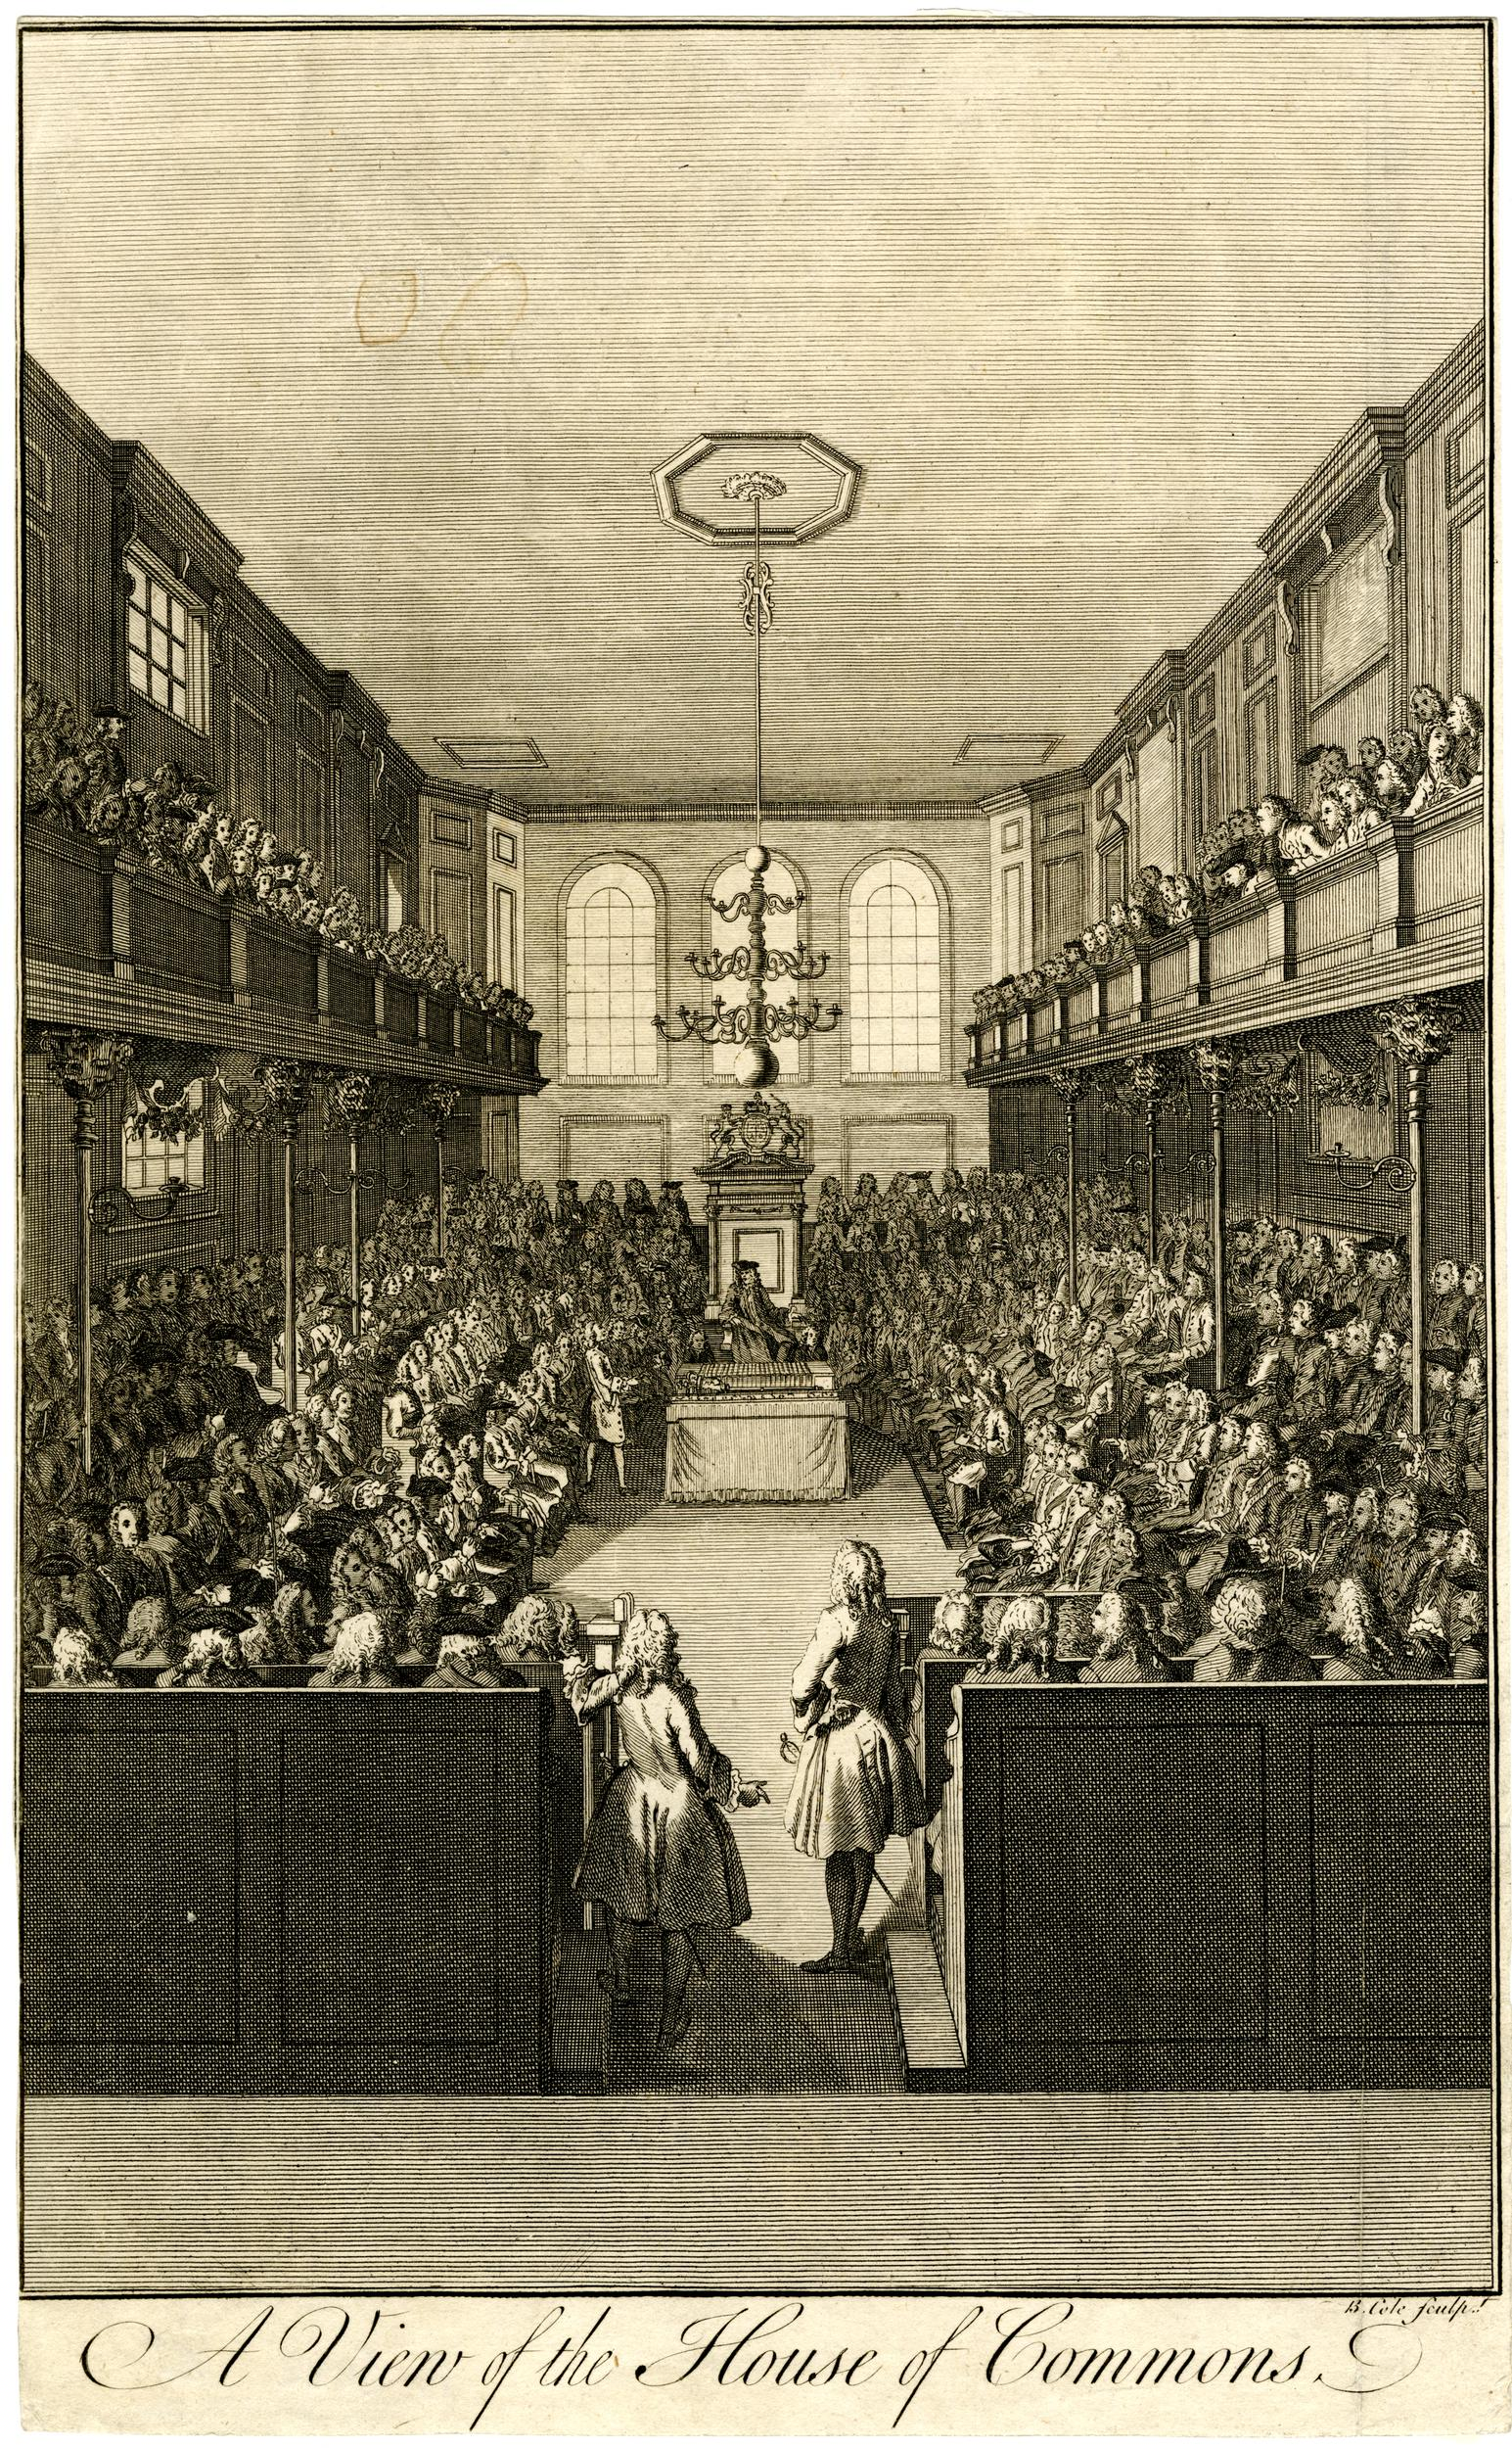
Anti-Abolitionist Response in Britain
The anti-abolitionists made 4 types of argument about the Saint-Domingue Revolt (Haitian Revolution)
  Threat to British Colonial Power
  (Political and economic)
  Challenge to Social Order (Social)
  Strategic and Military concerns (political)
  Financial and Diplomatic interests: (Economic and political)
© The Trustees of the British Museum. Shared under a Creative Commons Attribution-NonCommercial-ShareAlike 4.0 International (CC BY-NC-SA 4.0) licence.
Enquiry Question: How did supporters of slavery in Britain respond to the slave rebellion in Saint-Domingue?
Notes:
Go over the responses with pupils before the task on next slide

Slide 15

Gallery Walk
You have been given a worksheet with
4 headings
which match stations around the room.
Each of these stations outline a different reason why British supporters of slavery were worried about the revolt in Saint Domingue.
Use the information to complete your sheet.
Enquiry Question: How did supporters of slavery in Britain respond to the slave rebellion in Saint-Domingue?
Notes:
Can be done as a group activity gallery walk or individual task depending on timing and class ability/dynamic.
Print the next 6 slides separately
Gallery walk image: https://www.enlivenproject.eu/survival-kit/methods/gallerywalk/gallerywalk.html

Slide 16

Cold Calling Consolidation
Why did supporters of slavery see the rebellion on Saint-Domingue as a threat to colonial power?
Why did supporters of slavery see the revolution as a threat to the social order?
What strategic and military opportunities did pro slavery supporters see in relation to the slave revolt in Haiti?
To what extent did financial and diplomatic interests motivate the pro slavery response?
Enquiry Question: How did supporters of slavery in Britain respond to the slave rebellion in Saint-Domingue?
Notes:
Can be done as a group activity gallery walk or individual task depending on timing and class ability/dynamic.
Print the next 6 slides separately

Slide 17
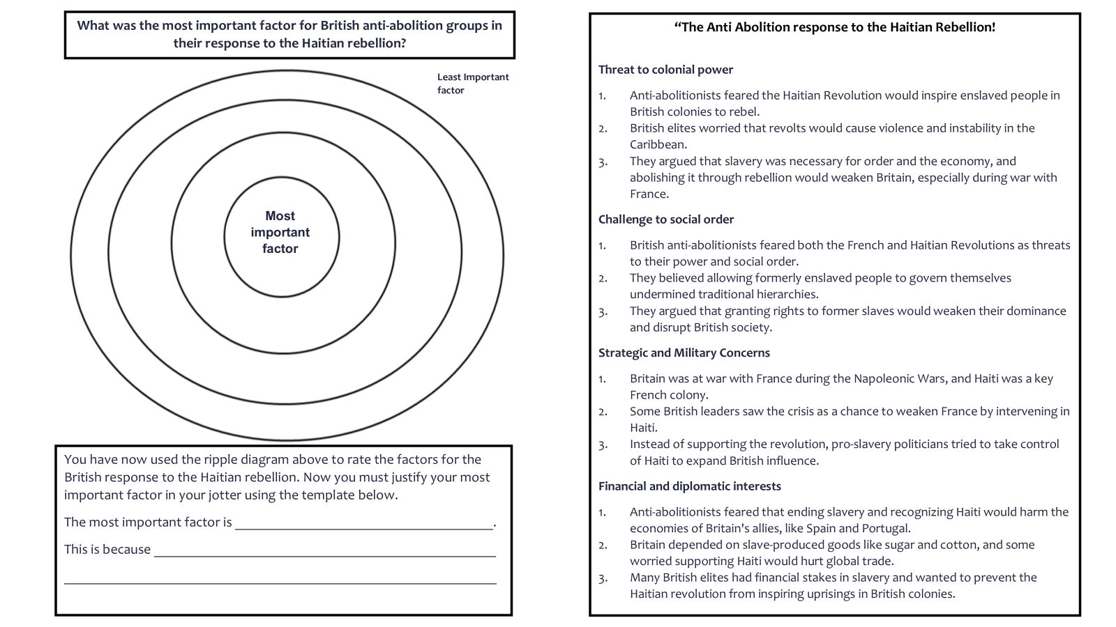
Plenary
You have learned about four reasons that supporters of slavery were worried about the revolt in Saint Domingue.
The worksheet on the right helps you think about how important each of these factors were – remember that it’s okay to disagree about this!
Enquiry Question: How did supporters of slavery in Britain respond to the slave rebellion in Saint-Domingue?
Notes:
Print out on next slide (Pupils have a to evaluate the motivations behind pro slavery responses to the Haitian revolution in the ripple diagram – they should then justify this by completing the response template below the ripple diagram.

Slide 18
So, which way did they swing?
  Good thing
  Bad thing
“The British engaged in an intricate dance of containment, isolation, & engagement with St Domingue/Haiti in an effort to reap the greatest benefit without further disruption to colonialism & slavery”
Historian, Julia Gaffield

Slide 19
Dilemma- messily resolved
"Dessalines proclaimed and published the Haitian Declaration of Independence in the midst of a long and violent war between France and Great Britain.
Haiti’s independence, therefore, provided an opportunity for the British to land a blow to France’s war efforts.
The centrality of war, in the end, trumped any kind of allegiance among European empires.
Warfare also proved to be more important than the fears of white planters and government officials in the British Caribbean that the revolution might spread to the other Caribbean colonies.”
Historian, Julia Gaffield
Notes:
Military strategy, in fact, encouraged the British to provide aid to Dessalines’s forces at the end of the 1803 and to withhold aid from the French forces.
The Jamaican (British) plantocracy did NOT want the British government to ‘recognise’ Haiti officially. So the British government did not recognise their Independence internationally.
Following the failure of the negotiations between Jean-Jacques Dessalines and the governor of
Jamaica, the British government did not issue an official statement regarding its relationship with Haiti. Given that Britain was indecisive and inconsistent in coming to grips with Haiti, what
happened when ships were caught trading with Haiti? How did the courts deal with them? Despite the continued silence regarding Haiti’s diplomatic status, the British explicitly allowed and regulated trade with Haiti beginning in late 1806 and therefore extended economic recognition of Haiti’s independence. The British Admiralty Courts, however, expanded
these terms and extended some degree of diplomatic recognition to Haiti between 1806 and 1826

Slide 20
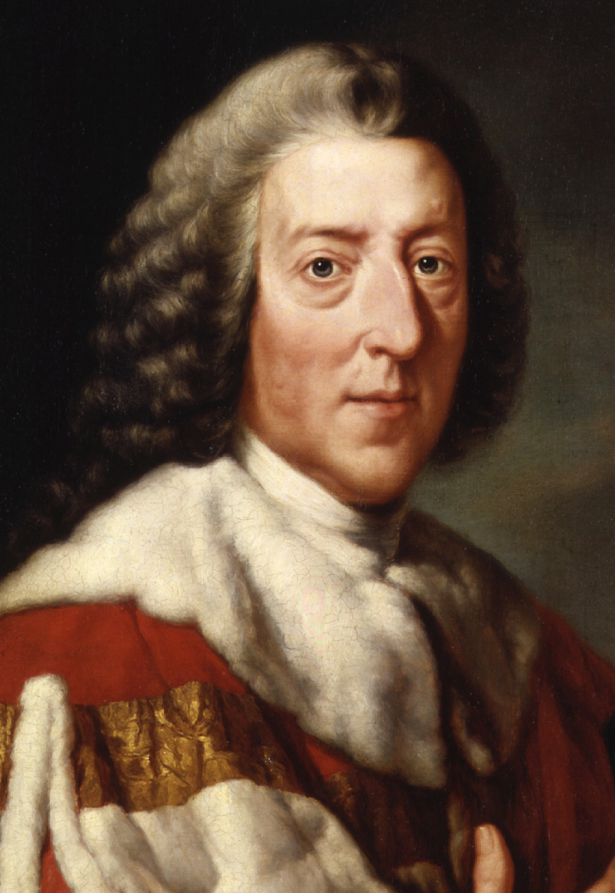
Anti-Abolitionist Response in Britain
In 1793, British Prime Minister William Pitt and Minister for War Henry Dundas sent soldiers to support slavery in Saint Domingue. Britian did not support the new French government, but nor did it support the struggle by enslaved people for control of the colony.
This intervention lasted 5 years and cost enormous sums. More than 40, 000 British soldiers died.
As they withdrew, the British accepted (but did not recognise) the new Black government of Saint Domingue, but it did so only because it did not want its enemy, France, to regain control.
1868: given to National Portrait Gallery by Philip Stanhope, 5th Earl Stanhope – William Pitt the younger
© National Portrait Gallery, London
Enquiry Question: How did anti abolition groups in Britain respond to the slave rebellion in Saint-Domingue
Notes:
William Pitt the Younger, while initially supporting abolition, eventually withdrew his support and voted against it, primarily due to the war with France and the influence of cabinet ministers against abolition, as well as events in St. Domingue.

Slide 21
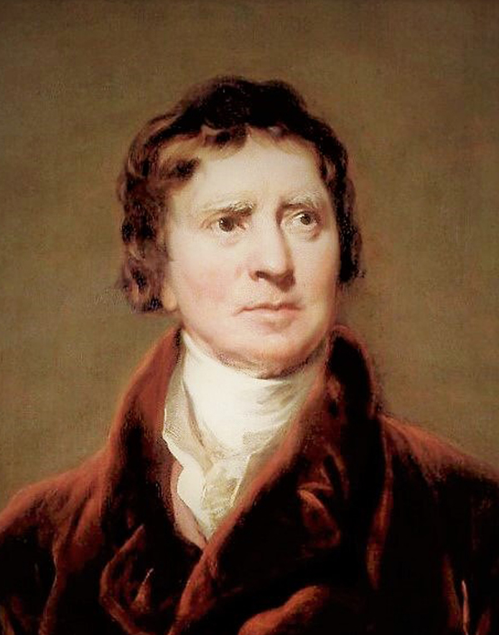

Governmental Response in Britain
In 1793, Minister for War, Henry Dundas gave his argument for why Britian should send troops to Saint Domingue.
“'I consider of infinite moment both in humbling the power of France and with the view of enlarging our national wealth and security‘”.
Britian was fighting France in the Napoleonic Wars at this time. The phrase "humbling the power of France" implies that Britain aimed to weaken France.
The phrase "enlarging our national wealth
and security" indicates that Britain saw the
potential to get rich from getting involved in the war.
Task: Watch the video and take notes on the role and activities of Henry Dundas in relation to the British Government and abolition
https://www.bbc.co.uk/bitesize/topics/zgc4jxs/watch/z3ttsbk
Henry Dundas, 1st Viscount Melville by Sir Thomas Lawrence - National Portrait Gallery, London Copyright ©
Enquiry Question: How did supporters of slavery in Britain respond to the slave rebellion in Saint-Domingue?

Slide 22
Section 2
Lesson Plan

Slide 23
Lesson Level Enquiry Question How did supporters of slavery in Britain respond to the slave rebellion in Saint-Domingue?
Purpose: | Do not link to syllabus If a pupil asks, ‘Why do I need to know this?’, what will you reply? The importance of Slave rebellions and uprisings to the abolition of slavery and the slave trade is often underappreciated in Britain. Important because the only successful slave rebellion and the British response was a key factor for abolition.
Objective: | The learning in this lesson links to the syllabus by What is the takeaway? To understand the significance of the Haitian Revolution and the responses of British anti-abolitionists to this event
Outcome: | Pupils will demonstrate their ability to answer the Enquiry Question by… Be able to identify the anti-abolitionist responses to the Haitian revolution and justify which one was the most important
Time | Teacher is… | Pupils are… | Checking learning
0-5 (Slides 1-6) Starter | Circling room to distribute and motivate/assist pupils with starter questions – go over any difficult words or answer pupils who are unsure Answers on Slides 6 & 7 including the Notes section of the ppt | Answering a set of analysis questions on the primary source from Bryan Edwards MP | Cold Calling pupils to get answers which contribute to a class discussion
5-12 Mins (Slides 10-15) | Explaining three slides on Haitian Revolution, Who are the pro slavery lobby? and explaining the instructions for Gallery walk | Pupils are note taking and looking for information to help answer the enquiry question. | Group discussion or pose some questions in relation to the enquiry Q
12 – 40 (Slide 15) and printouts | Teacher is circling class to ensure all pupils are attempting their questions | Going from station to station answering the questions | A set of random cold call questions (1 from each section to ensure pupils have achieved the outcome of the task)
40-50 (Slides 17-21) | Provide instructions for plenary task on 17 Cover information to help pupils complete their worksheets using Slides 18 -21 | Pupils to justify their most important factor from the anti-abolitionist responses to the Haitian rebellion on ripple diagram sheet | Teacher can check the exit pass (ripple diagram)
Home learning: (if necessary/ appropriate)

Slide 24
Section 3
Lesson Print Outs
Can you find any words or phrases that show the writer is biased (unfair) against African people?

Slide 25
“I might here expatiate upon the wonderful dispensations of Divine Providence in raising up enslaved Africans…the revolting n*****s of St. Domingo have been eye-witnesses of the benefits of civilised life among the whites; have seen in what manner and to what extent social order, sober industry, and submission to the laws, contribute to individual and general prosperity…
…Some superior spirits may hereafter rise up among them, by whose encouragement and example they may be taught, in due time, to discard the ferocious and sordid manners and pursuits of savage life; to correct their vices, and be led progressively on to civilisation and gentleness, to the knowledge of trust, and the practice of virtue”.
Bryan Edwards 1797
Expatiate: speak or write in detail about.
Dispensations: gifts
Divine Providence: God's kind and loving guidance and care for the world
St. Domingo: Old name for the French colonial island where Haiti is today
Progressively: Improving or getting better at something
Can you find any words or phrases that show the writer is biased (unfair) against African people?
What does the writer mean by "Divine Providence," and how does he suggest it has helped enslaved Africans?
How does the writer try to make slavery seem acceptable, and how might enslaved people or those against slavery have disagreed?
Challenge Question: How does this source reflect the racist attitudes and beliefs of Europeans in the 18th century?
Notes:
Print me – starter (Pupils to work on the starter and answer the questions on the sheet or in their jotters)
Bryan Edwards, An Historical Survey of the French Colony in the Island of St. Domingo
(Cambridge: Cambridge University Press, 2010 [1797]), 190–91.

Slide 26
Section One: Threat to British Colonial Power
Why did British elites fear the impact of the rebellion in Saint-Domingue could have on their Caribbean colonies?
How did British plantation owners justify the continuation of slavery?
What role did concerns about Napoleon’s France play in Britain’s stance on slavery?
How did the rebellion on Saint-Domingue challenge European colonial power?
Section Two: Challenge to Social Order
Why did British anti-abolitionists view the Revolution as a threat to social order?
How did British elites view free people of colour and enslaved Africans?
In what ways did the Revolution challenge traditional social structures?
Why did the British aristocracy fear that granting rights to formerly enslaved people could impact social order in the UK?
Notes:
Print this slide and the next together (double sided)

Slide 27
Section Three: Strategic and Military concerns
Why was Saint-Domingue (Haiti) important to France during the Napoleonic Wars?
How did some British leaders view the Revolution as an opportunity in their conflict with France?
Why did pro-slavery politicians in Britain seek to take control of Saint-Domingue in the 1790s?
Why was Saint-Domingue's location important for Britain’s control over Caribbean trade routes?
Section Four: Financial and Diplomatic Interests
Why did Britain’s anti-abolitionists believe recognizing independence of the enslaved could harm its European allies?
How was Britain’s economy dependent on slave-based goods like sugar, coffee, and cotton?
Why was Saint-Domingue, France’s most profitable colony?
What would Saint-Domingue have added to the British empire in the Caribbean?

Slide 28
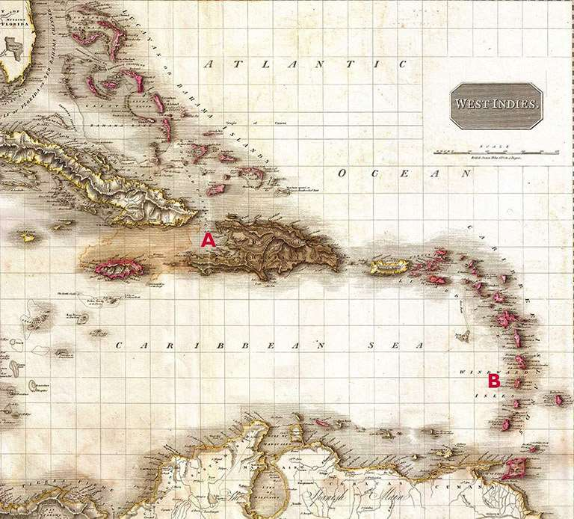
Threat to British Colonial Power
The rebellion on Saint-Domingue was the first and ultimately, only successful slave revolt, which inspired other slave colonies to revolt and resist in the region. Anti-abolitionists feared rebellion would become contagious in the Caribbean, particularly on their prised possessions of Jamaica and Barbados.
The fear enslaved people would revolt against plantation owners, leading to instability, violence and ultimately a decline in British power.
They argued that slavery was essential to maintaining order and economic prosperity, and that its abolition through revolutionary violence would result in anarchy and it would weaken Britain during a time when national security was under threat from Napoleon’s France.
A map of the West Indies published in 1818, with Saint-Domingue (Haiti) (A) and St Lucia (B) highlighted
© Public domain
Notes:
Print me individually and hang as a station in the room (Maybe blow up to A3)

Slide 29
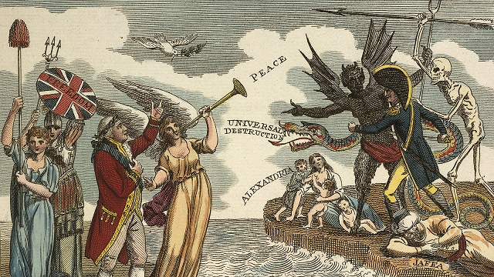
Challenge to Social Order
British anti-abolitionists hated the French revolution. They saw it as a mass uprising of the middle and lower classes as a threat to their ruling positions in Britain and likewise they believed the revolution on Saint-Domingue undermined traditional social structures by allowing formerly enslaved people to govern themselves.
This was because the saw themselves racially superior to freed and enslaved Black people and saw the latter as property i.e. not as fellow human beings.
They viewed the rebellion as a threat to their own dominance, arguing that granting rights to formerly enslaved people would destroy the political and social order back home in the UK.
Anti-revolutionary propaganda sheet from 1803 depicts King George III surrounded by symbols of British peace and liberty, while across the channel the figure of Napoleon is stalked by poverty and ‘universal destruction’ . (Source: The British Library)
Notes:
Print me individually and hang as a station in the room (Maybe blow up to A3)

Slide 30
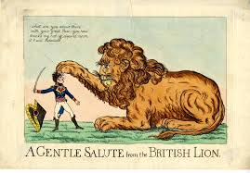
Strategic and Military Aims
Britain was at war with France (1793-1815) commonly known as the Napoleonic wars, and Saint-Domingue was France’s most valuable possession due to its location at the centre of the Caribbean and its sugar production.
Some British leaders seen an opportunity in the crisis and believed that annexing Saint-Domingue could weaken France economically and strategically.
Purely out of self-interest Britain used the rebellion as an excuse to seize control of Saint-Domingue.
Not only could the island serve as a strategic naval base for Britain, projecting power across the Caribbean, it could also provide huge amounts of revenue for the empire through the enslaved population's ability to produce sugar – and revenue helped the British with their military and strategic goals
BM Satires / Catalogue of Political and Personal Satires in the Department of Prints and Drawings in the British Museum
Notes:
Print me individually and hang as a station in the room (Maybe blow up to A3)

Slide 31
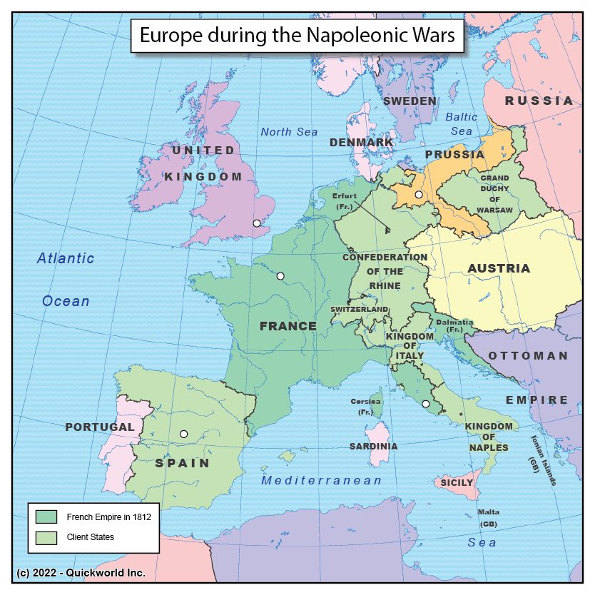
Financial and Diplomatic Interests
Fuelled by anti-Black racism, anti-abolitionists refused to even recognise Haitian independence, further spread of rebellion would damage the economies of their European allies, such as Spain and Portugal, who depended on slavery. These nations were important to Britain in the war against revolutionary France.
Furthermore, industrial Britain's businesses relied on the sales from the cash crops produced in slave-based economies, and some feared that acknowledging the independence of a slave republic would destabilize global trade and weaken Britain’s industrial economy.
Saint-Domingue was France's most profitable colony and produced 40% of the worlds sugar. By taking the island, Britain could add to its empire in the West Indies
Checking French influence and power was important to the British in the 1790s. They invaded Haiti to keep pro slavery nations such as Spain and Portugal content and in the British camp.
© https://mapoftheday.quickworld.com/posts/the-napoleonic-wars
Notes:
Print me individually and hang as a station in the room (Maybe blow up to A3)

Slide 32
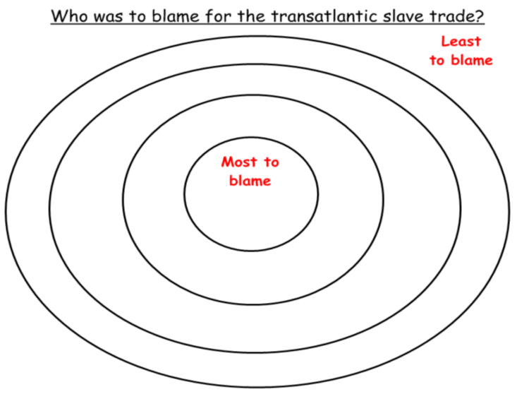
What was the most important factor for British anti-abolition groups in their response to the Haitian rebellion?
“The Anti Abolition response to the Haitian Rebellion!
Threat to colonial power
Anti-abolitionists feared the Haitian Revolution would inspire enslaved people in British colonies to rebel.
British elites worried that revolts would cause violence and instability in the Caribbean.
They argued that slavery was necessary for order and the economy, and abolishing it through rebellion would weaken Britain, especially during war with France.
Challenge to social order
British anti-abolitionists feared both the French and Haitian Revolutions as threats to their power and social order.
They believed allowing formerly enslaved people to govern themselves undermined traditional hierarchies.
They argued that granting rights to former slaves would weaken their dominance and disrupt British society.
Strategic and Military Concerns
Britain was at war with France during the Napoleonic Wars, and Haiti was a key French colony.
Some British leaders saw the crisis as a chance to weaken France by intervening in Haiti.
Instead of supporting the revolution, pro-slavery politicians tried to take control of Haiti to expand British influence.
Financial and diplomatic interests
Anti-abolitionists feared that ending slavery and recognizing Haiti would harm the economies of Britain's allies, like Spain and Portugal.
Britain depended on slave-produced goods like sugar and cotton, and some worried supporting Haiti would hurt global trade.
Many British elites had financial stakes in slavery and wanted to prevent the Haitian revolution from inspiring uprisings in British colonies.
Least Important factor
Most important factor
You have now used the ripple diagram above to rate the factors for the British response to the Haitian rebellion. Now you must justify your most important factor in your jotter using the template below.
The most important factor is _____________________________________.
This is because _________________________________________________
______________________________________________________________
Notes:
Print me Exit Task (Pupils have a to evaluate the motivations behind pro slavery responses to the Haitian revolution in the ripple diagram – they should then justify this by completing the response template below the ripple diagram.

Slide 33
Section 4
Sources

Slide 34
Sources
Bryan Edwards, An Historical Survey of the French Colony in the Island of St. Domingo (Cambridge: Cambridge University Press, 2010 [1797]), 190–91.
Image - Bryan Edwards - Portrait by Lemuel Francis Abbott © Public domain
Image - Toussaint Louverture – Haitian national hero – Date 19th century Source - Schomburg Center for Research in Black Culture, Photographs and Prints Division, The New York Public Library.
BBC Bitesize Video – Public domain https://www.bbc.co.uk/bitesize/topics/zgc4jxs/watch/z3ttsbk
Image: House of Commons in the 18th Century: Copyright © 2025 BBC https://ichef.bbci.co.uk/images/ic/480xn/p02gj1xz.jpg
Image - 1868: given to National Portrait Gallery by Philip Stanhope, 5th Earl Stanhope – William Pitt the younger © National Portrait Gallery, London
Image - Henry Dundas, 1st Viscount Melville by Sir Thomas Lawrence - National Portrait Gallery, London Copyright ©

