Slide 1
British Attitudes to Enslaved Resistance

Slide 2
What do primary sources tell us about how British people reacted to organised armed resistance by enslaved people?
Notes:
Enquiry Question that pupils will be focused on throughout the lesson and need to answer at the end.

Slide 3
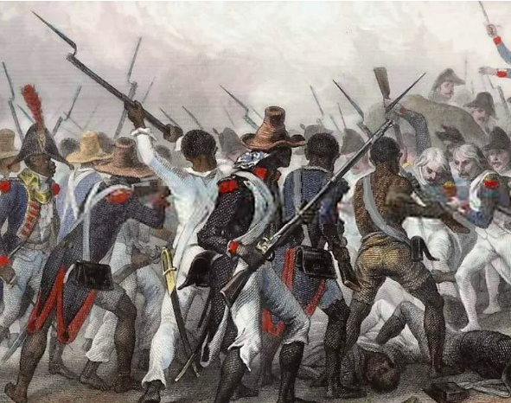



Starter – See, Think, Wonder
3 things you see
2 things you think
1 thing you wonder
Notes:
Pupils should be working on this talking about what they see in the picture, what they think is happening and what questions they have from looking at the picture. Source - https://www.europeana.eu/en/exhibitions/black-lives-in-europe/three-portraits-of-the-haitian-revolution

Slide 4
To be able to answer the following question:
What do primary sources tell us about how British people reacted to armed resistance by enslaved people?
I can describe some examples of armed resistance to slavery in the British Caribbean
I can use primary sources to explain how British people reacted to these events.

Slide 5
Most resistance to enslavement was small scale and covert, for example working slowly or breaking tools ‘accidentally on purpose’.
However, there were several examples of organised armed rebellions by enslaved people. These became more common after the French Revolution (1789) which had shown that people could overthrow oppressive governments.
Notes:
Unpacking the Painting French Soldiers in Blue and White – The French army usually wore blue coats with white trousers and red details (like cuffs or epaulettes). This tells us who the European troops are in the picture.
Black Haitian Soldiers in Mixed Uniforms – The revolutionary army often had a mix of uniforms: sometimes French-style blue coats (taken from captured supplies), sometimes simple white or brown cloth. This shows how they reused whatever they could.
Red Flashes of Colour – Red trimmings or hats (shakos) stand out in the French troops, giving a sense of order and tradition.
Dark or Earthy Colours on Defenders – The Haitian defenders sometimes appear in darker, plainer clothes, making them blend more with the smoke and earth—like guerrilla fighters.
Bright Against Smoky Grey – The clean blue, white, and red of the French uniforms stand out against the heavy black and grey smoke in the engraving.
It highlights the clash between (the French army) and resistance (the Haitian defenders). A Smaller Fort or Structure – In the middle or background you might spot what looks like a strong position or fort—this was the important Crête-à-Pierrot fort.
Strong Group Shapes – The soldiers form big shapes, like squares or lines, showing they’re organized even in chaos.
Context This fight was part of the Haitian Revolution, where free Black soldiers led by Jean-Jacques Dessalines defended the Crête-à-Pierrot fort until they had to leave because of heavy losses. Later, the French took control again (Author) Auguste Raffet was a famous French artist who loved drawing dramatic and powerful battle scenes (even if he hadn’t seen them in real life). He made them look full of energy and emotion

Slide 6
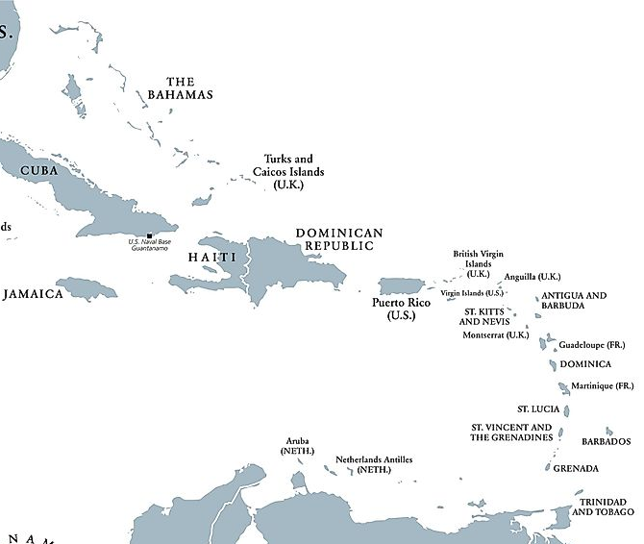
Haitian Revolution
1791 - 1804
Antigua
1736
First Maroon War 1728-1740
Second Maroon War 1795-1796
First Carib War 1769-1773
Second Carib War 1795-1797
Bussa’s Rebellion
1816
Demerara Rebellion
1823
Fedon’s Rebellion
1795 - 1976
Notes:
Here are some examples of rebellions that occurred in the Caribbean and when/where they happened. Gives pupils a chance to see that they happened over the course of many years and in many different places. Explain to pupils that this shows rebellions were not simply happening here and there, but they were happening all the time.

Slide 7

Between 1791 and 1804, free & enslaved people in Haiti had fought the Haitian revolution which successfully overthrew French rule, ended slavery and installed a free Black government.
This event gave even more confidence and inspiration to enslaved people in other European colonies.
Notes:
Map Source - https://www.worldatlas.com/geography/west-indies.html

Slide 8
Think! What would enslaved people need to do and need to have to launch an organised armed rebellion?
Notes:
Have the pupils discuss this and see what they come up with. Answers are on the next slide.

Slide 9
Here’s some things you might have thought of..
Strategic planning
Strong leadership
Creative and trusting forms of communication
Guerilla Warfare Tactics
Courage to fight European military troops
Source - https://www.europeana.eu/en/exhibitions/black-lives-in-europe/three-portraits-of-the-haitian-revolution

Slide 10
Haitian Revolution 1791-1804
This was a successful insurrection in the French colony of Saint Domingue, which is now known as Haiti. It included enslaved Africans and free people of colour from Saint-Domingue and European powers, some of which (Polish) eventually fought on the side of the Black rebels.
This revolt was extremely violent from the beginning and was led by Toussaint L'Ouverture, a self-educated former enslaved person.
This revolution was also encouraged by the French Revolution which had happened in 1789.
The revolution ended with independence and Saint Domingue became the independent nation of Haiti.
Notes:
Information before the task to give pupils a foundation of understanding in what happened with the Haitian Revolution.

Slide 11
Task One – Think, Pair, Share
You are going to be given a source which is shows how British supporters of slavery felt about the Haitian Revolution.
In pairs, read through the source and answer the questions.
Be ready to talk about what you and your partner thought about the source.
Questions
What does the source tell us happened?
What does it tell us the British supporters of slavery are fearful of?
What British colony are they most worried about? Why do you think this is?
Notes:
This slide is paired with the source 1 worksheet. The questions should be answered by the pupils.

Slide 12
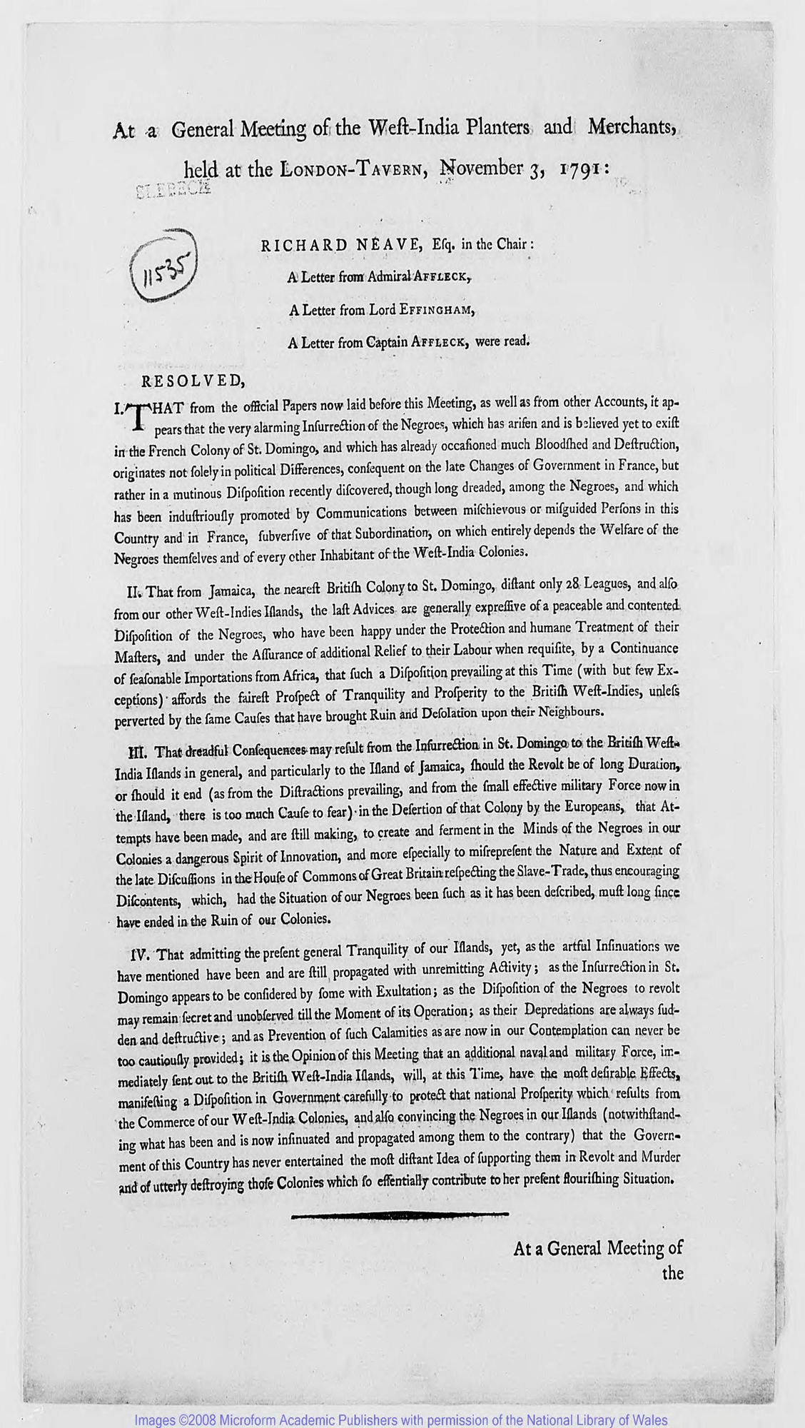
Source 1
This source describes an agreement made at a meeting. Who is at the meeting?
[we agree] that dreadful consequences may result from the insurrection in St. Domingo [Haiti] to the British West India islands in general, and particularly to the Island of Jamaica, should the [Haitian] Revolt be of long duration, or should it end… in the Desertion of that Colony by the Europeans [i.e. the French leaving].,
[we agree] that attempts have been made, and are still making, to create a ferment in the Minds of N- in our Colonies a dangerous Spirit of Innovation, and more especially to misrepresent the Nature and Extent of the late Discussions in the House of Commons of Great Britain respecting the Slave Trade, thus encouraging Discontents [i.e. unhappy people]

Slide 13
The Haitian Revolution helped decide the British Parliament to end the Trade in enslaved peoples
1. Fear of More Haitian-Style Revolts
The Haitian Revolution (1791–1804) showed enslaved people could rise up, defeat European armies, and create an independent Black republic. .
This terrified slaveholding societies in the Americas and Europe. .
Ending the trade (the constant importing of new, rebellious Africans) was seen as a way to calm fears and reduce the chance of future uprisings.
Notes:
2. Economic Shifts in the British Empire
By 1807, Britain’s economy was relying less on the transatlantic trade because of industrialization and new markets.
Some elites thought slavery could continue with existing enslaved people (through natural reproduction), so they no longer “needed” to keep shipping in Africans.
Ending the trade was a compromise: it protected planters’ wealth while cutting off the most violent part of the system.
3. Politics and Public Pressure
The Haitian Revolution, along with abolitionist campaigns in Britain, made the brutality of the trade impossible to ignore.
Abolitionists used Haiti as proof that slavery was unstable and morally wrong.
But powerful plantation owners still defended slavery itself as essential to the Caribbean economy, so Parliament only passed the easier step first: stopping imports, not freeing enslaved people.
But slavery itself lived on until 1833, because profits and planter power were too strong to defeat right away.

Slide 14
Why might many learners be surprised that the enslaved still had to resist after 1807?
What happened in 1807?
What happened in the 1830s
Why is one date studied far more than the other in Britain?

Slide 15
Baptist War 1831-1832
On Christmas Day 1831, a rebellion broke out in Jamaica involving 60,000 enslaved people. The rebellion was led by a Baptist preacher called Samuel Sharpe. It last 11 days and has become known as The Baptist War.
It began as a strike by enslaved workers and turned violent 2 days later when Kensington Estate was burned down by a group of enslaved people.
It was eventually defeated when Jamaican colonial government introduced martial law (military rule) and fought alongside a group of free people called the Maroons, suppressed the rebellion.
Some argue that the revolt and the ruthless response by the colonial government and plantation owner led to the beginning of real discussions about abolition of slavery.
Notes:
Some information about the Baptist war to provide the pupils with a basic understanding of what they are learning about.

Slide 16
Task Two– Think, Pair, Share
What does the source tell us happened?
What does it tell us about how the British acted because of the Baptist War?
Why do you think the British were so ruthless?
How might the experience of the Haitian Revolt in the French empire have affected the response by the British in Jamaica?
You are going to be given a source which is about how the British responded to the Baptist War.
In pairs, read through the source and answer the questions.
Be ready to talk about what you and your partner thought about the source.
Notes:
This slide is paired with worksheet 2. Pupils should use the source to answer the questions.

Slide 17
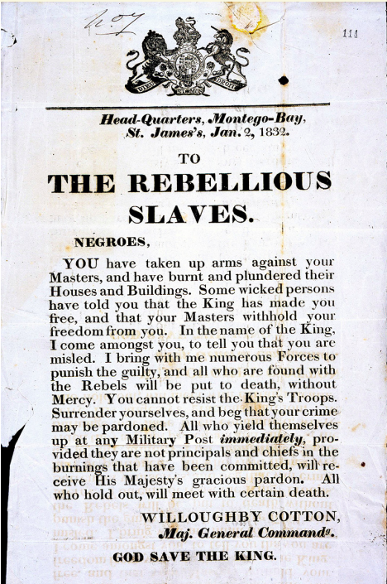
Source 2

Slide 18
Slavery Abolition Act
On August 28th, 1833, the Slavery Abolition Act was passed.
It came into effect on August 1st, 1834, and meant that slavery was abolished in most British colonies which led to over 800,000 enslaved Africans in the Caribbean, South Africa and Canada becoming free.
Constant acts of rebellion and resistance by enslaved people– both overt and covert – contributed to this
Notes:
Explain to the pupils that 1 year after the Baptist War had happened, Slavery was abolished in the UK and all her colonies. Explain that after the Baptist War, the government started to hold discussions about abolition in parliament. Why? Because they were fearful of many things, including what happened in France, if they did not agree to abolition.

Slide 19
Plenary – Exit Pass
On your post-it note, tell me your answer to the lesson question.
What do primary sources tell us about
how British people reacted
to organised armed resistance by enslaved people?
Stick this (here) before you leave.

Slide 20
Lesson Plan

Slide 21
Lesson Level Enquiry Question
Purpose: |  | What do primary sources tell us about how British people reacted to organised resistance by enslaved people?
Objective: |  | The objective of the lesson is to encourage pupils to use primary sources and prompting questions while looking at primary sources to see how the British became more fearful of rebellions by the enslaved as time progressed.
Outcome: |  | By the end of the lesson pupils should have a better understanding of the development of British opinion about rebellions in the Caribbean and be able to use the primary sources to explain why their reactions were becoming more severe as time when on.
Time | Teacher is… |  | Pupils are… | Checking learning
0 – 5 | Listening to what the pupils are saying for the starter task – See, Think, Wonder. This picture is from the Haitian Revolution and if need be, teacher should be asking the pupils some questions or pointing out some things to consider in their discussion. |  | Talking to each other about what they see in the picture, what they think is happening and what questions they may have about the picture. They should write any of these things down in their jotter so that they are ready to feedback. | Pupils should share their thoughts over the see think wonder task and teacher should see what questions arise from this.
5 – 20 | Firstly, the pupils will be asked to think about what is included in being part fo a successful rebellion. During this time, the teacher should be circling the room in order to listen into conversations and possibly encourage pupils to think more deeply about the task by asking questions. After this, the teacher will take the pupils through different factors that contribute to a rebellion and then provide some information about overt resistance that had occurred in the Caribbean. Teacher will then provide pupils with information about the Haitian Revolution and explain task 1. |  | Pupils will be engaged in conversation about what they think would be involved in taking part in overt resistance and then discussing as a class. They will then listen to some information about the Haitian Revolution and in pairs they will be working through the Source 1 task and answering questions on it. Pupils should be engaged in conversation and with the source, writing down any information that they feel would be important to answering the questions and feeding back. | For the task – pupils will have written down some answers about what they feel is going on within the source. They will have engaged with the source itself, highlighting important parts on the copy that they are provided, annotating around it and possibly asking questions about it.
20 – 45 | Discussion about the first source would be teacher led, asking the pupils what their answers to the questions were and their conclusions on how the British reacted to the Haitian Revolution. Teachers should try to make sure that pupils have hopefully come to the same conclusion. After this, pupils would go back into their pairs to engage with the second source about the Baptist War, with teachers circling the room to hear what is being discussed and help where needed. |  | Pupils would firstly feedback their answers and opinions on source 1 and discuss what they feel British reactions were. After this, they would return to their pairs and engage in discussion about the second source, answering the questions in their jotter and engaging with the source through highlighting and annotation. | To check how the pupils have engaged with the first source, a small class discussion about the information they have looked at is necessary to check that they are all receiving the same message that the source is giving. Then pupils should be back in their pairs talking about the second source and how the British reacted. By this point, pupils should see that the British were more fearful of the Baptist War. Have another small discussion about this once they are done.
45 – 50 | Pupils should complete the post-it note plenary answering the question in their own words about how the British reacted to organised armed resistance. The teacher should be encouraging them to give their truthful answer and ask prompting questions if need be. |  | Pupils should be writing down their answer in the post it note. | Pupils should hopefully mention that the British were becoming more fearful of resistance by the time the Baptist War happened and use an example from the source.

Slide 22
Worksheets

Slide 23
Source 1
This source describes an agreement made at a meeting. Who is at the meeting?
“[we agree]
that dreadful consequences may result from the insurrection in St. Domingo to the British West India islands in general, and particularly to the Island of Jamaica, should the [Haitian] Revolt be of long duration, or should it end… in the Desertion of that Colony by the Europeans [i.e. the French leaving].,
that Attempts have been made, and are still making, to create a ferment in the Minds of N- in our Colonies a dangerous Spirit of Innovation, and more especially to misrepresent the Nature and Extent of the late Discussions in the House of Commons of Great Britain respecting the Slave Trade, thus encouraging Discontents [i.e. unhappy people]

Slide 24
Source 2
“TO THE REBELLIOUS SLAVES.
N-
YOU have taken up arms against your Masters and have burnt and plundered [stolen] their houses and buildings. Some wicked persons have told you that the King has made you free, and that your Masters withhold your freedom from you. In the name of the King … you are misled [mistaken]. I bring with me numerous Forces to punish the guilty, and all who are found with the Rebels will be put to death, without mercy. You cannot resist the King’s Troops. Surrender yourselves and beg that your crime may be pardoned. All who yield [surrender] themselves up at any Military Post immediately, provided they are not principles and chiefs [leaders] in the burnings that have been committed, will receive His Majesty’s gracious pardon. All who hold out, will meet certain death.”

Slide 25
Acknowledgements.

Slide 26
Slide 2 and 8 – Picture of the Haitian Revolution. Came from Source - https://www.europeana.eu/en/exhibitions/black-lives-in-europe/three-portraits-of-the-haitian-revolution
Slide 5 and 6 – Map of the West Indies. Came from Source - https://www.worldatlas.com/geography/west-indies.html
Slide 11 and 20 - British Online Archives, Slavery, Exploitation and Trade in the West Indies, 1759–1832, “Reports, 1791 March, Page 14
https://britishonlinearchives.com/collections/1/slavery-exploitation-and-trade-in-the-west-indies-1759-1832
Slide 14 and 21 - https://cdn.nationalarchives.gov.uk/documents/education/spotlight-on-baptist-war.pdf

