Slide 1
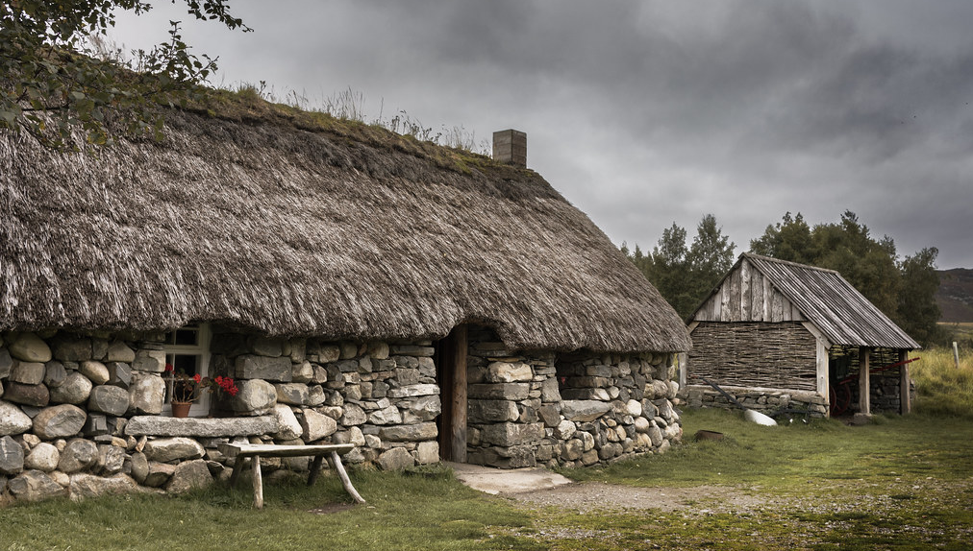
What do you think this picture is? Do you think it has anything to do with our topic on the Atlantic Trade in enslaved people?
Notes:
Teacher notes: Students come in and you open the lesson by asking what this is a picture of? Answer: A preserved croft in a Highland museum. Move to the next slide and explain that today we will discuss how the lives of people who lived in crofts like this were intertwined with enslaved Africans.

Slide 2
How were the lives of Highland crofters intertwined with the lives of the enslaved Africans 4000 miles away?

Slide 3
In today’s lesson you are:
Learning about how the work of crofters was intertwined with the enslavement of Africans.
Using sources to find out what happened .
Consider what historians have said about the importance of the connection between Highland crofters and enslaved Africans
By the end of the lesson:
You will be able to identify the ways Highlanders’ work was used to support the slave trade.
You will be able to explain the link between Highland crofters’ work in creating cloth and
You will be able to identify and explain a historian’s interpretation of this topic.

Slide 4
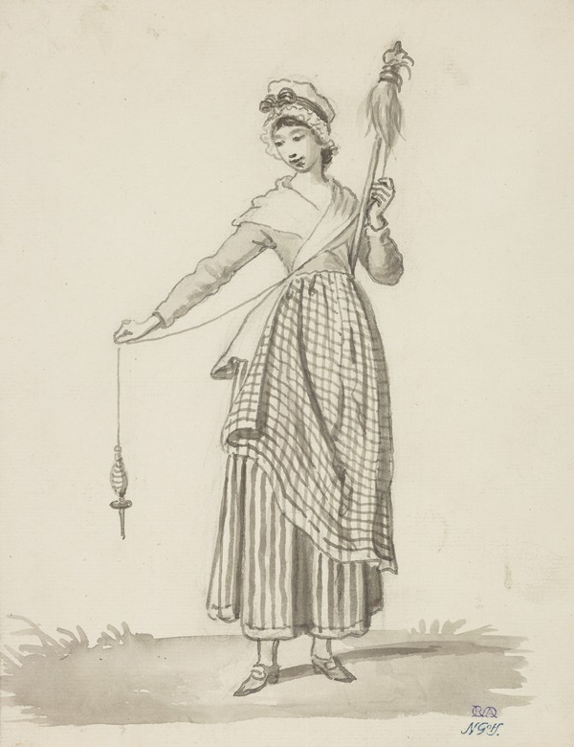
In the eighteenth century, many families in the Scottish Highlands lived as crofters. This meant that they rented a small farm. Often, they would also make money from spinning
Spinners turned flax fibres (which come from a plant) into yarn/ thread. This women is using a traditional distaff to spin. Highland women were very skilled at this and could even complete other household chores as they span.
Allan, David, Girl with distaff, c.1785, picture credit National Galleries of Scotland
Notes:
Teacher note: When the distaff was replaced by the spinning wheel by the British Linen company some highland crofters complained as they could no longer go about household chores while spinning. Go to the next slide to reveal the answers
Answers
1. It is a spinning wheel
2. This was used by crofting women to create yarn from natural fibres.
Picture 1 accessed at: https://blog.nms.ac.uk/2020/12/14/introduction-to-the-spinning-wheel-collection-in-national-museums-scotland/
Picture 2 accessed at: https://www.nationalgalleries.org/art-and-artists/8327/girl-distaff

Slide 5
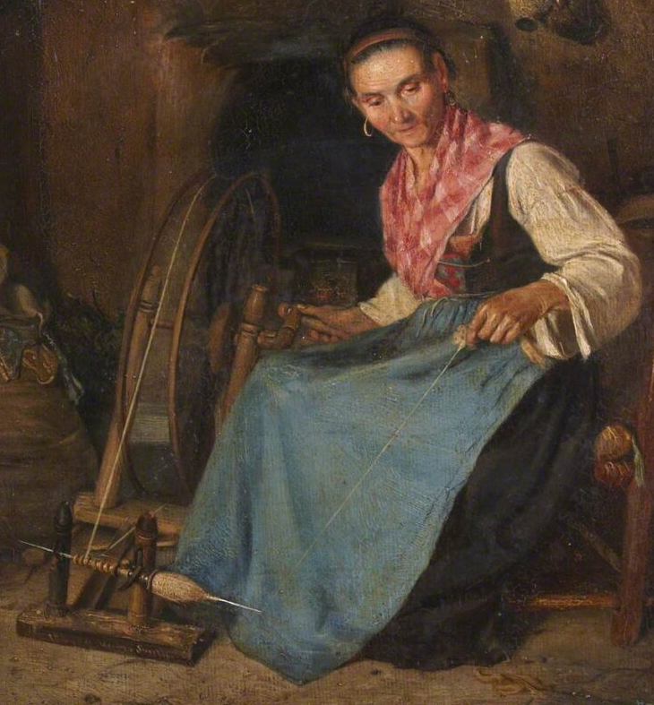
Women like this all over the Highlands were sent flax and wool by manufacturing companies to make into yarn.
At first they used a distaff, but manufacturing companies encourage them to switch to spinning wheels because they were much faster.
Do you think the spinners/ crofters were pleased about this?
THINK: How might spinning flax link to enslaved Africans?
Smith, Thomas Stuart; Woman Spinning. Picture credit: The Stirling Smith Art Gallery & Museum.
Notes:
Smith, Thomas Stuart; Woman Spinning. Picture credit: The Stirling Smith Art Gallery & Museum.

Slide 6
THINK: How might this link to enslaved Africans?
Merchant: trader
Trustee: a trusted person
Distributes: gives it to people
Parishes: areas
Exported: sold to another country
Source A
“several merchants at Aberdeen send a great quantity of flax to a trustee at Stornoway, who distributes it to be spun, not only in this, but in all the parishes of Lewis.”
(OSA, Vol. XIX, 1797, p. 278)
Source B
‘Slave cloth was exported in increasing quantities to provide the cheapest of clothing to enslaved labour on plantations in North America and the Caribbean…By the 1790s about nine-tenths of Linen exported from Scotland was for the plantations.’
David Alston, Slaves and Highlanders, 2021
Notes:
Teacher note: Guide students to connect that the flax being woven across the highlands was used as clothing for slaves

Slide 7
How were the lives of Highland crofters intertwined with the lives of the enslaved Africans 4000 miles away?
Your teacher will read 'The 18th Century Journey from Flax to ‘slave-cloth’.
As you listen to the story, plot the journey of the cloth on the map you have been given.
When this is completed, discuss this as a class.
Notes:
Teacher note: In the extension task. The last column shows how much these exports were approximately as a percentage of all the linen produced in Scotland in that year.Students could also extend by considering why there was a sudden drop in 1777. Answer: loss of American colonies after the War of Independence.
Data taken from: Durie, Alistair, The Markets for Scottish Linen, 1730-1775 in The Scottish Historical Review Vol. 52, No. 153, Part 1 (Apr., 1973), pp. 30-49, p.42

Slide 8
The 18th Century Journey from Flax to ‘slave-cloth’
The British Linen Company was founded in Edinburgh in 1746. In 1747, it started to pay Highland crofters to spin yarn.
At first, they span Scottish grown flax, but they needed more. They began to import flax from Riga and St Petersburg in the Russian Empire. This arrived in Cromarty near Inverness and was then sent to crofts across the Scottish Highlands and islands.
The yarn the women span was sent to mills across Angus, Perthshire and Fife which produced cheap coarse linen called osnaburgs. This fabric was better known as ‘slave-cloth’ since it was the cheapest product available to make clothes from and was popular with plantation owners for clothing enslaved workers. By the 1790s nine tenths of Scotland’s linen exports were heading to North American and Caribbean plantations.
The raw fabric would be given to the enslaved workers who had to use it to make their own clothes.

Slide 9
What do the words in bold mean?
What is the historian’s message?
How significant does he think spinning flax was for the Highlands?
‘Home-based employment for women, using a spinning wheel, was an enduring and significant social change in the Highlands. And it was a change driven by the use of enslaved labour in North America and the Caribbean.’
David Alston, 221
Use the sentence starters to say your answer out loud to the person next to you.
The historian’s message is …
I know this because…

Slide 10
Explain how the lives of Highland crofters were intertwined with the lives of enslaved Africans 4000 miles away?
?
One way the lives of Highland crofters were intertwined with the lives of enslaved Africans 4000 miles away was…
This can be seen by …
Therefore, this shows the connection between the lives of Highland crofters and the lives of enslaved Africans in the Americas was…

Slide 11
Until recently, museums of the linen trade have not said much about its links to slavery. Do you think it is important to make these links? Why?
Plenary Discussion
Notes:
Teacher note: Help students to think about what damage not knowing about this might do and then try to open up the benefits of knowing about this. For example: Could it lead to a better understanding of out interconnectedness to other countries? Even people living hundreds of years ago, in remote places, who seem to be totally isolated from the rest of the world are part of a global machine that enabled the enslavement of Africans. Is it damaging if we think of highland crofters without thinking about these links?

Slide 12
Lesson Plan

Slide 13
How were the lives of Highland crofters intertwined with the lives of the enslaved Africans 4000 miles away?
Purpose: | To understand how ordinary Scots were connected to the enslavement of Africans, considering the significance of this for Scotland.
Objective: | Learning about the work of crofters was intertwined with the lives of enslaved Africans by using sources to understand the narrative. Consider what historians have said about the importance of the connection between Highland crofters and enslaved Africans
Outcome: | You will be able to explain the link between Highland crofters’ work in creating cloth and the lives of enslaved Africans, and consider why its important people know about this.
Time | Teacher is… | Pupils are… | Checking learning
10 min | A quick discussion of introduction slide then move on to guiding students to try the picture starter on slide 4. Use Slide 5 to give context after class discussion | Completing starter task and sharing ideas. | Class discussion
10 min | Introduce sources and ensure students understand the language. Get students to discuss and gather ideas through limited class discussion | Engaging in discussion points when required. | Teacher Discussion with class.
15 min | Introduce the map and either read sheet with students or circulate to guide learning and prompt students to move on to extension. Model answer on the board at end of activity. | Completing map worksheet using slide 8-9 | Students hold up map, teacher models on board.
10 min | Guide students through thinking about the historians quote. Gater ideas to clarify the meaning. | Discussion with peers | Sharing ideas with groups and class
15 min | Explain plenary and give students time to write. FInish with a discussion of the question on slide 14. | Answer the enquiry question | Peer assess or share with the class

Slide 14
Worksheets

Slide 15
The c.18th journey from Flax to ‘slave-cloth’
Founded in Edinburgh in 1746, the British Linen Company (BLC) started using Highland crofters to spin yarn the following year.
The BLC started supplying the women with Scottish grown flax but very quickly realised that they couldn't grow enough to meet demand. They began to important flax from Riga and St Petersburg in the Russian Empire. This arrived in Cromarty near Inverness and was then sent to crofts across the Scottish Highlands and islands.
The yarn the women spun was sent to mills across Angus, Perthshire and Fife which produced cheap coarse linen called osnaburgs. This fabric was better known as ‘slave-cloth’ since it was the cheapest product available to make clothes from and was popular with plantation owners for clothing enslaved workers. By the 1790s nine tenths of Scotland’s linen exports were heading to North American and Caribbean plantations.
The raw fabric would be given to the enslaved workers who had to use it to make their own clothes.

Slide 16
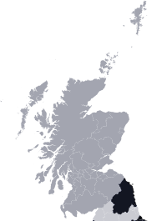
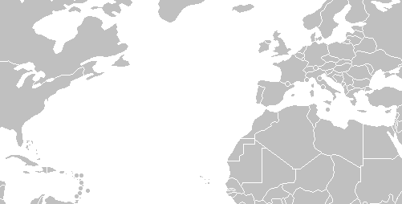
The c.18th journey from Flax to ‘slave-cloth’
Scotland
North America
Highlands
Riga
Cromarty
St Petersburg
Angus
Caribbean
Perthshire
Fife
Edinburgh

