Slide 1
What role did music play in the lives of enslaved people?
Life and culture on plantations

Slide 2

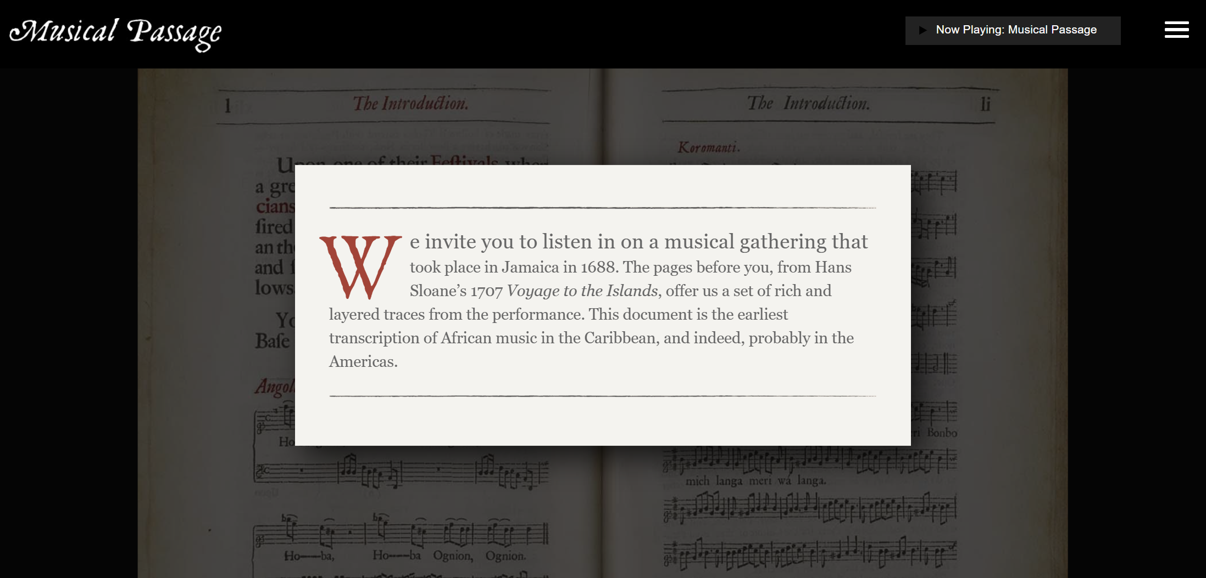

Notes:
‘The two pages forming the centre of this project are from Hans Sloane’s 1707 Voyage to the Islands of Madera, Barbados, Nieves, S. Christophers and Jamaica. This document is the first transcription of African music in the Caribbean. Thanks to this remarkable artifact, we can listen to traces of music performed long ago and begin to imagine what it meant for the people who created it.’ http://www.musicalpassage.org/

Slide 3
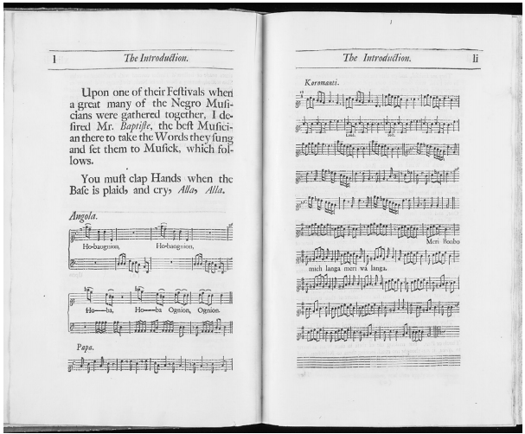
1688 musical gathering (Sloane source)
This is a reconstruction of the earliest recorded African-Caribbean music. There are no words in English, but the English observer noticed that ‘you must clap your hands when the bass is played and cry
‘Allah, Allah’.
Link - Musical Passage
Notes:
http://www.musicalpassage.org/
For further detail, context and historical analysis

Slide 4

Historian’s Analysis:
“Despite being forced to migrate and to survive under the most brutal circumstances, these performers and their descendants revolutionized global music. You’d be hard pressed to name a living genre of music that enslaved musicians didn’t help to create or transform.
Starter (a)
What genres of music can you name that came from enslaved Africans and their descendants?
Notes:
Image: https://today.duke.edu/2016/06/musicalpassage

Slide 5
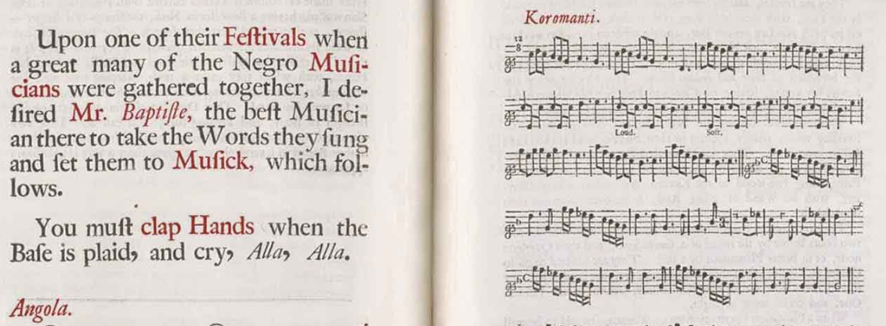
Historian’s Analysis:
Jazz,
country,
rock,
blues,
reggae …and the list goes on.
Turn on the radio and you are hearing echoes of enslaved culture. But we don’t know a lot about their early music because it was not preserved in conventional ways.
And that is why a little artifact like this is so important, because it helps us to know more about what their performances may have sounded like.”

Slide 6

1688 musical gathering (Sloane source)
Starter (b)
Choose 1 of the following questions to discuss
"Because so few records from that time show how enslaved Africans lived, and music was one of the only ways they could share feelings, keep traditions, and make new ones, why is a rare snapshot like Sloane’s so important for understanding their lives?“
"If most written records about slavery were created and saved by the enslavers, what might we miss about the voices and experiences of the enslaved—& how can sources like this music help fill those gaps?"
Notes:
http://www.musicalpassage.org/
For further detail, context and historical analysis

Slide 7
To develop our knowledge and understanding of the role music had in the lives of enslaved people as a form of resistance and means of expression.
I can analyse primary sources.
I can explain the impact of music on the lives of enslaved people in the Caribbean

Slide 8
Spiritual and work songs
Spirituals were religious songs that helped enslaved people express their faith and longing for freedom which were also sung during work hours.
Work songs were sung during labour to coordinate an efficient and effective working rhythm of certain tasks and provide an emotional release.
Both types of music carried hidden meanings and acted as forms of resistance and solidarity.

Slide 9
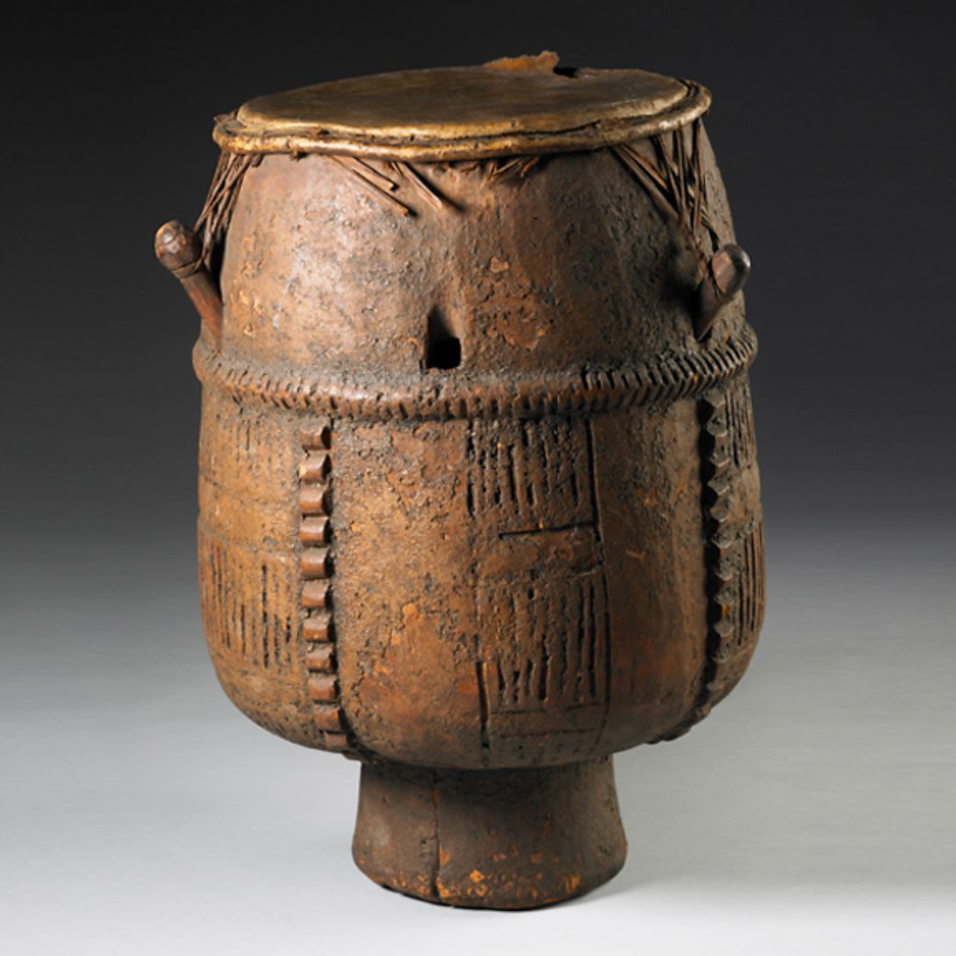
African Drums
Drumming by Enslaved Africans was banned by many plantation owners across the British Caribbean islands.
Drumming was a form of communication which could bring large groups of African people together.
Drumming was an important part of many African musical and religious traditions. By not being allowed to do it, enslaved people were controlled even in non-working hours.
Notes:
drum | British Museum

Slide 10
The 5Cs
Why was music important to enslaved people in the Caribbean? Task: Link the 5 Cs to their explanations
The cultural mix of their music was unique and inventive: drawing on styles they heard elsewhere & what came forth from their imagination.
The sound of certain instruments or particular rhythms was the means to deliver private messages over the great distances of rural landscape between the enslaved communities across different plantations.
African captives, forced into chattel slavery, came with the memories, talent, & skills to fashion music & instruments remembered from various African homelands.
While so much of an enslaved's life was out of their power, the music they played was solely theirs to create, adapt, and perform as they wished.
The music of the enslaved spoke of complex emotions: hopes, pain, and sorrow. But it also expressed their joy, jubilation, and fun.
Control
Creativity
Celebration
Continuity (of culture)
Communication

Slide 11
The 5Cs
We can use the Five Cs to help us understand why music was important to enslaved people
While so much of an enslaved's life was out of their power, the music they played was solely theirs to create, adapt, and perform as they wished.
The cultural mix of their music was unique and inventive: drawing on styles they heard elsewhere & what came forth from their imagination.
The music of the enslaved spoke of complex emotions: hopes, pain, and sorrow. But it also expressed their joy, jubilation, and fun.
African captives, forced into chattel slavery, came with the memories, talent, & skills to fashion music & instruments remembered from various African homelands.
The sound of certain instruments or particular rhythms was the means to deliver private messages over the great distances of rural landscape between the enslaved communities across different plantations.
Control
Creativity
Celebration
Continuity (of culture)
Communication

Slide 12
Account from an enslaved African talking about music on plantations
What can we infer about how enslavers felt about enslaved music on plantations?
When they go round singin’ “Steal Away to Jesus,” dat mean dere gwine be a ’ligious meetin’ dat night. De masters . . . didn’t like dem ’ligious meetin’s, so us natcherly slips off at night, down in the bottom or somewhere. Sometimes us sing and pray all night.
Which of the 5 Cs is inferred here?

Slide 13
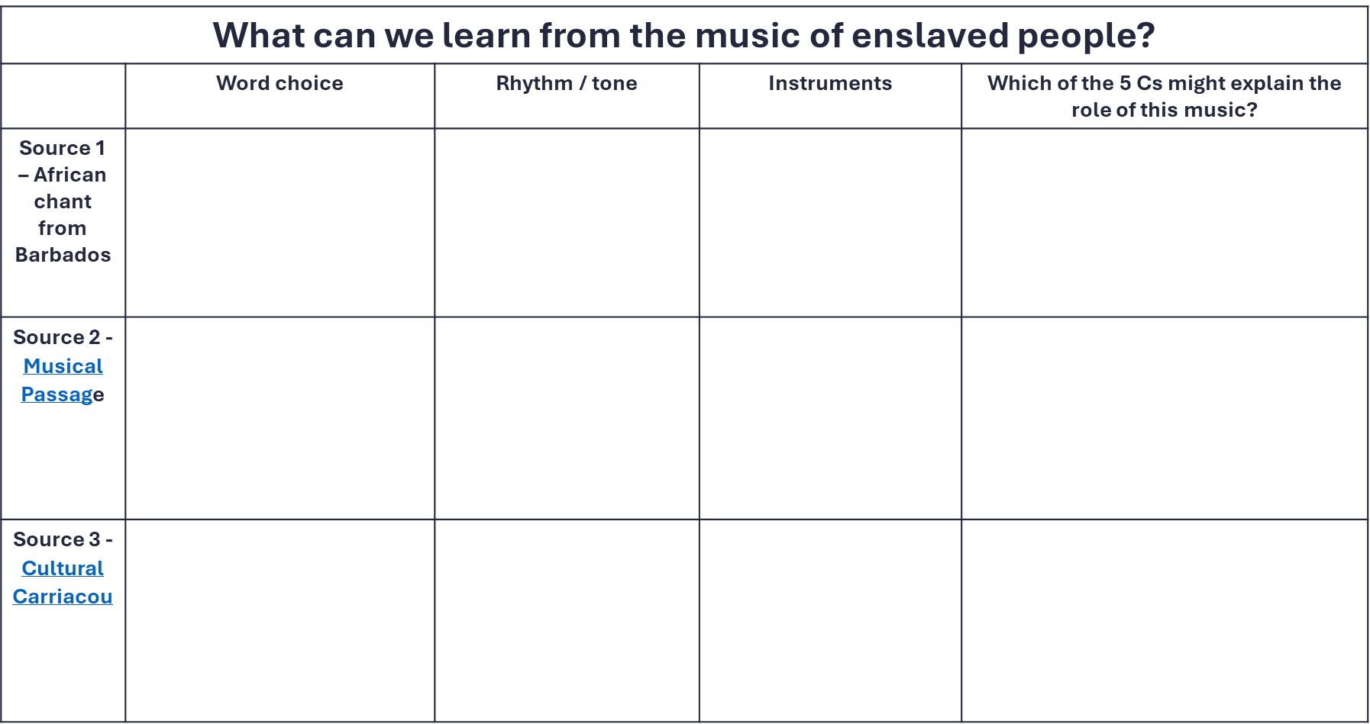
ACTIVITY TIME – The 5 C’s - Why was music used on Plantations?
We are going to explore 3 examples of music. .
You will need to consider the lyrics, the rhythm and the instruments used. Finally, you will need to recall the Five Cs to consider why this music important to enslaved people in the Caribbean.
We will do the first as a class,
the second as a pair
and the final one as an individual
Remember?

Slide 14
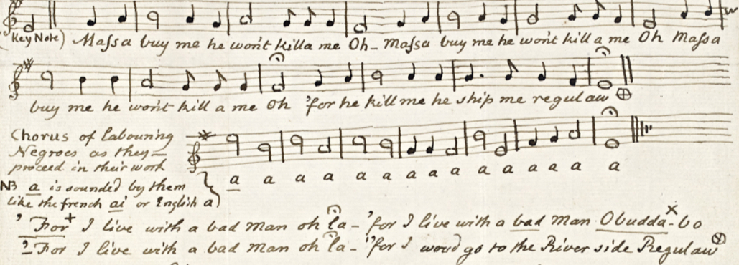
“An African Song or Chant from Barbados” – Origin Date unknown. Heard and recorded in the 1770s
Notes:
Slave Chant c 1775 ROGER GIBBS https://media.unesco.org/sites/default/files/webform/mow001/barbados_uk_song_eng_0.pdf
‘The survival of the ‘African song or chant from Barbados’ is remarkable as it was heard by William Dickson, Secretary to the Governor of Barbados, then notated by his friend the prominent abolitionist, Granville Sharp, who was also a good musician and record keeper.’
Scotsman, Dr. William Dickson lived in Barbados for about 13 years, starting in 1772. He served as Secretary to Governor Edward Hay in the 1780’s and later became a leading member of the anti-slavery movement in Great Britain. Dickson came by this song, presumably by observing enslaved field workers while he lived in Barbados. The song was transcribed Granville Sharp, a founder of the British abolitionist movement
The song, An African Song or Chant from Barbados, dates from the time of enslavement (mid-seventeenth-century to 1824). This song text is the only known manuscript of an African work song that was chanted in the sugar fields of Barbados
Written in a minor key, it is quite unlike other Barbadian folk songs which privilege the major key. The song does not have a time signature. The song was first heard by Dr. William Dickson, when he was Secretary to Edward Hay who governed Barbadoes (now spelt Barbados), during the period, 1772-1779.
The song was transcribed by Granville Sharpe, a founder of the antislavery movement in Great Britain. The song represents a part of the Barbadian documentary heritage (song) of which there are no other known examples. It is a unique voice which represents how the enslaved saw their lot and how they commented on their lived experience. It also represents one of the tools that the oppressed used in their resistance and as a strategy for surviving the foul regime of enslavement.

Slide 15
Source 1:“An African Song or Chant from Barbados” – (mid 17th century – 1824)
Massa buy me he won’t kill a me
Oh Massa buy me he won’t kill a me
Oh he kill me he whip me regulaw
For I live with a bad man Oh

Slide 16
I do– ‘An African song or Chant’
Highlight key words
What does the word choice show about their feelings towards their enslaver?
What is the general feeling of this song?
Which C (could be more than one) does this belong to?
Why?

Slide 17
Highlight key words
What does the word choice show about their feelings towards their enslaver?
What is the general feeling of this song?
Which C (can be more than one) does this belong to? Why?

Slide 18
Highlight key words – ‘massa, killa me, buy me’
Shows the enslaver / enslaved relationship. ‘Massa buy me, he wont killa me’ – horrific nature of enslavement but also shows the singers sense of own self worth.
An African Chant gives a feeling of violence between the enslaved and enslaver. This helps us understand how horrific the conditions on plantations were.
This song is a clear example of communication of the experiences on plantations.
What does the word choice show about their feelings towards their enslaver? –
What is the general feeling of this song?
Which C (can be more than one) does this belong to? Why?
Notes:
Living Histories of Sugar in the West Indies and Scotland
Songs from the Archives Collection
Nathalie Bertaud and Marisa Wilson

Slide 19
Investigating task – You do
We are going to read through / listen to two examples of songs from plantations in the Caribbean.
Whilst we investigate, we aim to investigate the following –
Word choice
Rhythm / tone /Instruments
Which of the 5 Cs ?

Slide 20
Source 2
This is a reconstruction of the earliest recorded African-Caribbean music. There are no words in English.
Helpful hint –
The mention of the riverside in the lyrics could be a reference to spiritual practices carried out near the water. As most dances occurred during religious holidays and on Sundays, sources that mention the music and culture of the enslaved usually refer to events that occurred during such holidays or slave funerals.
Link - Musical Passage
Notes:
Musical Passage

Slide 21
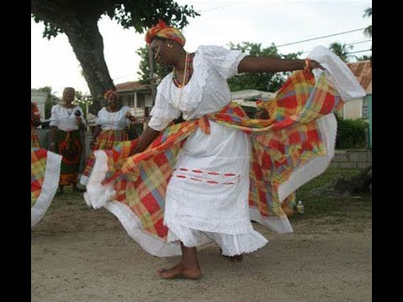
Source 3
A small group of people on the island of Carriacou in the Caribbean nation of Grenada identify with the Temne ethnic group of Sierra Leone.
They still call themselves “Temnes,” and they celebrate their heritage with a Temne song, dance, and drum routine handed down for centuries.
They have preserved the memory of its African roots and elements of its African culture for more than 250 years.
Big Drum music has African elements but was created in the Caribbean.
Link - 05. Temne-o (Nation song)
Notes:
Cultural Carriacou, music and origins, wedding and funeral.
The Temnes of Carriacou, Grenada - The Patriotic Vanguard
Big Drum Dance at Six Roads Maroon Carriacou

Slide 22
Plenary – Explain the Role of Music
Jazz,
country,
rock,
blues,
reggae and the list goes on.
Choose a music style. Research & create a presentation
on the links to the Caribbean & Atlantic trade in enslaved peoples
Explain the impact of music on the lives of enslaved people in the Caribbean
Give 4-6 explanations
Notes:
https://www.youtube.com/watch?v=7_mbueJ_VgY 1 minute Clip of ongoing importance of music today to each of the Island's identities

Slide 23
What can we learn from the music of enslaved people?
 | Lyrics: Word choice | Rhythm / tone or use of instruments | Which of the 5 Cs might explain the role of this music?
Source 1 – African chant from Barbados
Source 2 - Musical Passage
Source 3 - Cultural Carriacou

Slide 24
What can we learn from the music of enslaved people?
 | Lyrics: Word choice | Rhythm / tone or use of instruments | Which of the 5 Cs might explain the role of this music?
Source 1 – African chant from Barbados | Expresses the harrowing reality of enslaved life: “Massa buy me he won’t killa me.” “For I live with a bad man” underscores cruelty. References to being shipped again: “he ship me regulaw” highlight instability. | Haunting quality and tone Minimal rhythmic accompaniment which adds emphasis to the solo lead | Communication – the lyrics are communicating the horrors that were faced during enslavement
Source 2 - Musical Passage | Lyrics reflect ritual, cultural, or communal traditions brought from West Africa to maintain community. | Preserve African melodic structures Accompanied by percussion (drums) or vocal rhythmic patterns. | Continuity – language and instruments are preserved from culture. Celebration – This music shows preservation and celebration of traditions that were brought from their home.
Source 3 - Cultural Carriacou | Lyrics celebrate ancestry, identity, and African heritage. | Drums Chanting Call‑and‑response within main singer and the rest of the group | Creativity - Maintaining and creating styles of music which tie with their heritage. Celebration – This is a clear example of music being used for enjoyment – dancing etc.

Slide 25
Lesson Level Enquiry Question How important were markets in Jamaica in supporting enslaved women to survive and resist enslavement?
Purpose: | Interdisciplinary: Music & History Resistance & Retention/Innovation of culture
Objective: | The learning in this lesson links to the syllabus by What is the takeaway? To understand how enslaved people used music as a way of survival & resistance on plantations through the 5 C’s.
Outcome: | Pupils will demonstrate their ability to answer the Enquiry Question by… Making a judgement on the thermometer handout in relation to the EQ and providing an explanation for this.
Time | Teacher is… | Pupils are… | Checking learning
0-10 | Circling room – checking in on starter progress. | Completing starter task and sharing ideas. | Class discussion
10-20 | Going over background information regarding the role of music on plantations with regard to the 5 C’s. First example of music will be discussed. | Engaging in discussion points when required. | Teacher Discussion with class.
25-40 | Modelling how to answer questions for source analysis. Explain / play music for next 2 sources. | Analysing sources of evidence by answering questions on sources | Completing worksheet
40-50 | Circling room – offering support/scaffolding to answer enquiry question. | Plenary – answering the Enquiry Question. | Explanation question/ EQ is answered.

