Slide 1

Resistance
Were there distinctive female patterns of resistance by enslaved people?

Slide 2
Starter Activity
What does the word “Resistance” mean?
Write a definition of the word.
Notes:
Starter Learner Options:
Freeze Frame: In small groups, create a still image (like a paused scene in a movie) showing a moment of resistance. It could be historical or imagined.
Think: Who is resisting? What are they resisting? How do they feel? Photo Description: Find (using devices) or use a provided photo that shows an act of resistance (e.g. a protest, a rebellion, or defiance). Describe what’s happening in the image and what it tells us about resistance.
Word Web: Quick Draw a mind map starting with the word "Resistance" in the centre. Add connected words, events, people, or ideas that relate to resistance in history or daily life.
One-Minute Timed Write: Individually, write a short paragraph starting with: "Resistance means..." include examples from history, your life, or imagination.

Slide 3

Paired Task - Discuss How might enslaved people have resisted slavery?
Resistance can be defined as:
the refusal to accept or comply with something
or
the challenging/opposing of systems or situations
Note this definition
2 minutes
Notes:
Option to: Note one or both of these definitions down

Slide 4
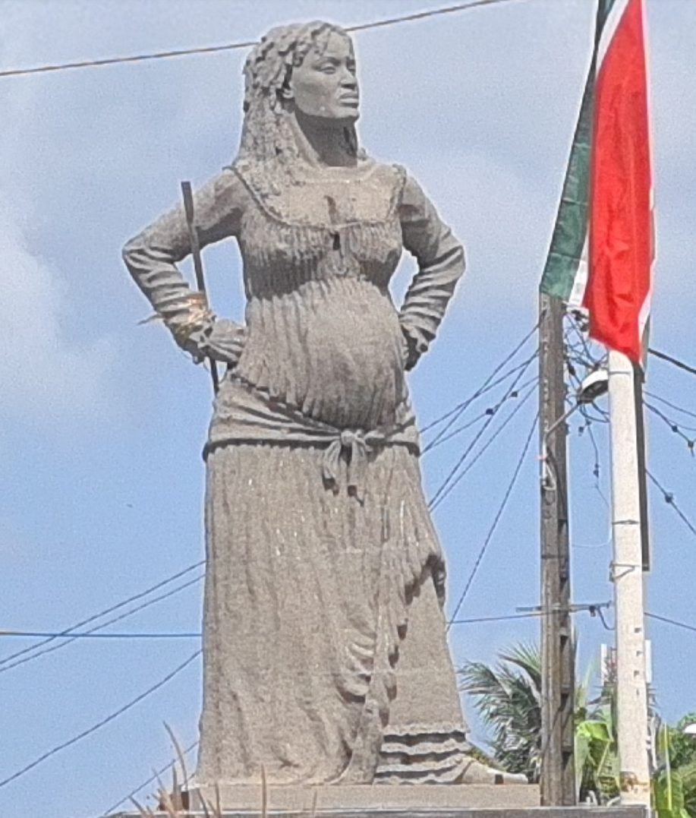
Does this body language feel like resistance?
Solitude is a well-known Caribbean heroine who, while pregnant, fought against the French army and the re-enslavement of her people on the island of Guadeloupe until her death in 1802.
One account notes that Solitude is remembered by the community as a fierce and fearless warrior, expertly wielding a machete against colonial troops.
Notes:
Suggestion that learners strike this pose in class, and perhaps an ‘opposite’ pose to this ‘feeling’ & then express their observations.
Teachers might also mention that it would often have been punishable by physical force for an enslaved person to strike this pose to an enslaver – and that physical punishment was legal in the British Caribbean.

Slide 5
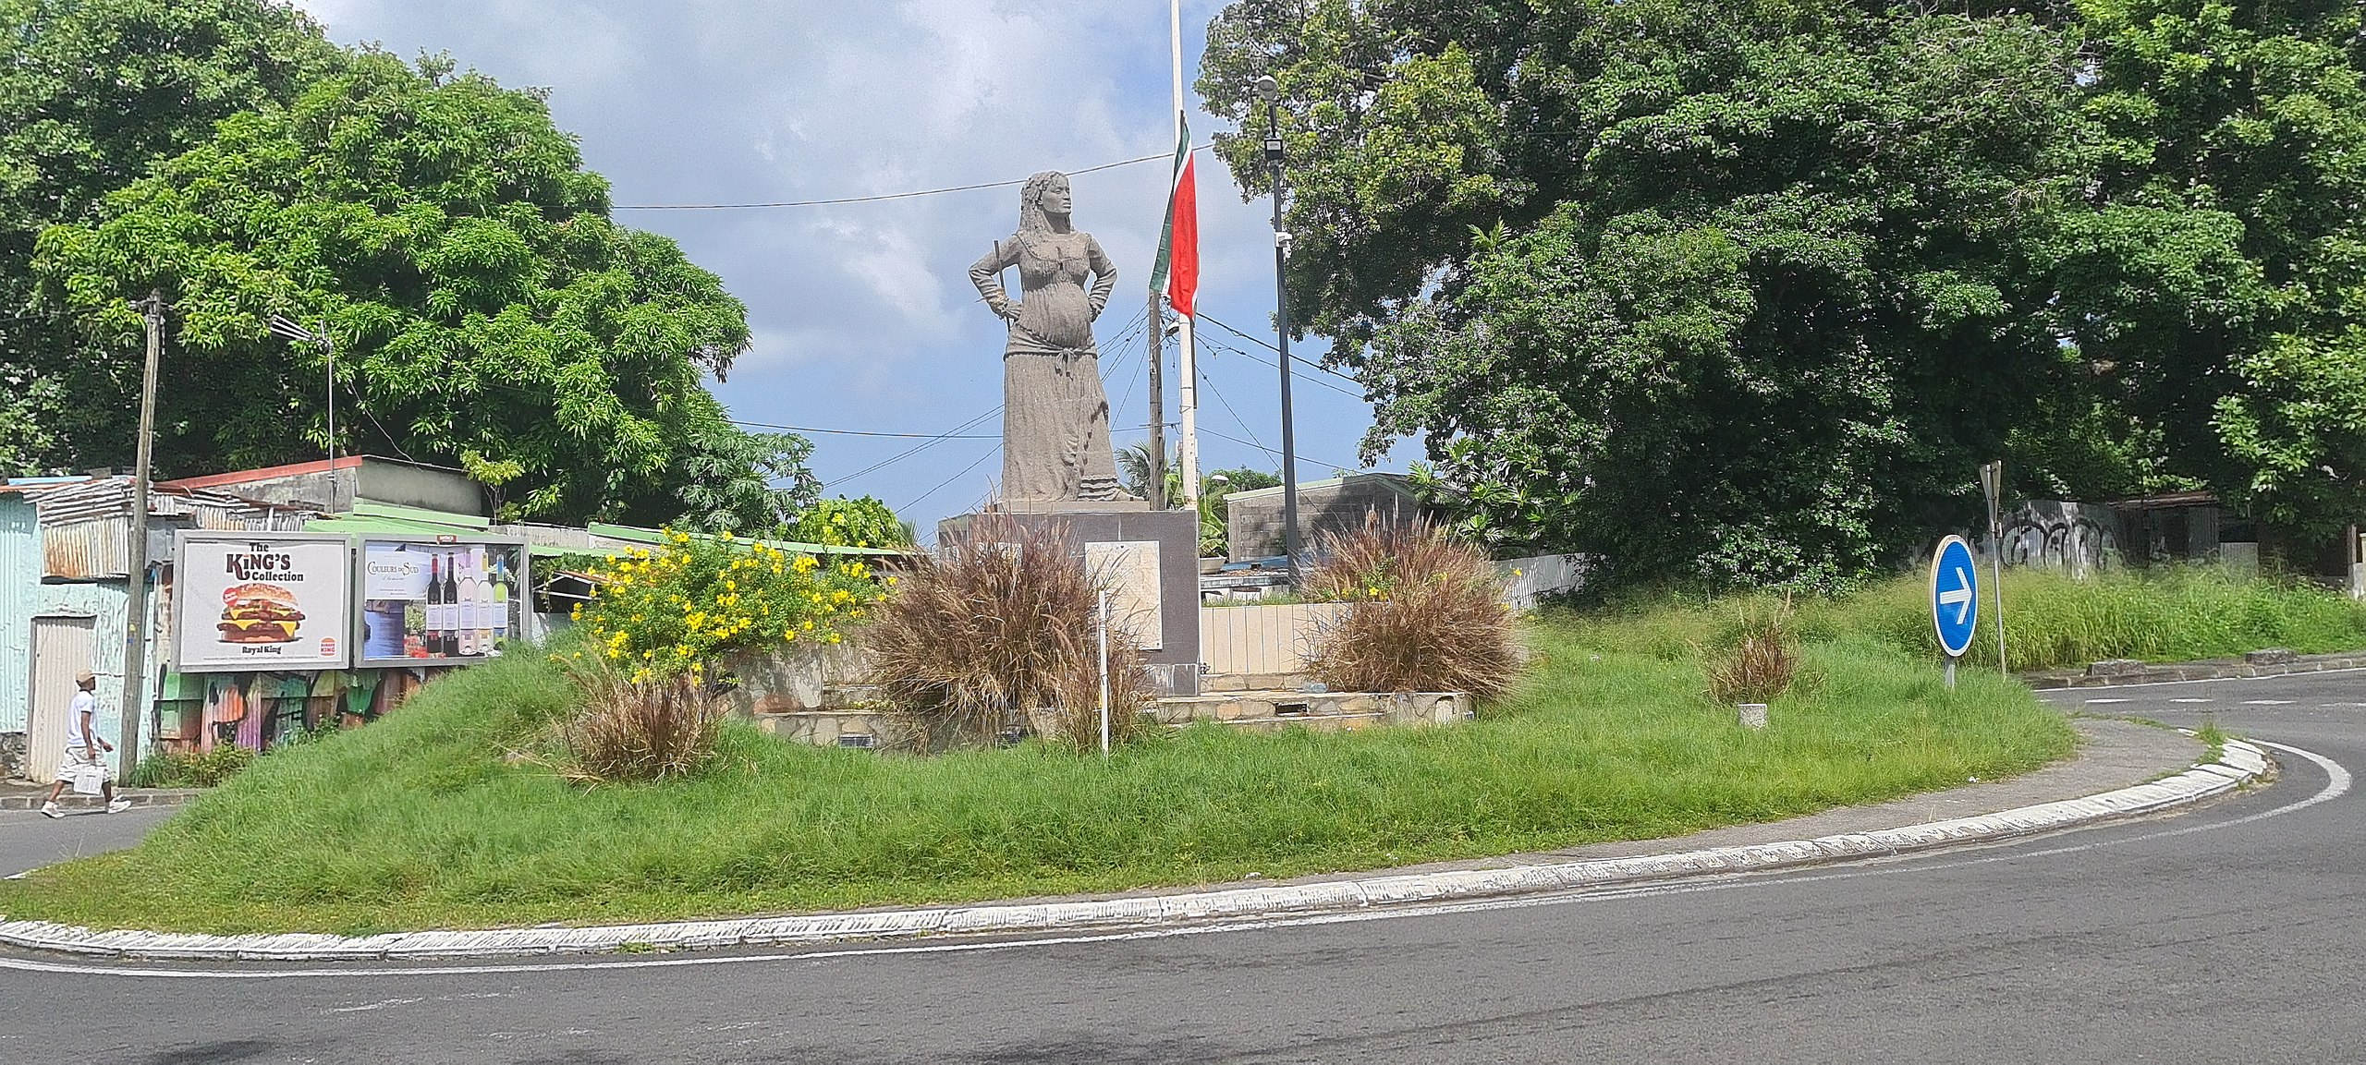
Direct Action
Answer the following questions below, explaining your answers fully:
Notes:
Black Women’s contribution to rebellion were celebrated at the time by local Black people.
& Today she is still celebrated in island cultural events, but is neglected in history books and classrooms – even on her own island.

Slide 6
Gendered Roles Create a mind map with the roles and jobs that have historically been ascribed (given to) women in the eighteenth/nineteenth centuries
What are historically female gendered roles?
home, work and family
Notes:
Prior to this task you can have a discussion with pupils regarding what 'stereotypes' means. This should allow them to complete the task fully with a deeper understanding.
Definition of stereotype: "A stereotype is a fixed general image or set of characteristics that a lot of people believe represent a particular type of person or thing"

Slide 7




Gendered Roles In your jotter, create a mind map with the roles and jobs you stereotypically associate with females.
Being a mother, caring for the family
Cooking
Domesticity
Pregnancy and breastfeeding
Notes:
Question: What views resulted in women having these roles?

Slide 8

Stereotypes
It is important to note that men also undertook the roles that we are discussing within this lesson today.
Historians now try to be careful not to bring assumptions to sources of evidence and case studies.
Historians are fascinated by anomalies and often point out where the evidence challenges stereotypical assumptions.
However…

Slide 9
Taking a gendered approach is considered a legitimate treatment of the sources.
The narrow definition of the term ‘resistance’ of slavery has failed to take into account the gendered nature of slave resistance and has overlooked the many means by which slave women resisted their oppressors
Amrita Chakrabarti Myers
Notes:
Too often, the concept of resistance is viewed as an overt, violent reaction to oppression (ie., murder, rebellion, arson, etc). Furthermore, these acts of overt and violent resistances are often only associated with men. Women's resistance to enslavement (violent or otherwise) has often been overlooked. The Quote can be used for a class discussion regarding why this has historically been the case and why gendered approaches are more common now than 50 years ago.

Slide 10
To investigate distinctively female patterns of resistance from enslaved people.
I can define resistance.
I can describe different forms of female resistance.

Slide 11
Resistance: a gendered concept
Activity:
Thinking back to your mind map of female roles, can you match
women’s roles to types of resistance to think of any examples of female forms of resistance to slavery?

Slide 12

Forms of resistance | Explain how women could have resisted enslavement in this setting or circumstance. | Consider the impact of this resistance on the enslaved and the enslaver:

Slide 13
Female Resistance
Be ready to discuss your answers
Complete the worksheet grid, Consider ways in which women could have resisted enslavement.
Extension: Create your own icon and describe another way women could have resisted.

Slide 14
Forms of resistance | Explain how women could have resisted enslavement in this setting or circumstance. | Consider the impact of this resistance on the enslaved and the enslaver:
 | Use their position in the house to access further information. Refusing to do certain household chores or doing these slowly. An example is not opening the correct blinds within the house. | By discovering new information, the women can educate themselves further and share their experiences of being enslaved. This may anger the enslaver by the tasks that the women would purposefully get wrong.
 | Limit their pregnancy or fertility. May bring on miscarriages. Using prolonged breastfeeding as a form of contraceptive protection. | By limiting their pregnancies or controlling their fertility. This impacted on the reproduction of enslaved workforce. By continuing breastfeeding. This allowed for pregnancies to be spread further apart, allowing women to take control over their bodies.
 | Women would use their position as domestic house workers, as well as their knowledge regarding poisonous plants and ingredients to poison the owners and their family. Continue to use African cooking practices. | By continuing to use West African ingredients and practices, it allowed for cultural traditions to be shared and passed on. By poisoning or attempting to poison the enslavers it is a direct resistance to their enslavement.
 | Women organised and led work strikes | Impact productivity of fieldwork and therefore also impact on enslavers profits.

Slide 15
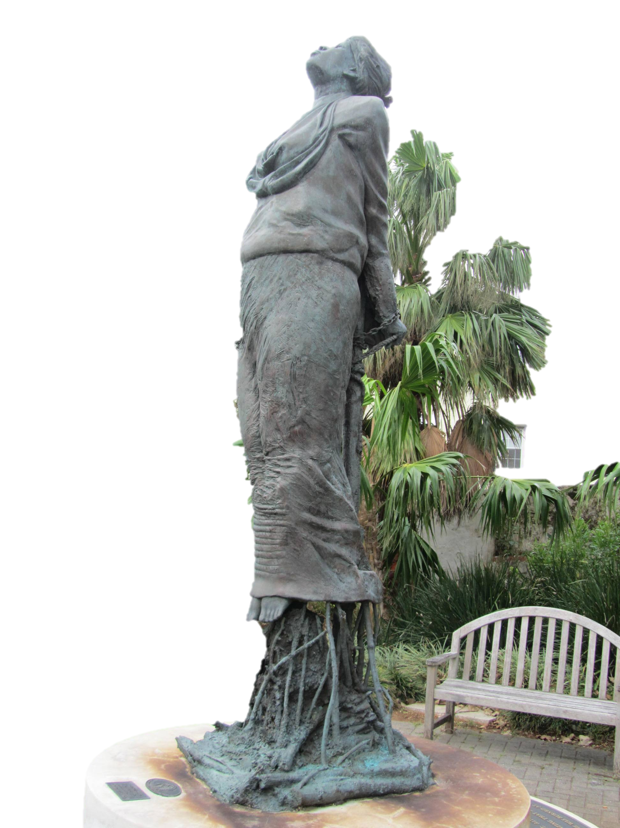
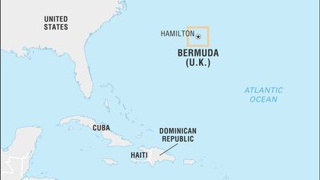
Case Study: Sarah (Sally) Basset

Slide 16
Sarah (Sally) Bassett was an older enslaved African women who was accused of poisoning the white couple, Thomas and Sarah Foster, who owned her granddaughter, Beck…

Slide 17
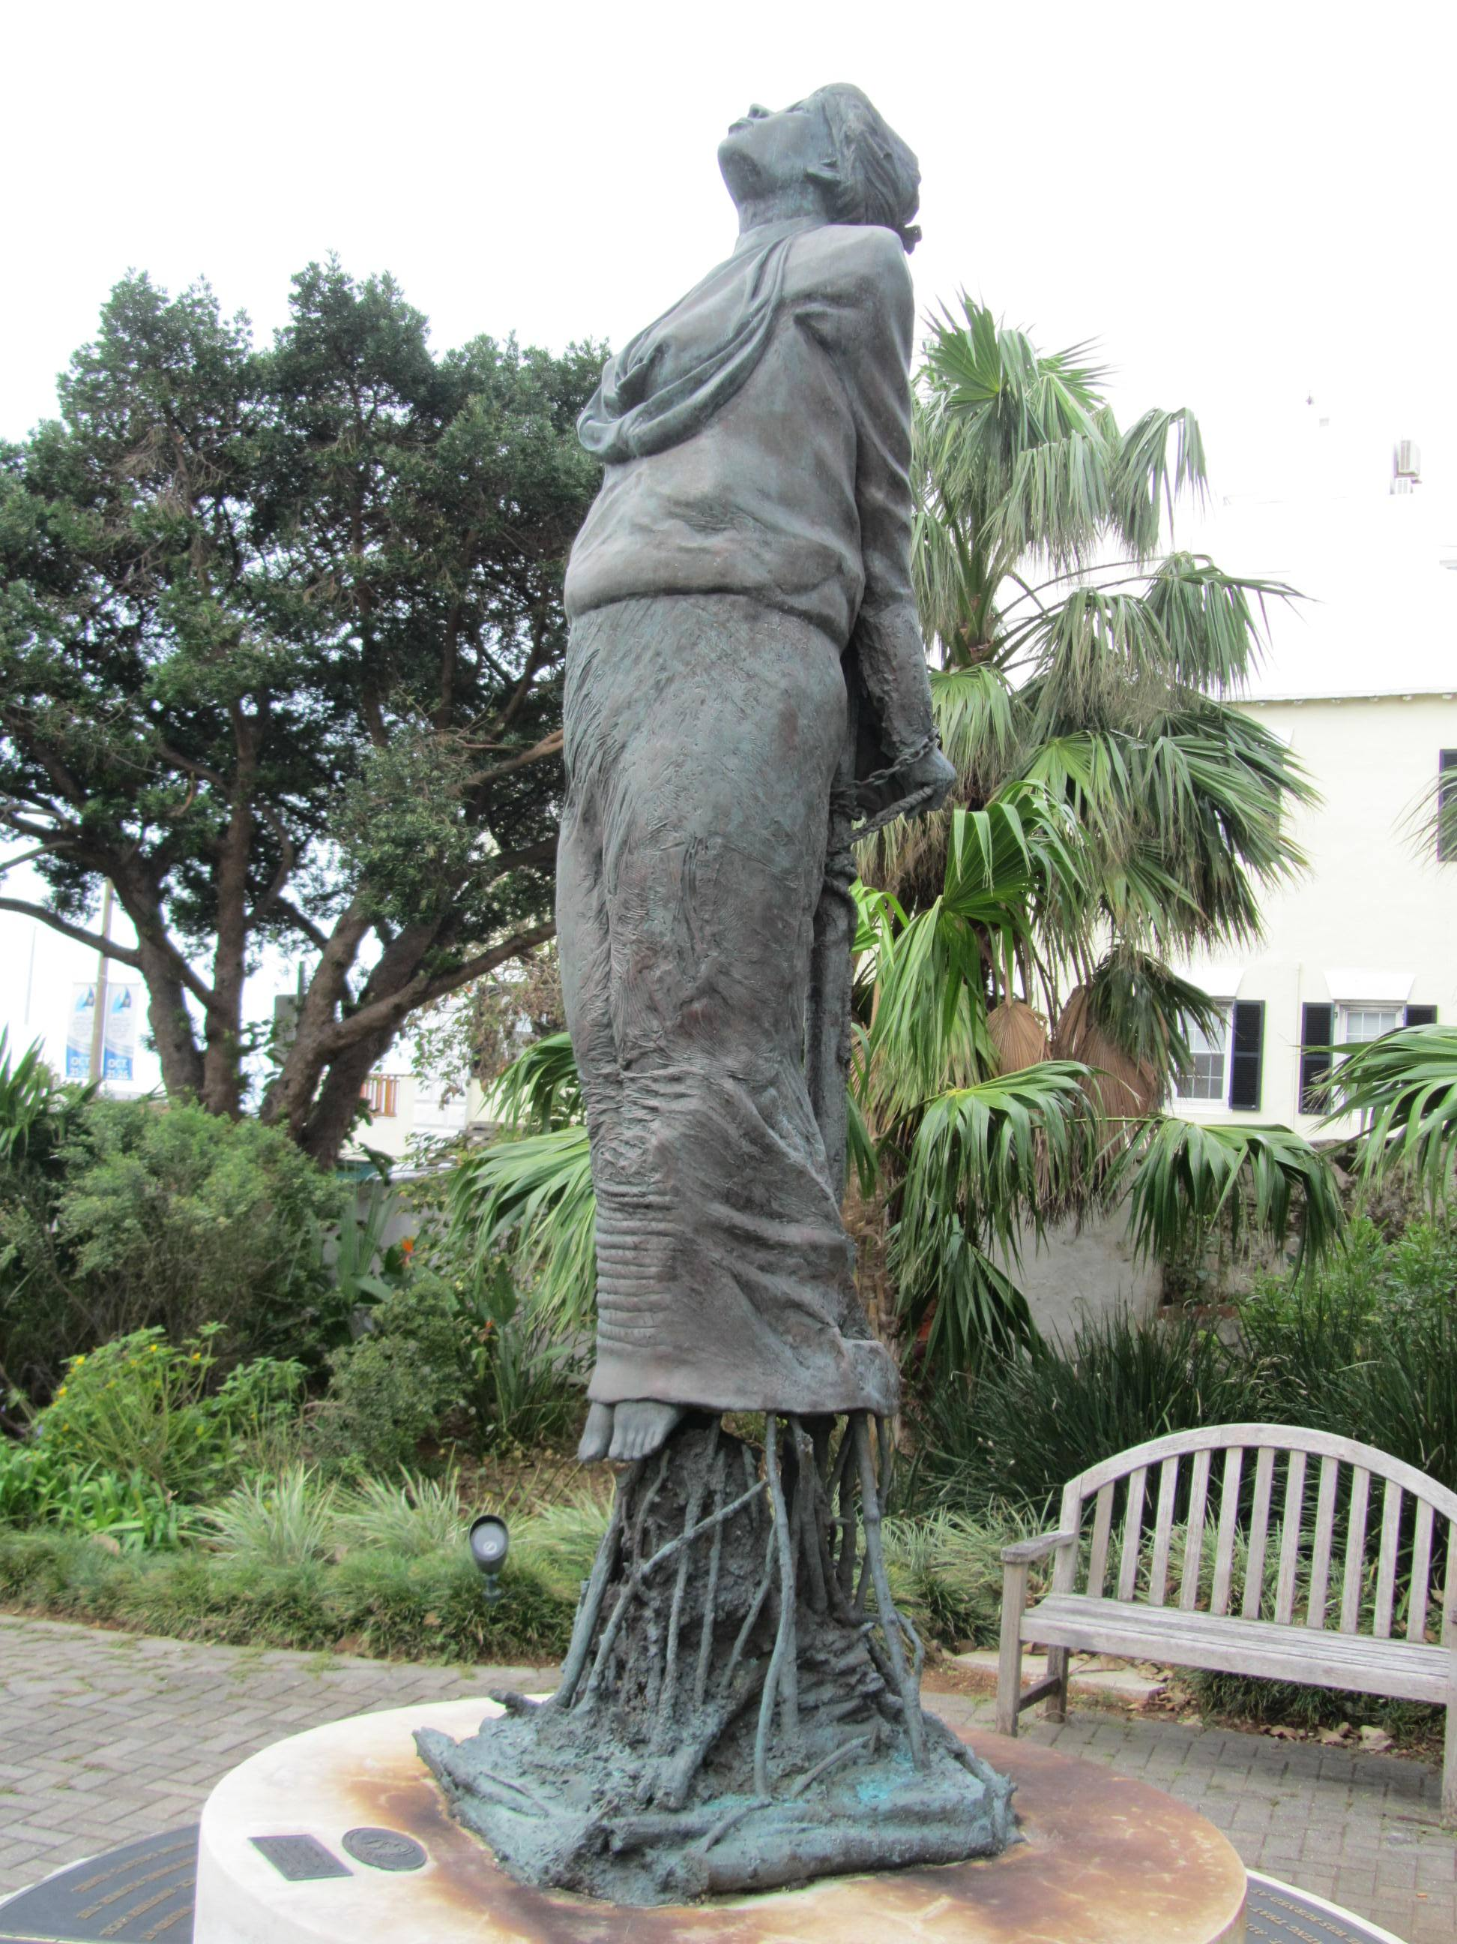
Case Study: Sarah (Sally) Basset
Using the worksheet provided, read the information about Basset and answer the following questions:
What was Basset accused of doing?
Was her act of resistance an example of female resistance?
What impact did Basset’s resistance have?
Spirit of Freedom, monument in honor of Sarah (Sally) Basset, 2009. The monument is part of the African Diaspora Heritage Trail in Bermuda, CIPD

Slide 18
Extension/Homework: Describe Question
“Describe how female enslaved people resisted slavery”
4 marks
= 4 separate points
‘One way enslaved women resisted slavery was___________’
‘A second way they resisted was ___________’
‘A third way they resisted was ___________’
‘A fourth way they resisted was ___________’

Slide 19
Plenary
Basset’s statue does not reference poison.
Solitude’s does not have her holding a machete
What is your opinion of the two statue designs? .
Reflect on what you would keep and what you would add & why?
Notes:
Possible additional thought: Are there statues of women in your area? How are they posed?

Slide 20
Sarah “Sally” Bassett
Sarah (Sally) Bassett was an older enslaved African women who was accused of poisoning the white couple, Thomas and Sarah Foster, who owned her granddaughter, Beck. Bassett was convicted of the attempted murder by poison of Mr and Mrs Foster, along with their enslaved domestic worker Nancy, in June 1730. During the trial, it was claimed that Beck was given several types of poison from Basset, such as ratsbane and manchineel root, along with careful instructions on how to use these substances. Basset instructed Beck to use one set of the poisons for Sarah Foster and to use it gradually in her food over a long period of time to make it appear as if she was becoming ill from disease. Once the poison was discovered, Bassett was put on trial and sentenced to be executed, as seen in the statue in honor of Bassett.
Bassett was one of many enslaved people, and specifically women, to be accused of poisoning. Enslavers grew worried and fearful of slave poisoning, which was shown through the introduction of laws that prohibited enslaved people from possessing and accessing poisons, and the harsh punishments introduced for those who did. Many of the enslaved people who were accused of poisoning were in fact women, and their role within the domestic setting, such as cook, house servant and maid to the owner's children, meant that they were living and working within close quarters with their potential victims.
Glossary:
Ratsbane: Rat poison
Manchineel Root: A root from a very toxic tree
Executed: to kill someone as a legal punishment
Prohibited: to officially forbid something
Possessing: to have or to own something
Close quarters: at close distance or range
Convicted: having officially been found guilty of a crime
Spirit of Freedom, monument in honor of Sarah (Sally) Basset, 2009. The monument is part of the African Diaspora Heritage Trail in Bermuda, CIPD

Slide 21
Forms of resistance | Explain how women could have resisted enslavement in this setting or circumstance. | Consolidate your ideas:

Slide 22
Forms of resistance | Explain how women could have resisted enslavement in this setting or circumstance. | Consider the impact of this resistance on the enslaved and the enslaver:
 | Use their position in the main house to access further information. Refusing to do certain household chores or doing these slowly. An example is not opening the correct blinds within the house. | By discovering new information, the women can educate themselves further and share their experiences of being enslaved. This may anger the enslaver by the tasks that the women would purposefully get wrong.
 | Limit their pregnancy or fertility. May bring on miscarriages. Using prolonged breastfeeding as a form of contraceptive protection. | By limiting their pregnancies or controlling their fertility. This impacted on the reproduction of enslaved workforce. By continuing breastfeeding. This allowed for pregnancies to be spread further apart, allowing women to take control over their bodies.
 | Women would use their position as domestic house workers, as well as their knowledge regarding poisonous plants and ingredients to poison the owners and their family. Continue to use African cooking practices. | By continuing to use West African ingredients and practices, it allowed for cultural traditions to be shared and passed on. By poisoning or attempting to poison the enslavers it is a direct resistance to their enslavement.
 | Women organised and led work strikes | Impact productivity of fieldwork and therefore also impact on enslavers profits.

Slide 23
Forms of resistance | Explain how women could have resisted enslavement in this setting or circumstance. | Consider the impact of this resistance on the enslaved and the enslaver:
 | Use their position in the main ____________ to access further information. Refusing to do certain household chores or doing these _____________. | By discovering new _______________, the women can educate themselves further and share their experiences of being enslaved. This may anger the enslaver by the tasks that the women would pur___________ get wrong.
 | Limit their pregnancy or fertility. May bring on miscarriages. Using prolonged _______________________ as a form of contraceptive protection. | By limiting their pregnancies or controlling their fertility. This impacted on the reproduction of enslaved workforce. By continuing breastfeeding. This allowed for pregnancies to be spread further apart, allowing women to take control over their _______________.
 | Women would use their position as domestic house workers, as well as their knowledge regarding poisonous ___________ to poison the owners and their family. Continue to use African ___________ practices. | By continuing to use West ______________ ingredients and practices, it allowed for cultural traditions to be shared and passed on. Poisoning or attempting to poison the enslavers is a direct resistance to their enslavement.
 | Women organised and __________ work strikes | Impact productivity of fieldwork and therefore also impact on enslavers _____________.

Slide 24
Lesson Level Enquiry Question Were there distinctive female patterns of resistance by enslaved people?
Purpose: | To consider the ways in which women distinctively resisted enslavement. To consider how the gender roles determined the types of resistance females did.
Objective: | To understand how women resisted enslavement through distinctive female patterns.
Outcome: | Pupils will demonstrate their ability to answer the Enquiry Question by… Considering how gender roles can impact resistance, take part in a case study about one women and consider other ways women could resist. They will answer the enquiry question as the plenary.
Time | Teacher is… | Pupils are… | Checking learning
0-5 | Viweing the options for the starter task in the notes in preparation. Circulating the room and supporting pupils. Encouraging student discussion during paired task. | Completing the starter activity and then paired work about resistance to enslavement. Sharing answers as a class. | Class discussion, as well as teacher check ins throughout paired task.
5-10 | Circulating the room. Organising class discussion around gender roles. | Considering gender roles, completing the grid. Differentiation: cut up the ‘answer grid’ as a card sort Or print off the grid with gaps Take part in class discussion. | Teacher walk round classroom. Class discussion.
10-40 | Read Bassett case study. Circulate the room during question activity and female resistance table. Support pupils who require guidance. Facilitating a class discussion. Showing the answer table on slide 11. | Case study on Sarah (Sally) Bassett. Answering questions individually. Class discussion once complete. | Answers on Bassett case study. Class discussion.
40-50 | Directing pupils to plenary activity. Reflecting on learning with the pupils. | Complete the plenary questions and effectively answer the lesson's enquiry question. Reflect on learning. | Class feedback. Answers to plenary.
Home learning: (if necessary/ appropriate) Extension/Homework: Describe question can be completed as extension activity or homework depending on timing.

