Slide 1
Did the Dolben Act work as intended?
Notes:
Mr Joseph Ash – History/Modern Studies

Slide 2
Lesson Starter:
Ship Name | Total Captives Sold | Children | Year | Origin Location
King of Prussia | 242 | 19% | 1777 | Old Calabar
Swift | 180 | 13% | 1778 | Old Calabar
Henry | 150 | 16% | 1784 | Bonny
Mary Ann | 400 | 16% | 1785 | Sierra Leone
Schooner Fly | 45 | 49% | 1789 | Bananas Islands
Schooner Flora | 71 | 41% | 1791 | Sierra Leone
Barque Fanny | 233 | 34% | 1791 | Benin
Jupiter | 342 | 42% | 1793 | New Calabar
African Queen | 202 | 41% | 1793 | Cameroon
Rodney | 324 | 30% | 1793 | Bonny
The table on the left tells us about some slaving ships which left Liverpool between 1778 and 1793.
What pattern do you notice in the percentages over time?
Can you see a date when things change suddenly?
Speculate - What might have caused this?
Table created using data from www.slavevoyages.org

Slide 3
In this lesson I will be:
Developing my knowledge and understanding on the effects of the Dolben Act 1788 on the enslavement and conditions of enslaved Africans
By the end of this lesson I will be able to:
Explain what the Dolben Act 1788 was and its provisions
Make an independent judgement as to whether the Dolben Act 1788 worked.

Slide 4
Key Words for Today’s Lesson
Regulate – To control something by bringing in rules or laws.
Abolitionist - Someone who wants to abolish (end) slavery and the slave trade.
Mortality Rate - The proportion of a population who die of a particular cause

Slide 5

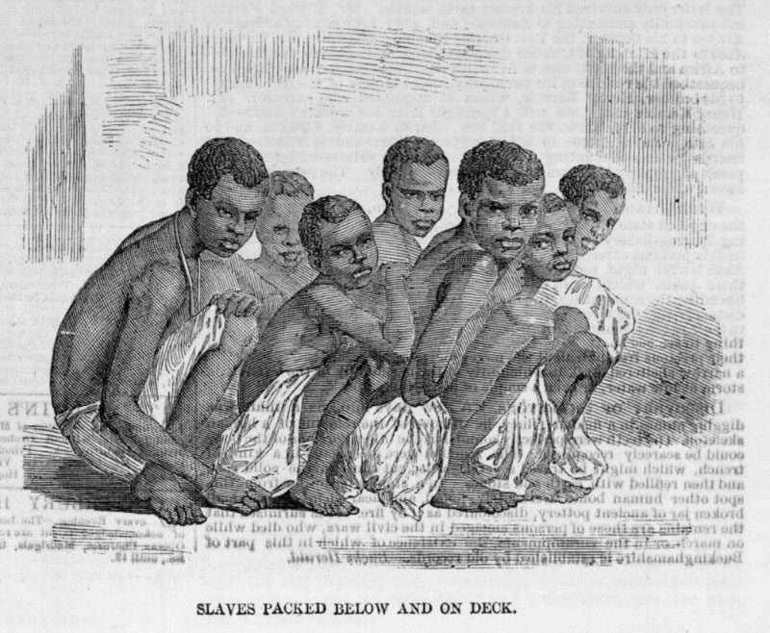
Discussion
Why do we have laws? What is the purpose of them?
Are all laws good? If not, can you think of an example?
What can make laws ineffective?
Africans Packed into a Slave Ship
. [The Illustrated London News (June 20, 1857), vol. 30, p. 595]

Slide 6
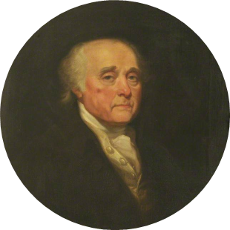
Sir William Dolben and the Call to Reform
Sir William Dolben, MP for Oxford University (1780–1806), was a committed abolitionist, described by biographer Nigel Aston as having “no cause dearer to him than the abolition of slavery”.
In 1788, he visited the slave ship Brookes to inspect its conditions.
A c. 1802 portrait of William Dolben by Mather Brown © Public Domain

Slide 7
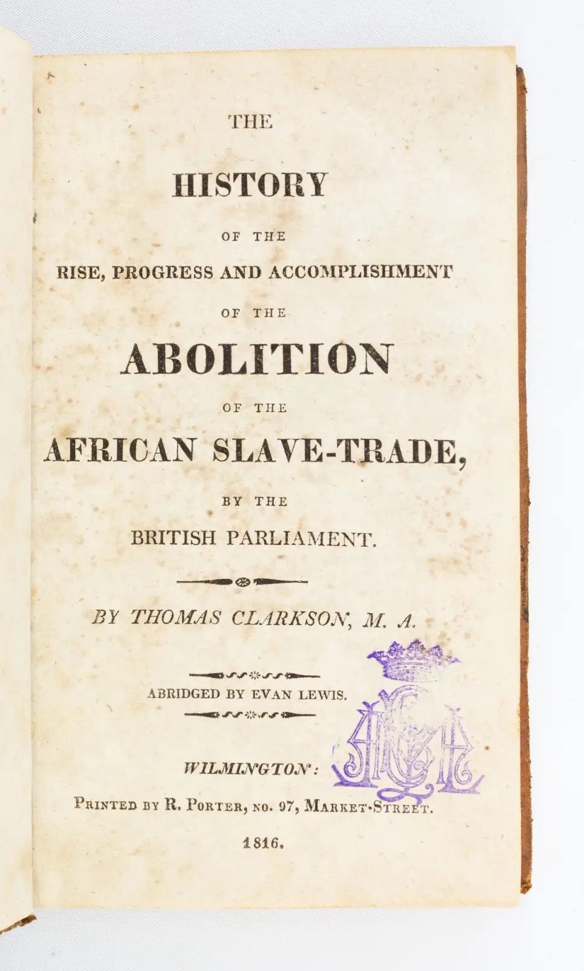
Dolben speaks about slave ships
After Dolben saw the Brooks, he spoke in the House of Commons about the conditions. According to another abolitionist, Thomas Clarkson,
[Dolben said that] Thus, crammed together like herrings in a barrel, [captives] contracted putrid and fatal disorders: so that they who came to inspect them in a morning had occasionally to pick dead slaves out of their rows and to unchain them from the bodies of fellow sufferers. Nor was it merely to the slaves that the baneful effects of the contagion thus created were confined. This contagion affected the ships crews, and numbers of seamen employed perished.’
This evil he [Dolben] said called aloud for a remedy: otherwise no less than ten thousand lives might be lost”
Dolben is not calling for an end to the slave trade. What is he asking for?
From: Thomas Clarkson, History of the Rise, Progress and Accomplishment of the Abolition of the African Slave Trade by the British Parliament, J.W. Parker, pp.295-296

Slide 8
The Slave Trade Act 1788 (The Dolben Act)
In 1789, the Dolben Act became law, and it was the first attempt to control and regulate the slave trade to reduce overcrowding and reduce deaths.
It introduced two important rules:
If more than 80% of the captives on board were children shorter than 4ft 4 inches, then the ship’s captain could report that there were fewer captives on board.
Ships must carry a surgeon who kept a 'regular and true journal' of sickness and death on board. The surgeon must hand the log to officials in Britain
It also allowed for financial bonuses for slave ships which reduced their death rates.

Slide 9
Group Discussion
Children as being under 4 foot 4 inches tall.
Slave traders could take more enslaved people aboard, provided they were under 4’4″ and presumed to be children.
What impact do you think this law may have had on the conditions during the Middle Passage?
Is this what Dolben intended?
Ships must carry a surgeon who kept a 'regular and true journal' of sickness and death on board. The surgeon must hand the log to officials in Britain

Slide 10
Did the Dolben Act have an impact on Child Enslavement Group Task
In your group number yourself 1-4. Each individual will become an expert on one of the areas that the Dolben Act impacted:
Source 1: The Role of Surgeons
Source 2: Overcrowding and Mortality
Source 3: Child Enslavement
Source 4: Disease and Medical Care
Individually you will have 10 minutes to read the extract and complete your section of the table the questions and feedback your findings to your group.

Slide 11
 | What did the Dolben Act Change? | What was Dolben trying to achieve? | What actually happened?
The Role of Slave Surgeons
Mortality and Overcrowding
Enslavement of Children
Medical and Disease Treatment

Slide 12
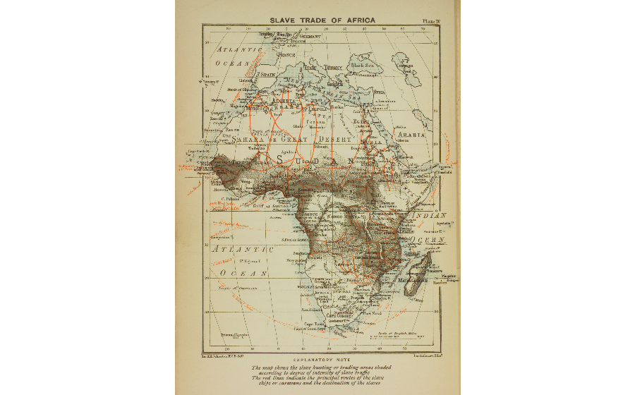

Plenary – State Your Opinion
Did the Dolben Act Actually Work?
Sir William Dolben when advocating for the passage of the Slave Trade Act argued that his bill would address the ‘most crying evil’ of the slave trade. However, you must come to an opinion as to whether it worked and was effective?
State your opinion using three reasons to back up your answer:
Overall, the Dolben Act did/did not work because………
Johnston, Harry Hamilton, Sir and J. G. Bartholomew, “Slave trade of Africa,” Digital Public Library of America

Slide 13
Lesson Plan

Slide 14
Did the Dolben Act work as intended?
Purpose | Pupils should understand that the 1788 Slave Trade Act aimed to regulate, not abolish, slavery—unintentionally prolonging the trade. They should also analyze how such regulations indirectly reinforced the system rather than dismantling it.
Objective | Pupils will understand how the Dolben Act aimed to reduce overcrowding on slave ships but led to minimal improvements, while new financial incentives encouraged traders to transport more children, altering the demographics of the enslaved. This directly links to the National 5 curriculum in terms of the middle passage and how the organisation of the enslavement of African people directly due to the Dolben Act
Outcome | Pupils will demonstrate their ability to answer the Enquiry Question by answering the plenary in which they will be using all evidence that they have engaged with to make a reasoned and evaluative judgement as to whether the Dolben Act worked.
Time | Teacher is … | Pupils are … | Checking learning
0 – 5 minutes | Introducing the lesson, going through learning intentions and success criteria. Prompting them to begin the starter task. | Looking at the table and processing the changes in enslaved ship log | Teacher-led class discussion
5 – 8 minutes | Introducing the idea of the notion of laws and receiving pupils answers on the purpose of laws/ are all laws effective/good? | Pupils are thinking about which country is being described | Pupils will discuss initially as a group and then will feedback to the teacher
10 – 18 minutes | Teacher introduces William Dolben and the Dolben Act | Pupils as a group will have the copy of the source, read through and highlight key conditions identified and answer the questions | Checking via verbal feedback and peer marking of answers
20 – 40 minutes | Teacher organises pupils into groups of 4, explain task | Pupils will have 10 minutes to become an expert on their area. 10 more minutes will be provided to help their group to fill in their table | Pupil work to be checked upon completion of table and discussion between groups to finish table
45 - 50 minutes | Teacher is introducing the plenary task in which they need to come to a judgement on the Dolben Act | Pupils will complete the plenary individually. | Class discussion and written response (can be done in their jotter or on a post it note or digital apparatus)

Slide 15
Resources

Slide 16
Did The Dolben Act work as intended?
 | What did the Dolben Act Change? | What was Dolben trying to achieve? | What actually happened?
The Role of Slave Surgeons
Mortality and Overcrowding
Enslavement of Children
Medical and Disease Treatment

Slide 17
Source 1 – The Role of Surgeons
John Matthews, a surgeon on a slave ship (1789) The log must be kept true, yet some captains suggest omissions. The air in the lower decks festers with fever, and my hands hold no cure. If fewer perish, coin awaits, and so does silence.”
Leigh D. The View from “White Man’s Bay”: The Captain John Matthews Papers on Sierra Leone at the Firestone Memorial Library, Princeton University. History in Africa. 2021;48:383-396
The Dolben Act made it a legal requirement that every slave ship carry a trained surgeon, responsible for monitoring the health of both the enslaved people and the crew. To promote better care, the act introduced financial rewards for captains and surgeons who managed to reduce the mortality rate of enslaved people during the voyage. If the death rate was kept below 2%, captains and surgeons were eligible for a bonus.
Additionally, surgeons were required to keep a detailed journal documenting every death on board, specifying the cause of death. These journals had to be submitted upon arrival at the first British port.
Example: If a ship carried 400 enslaved people, the surgeon’s pay could be calculated as follows: Less than 2% Mortality (8 or fewer deaths) Surgeon’s salary: £4 per month (average voyage → £48 total) Bonus for low mortality:£50 Total earnings: £98
This change led to a greater presence of surgeons on slave ships, which, in some cases, resulted in improved medical attention and efforts to maintain better hygiene. The financial incentives encouraged certain captains and surgeons to focus on reducing mortality rates, knowing they would receive additional compensation.
Some surgeons and captains falsified logs to make it appear as though fewer deaths occurred, allowing them to claim bonuses dishonestly. Others, fearing an increased mortality rate might reduce profits, would throw severely ill individuals overboard to prevent their deaths from being recorded. Furthermore, while trained, many surgeons had little to no experience treating tropical diseases such as dysentery and smallpox, meaning their effectiveness in preventing widespread illness remained limited.

Slide 18
Source 2 – Overcrowding and Mortality
The act introduced new regulations on how many enslaved individuals could be transported per ton of ship weight. This was intended to reduce extreme overcrowding and, in theory, lower mortality rates. Ships were also required to improve ventilation and sanitation to combat the spread of disease, a leading cause of death on the Middle Passage.
Average Mortality Rate before the Dolben Act | Average Morality Rate After the Dolben Act
15-18% | 13-15%
While some ships adhered to these new regulations, slightly improving conditions for enslaved Africans, the mortality rate only saw marginal declines. Some captains used the changes to their advantage, reducing the number of people per ship but increasing the number of voyages, ensuring the overall volume of enslaved Africans transported remained constant.
Unnamed Ship Surgeon – 1791: “The numbers may be lower on paper, yet the suffering remains. Fewer to a chain, yet the same cries in the dark.”
Maya Levin (2021), Putrid Disorders and Dangerous Diseases”: Slave Ship Surgeons’ Journals and Medicine on the Middle Passage, Yale Historical Review, 2021
Many captains also manipulated ship logs to appear compliant while still overcrowding their vessels. Though mortality rates decreased in some cases, it was not a universal trend, and conditions on most ships remained inhumane. The limited ventilation improvements often failed to prevent the rapid spread of disease, and with little understanding of medical care, most infections and illnesses led to high fatality rates.
Additionally, the Dolben Act did nothing to address the widespread physical abuse, malnutrition, and extreme punishments inflicted upon enslaved people.

Slide 19
Source 3 – Child Enslavement
The Dolben Act defined children based on height, specifically as anyone under 4 feet 4 inches tall. It legally allowed slave traders to transport more children than adults, which traders exploited. Since the act did not specify a minimum age for children, enslavers increasingly transported more adolescents between the ages of 12 and 18, classifying them as "children" to circumvent restrictions on the number of enslaved individuals per ship.
Ship Name | Total Captives Sold | Children | Year | Origin Location
Henry | 150 | 16% | 1784 | Bonny
Mary Ann | 400 | 16% | 1785 | Sierra Leone
Schooner Flora | 71 | 41% | 1791 | Sierra Leone
Barque Fanny | 233 | 34% | 1791 | Benin
Jupiter | 342 | 42% | 1793 | New Calabar
African Queen | 202 | 41% | 1793 | Cameroon
The act allowed captains to report fewer total enslaved people if the majority of them were children. This incentivised captains to transport more young individuals to manipulate ship logs
While the Dolben Act slightly reduced overcrowding, it unintentionally led to an increase in child trafficking. Many of these children faced extreme conditions, and their smaller bodies were often more vulnerable to malnutrition and disease. The mortality rate among enslaved children remained high.
Captain John Williams – 1792: With the smaller ones, our counts are lower. The law allows, so we take them. Their limbs weaken faster, but they are easier to manage.”
Maya Levin (2021), Putrid Disorders and Dangerous Diseases”: Slave Ship Surgeons’ Journals and Medicine on the Middle Passage, Yale Historical Review, 2021

Slide 20
Source 4 – Medical Care
The Dolben Act required ships to carry more medical supplies and improve sanitation conditions. Ships were required to stock medicines such as laudanum (an opium-based painkiller), mercury compounds (used for treating syphilis), and purgatives for digestive illnesses. However, crew members were prioritised over captives when it came to treatment.
Christopher Bowes’ Medical Journal (1792) (Logbook): “[The captives] suffer from fever and severe flux (dysentery). I have given them small doses of rhubarb and Glauber’s salts. Many do not survive the treatment. However, the crew members who fall ill are given stronger spirits of lavender, and most recover. The captain is satisfied that the losses remain low, ensuring financial stability. We will continue recording cases carefully, as an accurate medical log is required under the new laws."
Memorandum, "Entry for 'Medical log of the slave-ship 'Lord Stanley', kept by Christopher Bowes,'" n.d., http://surgicat.rcseng.ac.uk/Details/archive/110004314.
Although these measures contributed to minor improvements in overall ship conditions, they did not eliminate the primary causes of disease outbreaks. Many ships still lacked sufficient clean water and nutritional food, and medical supplies were often inadequate.
Surgeons lacked the knowledge and tools to effectively treat the illnesses that spread rapidly in the confined quarters of a slave ship. Many of the medical supplies that were used to treat sick enslaved Afrcians were too weak and many did not survive the treatment. Diseases like thypus and dysentery was still a serious problem on the slave ships.
The Act did nothing to prevent surgeons from force-feeding enslaved people who refused to eat or to stop the violent punishments inflicted upon those who were sick.

