Slide 1
What was the impact of Phillis Wheatley’s visit to
Britain on debates about slavery?

Slide 2
To develop our knowledge and understanding of the importance of black women in the abolitionist movement
I can analyse primary sources.
I can research information about Phillis Wheatley.
I can make a judgement on the impact of the work of Phillis Wheatley.

Slide 3

Starter
What arguments were used by those in favour of slavery and the slave trade?
What arguments did abolitionists present against slavery?
Notes:
This should take 5 mins max

Slide 4
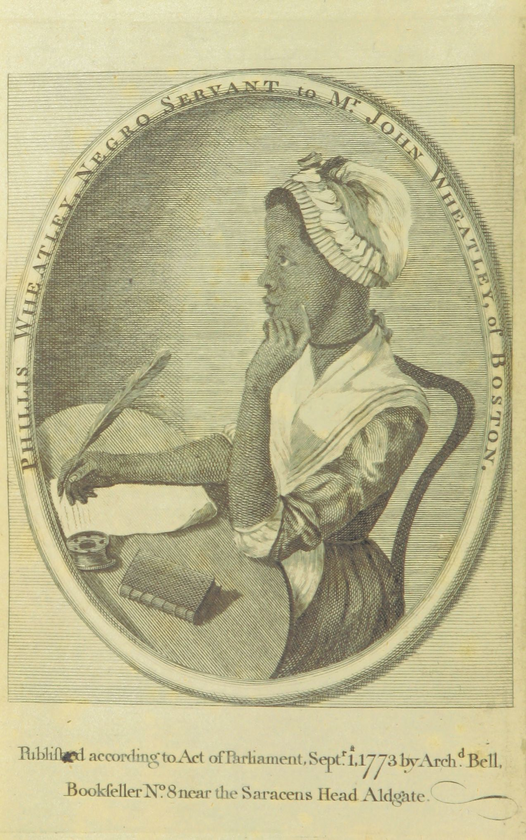
Who was Phillis Wheatley?
Born circa 1753, Phillis Wheatley was taken from West Africa at the age of 8 years old and became enslaved in Boston, Massachusetts, USA.
Her birth name is not known - she was given her Western name having been transported aboard a ship called 'The Phillis'.
She was purchased as a personal servant for the wife of John Wheatley, a wealthy American merchant.
But Phillis' life was different from many other enslaved people, as the Wheatleys educated her in English, Classics, literature and theology, at a time when the enslaved were not given access to education and actively discouraged from learning how to read and write.
Image source: Portrait of Phillis Wheatley, attributed by some scholars to Scipio Moorhead, British Library, 992.a.34.
Notes:
https://www.surreycc.gov.uk/culture-and-leisure/history-centre/marvels/phillis-wheatley-the-mother-of-black-literature#:~:text=Endorsed%20by%20British%20nobility%2C%20Phillis,Religious%20and%20Moral'%20was%20published.

Slide 5
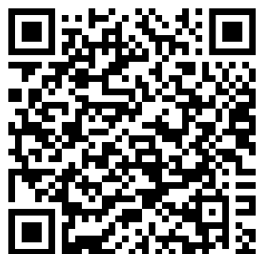
Speedy Research- Phillis Wheatley in London
https://www.blackhistorymonth.org.uk/article/section/author-and-historians/phillis-wheatley-in-london/
Using the following QR code/link, you should find out answers to the following questions:
When did Wheatley come to London?
Why did she come to London?
Name two important figures she met.
You have 5 minutes to complete this task!

Slide 6
In 1773, Poems on Various Subjects, Religious and Moral by Phillis Wheatley became the first book of poetry published by a person of African descent in the English language.
It was a collection published in Britian of 39 poems about various important issues in the news.

Slide 7
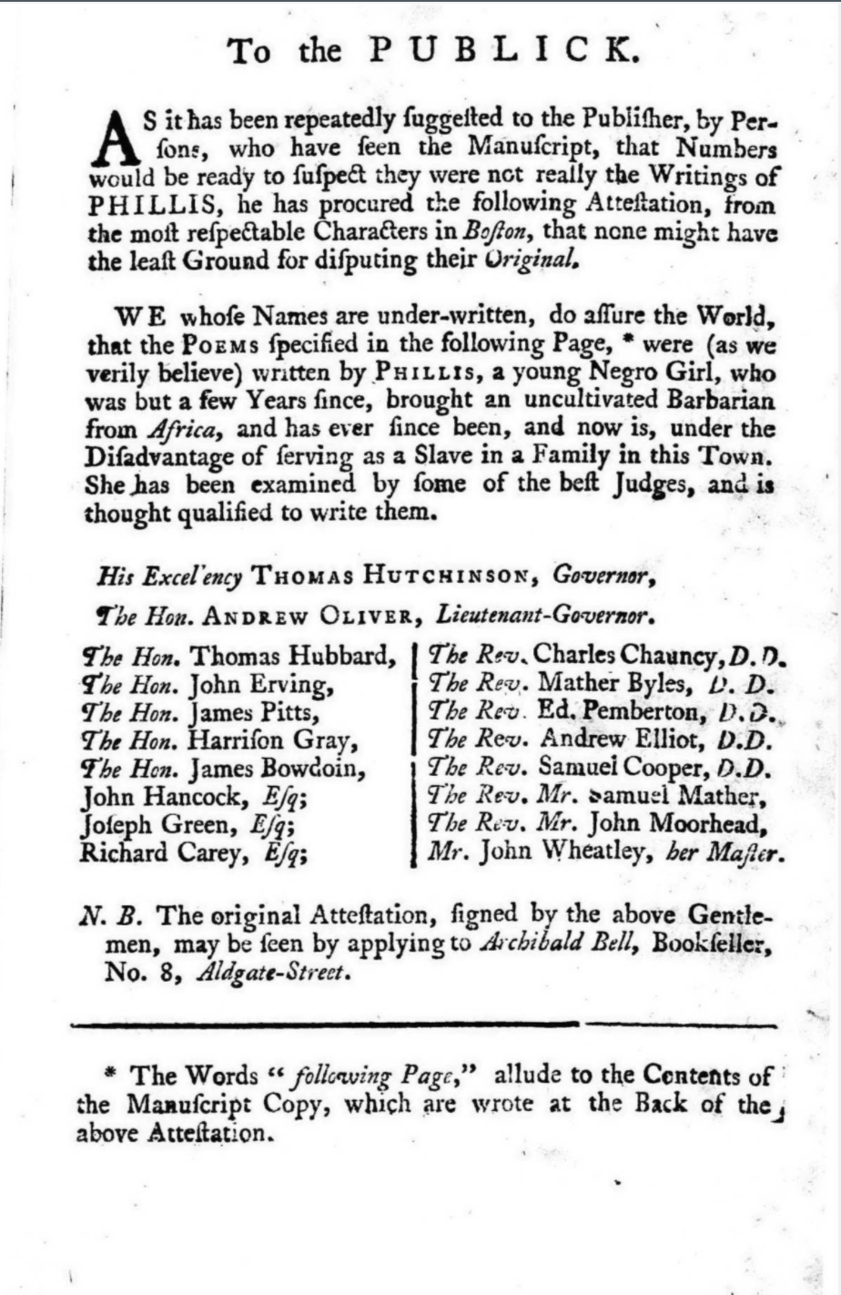
We whose Names are under-written, do assure the World that the POEMS specified in the following Page, were (as we verily believe_ written by PHILLIS, a young N___o Girl
When Phillis’ poems were published, this ‘attestation’ appears on the first page. Why do you think the publishers thought they needed one?
You have 3 minutes to discuss!
Source: Attestation from 1773 edition accessed via https://womensprinthistoryproject.com/blog/post/25 20/2/25
Notes:
https://womensprinthistoryproject.com/blog/post/25

Slide 8
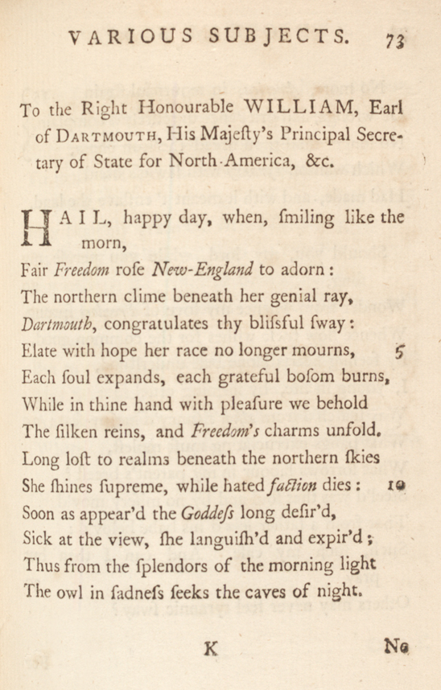
Group Primary Source Analysis (20 minutes)
Get into groups of 3 or 4.
You will be handed an A3 copy of one of Phillis Wheatley’s poems.
Work with your group to analyse the poem using the questions surrounding the poem.
Source: Phillis Wheatley, “To the Right Honourable William, Earl of Dartmouth” (wr. 1772), in Poems on Various Subjects, Religious and Moral, 1773. (The Gilder Lehrman Institute, GLC06154) accessed via: Phillis Wheatley’s poem on tyranny and slavery, 1772 | Gilder Lehrman Institute of American History

Slide 9

Plenary- Exit Ticket
Discuss in pairs: In what ways did Phillis Wheatley’s visit to Britain contribute to the abolitionist movement and the broader debate about slavery?
Complete individually: Now that you have discussed, answer the question above in 50 words or less.

Slide 10
Extension- Discussion task
How did Wheatley’s existence as an educated, talented Black woman challenge the racial ideologies of the time?
Notes:
https://womensprinthistoryproject.com/blog/post/25

Slide 11
LESSON PLAN

Slide 12
Lesson Level- N4/5 Enquiry Question- What was the impact of Phillis Wheatley’s visit to Britain on the debates about slavery?
Purpose: | To develop understanding of Phillis Wheatley and her contribution to debates on slavery. If a pupil asks, ‘Why do I need to know this?’, what will you reply? She was the first black woman who had poetry published in the English Language so is an important figure to learn about.
Objective: | The learning in this lesson links to the syllabus by linking in with abolition of the Slave Trade. It brings in abolition from a female perspective and also a black perspective and removes the sole focus on male and mostly white abolitionists. What is the takeaway? Pupils should be able to answer the enquiry question: What was the impact of Phillis Wheatley’s visit to Britain on the debates about slavery? They should also be able to recognise the impact that previously minoritized groups had on the abolition movement.
Outcome: | Pupils will demonstrate their ability to answer the Enquiry Question by completing all of the tasks within the lesson particularly in relation to the primary source materials such as the attestation and the poem.
Time | Teacher is… | Pupils are… | Checking learning
3 minutes | Talking through the enquiry question and LI and SC. Introduce starter task. (slide 2-4) | Listening to the teacher | Check pupils understand the starter task- repeat back etc.
3 minutes | Starter task- Circulating the classroom for first few minutes and then getting feedback from pupils. | Discussing the questions with their shoulder partner | Feedback from pupils
2 minutes | Reading through slide 5 which gives initial information about Phillis Wheatley. Introduce speedy research task on slide 6. | Listening to the teacher
5 minutes | Teacher circulating classroom and checking understanding, engaging in conversation with young people. | Pupils completing speedy research task. | Feedback from pupils and answers to questions.
2 minutes | Read through slide 7&8
10 minutes | Teacher to go through task instructions and set pupils off on task. This task uses the first worksheet which is the attestation at the start of Wheatley’s published works. Get feedback from pupils on task. | Discussing the first piece of primary source material. They will then provide feedback to the teacher regarding this. | Feedback from pupils and answers to questions.
20 minutes | Introduce group primary source task and set pupils off on task. | Pupils will be working in small groups and engaging in conversation regarding this.
3 minutes | Plenary
EXTENSION TASK | If time allows/ dependent on the class in front of you, there is an additional extension task. This can be completed either verbally or written.

Slide 13
WORKSHEETS/
HANDOUTS

Slide 14
Attestation for task on slide 9.
Source: Attestation from 1773 edition accessed via https://womensprinthistoryproject.com/blog/post/25 20/2/25

Slide 15
Source worksheet for task on slide 8 on the next slide.
This should be printed on A3 paper to allow space for young people to record answers.
Source: Phillis Wheatley, “To the Right Honourable William, Earl of Dartmouth” (wr. 1772), in Poems on Various Subjects, Religious and Moral, 1773. (The Gilder Lehrman Institute, GLC06154) accessed via: Phillis Wheatley’s poem on tyranny and slavery, 1772 | Gilder Lehrman Institute of American History

Slide 16
Identify between 2-3 specific lines from Wheatley’s poem in which she describes the horror of enslavement.
2. Why do you think Wheatley is using rhetorical questions? Who is she addressing?
No more, America, in mournful strain Of wrongs,
and grievance unredress’d complain,
No longer shall thou dread the iron chain,
Which wanton Tyranny with lawless hand Had made,
and with it meant t’enslave the land.
Should you, my lord, while you peruse my song,
Wonder from whence my love of Freedom sprung,
Whence flow these wishes for the common good,
By feeling hearts alone best understood, I, young in life, by seeming cruel fate
Was snatch’d from Afric’s fancy’d happy seat:
What pangs excruciating must molest, What sorrows labour in my parent’s breast?
Steel’d was that soul and by no misery mov’d
That from a father seiz’d his babe belov’d:
Such, such my case. And can I then but pray Others may never feel tyrannic sway?
3. Pick out 3-5 words which show Wheatley's negative attitude to slavery and explain how they do this.
4. What is the message she is trying to get across in the final two lines?

