Slide 1
How did the people of Igboland resist the Slave trade?

Slide 2
I can:
Analyse primary and secondary sources sources
Compare and contrast different responses to the slave trade within Igboland
I can describe the long term impact that the slave trade had on the Bight of Biafra
We will learn about how Igbo communities living in the 18th century Bight of Biafra resisted the slave trade from 1640 to 1800.

Slide 3
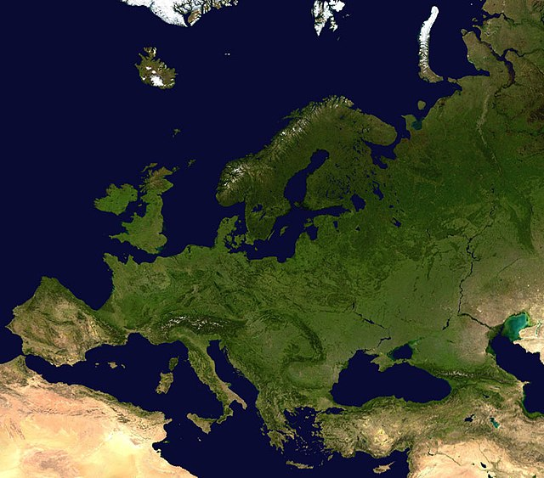
Starter: Think, pair, share
A satellite map of Europe created by Nasa © Public Domain
As someone who lives in Scotland, what might make you different
Other people in Scotland?
People who live in the rest of the UK?
People who live in another country in Europe?

Slide 4

Activity: Which modern day country am I talking about?
It has the 7th largest population in the World, it’s the most populated country on its continent.
There are at least 250 different languages spoken in this country, possibly as many as 400!
It’s home to one of the fastest growing film industries in the world – producing 50,000 films a year!
The most popular sport in the country is football.
The country’s biggest export is oil.

Slide 5
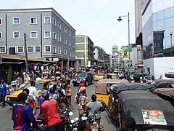
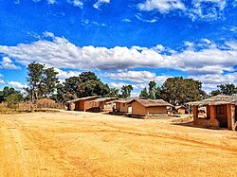
Answer: Nigeria!
It’s important to remember that Africa as a continent is very diverse – both now and in the past!
Individual countries, societies and communities within Africa are also very diverse!
The shopping district in Lagos, Nigeria’s most populous city © Creative Commons Attribution-Share Alike 4.0
A rural village in Nigeria © Creative Commons Attribution-Share Alike 4.0

Slide 6
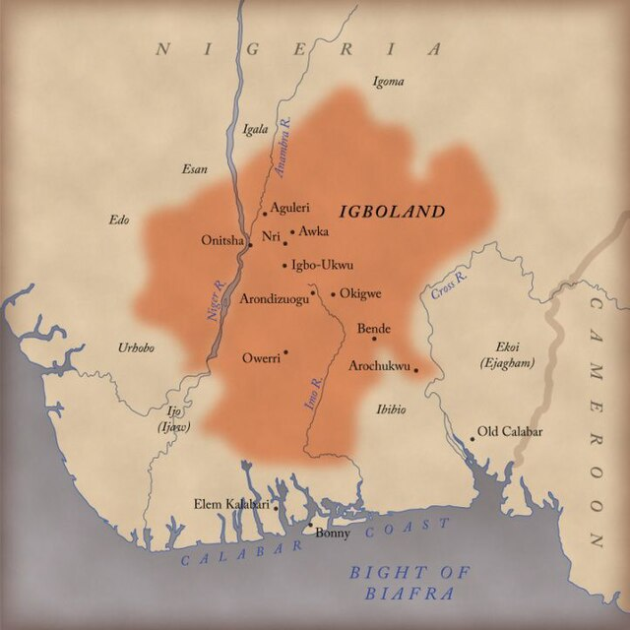
Where is the Bight of Biafra?
Igboland © Creative Commons Attribution-Share Alike 4.0
The Bight of Biafra is in West-Central Africa. In the 18th century it was home to various communities of Igbo-speaking people. This region is now sometimes referred to as 'Igboland'.
It was among the areas of West Africa which experienced the most intensive slave-trading activities between the 17th and 19th centuries.
Although the total number of Africans enslaved remains unknown, available estimates suggest that about 637,500 Igbo-speaking people were taken to Americas between 1640 and 1800.

Slide 7
How was the slave trade organised in Igboland?
Although over 637,000 Igbo were enslaved, it is also true that Igbo were among the leading providers of enslaved people to European traders.
This means that Igbo people enslaved other Igbo people and sold them to the Europeans. This might seem surprising, but Igbo is a language group which contained many different nations.
Much of the trade in Igboland was dominated by traders from the Aro nation. The Aro traders used warriors, known as the ‘Abam’, to raid villages and towns to capture people to be sold into slavery.
Usually, the Abam warriors would attack at night, taking communities by surprise.
It was up to local communities to organise their own defence against the Abam raiders.

Slide 8
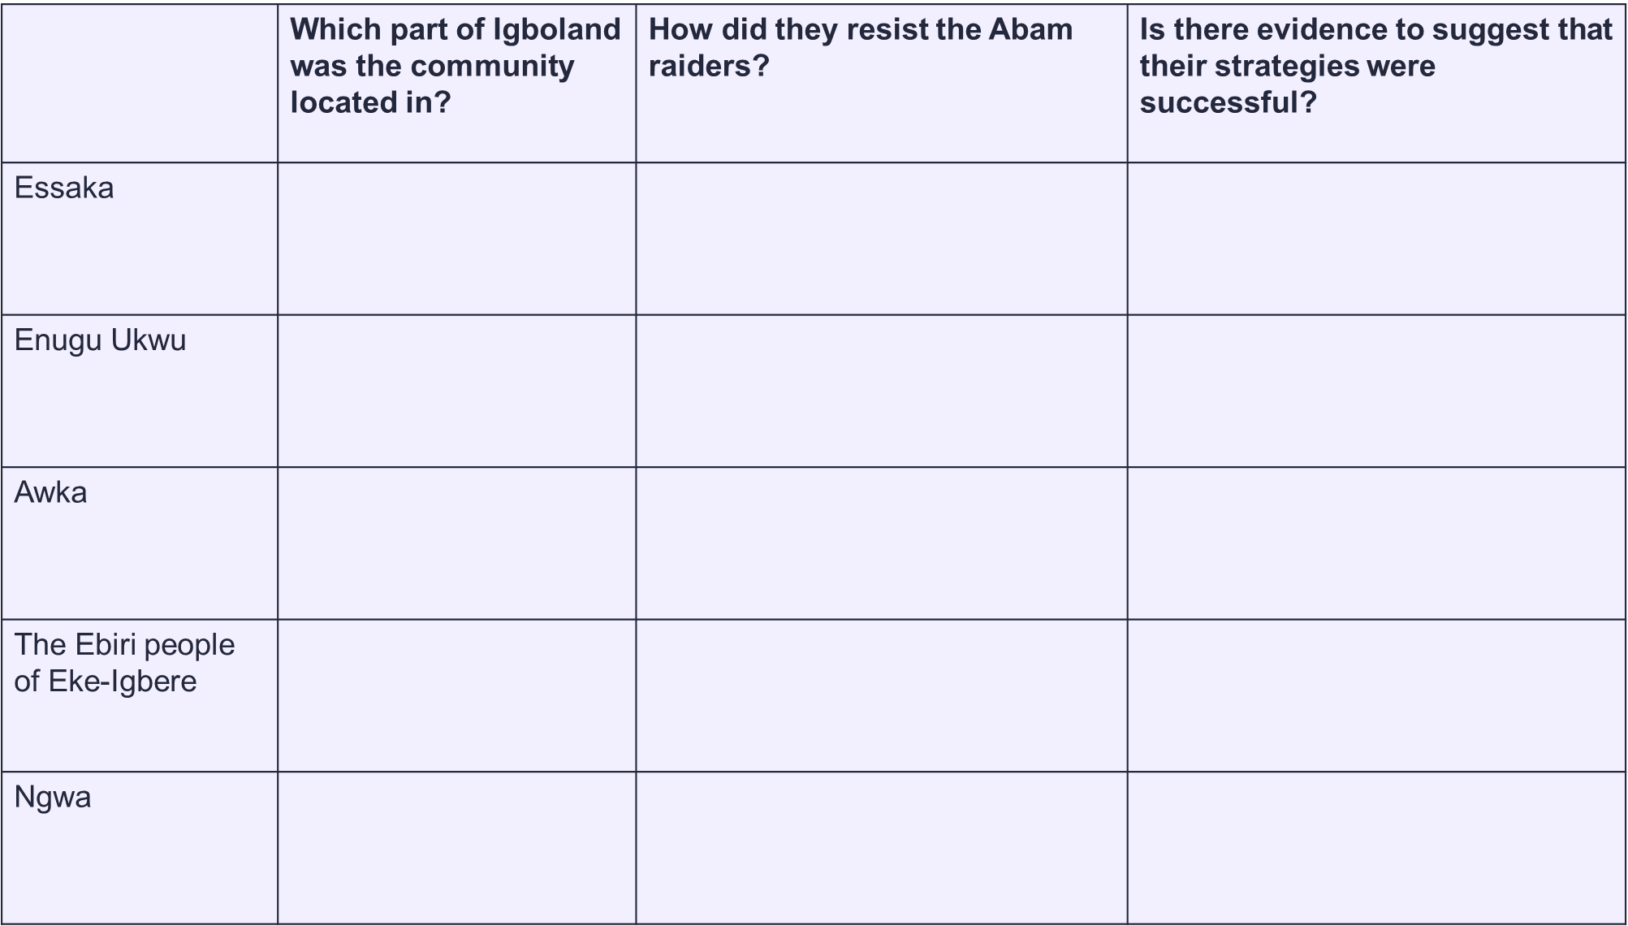
How did Igbo resist?
As we have already seen, the Igbo were a very diverse people.
John N Oriji argues that within Igboland responses to the slave trade were ‘wide ranging’ and without stiff resistance from communities the impact of the Slave trade in the region would have been far worse.
In this lesson, we will learn about five Igbo nations who resisted the Abam warriors of the Aro. We will do the first one, the Essaka, as a class and then you will do the other four in pairs.

Slide 9
 | Which part of Igboland was the community located in? | How did they resist the Abam raiders? | Is there evidence to suggest that their strategies were successful?
Essaka | Western Igboland
Enugu Ukwu
Awka
The Ebiri people of Eke-Igbere
Ngwa
Notes:
Is there any evidence to suggest that their strategies were successful?

Slide 10
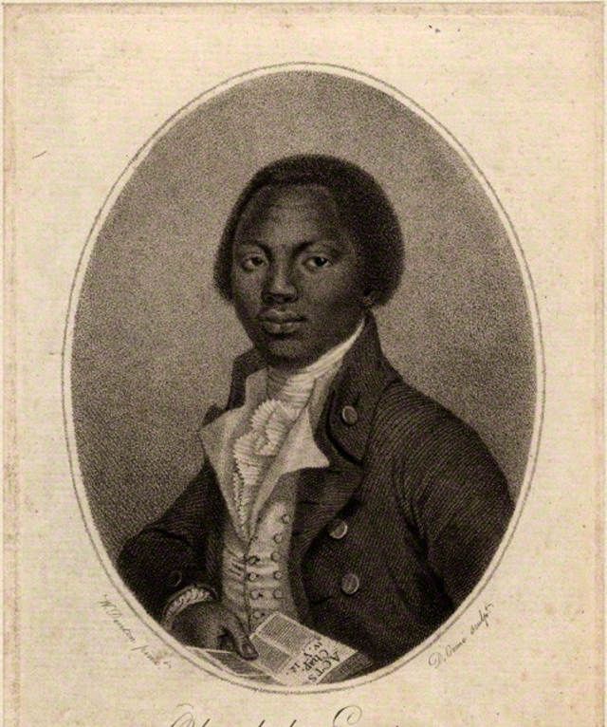
As a whole class
Olaudah Equiano was an enslaved man who wrote his biography as an adult. The book was popular in Britain and helped to raise awareness of the horrors of slavery.
Equiano was born in Essaka in Western Igboland. Around the age of 11 he and his sisters were kidnapped and sold into slavery.
His memoir gives us some important information about Igbo resistance.

Slide 11
From 'The Interesting Narrative of the Life of Olaudah Equiano'.
We have fire-arms, bows and arrows, broad two-edged swords and javelins: we have shields also which cover a man from head to foot. All are taught the use of these weapons; even our women are warriors, and march boldly out to fight along with the men. Our whole district is a kind of militia: on a certain signal given, such as the firing of a gun at night, they all rise in arms and rush upon their enemy. It is perhaps something remarkable, that when our people march to the field a red flag or banner is borne before them. I was once a witness to a battle in our common. We had been all at work in it one day as usual, when our people were suddenly attacked. I climbed a tree at some distance, from which I beheld the fight. There were many women as well as men on both sides; among others my mother was there and armed with a broad sword. After fighting for a considerable time with great fury, and after many had been killed our people obtained the victory, and took their enemy's Chief prisoner. He was carried off in great triumph, and, though he offered a large ransom for his life, he was put to death.

Slide 12
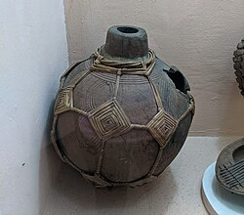
How did different Igbo Nations resist slave raids?
Enugu Ukwu is located in the North of Igboland. Instead of fighting the Abam warriors directly, they set traps. They left poisoned food, water and wine along the routes that the Abam warriors travelled.
The Abam were terrified as many of their warriors mysteriously dropped dead before raids. As a result, they started to avoid the town of Enugu Ukwu.
The people of Awka in Northern Igboland set up vigilante groups to defend themselves against the Abam warriors. Abam warriors liked to catch villages by surprise in the dead of night, but by arming themselves with Snider rifles, the people of Awka could fire their guns to defend themselves AND to raise the alarm for people who were sleeping.
The people of Awka also fortified their town against the Abam warriors. They built high walls around their houses and guard towers to keep an eye out for intruders.
Reports of slave raids in nearby communities in Southeastern Igboland put the people of Ngwa on high alert.
In order to protect themselves, female farmers worked in groups and when they travelled to distant markets they were accompanied by their husbands or armed male guards.
The people of Ngwa also sought spiritual protection against slave raids. Young men were initiated into the cult of Ike-Oha, a war god. This was supposed to protect them from bullet wounds. The young men were then given military training so that they would be able to defend their communities against the Abam warriors.
Left - The Igbo people were skilled ‘potters’. This is an example of an ‘Udu’ a clay pot that is also used as a musical instrument.
An Udu-Agha (a war pot) would have been carried by the head warrior whose duty it was to warn people of an invasion and lead other warriors against the Abam raiders.
The Ebiri people lived in Southeastern Igboland were targeted by Abam slave traders twice.
The first time the Ebiri people were forced to flee from their homeland in Orini to a new location. The second time the Abam warriors came the Ebiri people sent out their own armed warriors to patrol the community. This led to full scale battles between the Ebiri and the Abam in which the Abam warriors were forced to retreat.
The bravery of the Ebiri warriors who defeated the Abam is remembered today. They now call their town ‘Igbo Erughi’ which translates at the ‘town that the Aro could not reach/capture’.

Slide 13
Plenary: Discuss
“Although the people [of Ngwa] who enroute turned out in thousands to look at us appeared to be very friendly and peacefully disposed, not a man apparently moved a step without carrying a naked sword in one hand and a rifle at full lock in the other. Even the boys, some of them not higher than an ordinary man’s knee … walked out armed with bows and pointed arrows”
A quote from Major A Leonard, a British military officer who arrived in the Ngwa region of Igboland in 1898.
Which Igbo communities resisted the slave trade in similar ways?
Were there any communities which resisted the slave trade in an entirely different way to the others?
Have a look at the quote, what kind of long term impacts do you think the slave trade might have had on Igboland?

Slide 14
References
John N Oriji 'Igboland, Slavery and the Drums of War and Heroism' Fighting the Slave trade, West African strategies. Edited by Slyvanie A Diouf, Ohio University Press, 2003.
Olaudah Equiano, The Interesting Narrative of the Life of Olaudah Equiano

Slide 15
How did the people of Igboland resist the slave trade?
Purpose | Pupils should understand that African societies were complex and diverse. Pupils should also understand that resistance to slavery did not begin on the middle passage, African societies under threat from slave raids responded to this threat in diverse ways.
Objective | The key takeaway from this lesson will be that the slave trade impacted different African societies in different ways. This links to the National 5 curriculum which states that pupils should be able to explain the impact of the slave trade on Africa.
Outcome | Pupils will demonstrate their ability to answer the Enquiry Question by answering the plenary questions which encourage them to compare and contrast the responses of the different societies which they have learned about in the lesson.
Time | Teacher is … | Pupils are … | Checking learning
0 – 5 minutes | Introducing the lesson, going through learning intentions and success criteria. Prompting them to begin the starter task. | Thinking about the questions on the board, then discussing them with a partner. | Teacher-led class discussion
5 – 10 minutes | Teacher is reading out the clues | Pupils are thinking about which country is being described | Pupils volunteer possible answers in class discussion
10 – 20 minutes | Teacher introduces source task | Pupils read about one of the Igbo societies, uses the source to fill in their row of the table worksheet
20 – 40 minutes | Teacher organises pupils into groups of 5 | Pupils take turns of 4 minutes each to describe their society’s resistance and help their group to fill in their table | Pupil work to be checked upon completion of table.
40-50 minutes | Teacher is introducing the plenary task | Pupils are completing the plenary task in pairs | Class discussion

Slide 16
 | Which part of Igboland was the community located in? | How did they resist the Abam raiders? | Is there evidence to suggest that their strategies were successful?
Essaka | Western Igboland
Enugu Ukwu
Awka
The Ebiri people of Eke-Igbere
Ngwa
Notes:
Is there any evidence to suggest that their strategies were successful?

Slide 17
How did different Igbo nations resist raids?
Enugu Ukwu is located in the North of Igboland. Instead of fighting the Abam warriors directly, they set traps. They left poisoned food, water and wine along the routes that the Abam warriors travelled.
The Abam were terrified as many of their warriors mysteriously dropped dead before raids. As a result, they started to avoid the town of Enugu Ukwu.
The people of Awka in Northern Igboland set up vigilante groups to defend themselves against the Abam warriors. Abam warriors liked to catch villages by surprise in the dead of night, but by arming themselves with Snider rifles, the people of Awka could fire their guns to defend themselves AND to raise the alarm for people who were sleeping.
The people of Awka also fortified their town against the Abam warriors. They built high walls around their houses and guard towers to keep an eye out for intruders.
Reports of slave raids in nearby communities in Southeastern Igboland put the people of Ngwa on high alert.
In order to protect themselves, female farmers worked in groups and when they travelled to distant markets they were accompanied by their husbands or armed male guards.
The people of Ngwa also sought spiritual protection against slave raids. Young men were initiated into the cult of Ike-Oha, a war god. This was supposed to protect them from bullet wounds. The young men were then given military training so that they would be able to defend their communities against the Abam warriors.
Left - Igbo people were skilled ‘potters’. This is an example of an ‘Udu’ a clay pot that is also used as a musical instrument.
An Udu-Agha (a war pot) would have been carried by the head warrior whose duty it was to warn people of an invasion and lead other warriors against the Abam raiders.
The Ebiri people lived in Southeastern Igboland were targeted by Abam slave traders twice.
The first time the Ebiri people were forced to flee from their homeland in Orini to a new location. The second time the Abam warriors came the Ebiri people sent out their own armed warriors to patrol the community. This led to full scale battles between the Ebiri and the Abam in which the Abam warriors were forced to retreat.
The bravery of the Ebiri warriors who defeated the Abam is remembered today. They now call their town ‘Igbo Erughi’ which translates at the ‘town that the Aro could not reach/capture’.

