Slide 1
What can the accounts of the 8th West India Regiment’s rebellion tell us about how enslaved soldiers viewed their status?

Slide 2
Learning about
By the end of the lesson
The role of the enslaved soldiers in the West India Regiments
The role of the British army in purchasing enslaved peoples
All students will be able to describe how the soldiers of the 8th West India Regiment viewed their status
Most students will be able to to describe how the soldiers of the 8th West India Regiment viewed their status using more than one source
Some students will explain contradictions or limitations of the enslaved soldier’s status

Slide 3
Warning
During this lesson we will be analysing primary sources that contain discriminatory language such as the ‘Ne’ word.​
It is dehumanising and will not be read aloud and will be covered in these sources with​ N******
This is a racist slur that is used regularly in records of the trade in enslaved people and distinguished black enslaved people from white enslavers.​
Please be mature and respectful when working with these primary sources.
.

Slide 4

Starter Activity – Think, Pair , Share
What work did enslaved people do in the Caribbean?

Slide 5
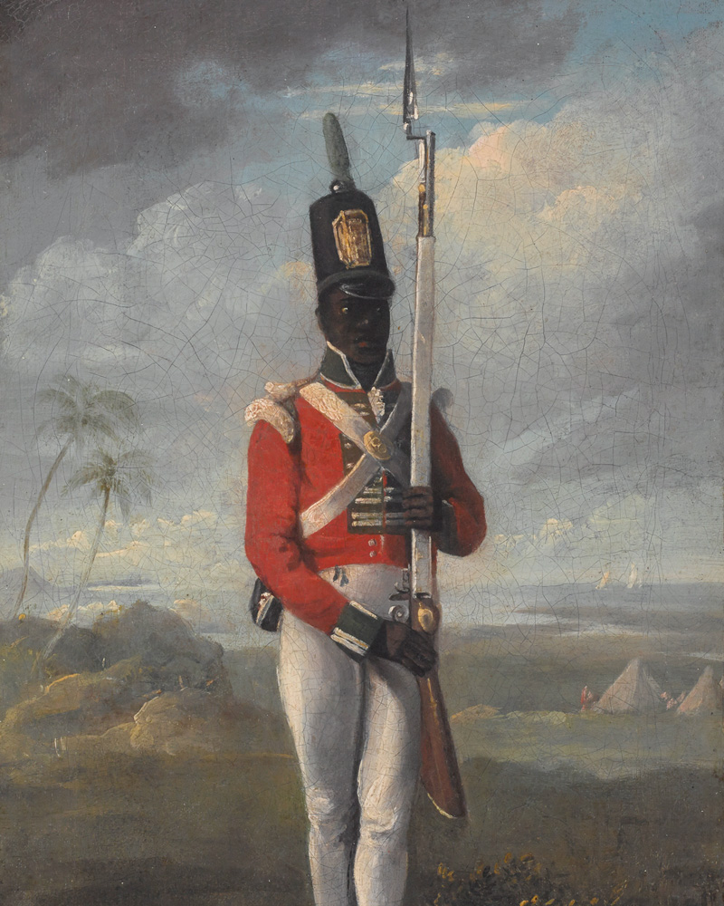
Do you think that this person is enslaved?”
National Army Museum: (out of copyright) https://collection.nam.ac.uk/detail.php?acc=2018-07-13-1​
Notes:
The soldier is a Black British Soldier. He is armed. Enslaved people were not armed as they could be a threat to the plantocracy. However, this soldier is enslaved. He was purchased by the British army to defend the West Indies against the French during the Revolutionary/Napoleonic wars 1792-1815

Slide 6

Answer – Enslaved!
In 1795, the British army was short of soldiers in the Caribbean to fight the French. The British decided to buy enslaved people to fight in the army.
Between 1795 and 1807, The British army was the single biggest purchaser of enslaved Africans. 7% of all enslaved Africans (13, 400 men) transported to the West Indies became soldiers.
Enslaved soldiers were subject to slave laws made by the Jamaica Assembly (Parliament) until 1807.
All British soldiers, including those who were enslaved, were paid a wage and subject to military discipline which could include flogging.

Slide 7
So, did the soldiers view themselves as……………
Enslaved soldiers who could be treated differently to other soldiers?
Soldiers who could not be treated differently to other soldiers?

Slide 8
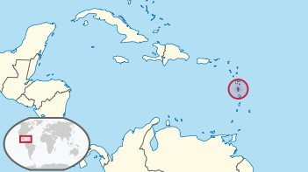
1802 Dominica Mutiny – 8th West India Regiment (8th WIR)
Dominica is in the Caribbean (circled in the map below). In 1802, the 8th West India Regiment of the British army mutinied killing some of their white officers.
A mutiny is when soldiers refuse to take orders from their superiors and often use violence against them
Read the extract from Historian Tim Lockley on the next slide.
courtesy of Wikimedia commons https://commons.wikimedia.org/wiki/File:Dominica_in_its_region.svg
Notes:
Linked worksheet on this slide

Slide 9
Worksheet 1 – The mutiny
What work were the soldiers made to do – how long had they been doing the work?
How does the historian describe how the soldiers viewed the work they had been told to do? Does this suggest the soldiers thought they were enslaved, or saw themselves as a soldier like any other?
From around the middle of March 1802, soldiers from the 8th WIR were daily employed from the hour of dinner to sunset in cutting down the brushwood in the swamp…………… These soldiers made a clear distinction between military labour which might be expected of any soldier regardless of skin colour and work normally associated with slave labour. Colonel Johnstone had miscalculated what he could order the men to do and the consequences were severe. On the night of 9 April 1802…….. a mutiny broke out, and within an hour five white officers were dead.
In his defence, Johnstone blamed the mutiny on “new n*****s unaccustomed to military life", though the paybooks confirm that 10 of the 13 men executed for their involvement in the mutiny had been members of the regiment since at least June 1798”
Tim Lockley, Military Medicine and the Making of Race – Life and Death in the West India Regiments 1795-1874: Cambridge Press, 2022 , pages 105 to 106.
What did the soldiers do on 9th April 1802?
How did Johnstone try to explain the soldier's mutiny? Does the historian accept his explanation?

Slide 10
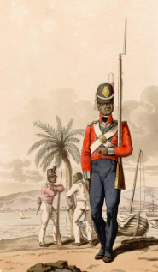
Task 2 – Court of Enquiry
The enslaved soldiers had been ordered to cut down brushwood in the swamp, but they felt this work was too similar to the work that enslaved people did on plantations – they felt this was humiliating.
After the mutiny, a Court of Enquiry was formed to find out what had happened. On the next slide, you will read some statements that were made to the court.
Use it to help form a judgement on the enquiry question. Did the soldiers of the 8th West Indian regiment consider themselves the same as other enslaved people or the same as other soldiers?
National Army Museum, (out of copyright) https://collection.nam.ac.uk/detail.php?acc=1950-11-33-42
Notes:
HIGHLIGHT anything in both the text and provenance that suggests the enslaved soldiers did not view themselves as enslaved. Is there any evidence as to what the Historian thinks caused the mutiny?
They could give evidence
Some of the mutineers were not killed when the fort was taken back and their voices were heard
Field work was considered an enslaved person’s job
The soldiers were not paid for the labour despite being promised
The pay was “extra” meaning that they were paid anyway
the enslaved men were happy to use a musket as it gave them status

Slide 11
Task 2 – The Court of Enquiry
Name of witness | Statement
Sergeant Gold | Now bill hooks* were put in our hands, hoes* would soon after
Captain Cassin | They carried flintlocks* for some time and would not use hoes
Corporal Strong | not receiving any compensation for their work at the swamp, as promised them, caused them to be dissatisfied
Corporal Davy | working at the swamp without receiving any recompense* for our labour reinforced the idea that we were to become field n*****s
Glossary
Bill hook | a short knife used by enslaved people on plantations to cut sugar cane.
Hoe | a tool used on plantations to remove weeds from the ground.
Flintlock | a type of gun
Recompense | Payment
Which of the witnesses do you think were enslaved? Explain why you think this
Write out two quotes.
  One which suggests the witness did not see himself as enslaved
  One by an officer which suggests he sympathised with the enslaved.

Slide 12
Task 3 – Answering the Enquiry
“What can the accounts of the 8th Regiment’s rebellion tell us about how enslaved soldiers viewed their status?”
Use these sentence starters to write an answer in full sentences.
The soldiers of the West Indian Regiment saw themselves as….. (Enslaved soldiers who could be treated differently to other soldiers/ Soldiers who could not be treated differently to other soldiers)
One piece of evidence that backs this up is……
This links to another piece of evidence…..

Slide 13

Plenary - Has your understanding of enslavement in the early 19th century changed? If so, explain how?
Was to be enslaved a single experience, or did enslaved peoples experience different forms of slavery?
Jot your ideas down on post it note for the door.

Slide 14
S4 National 5 Enquiry Question What can the accounts of the 8th West India Regiment’s rebellion tell us about how enslaved soldiers viewed their status?
Purpose: | To develop enquiry skills which is a meta life skill. Using History, students will enquire ………… The role of the enslaved soldiers in the West India Regiments The role of the British army in buyingenslaved peoples
Objective: | The learning in this lesson links to the syllabus by – SQA National 5 History – Historical British Study – Part 3 – The Trade In Enslaved Africans 1770-1087 – Section The Captives’ Experience “other forms of slave labour on the Caribbean islands” What is the takeaway? The British army was the biggest purchaser of Enslaved Africans Soldiers of the WIR did not view themselves as enslaved to work as labourers
Outcome: | Pupils will demonstrate their ability to answer the Enquiry Question by… being able to describe why Britain needed armed enslaved soldiers being able to explain how the soldiers of the 8th West India Regiment viewed their status Being able to explain contradictions or limitations of the enslaved soldier’s status
Time | Teacher is… | Pupils are… | Checking learning
0-10 | Circling room – checking in on starter progress. | Completing starter task and sharing ideas. | Class discussion
10-15 | Teacher introduces role of the British army in the enslavement of the peoples from Africa | Students read and glue in info sheet on the British army and the slave trade (Task 1) | Teacher Discussion with Groups.
15-25 | Circling the room – facilitating/scaffolding/questioning in relation to Secondary source analysis task. (Historian’s view) | Completing secondary source analysis in groups. (Task 2) | Teacher Discussion with Groups.
25-35 | Circling the room – facilitating/scaffolding/questioning in relation to primary source analysis task. (soldiers’ views) | Completing primary source analysis in groups. (Task 3) | Teacher Discussion with Groups.
35-45 | Modelling first paragraph of worksheet 4 Then, circling room to support. | Completing Task 4 using the template – | Teacher checking write up of hypothesis
45-50 | Plenary Circling room – offering support/scaffolding to answer plenary question. | Plenary – answering the plenary Question. | Judgement made and explanation om postit EQ is answered.
Home learning: (if necessary/ appropriate)

Slide 15
Extension
The next slide contains part of a report by General Hislop in 1801. Hislop had been a colonel of the 11th WIR. Read it, then answer these questions (also linked in the worksheet above).
How did General Hislop view the men of the WIR?
Highlight with one colour any text or words that suggest Hislop thinks the soldiers ARE enslaved?
Highlight in another colour any text or words that suggest Hislop thinks the soldiers are NOT enslaved
Why might Hislop want to portray the WIR in the way he did?
Whose laws was General Hislop testing his idea against that the soldiers of the WIR were free?
Which group on the Caribbean Islands would have both welcomed and detested the presence of the WIR?
Why would this group both welcome and detest the presence of the WIR in the Caribbean?
Notes:
https://www.jstor.org/stable/44224924?read-now=1&seq=1#page_scan_tab_contents

Slide 16
General Hislop writing to the Commander of Chief the Duke of York 1801.
“………….. to lift the African soldier in his own estimation by giving him rank of the free man and placing him in respectability above a slave as soon as he receives pay, then he becomes a subject to the Mutiny Act * His evidence is received at court martial* even against whites. By good behaviour he becomes a non-commissioned officer* nay it may be conceived though not likely that he may be advanced to the rank of the Commissioned officer and sit on the courts martial. Do any of these circumstances accord with the idea of his being in a state of slavery and under the influence of the slave laws? …………………… I think it may fairly be answered that these laws are neither applicable nor suitable to his condition and therefore as to him are not in force.”
*Mutiny Acts – laws that British soldiers had to obey. These laws regulated what a soldier could and could not do.
*Court Martial – Military trial
*Non Commissioned Officer (Corporal and Sergeant)
Notes:
https://www.jstor.org/stable/44224924?read-now=1&seq=1#page_scan_tab_contents

Slide 17
Information on uniforms of the British army 1800-1815
Regiments of 800 men were split into companies of about 80 men each
8 companies were known as line companies and wore a red and white plume in their hat. These companies had no ruffles (wings) on their shoulders.
Specialist companies had ruffles on their shoulders. These were either the bravest soldiers or those trusted enough to work without their officers’ direct supervision.
Light companies wore green plumes in their hats. Their job was to fight independently of the main regiment by moving forwards and sniping at the enemy, sometimes without officers.
Notes:
Printout of this slide might hep with next picture

Slide 18

So what about this painting?
What company did this soldier belong to?
What tasks would this soldier do that an enslaved person would not be allowed to do?
National Army Museum: (out of copyright) https://collection.nam.ac.uk/detail.php?acc=2018-07-13-1
Notes:
National Army Museum: (out of copyright) https://collection.nam.ac.uk/detail.php?acc=2018-07-13-1

