Slide 1

What kinds of relationships did African nations have with Europeans in the Middle Ages?
What kinds of sources can we use for the Middle Ages?

Slide 2
To investigate the relationships that African nations had with Europeans in the Middle Ages.
I can:
State when the Middle Ages were
Describe at least two things that African nations traded with Europeans at this time
Explain how Europeans viewed some African nations at this time, making at least 2 points.

Slide 3

When was the ‘Middle Ages’?
The term ‘Middle Ages’ refers to the period after the fall of the Roman Empire until the 14th century.
We can also describe this period as Medieval.

Slide 4
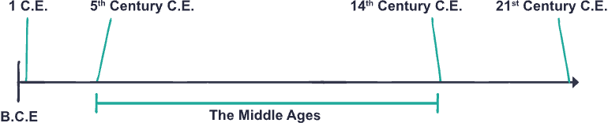

Timeline
The Middle Ages lasted for nearly 1000 years

Slide 5



Which of these events happened in the Middle Ages?
Joan of Arc leads French Armies in the Siege of Orleans (1429)
Battle of Hastings (1066)
Battle of Bannockburn (1314)
Boudica leads Celtic armies against the Roman Empire (60)
Battle of Culloden (1746)
Da Vinci paints the Mona Lisa (1503)

Slide 6

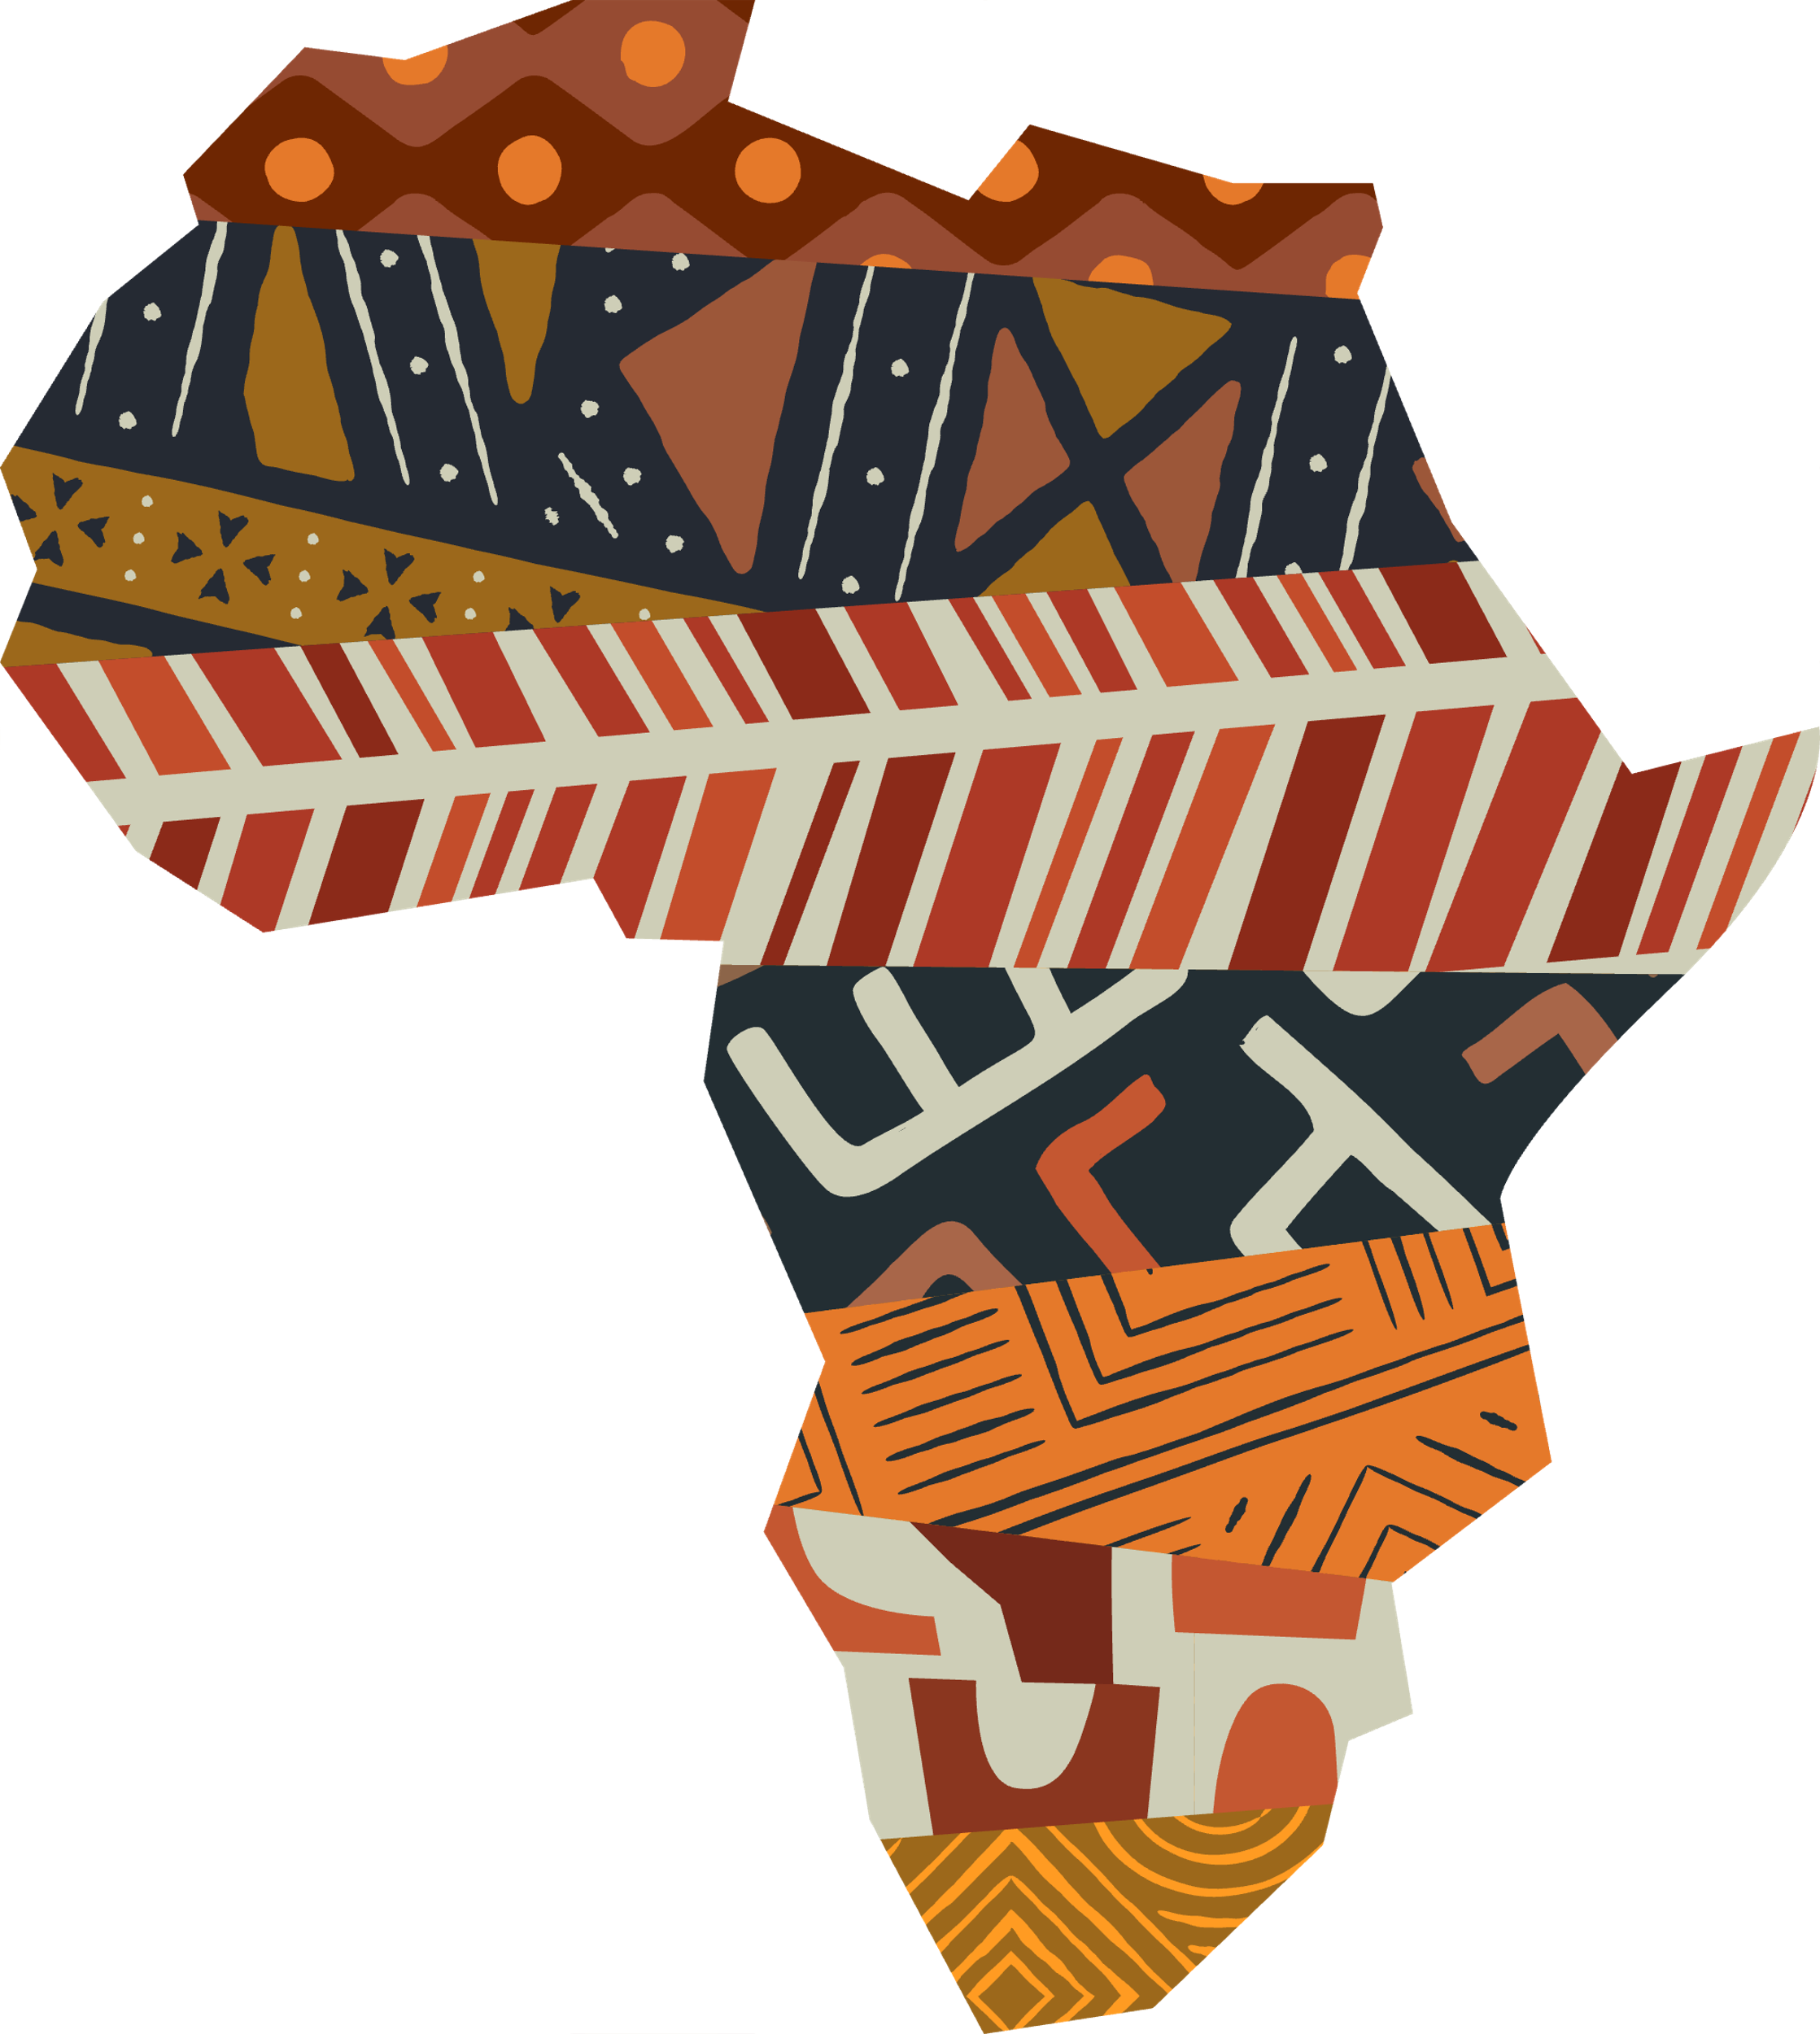
Africa in the Middle Ages
How much would Europeans have known about Africa in the Middle Ages?
How can we find out more about this?
Note down your ideas

Slide 7
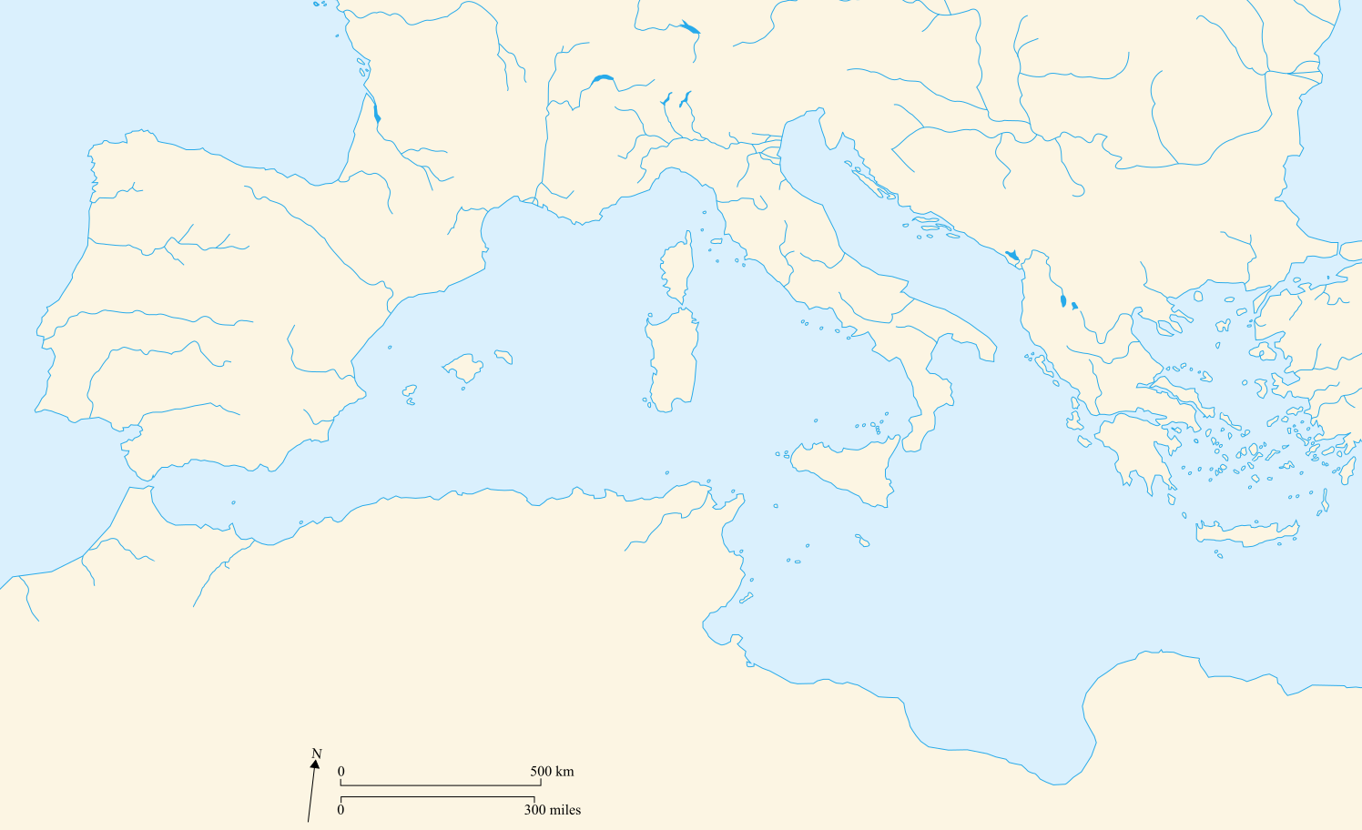

At the closest point Africa and Europe are only 8 miles
(13 kilometers) apart.
North Africa and Southern Europe were connected across the Mediterranean Sea
– a trade route for millennia.

Slide 8

Source
Activity

Slide 9

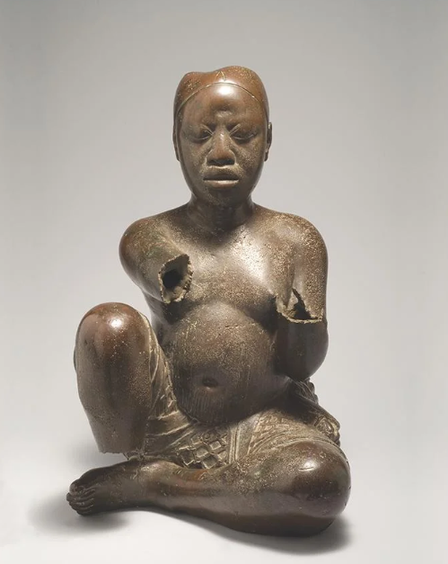
Where might this sculpture be from? What do you think it is made from? What time period do you think it comes from? What can it tell us about the past?
Source A
Source A

Slide 10
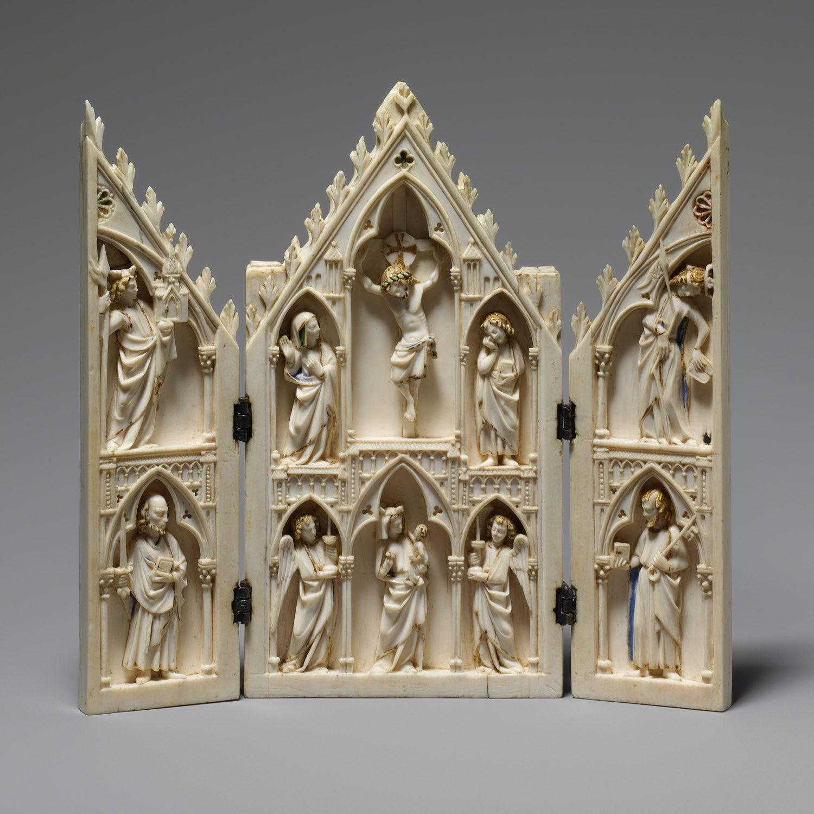
Where might this sculpture be from? What do you think it is made from? What time period do you think it comes from? What can it tell us about the past?
Source B
Source B

Slide 11
African sculpture, from modern day Nigeria From the late 13th / early 14th century Made with copper mined in France. What might this tell us about relationships between countries in Europe and West Africa at this time?
Source A
Source A

Slide 12
Religious carving from Northern France Date – c. 1250 Made of ivory What might these two sculptures tell us about relationships between countries in Europe and West Africa?
Source B
Source B
Notes:
Note to teachers: Ivory is from African elephants—indicating trade between Africa and France.

Slide 13
Source Work: Artifacts
Copper was an important metal. The fact that copper mined in France was used in African societies to make sculptures tells us that valuable European goods were being traded to Africans.
Ivory is a very valuable material. European nations wanted to purchase this to make sculptures and ornaments particularly in religious settings.
This suggests that European and African societies traded valuable resources as equal partners during the Middle Ages.

Slide 14
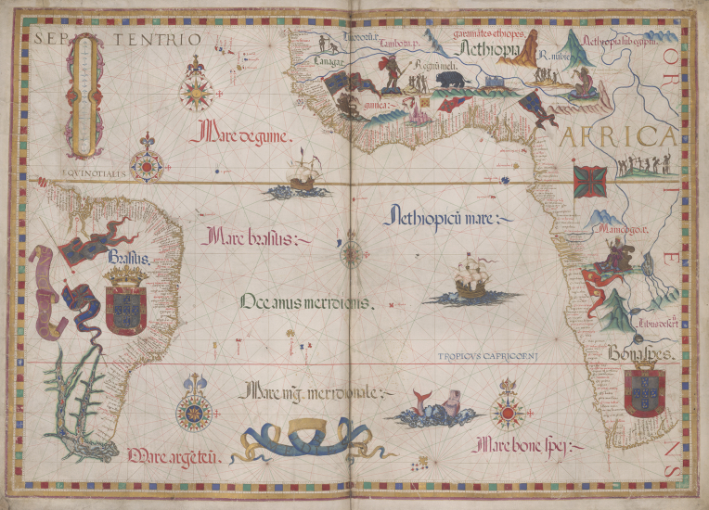
Map A
What does this map show us?
Where do you think it was made?
What can it tell us about Africa and Europe at the time?
Notes:
Queen Mary Atlas. Made for Queen Mary I of England and her husband Phillip II of Spain, by Portuguese Cartographer Diogo Homem c. 1555

Slide 15
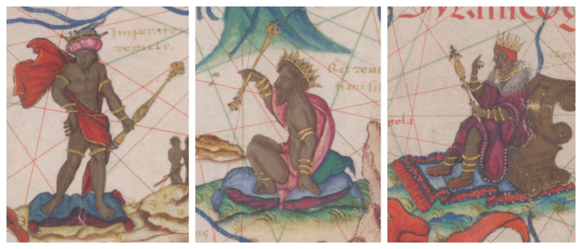
Enlarged images of African rulers from the Queen Mary Atlas (Map A)
Notes:
Queen Mary Atlas. Made for Queen Mary I of England and her husband Phillip II of Spain, by Portuguese Cartographer Diogo Homem c. 1555

Slide 16
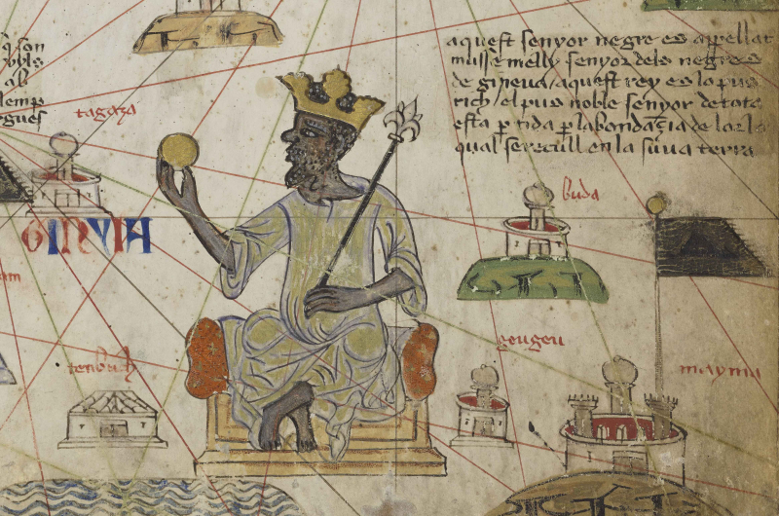
Map B
What does this picture show us?
Where do you think it was made?
What can it tell us about Africa and Europe at the time?
Notes:
Illustration of Mansa Musa from the Catalan Atlas (c. 1375)

Slide 17
Source Work: Maps (A & B)
These maps show that European rulers were interested in Africa and wanted to know more about it. There was a knowledge of the nations
on the coast but less known about places further inland.
African kings are shown as rich, with gold and expensive clothes, and castles.
This tells us that Europeans at this time believed African kingdoms to be wealthy and important.

Slide 18

What kinds of relationships did African nations have with Europeans in the Middle Ages?
Based on this lesson, write a paragraph summarising some of the relationships between African nations and Europeans.
Make sure you refer to at least one of the objects.
Use this starter: ‘We can tell from [map/source] ….’
You might want to consider:
How much Europeans might have known about African nations
What Europeans might have thought about these nations
What sort of goods went between Africa and Europe

Slide 19


