Slide 1

Solve the clues to discover the continent we will be studying:
I have 54 countries.
Today it is believed there are 1500-2000 languages spoken on this continent.
Footballers such as Didier Drogba, Samuel Eto’o and Mohamad Salah were all born on this continent.
Famous people such as Lupita Nyong’O, Elon Musk and Trevor Noah were all born here too.

Slide 2



Solve the clues to discover the continent we will be studying:
Today we are going to look at history within Africa.

Slide 3

Nri (Igbo) and Asante
West African Culture
Lesson 1

Slide 4
Enquiry Question How similar were the Nri and Asante civilizations before 1880?
Notes:
Image credit - https://diabeticnation.com/tag/clusters/
If the learners don’t have enough content to answer this satisfactorily, the rest of the lessons will stretch and challenge with more detailed information.

Slide 5

Asante
Nri (Igbo)

Slide 6
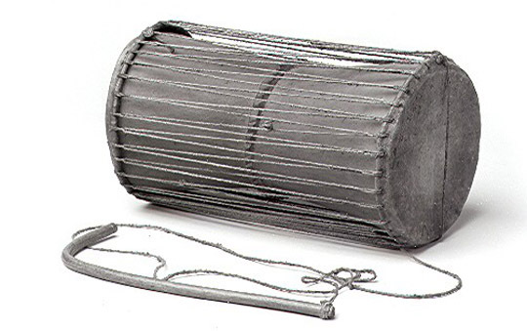
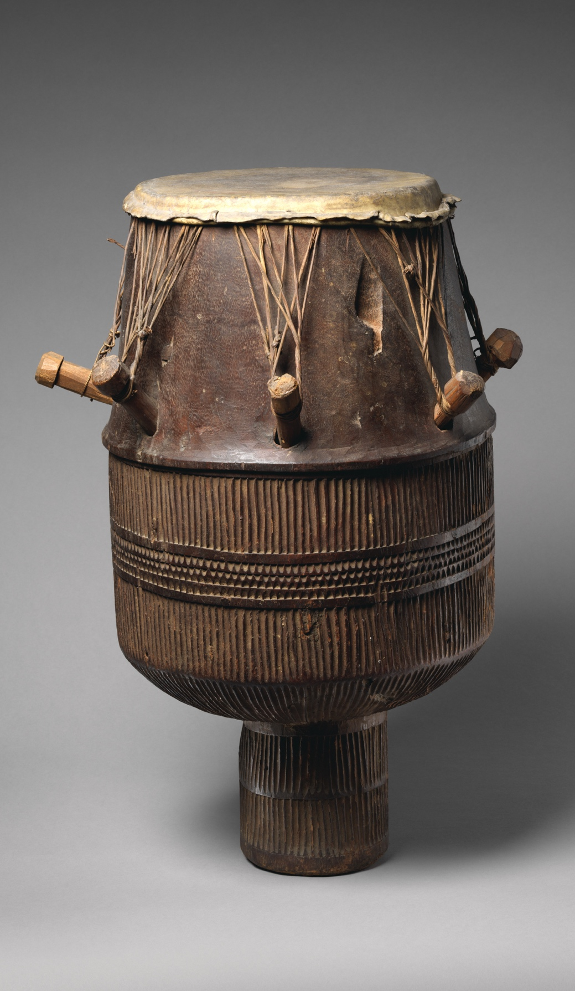
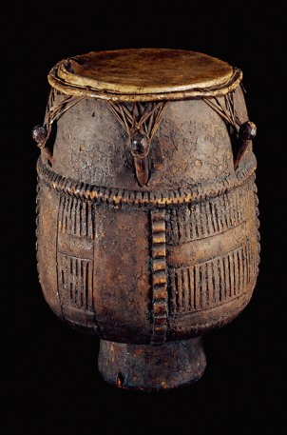
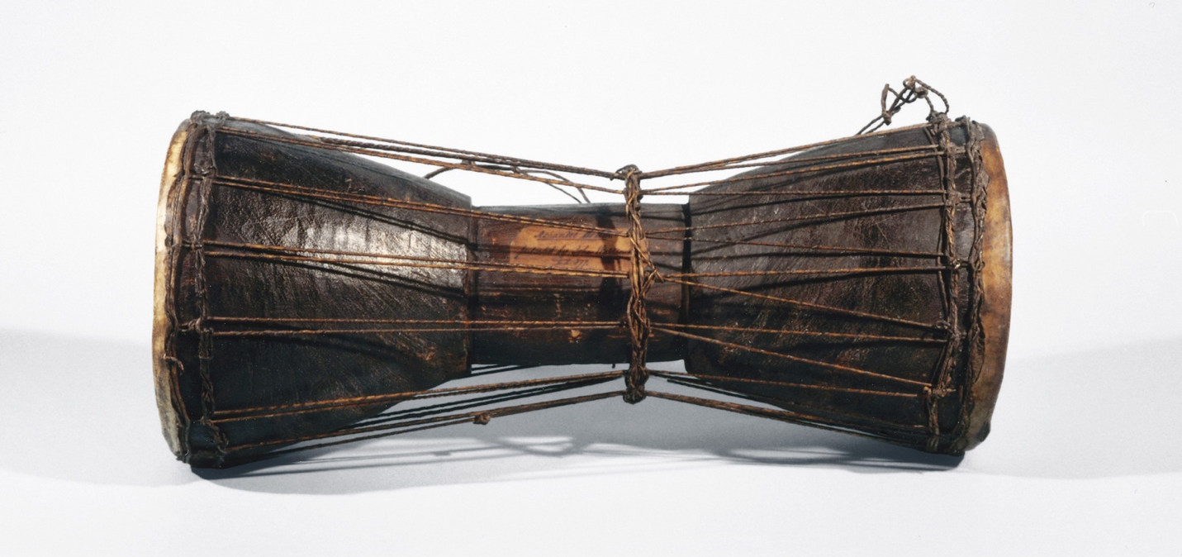
What do these artefacts have in common?
Notes:
Photo credits - http://teachinghistory100.org/objects/about_the_object/akan_drum
https://understandingslavery.com/artefact/small-drum-with-stick/ https://understandingslavery.com/artefact/talking-drum-from-the-asante-of-ghana/
https://www.metmuseum.org/art/collection/search/501976

Slide 7
What do these artefacts have in common?
Made by skilled Asante crafts people
Old – mostly nineteenth century
Beautiful – the photos don’t do them justice!
Entertaining – as drums for music
Crafted from wood and leather
Functional – they are all talking drum: https://www.youtube.com/watch?v=Ov9FUu7alKk
Now held in UK/US museums
Notes:
Photo credits - http://teachinghistory100.org/objects/about_the_object/akan_drum
https://understandingslavery.com/artefact/small-drum-with-stick/ https://understandingslavery.com/artefact/talking-drum-from-the-asante-of-ghana/
https://www.metmuseum.org/art/collection/search/501976

Slide 8

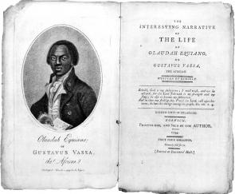
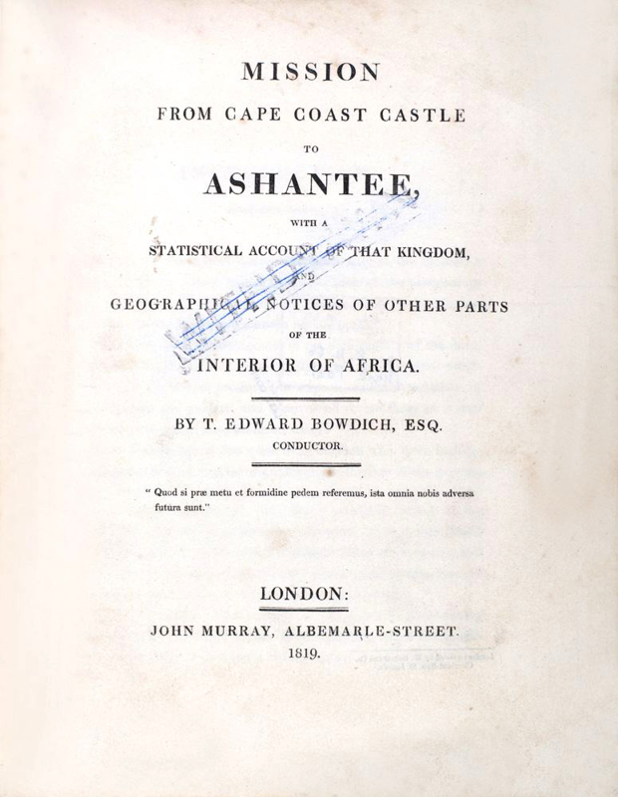
Your group will be annotating a source which reveals something about either Asante or Igbo culture.
Make sure you look carefully at the details of the words or picture, and try to read between the lines!
Everyone in the group should add at least one thought to the sheet!
Think about who made the source and why in deciding whether or not you trust it – remember, it’s ok to be somewhere in between!
Notes:
Image credits - https://ap.gilderlehrman.org/resource/olaudah-Equiano ;
https://www.splrarebooks.com/collection/view/mission-from-cape-coast-castle-to-ashantee-with-a-statistical-account-of-th

Slide 9


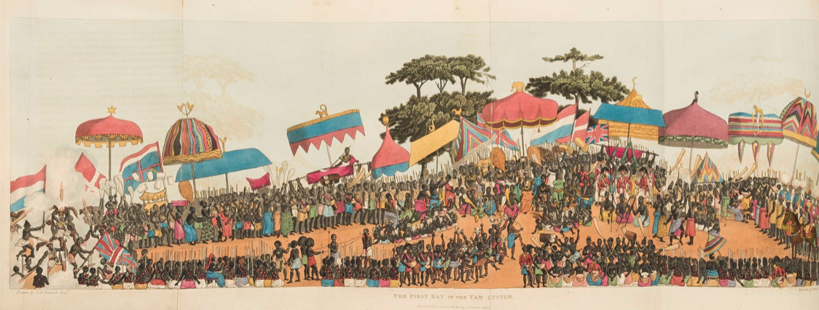
What does this show/ suggest about Asante culture?
What questions does this raise?
Do you trust the creator of this source? Why or why not?
From Edward Bowditch, ‘Mission from Cape Coast Castle to Ashantee’, published 1819. Bowditch was from Bristol and worked for the ‘African Company of Merchants’, which made money from the kidnap and enslavement of people in West Africa, and their forced transportation across the Atlantic.
Notes:
This drawing shows the first day of the yam festival in Kumasi in 1817. This was an annual ceremony where Asante people paid tribute to their king. It was used as an illustration in Thomas E. Bowdich’s account of his journey to meet King Osei Bonsu. He donated a large number of Asante objects to the British Museum after his return. (https://www.britishmuseum.org/collection/search?keyword=bowdich)
The yam festival lasted five days each year and marks the first harvest of yams. Yams are a bit like potatoes, and grow mostly underground. They have to be peeled and cooked thoroughly to be eaten and are sometimes mashed or pounded into a kind of paste. Like potatoes, they are a staple food, cheap and filling. They are harvested by hand with sticks of diggers. They are a very reliable crop and can be cooked in a lot of different ways. For that reason they are very important in West Africa. In the yam festival, an offering is made to ancestral gods and yams are carried in the procession on the second day.
In this depiction, the Asantehene is sitting slightly right of centre of the image beneath an umbrella topped with an elephant (a royal symbol). Children are sitting at his feet, with fly whisks to keep away insects. And servants have fans around him.
An aristocrat named Odumata is shown reclining in a hammock. His symbol of nobility, a leopard is on the hammock. On the left-hand side are a group of military men with blunderbusses, a 19th century gun. On the far right, the men with turbans are Moors, also watching the events.
In real life, the umbrellas would be lifted up and down in a kind of dance – they were believed to be a type of living object with a spirit.
What does this image show about Asante culture?
-- colourful textiles
-- musical instruments: drums, flutes, bells, and horns
-- European flags on display: UK, Netherlands.
-- different animals as decoration / motifs
-- punishment / torture in the foreground
-- body art / painting of performers
What questions does this raise?
-- why are yams so significant? What is the significance of yams?
-- why were European flags flying?
-- who were the people attending?
Do you trust the creator of this source?
-- he was an eyewitness to events
-- his written account is very detailed and he was a good observer
-- he was sent on a diplomatic mission so had access to royal court
-- he was British, and may have wanted to emphasise Britain’s influence / good relations with Asante
May have had an interest in emphasising the more violent aspects of Asante society (the depiction of torture/ punishment doesn't align with a yam festival, when punishment of prisoners was suspended)
-- he was interested in trade with Asante and maximizing profit

Slide 10

We are almost a nation of dancers, musicians, and poets. Thus every great event, such as a triumphant return from battle, or other cause of public rejoicing is celebrated in public dances, which are accompanied with songs and music suited to the occasion. The assembly is separated into four divisions, which dance either apart or in succession, and each with a character peculiar to itself. The first division contains the married men, who in their dances frequently exhibit feats of arms, and the representation of a battle. To these succeed the married women, who dance in the second division. The young men occupy the third; and the maidens the fourth. Each represents some interesting scene of real life, such as a great achievement, domestic employment, a pathetic story, or some rural sport; and as the subject is generally founded on some recent event, it is therefore ever new. This gives our dances a spirit and variety which I have scarcely seen elsewhere. We have many musical instruments, particularly drums of different kinds.’
From Olaudah Equiano ‘The Interesting Narrative of the Life of Olaudah Equiano’, published 1789. Equiano was an anti-slavery activist who had been born in the Igbo civilization, been enslaved, succeeded in escaping and became a hugely successful speaker and author.
What does this show/ suggest about Igbo culture?
What questions does this raise?
Do you trust the creator of this source? Why or why not?
Notes:
Text credit - https://www.gutenberg.org/files/15399/15399-h/15399-h.htm Chapter 1
This was written by an Igbo man named Olaudah Equiano in 1789. He was remembering his childhood home before he was abducted into slavery. He was able to escape slavery, by buying his own freedom. He became an anti-slavery activist, and a hugely successful speaker and author. He travelled and made anti-slavery speeches in Scotland in the 1790s, he visited Edinburgh, Glasgow, Paisley, Dundee, Perth and Aberdeen.
Poetry and dance (and the combination of both) were very important in Igbo culture, as a means of entertainment and also communicating and passing on particular stories. Igbo was spoken over a very wide area in west Africa, across what Europeans called the Bight of Biafra. These Igbo-speaking people had a lot of sub-groups, including Nri. Equiano was from a village named Essaka and described himself as Igbo. Outside west Africa Igbo-speaking people were more likely to identify themselves as one unified group and their drum dances were very influential in the Caribbean.
What does this text show about Igbo culture?
-- importance of dance
-- significance of drums and drumming
-- men and women danced separately for these occasions
-- significance of marriage
-- dance used to tell a story, like a musical
What questions does this raise?
-- what kinds of battles were fought and celebrated?
-- why did men and women dance separately?
-- what did the music sound like?
-- what did the dances look like?
-- what did the dancers wear?
Do you trust the creator of this source?
-- he was an eyewitness
-- he was a member of that group and so had a very good knowledge of their customs
-- he spoke the language and may have participated in the dances
-- he was only a child and is remembering a long time ago

Slide 11


Asante and Nri Culture
You will be allocated a new group including people who’ve just been studying Asante and Igbo culture
Use your source analysis, as well as your jotter notes from the last two lessons, to add as many ideas as possible to the Venn diagram about similarities and differences between and within the two civilizations.
Prize for the group with the most ideas!
Asante Civilization
Nri Civilization

Slide 12




How similar were the Nri and Asante civilizations before 1880?
Not at all similar
We still need to learn more!
Somewhat similar
Significantly similar
Something else!
Notes:
Image credit - https://diabeticnation.com/tag/clusters/
If the learners don’t have enough content to answer this satisfactorily, the rest of the lessons will stretch and challenge with more detailed information.

Slide 13
How similar were West African nations between 1770 and 1807?

Slide 14
Nri and Asante
Geography
Lesson 2

Slide 15

What do we know about countries in West Africa in the eighteenth century?
Notes:
The two societies we are looking at are two regions form which large numbers of captives were taken across the Atlantic. Others could have been chosen.

Slide 16
Learning about:
• The geographical location of the Igbo and Akan peoples of Africa.
Learning to:
• Complete map work to show where these peoples were located.
By the end of this lesson I will have a greater understanding of some of the ethnic groups located in Africa in the 18th century.
By the end of this lesson I will be able to show where the ethnic groups I have looked at were located within Africa.

Slide 17

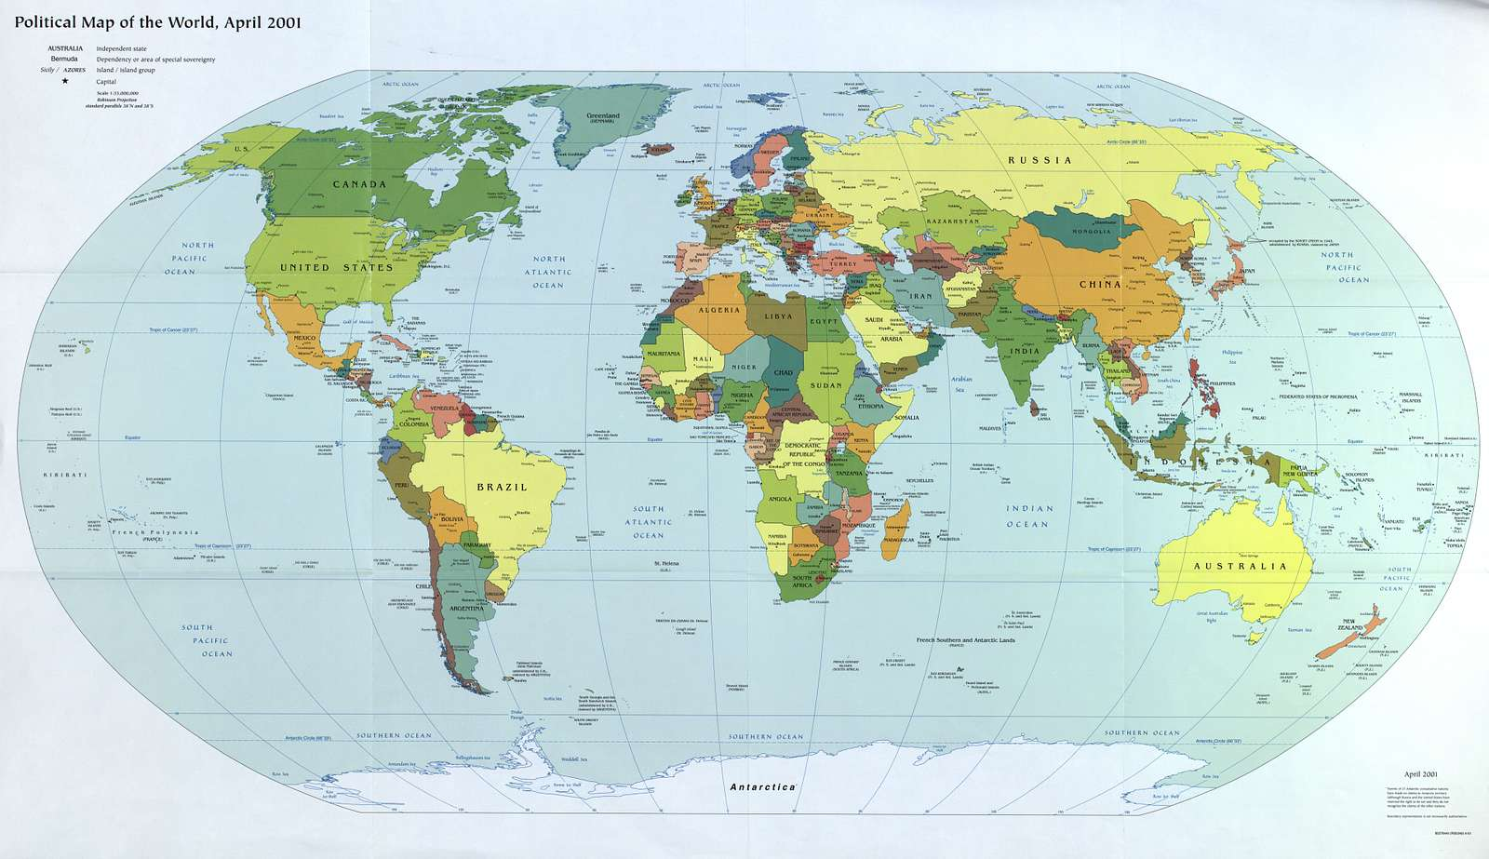
How do we define a nation in the 21st century?
Look at your atlas. What helps make Scotland and England distinct?
What makes France and Germany distinct?
Nations in the 21st century are defined by borders. Language can cross borders as can culture but countries are firmly determined by the internationally agreed territory.
In the 18th century Europe and Africa looked very different. Today's borders did not exist and nations were more fluid.

Slide 18
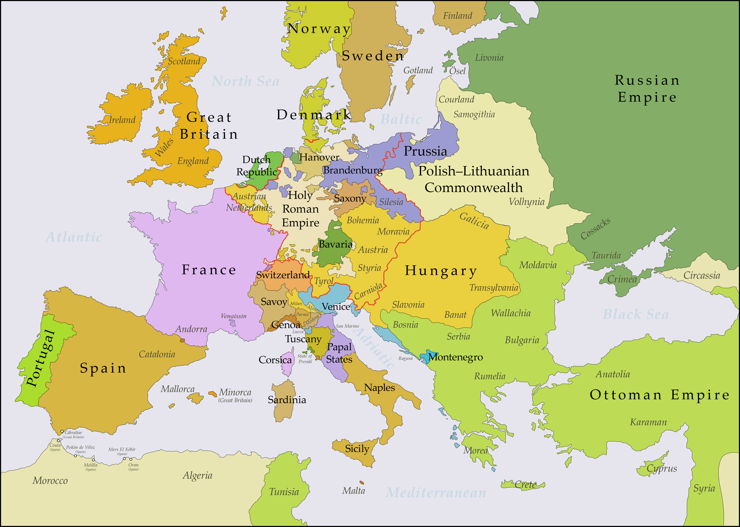
Map of Europe
Image needed
What can you see in this map that we would still see today?
What is different in this map?

Slide 19
Notes:
Some differences: Holy Roman Empire, Hungary much larger, Ottoman Empire, no border in Ireland, Polish-Lithuanian Commonwealth.

Slide 20
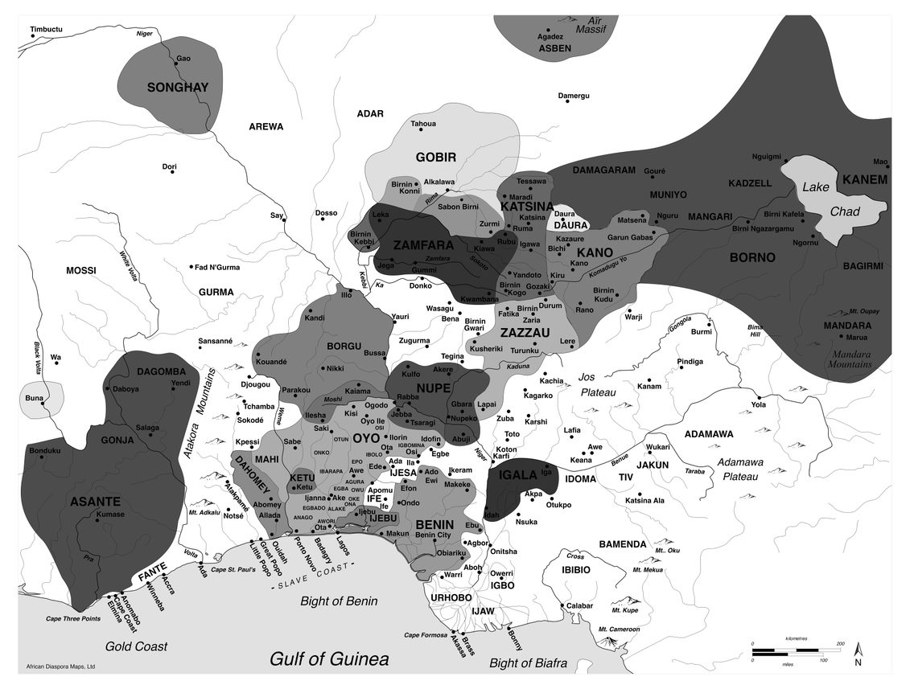
Map of West Africa
Image needed
Are there any places on this map that you recognise?
Are there any names you have never heard of before? Check your atlas to see if they still exist.

Slide 21
Map skills
Take a copy of a map of Africa and use an atlas.
Use the contents page/index page of the atlas to find the map of Africa.
Use the information from the previous slide and your atlas to locate where these two ethnic groups were found on the African continent.
On your map create a key to show each ethnic group and colour in the geographical area on the map that they were found.

Slide 22

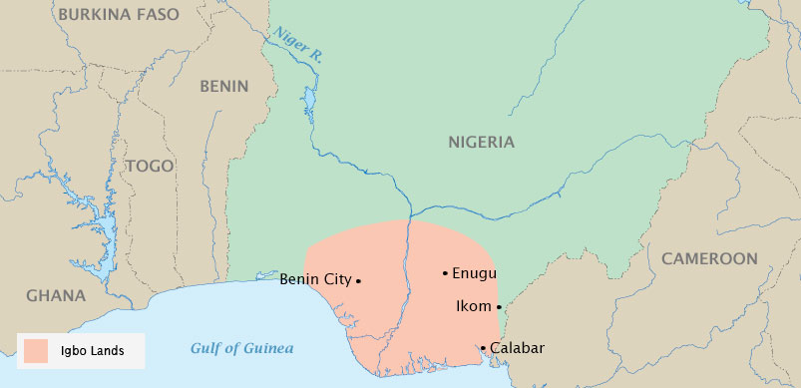

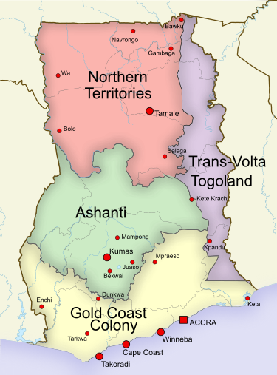
Igbo
The Igbo people, or Ndigbo, as they like to be called, inhabited the south-eastern parts of today’s Nigeria, including west of the River Niger. Igboland was in the tropical rain forest region near the Atlantic coast.
Asante
Asante (sometimes seen written as Ashanti) people were found in today’s south-central Ghana and areas of today’s Togo and Côte d’Ivoire. Most of the Asante lived around the city of Kumasi, which was the capital.
Notes:
Note to teachers – emphasise to students that these are two ethnic groups from the West of Africa so we are not teaching them about how all Africans lived. These are ethnic groups that help us to understand a little about how life was like in West Africa before the colonization of Africa by the Europeans.

Slide 23
Asante
Igbo

Slide 24
Copy and complete the table below in your jotter. Use this link to help: https://www.culturesofwestafrica.com/timelines/
 | Kingdom of Nri | Ashanti Empire
Ethnic group | Igbo | Akan (Asante are a sub-group of the Akan people)
Language | Igbo | Twi
Dates
Notes:
Teacher note: You could show this timeline first: https://www.culturesofwestafrica.com/timelines/ to show how many kinds of states there were in West Africa and explain that you are zooming into these two. Nri is one of a few different kinds of political systems organised by Igbo people, so important to emphasise that it had a flat, very local democratic structure, with each village having considerable autonomy.

Slide 25

How similar were West African nations between 1770 and 1807?
Start to think about answering our enquiry question.
Write down any thoughts you have about this in your jotter.
These can be done in note form.

Slide 26
Igbo and Asante
Hierarchy, Language, Religion, Law and Order
Lesson 3

Slide 27
How do you think Scotland was organised and run politically in the 18th and 19th centuries?
Until 1832 Scottish politics remained in control of landowners in the country, and of small cliques of merchants.

Slide 28
How similar were West African nations between 1770 and 1807?

Slide 29
Learning about:
Learning to:
The Kingdom of Nri and the Asante Empire
How they were organised.
Understand their beliefs and politics.
Understand how their languages influenced other languages.
Compare the Kingdom of Nri to other cities around the world.
Summarise how Asante operated.
Understand the basics of religion in Asante and Nri
Understand how their languages travelled

Slide 30


Igbo

Slide 31
Igbo
Igbo people were often described by British colonial officials and others in the 20th century as ‘stateless’. Historian Margery Perham, writing in the mid twentieth century, described Igbo as ‘having no great history, no impressive chiefs or cities’.
Archaeological and oral history evidence, on the other hand, suggests that there were numerous political structures to the west and east of the Niger River. It is better to describe Igbo as ‘decentralised’.
Notes:
Historians now prefer to say ‘politically decentralised’ instead of ‘stateless’. Terms like ‘stateless’ defines people by what they are not/do not have. They were politically decentralised societies, with the local as the basic political unit. This means that Igbo were not stateless, but rather political authority was widely devolved, even more than political authority in Scotland is devolved from the United Kingdom.

Slide 32
Igbo
Across these different communities and small states, Igbo people formed several different political formations, including:
The State (Kingdom) of Nri

Slide 33
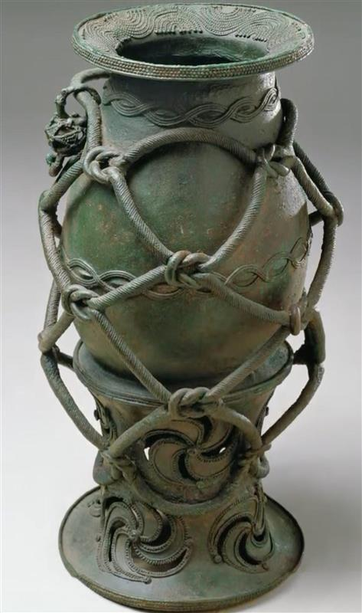
Kingdom of Nri
Ọ̀ràézè Ǹrì in Igbo
1043-1911

Slide 34
Kingdom of Nri
The Kingdom of Nri is Igbo's oldest state.
The role of the leader, Eze Nri, the priest-king, was mostly symbolic.
The Eze Nri leadership style is unique in that it does not rely on military might to assert its authority. Instead, it used religious influence and control of trade routes to expand and maintain power.
The kingdom's philosophy is one of peace, truth, and harmony.
Ndi Nri were Eze Nri's officials, who would select and install new Eze Nri.

Slide 35
Kingdom of Nri: Sanctuary for enslaved people
The kingdom was a haven for all those who had been rejected in their communities, as well as a place where the enslaved were set free; they did not practice slavery, and anyone who set foot in the kingdom after the 10th Eze Ndi was declared free.

Slide 36
Kingdom of Nri: Philosophy
Peace, truth, and harmony were central to the Nri tradition. Its ideology was spread by traders who travelled around spreading the word. The Nri kingdom expanded through allegiance rather than force to neighbouring communities. Igbo was a kingdom of peace and a haven for human life.

Slide 37
Kingdom of Nri: Iron
People in Nri were also the masters of iron technology, but would not produce weapons. To ensure that iron technology was not weaponised and misused to cause bloodshed the rules were to transform weapons into ritual objects, putting a stop to unnecessary violence. People in Nri believed violence was an abomination that polluted the earth. Nri's peaceful lifestyle is said to be one reason trade flourished in the Kingdom.

Slide 38
Kingdom of Nri: Holy Land
At its height, Nri's social and religious impact became known as an Africans' Holy Land.
What other holy cities in the world could the Kingdom of Nri be compared to?
Notes:
Rome, Mecca, Jerusalem could all be compared.

Slide 39
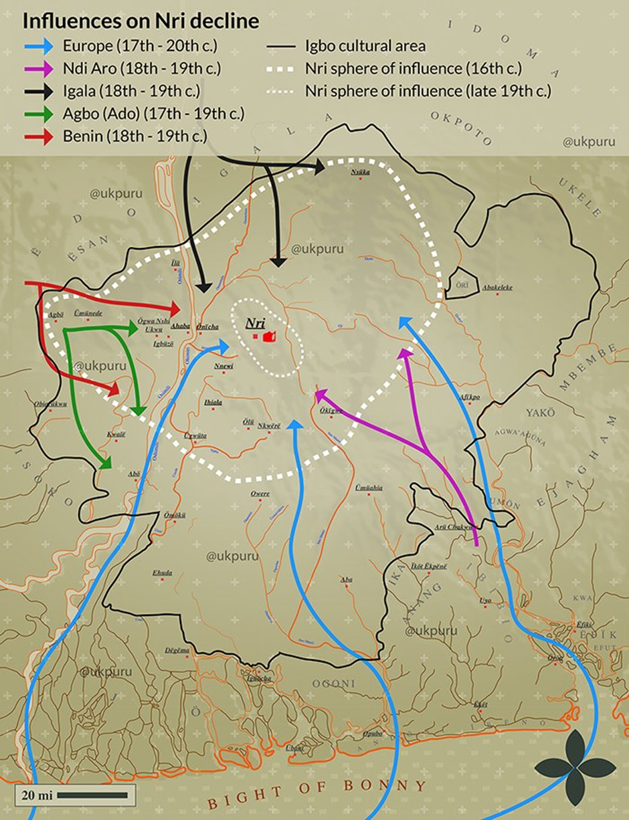
The end of the Kingdom of Nri
The kingdom of Nri was gradually pressed on all sides by both African and European competitors until it’s final destruction by the British
According to oral tradition, Enwelana, an Eze Nri, was so upset by the slave trade that he appealed to the other kingdoms (states).
M. Angulu Onwuejeogwu (1972). "A Short History of the Odinani Museum". Ọdinani. p. 50. Map after Onwuejeogwu (1979).

Slide 40

Asante Kingdom

Slide 41
Asante: how it was established
The Asante Empire was established in the late 1600s, shortly after its people's first encounter with Europeans. In some ways the Empire grew out of the wars and dislocations caused by Europeans who sought the famous gold deposits which gave this region its name, “The Gold Coast”.
Asante mostly exchanged gold with the Portuguese, giving them wealth and weaponry in exchange, enabling the small state to become more powerful than its neighbours.

Slide 42
Asante: transatlantic trade
The economy of the early Asante Empire depended on the gold trade. By the 1730s it had become a major exporter of enslaved people to meet the growing demand of the British, Dutch and French for captives. In exchange, the Asante received luxury items and some manufactured goods including, most importantly, firearms.

Slide 43
Asante: Osei Tutu
Asante was a powerful militarised and centralised state.
Osei Tutu (1801-1824), the first Asantehene or king of Asante.
As a confederacy and military expansionist state, it is often referred to as the Asante Empire.

Slide 44
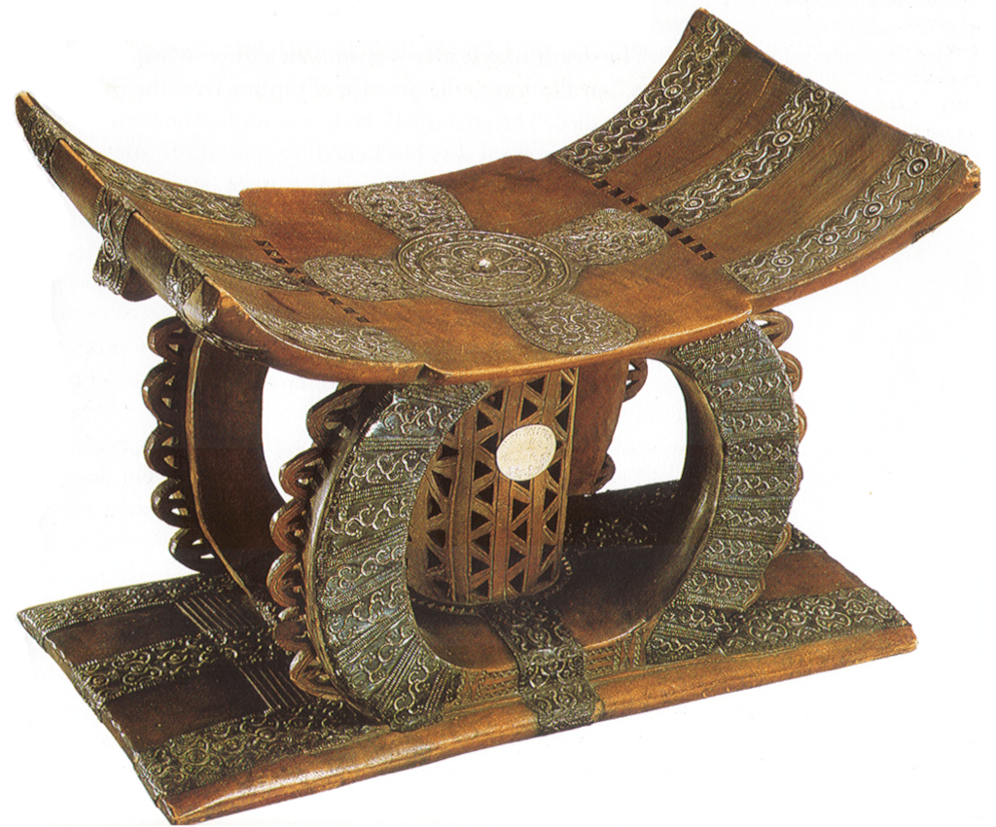
The Golden Stool
The Golden Stool was a sacred object made from solid gold. It represented the Asantehene’s authority as well as being the Asante symbol of unity and good fortune. In 1900, Frederick Mitchell Hodgson, the British Governor of the Gold Coast, demanded that the Asante people give him the Golden Stool. In response, Yaa Asantewaa, the Asante Queen Mother, began a military revolt against the British which led to the War of the Golden Stool. Yaa Asantewaa was defeated in July 1900 and exiled to the Seychelles, along with the Asantehene and other Asante leaders, but the stool was never surrendered to the British.

Slide 45
Asante: Queen Mother - Asantehemaa
She was a very important figure in Asante political systems.
She played a major role in the nomination and selection of the King.
She was involved in decision-making alongside the Council and Chefs.
Not only did she participate in the judicial and legislative processes, but also in the making and unmaking of war, and the distribution of land.

Slide 46
Asante: Kotoko: State control in Asante
Similar to our political cabinet
Kotoko Council consisted of the following people:
Asantehene - The King
Asantehemaa – The Queen Mother
Chiefs

Slide 47
Asante: Asantemanhyiamu – general assembly
The Asantemanhyiamu was a federal council of the Asante Empire which met at least once a year.
The king, who was also a councilor, presided over the meetings.
The council consisted of the representatives of the individual family clans which goes through the female line, abusua (our culture goes through the male line), who were elected and appointed by the Queen Mother.
This was seen as a very effective system which largely, if not always, spared the empire from devastating succession disputes.

Slide 48
Asante: Family line
Asante women could accumulate wealth and property through their maternal family line (abusua). A source of great esteem for women was to pass on material wealth to their children.
Compare the female leadership, position in Scotland today with the female leadership in Asante in 18th century.

Slide 49
Asante: State control
Create a diagram to show how Asante was run.
Key words
Asantehene, the king
Asantehemaa, the Queen Mother
Kotoko, Inner council
Asantemanhyiamu, general assembly

Slide 50
Languages

Slide 51

Nri
Asante
Igbo
One of the largest languages of West Africa, is spoken by approximately 18 million people in Nigeria.
Twi
West African language spoken by approximately 9 million people in Ghana

Slide 52
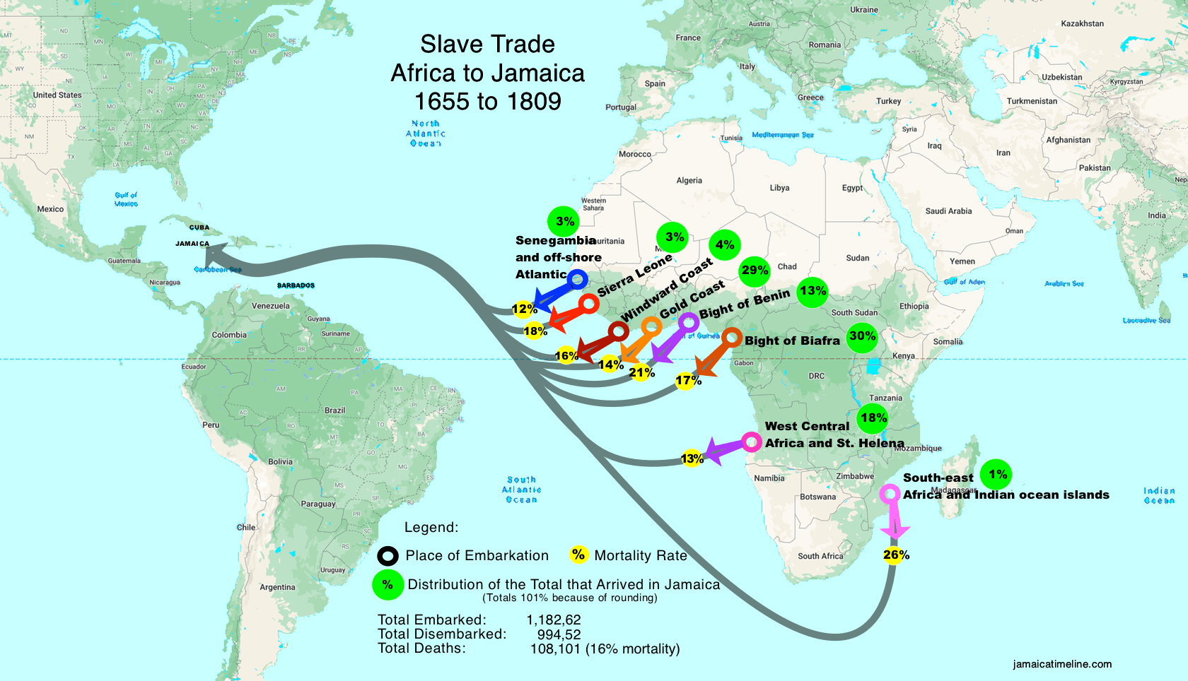
Twi / Asante words feature heavily in Jamaican creole. Rev Walter Brown 1919 wrote that the 'Jamaica dialect commonly heard in our streets in Jamaica contains so many Igbo words. For example, unu for you, soso for only, and okro a corruption of okwuba. [okwuba means word in Igbo]' There is also a ‘nation dance’ on Carricou in the Grenadines called ‘Scotch Igbo’.
Why do you think there are these connections?
These connections are largely due to
the transatlantic trade.
+

Slide 53
Religion

Slide 54
These ‘religions’ are over 6000 years
Odinani - Omenala
Igbo
Asante
Akan
Most historians and religious studies scholars argue that the aspects of life that have since approximately the eighteenth century been referred to as ‘religion’ are present in the very earliest human societies.

Slide 55
Religion is the late 18th Century
In the late 18th century religious and spiritual beliefs were strongly connected with ideas about how the world and people came into being.
Igbo
Their belief was the Igbo people descended from Eri, a divine figure sent by Chukwu to begin civilization.
Their belief was the High Priest Okomfo Anokye called the ‘Golden Stool’ down from heaven into the lap of Osei Kofi Tutu I in at the end of the 17th century.
Asante

Slide 56
Compare
What do these religious stories have in common with each other and with other religious stories you know?
How do they differ?
Igbo
Their belief is the Igbo people descended from Eri, a divine figure sent by Chukwu to begin civilization.
Their belief is the High Priest Okomfo Anokye called the ‘Golden Stool’ down from heaven into the lap of Osei Kofi Tutu I in at the end of the 17th century.
Asante

Slide 57
Comparing the Kingdom of Nri with Asante
Were the rulers:
Hereditary or not?
Based on religion and morals or military power?
How did the rulers:
Use their resources?
Operate during the transatlantic trade?

Slide 58
How similar were the Asante and Nri civilizations before before 1880?
Use specific evidence from the last 3 lessons! You can use one of the structures below to help:
The two civilizations were not at all similar because…. For example… This shows us that… because… therefore…
The two civilizations were somewhat similar because… For example… This shows us that… because… therefore…
The two civilizations were significantly similar because… For example… This shows us that… because… therefore…
We still need to learn more because… For example… This shows us that…because…therefore…

Slide 59

How similar were the Igbo/Asante civilizations before 1880?
Listen carefully – you could be picked on to speak at any time!
Remember you can disagree with what the other side said, BUT try not to repeat what your side has already said.
I’ll pick on people from this side of the class to explain how these three civilizations were mostly similar
I’ll pick on people from this side of the class to explain how these three civilizations were mostly different

Slide 60



