Slide 1

What can personal accounts tell us about the middle passage?

Slide 2
The Middle Passage
What can personal accounts tell us about the middle passage?
Lesson 1

Slide 3


How can we know about the middle passage?
Notes:
Learners could come up with 5 types of evidence on one hand
And ten on their table

Slide 4
Today we are learning about the experiences of enslaved people as they were transported across the Atlantic ocean.
I will be able to explain why personal accounts of History are a valuable source
I will be able to describe what the middle passage was like for enslaved men, women and children based on their personal accounts

Slide 5


What is the Middle Passage?
On the board you will see a time lapse showing ships crossing the middle passage between 1520 and 1860. While you watch, consider the following:
What countries do you see participating in the Atlantic Slave Trade?
Is a period of time where you see a big change?
If so, when? Any idea why?
Link:
https://www.slavevoyages.org/voyage/trans-atlantic#timelapse
Notes:
This timelapse is aimed at giving students a very brief but effective overview of the massive amount of ships that transported enslaved people across the Atlantic. It reflects the different countries involved, changes in those countries overtime and the boom and then decline of the trade. Learners need not write anything down during this task but discussion on the questions after would be valuable.
https://www.slavevoyages.org/voyage/trans-atlantic#timelapse

Slide 6

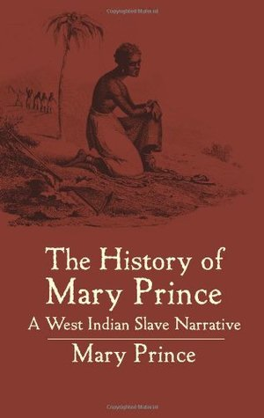

Think, Pair, Share
Who did Mary Prince, a formerly enslaved person born in Bermuda think her audience was here?
‘I have been a slave, I have felt what a slave feels, and I know what a slave knows … hear from a slave what a slave has felt and suffered.’
Notes:
Who did she think her audience was? (who is she imploring?) Mary Prince was born enslaved in Bermuda and was known to have been the property of 5 different enslavers in her life. She gained her freedom after moving to London in 1828 with her enslavers. She walked out of the house, and as slavery was no longer allowed in Britain (although still allowed in her colonies at this time) she was free. She dictated her autobiography to Susannah Strickland, a young English abolitionist, as part of the British abolition campaign. Mary is known to be the first formerly enslaved woman to write an autobiography and to petition the British Parliament for confirmation of her freedom.
Mary Prince did not experience the Middle Passage, so this example helps to contextualise enslaved people’s broader experiences and the value of personal accounts rather than specifically the Middle Passage. It could be omitted to maintain focus on the Middle Passage itself.
A digital edition of Mary Prince’s Narrative is here: https://books.google.ca/books?id=RTJcAAAAcAAJ&dq=history%20of%20mary%20prince&pg=PP7#v=onepage&q&f=false
Teachers could select further short extracts to illustrate the point about the significance of first hand narrative accounts.

Slide 7
What is the importance of using first-hand accounts to learn about History
Notes:
Have the class give their ideas and note them around the question on a smart board/white board.

Slide 8
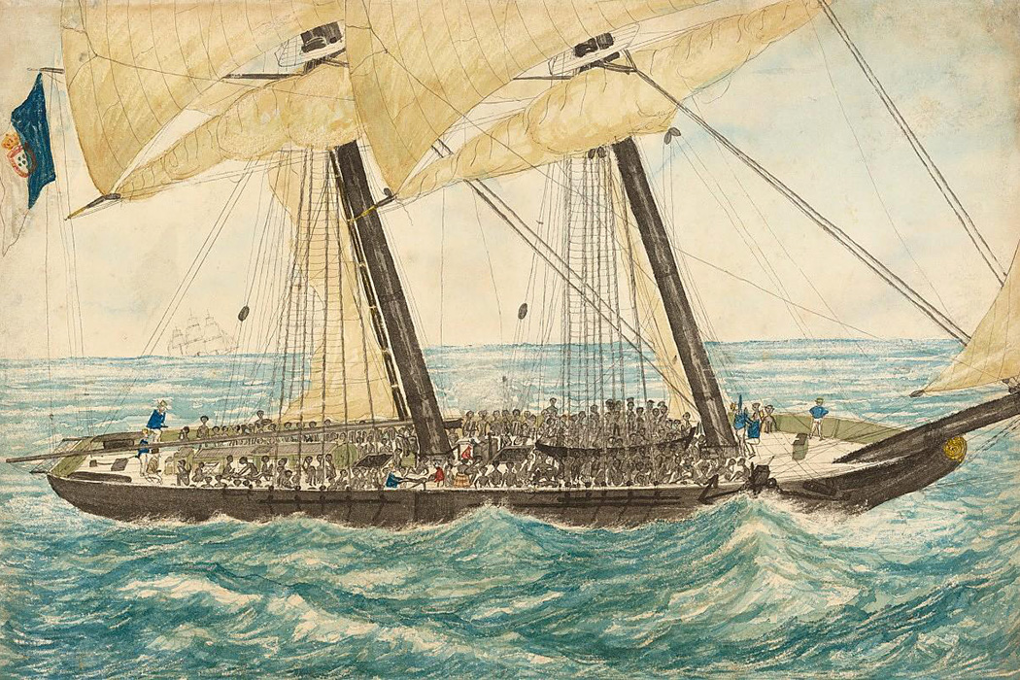
What was the experience on the Middle Passage like for enslaved people?
In groups, you are going to find out about what the middle passage was like from 4 different personal accounts of people who were on the ships.
You will each investigate one account and then share what you have found out with your group to complete the table.
Notes:
Put students in groups of 4 (or have them choose) and give each a source pack (P1 Middle Passage Accounts.pdf) with the 4 accounts. They can each investigate one and answer the corresponding questions (for discussion /note taking (teacher choice), they do not need to write the answers to these questions down). They will then share their findings with their group and together complete a chart detailing the experiences of enslaved people on board the ships.

Slide 9

Now that your group has discussed each account, use the information within these sources to complete the table below.
1. Treatment | 2. Conditions | 3. Punishments | 4. Resistance
Treatment
Notes:
Complete this table based on the sources. Discuss what might go in each column as a class (or write it in on smartboard/whiteboard based on student feedback) Source: (P1 Middle Passage Accounts.pdf)
There is not necessarily a clear distinction between the four categories. Students could also decide on different categories under which they would like to organize their thoughts.

Slide 10
Account of a young girl, Benomê, from the interior of Africa. She was enslaved at age 7 in 1833.
“When the slavers had been at sea about three weeks, they heard one night a tremendous noise on deck, the trampling of feet, and the firing of guns; and when the hatches were removed the next morning, the slaves looked up and saw several strangers, “gentlemen with fine coats and caps, shining with gold”. These were the officers of a British man-of-war, which had captured the slavers after a severe contest, and who now called upon the poor Negroes to come up on deck, assuring them they were now free! On ascending from the hold of the vessel, they beheld the deck covered with blood; and the captain and sailors belonging to the slaver sitting side by side, bound in irons.”
What do you think has happened to the ship Benomê is on?
What language clues reveal how might she have felt during this experience?
Notes:
Important context: The account is of a Royal Navy vessel seizing the slave-trading ship that Benome was held captive on. Benome and the other enslaved children on the Spanish slave ship “The Negrita” were 'liberated' from slavery but did not become completely free. They were taken to Trinidad where they became indentured workers.
This experience of a Middle Passage journey that was interrupted by the Royal Navy was unusual but provides a first hand account that we would otherwise not have.

Slide 11

Paired Reflection
With a partner, reflect on the following questions:
What do personal accounts tell us?
What are their potential limitations as evidence?
What other sources of evidence might we use to get a fuller picture of what is taking place?
Notes:
One point to try to bring out in the discussion is that despite their great value, there are very few acconts of the Middle Passage from its survivors. For the vast majority, we do not have any evidence in their own words.

Slide 12

In one word…
What single word would you use to describe the experience of the middle passage?
Notes:
Have your students either write on a post it note the one word they would use to describe the experience of the middle passage based on what they have learned over the last lesson as they leave the room. Type these into the word cloud generator to reveal the common themes/ideas.
https://monkeylearn.com/word-cloud/
Display the word cloud at the start of the following lesson as a wee recap/starter task.

Slide 13
The Middle Passage
Was there a typical experience of the middle passage?
Lesson 2
Notes:
For lesson 2: Learners can consider any of the 4 accounts that have been studied in lesson 1. Ask students to reflect on what these experiences were like before putting together their fact file using the quantitative data. They should recall as many details from the specific account such as origin, destination, age when enslaved, length of journey, details of boarding/early journey etc.

Slide 14
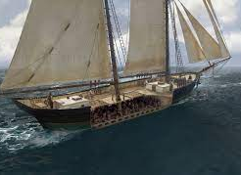
The Middle Passage
You will see a virtual tour of a 3D reconstructed slaving vessel.
In your jotter, note down which parts of the ship do you recognise from last week’s accounts
Link:
https://www.slavevoyages.org/voyage/ship#3dmodel/0/en/
Notes:
https://www.slavevoyages.org/voyage/ship#3dmodel/0/en/
Choose one of the two models and play the video.

Slide 15
Today we are learning about how enslaved people were transported across the Atlantic ocean.
By the end of the period, I will be able to describe the journey across the Atlantic ocean.
By the end of the period I will be able to use quantitative data to analyse a historical event

Slide 16
Was there a typical experience of the middle passage?
Last time we looked at personal accounts of the middle passage and now have a deeper understanding of what enslaved people went through on the journey across the Atlantic ocean.
What did you learn about the individual you studied?
Origin
Destination
Enslaving Country
Age at enslavement
Treatment?
Today we will be using data from different slaving vessels in order to find out whether the experiences we analysed last week would be ‘typical’ of the middle passage.
Notes:
The individual denotes whichever of the 4 personal accounts you have chosen to analyse as a recap to last week learning and to preface the quantitative data task for todays lesson.

Slide 17
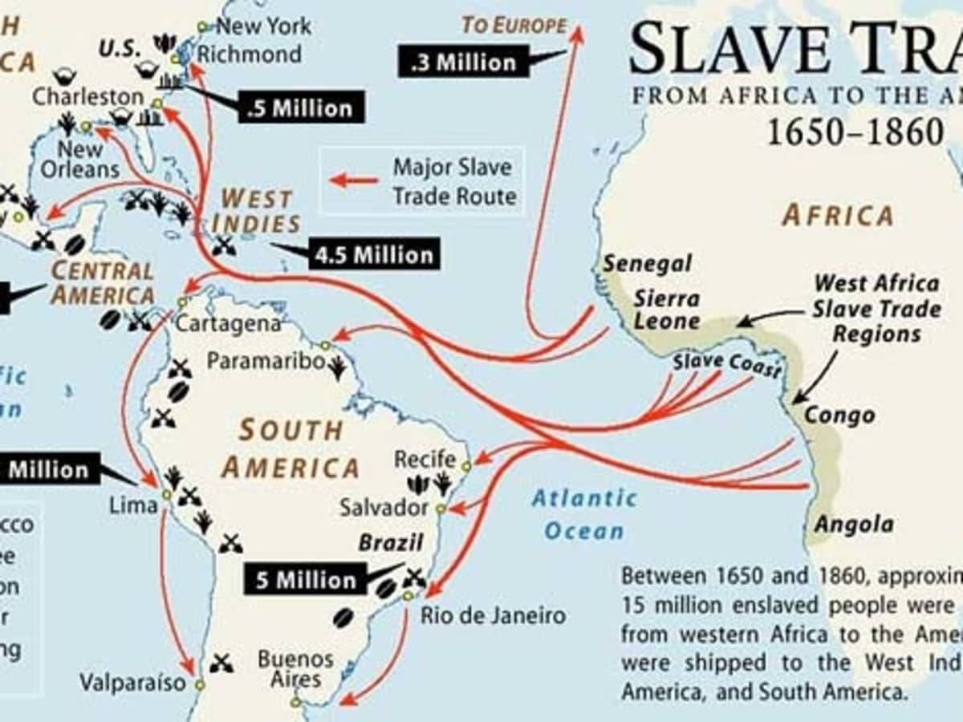

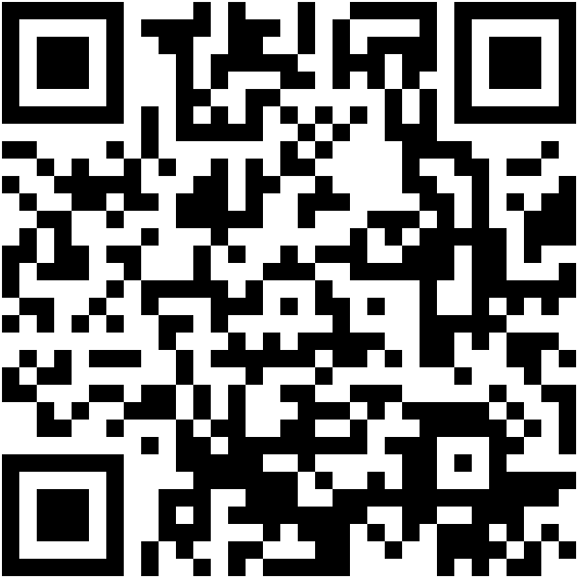
Case studies
You will now be given an information pack with details about specific ships that made the journey across the middle passage. You should work in groups of 2 or 3 in order to fill in the remainder of your fact file
Notes:
If you have access to ICT/ 1:1 iPads this task can be done entirely digitally using the Slave Voyages database https://www.slavevoyages.org/voyage/database
Give the students the specific voyage numbers to help them use the database.
They will need to search by inserting the voyage number under ‘ship, nation, enslavers → voyages, enslavers and vessels → Voyage ID
Voyage 1: 91644 (Essex)
Voyage 2: 81090 (Dumfries)
Voyage 3: 82894 (Nelly)
Voyage 4: 81132 (Edgar)
Sources: (P2 Middle Passage Journeys.pdf) (P2 factfile.pdf)
An extension activity would be to ask students to find out what other journeys the same ship or the same captain made. Note that sometimes the same name was given to different ships, but if investors, captains and ports are the same or overlap, it is likely to be the same ship.

Slide 18


The BIG question:
“Was there a typical experience of the middle passage?”
Give a detailed answer that includes at least ONE piece of evidence from today’s lesson.
Notes:
What were the common denominators? What were the variables?

Slide 19


