Slide 1
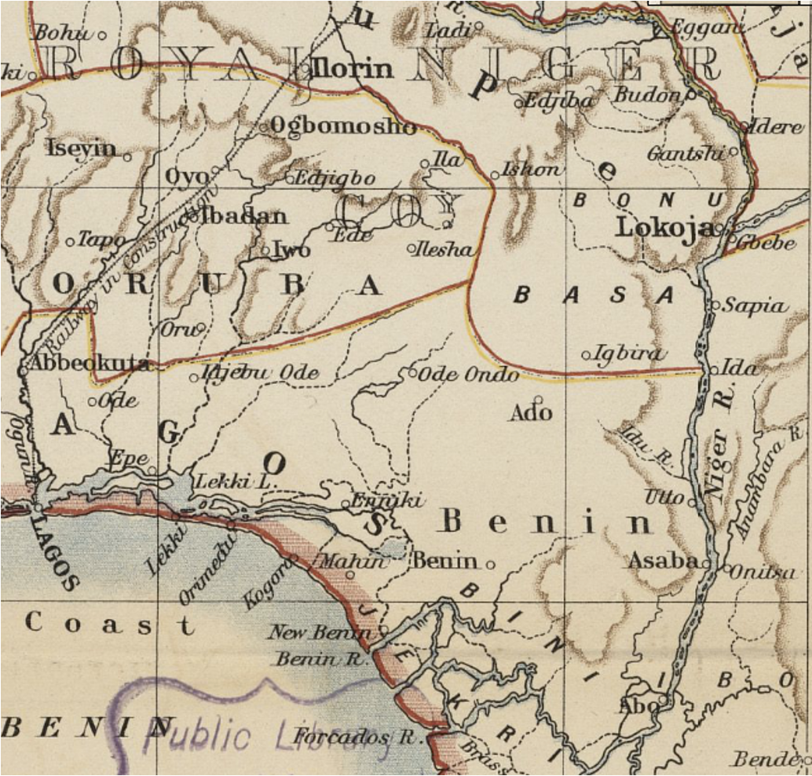
What influenced the development of West Africa in the late 18th Century?

Slide 2
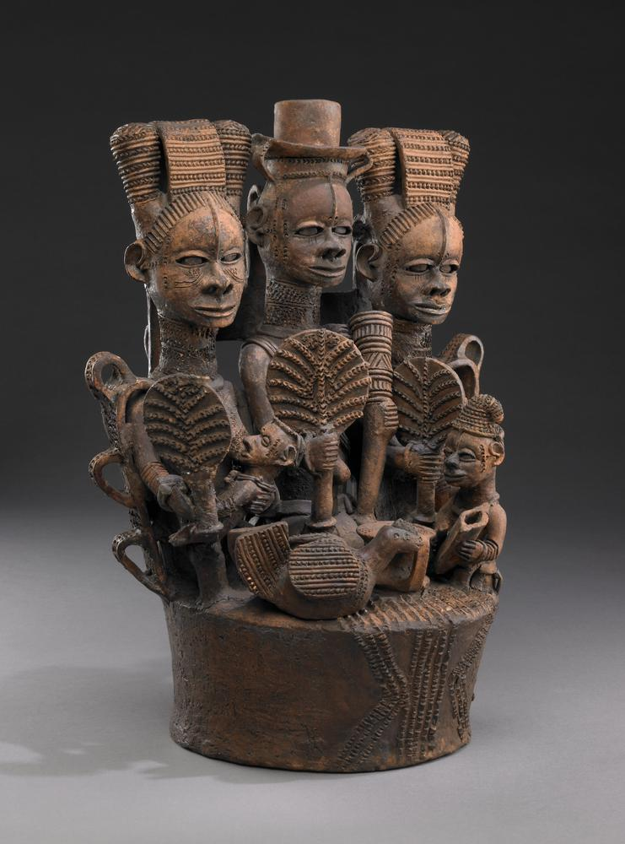
How did Igbo communities respond to the Trade in Enslaved African People?
Lesson 3
Igbo Ceramic group of figures, Af1951,01.1, The British Museum

Slide 3



Think
Pair
Share
How would you protect your family and community from danger?
Try and think of three examples of self-defence.

Slide 4
We will learn…
About the cultural, political and economic diversity of Igboland.
To draw conclusions on the impacts that the Trade had in different communities in Igboland
To form an opinion on what these impacts meant for these communities.
We will be successful if we can…
Gather information from primary and secondary sources.
Describe 3 ways in which different communities protected themselves against the Slave Trade.
Explain the reasons behind their chosen methods of protection.

Slide 5
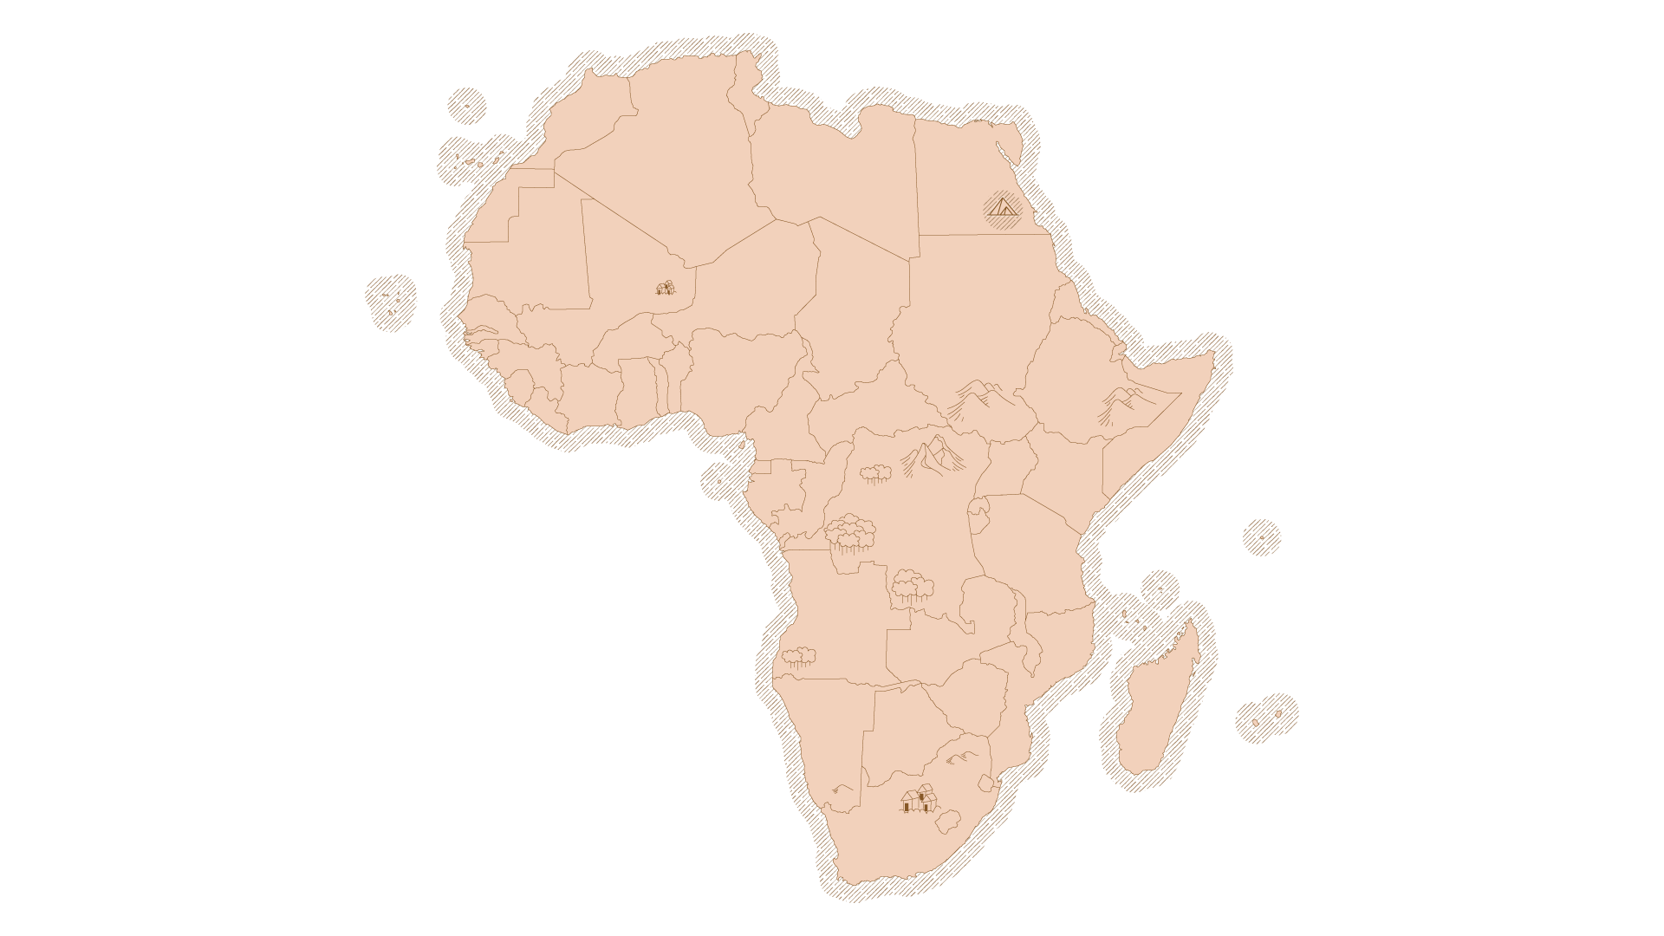
Igboland
Some context…
The various Igbo-speaking communities were historically fragmented and decentralised, with a lot of town or village based centres of power.
There was a well-established network of trade in salt from the coast to the interior and agricultural products from the interior to the coast.
Communities were responsible for their own defence and safety. Their response depended on the environment they lived in.
Notes:
https://www.google.com/imgres?q=map%20of%20igboland&imgurl=https%3A%2F%2Fcdn.kastatic.org%2Fka-perseus-images%2F31f0155da7d49e6806ab227f8eabc26aba3e25a3.jpg&imgrefurl=https%3A%2F%2Fwww.khanacademy.org%2Fhumanities%2Fart-africa%2Fwest-africa%2Fnigeria%2Fa%2Fikenga-igbo-peoples&docid=uJeuiLi_z6JgAM&tbnid=1r5s8HwHwQYGTM&vet=12ahUKEwiG9onxmdGGAxWnW0EAHUnDCCwQM3oECFAQAA..i&w=870&h=923&hcb=2&ved=2ahUKEwiG9onxmdGGAxWnW0EAHUnDCCwQM3oECFAQAA

Slide 6
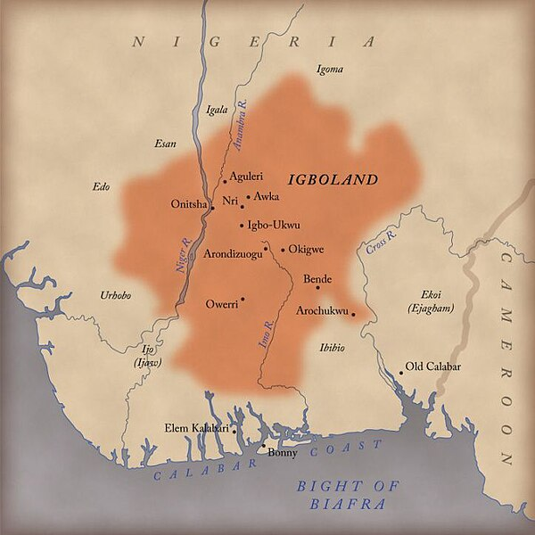
Igboland
Some of these groups were enslaved, others participated in the trade as a form of defence.
The major areas we will study are:
- Western Igbo communities
- Northern Igboland – like Okigwe - which experienced the most intensive raids
Riverine and coastal towns
South-Eastern Igbo communities, who were the main dealers in enslaved people in the area.
- Southern Igbo communities like Owerri.
Notes:
Map from WIKIPEDIA

Slide 7



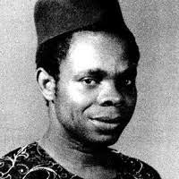
Guided Reading
Excerpts from ‘The Drums of War’ by John N. Oriji, Professor of African History
Read the section of the article and answers the questions in the boxes in the margins.

Slide 8
How did Igbo communities resist?
Copy and complete the table below.
Location | How did they resist? | (In your opinion) Why like this?
Western towns
Northern towns
Riverine and Coastal towns
South-Eastern towns
Southern towns

Slide 9
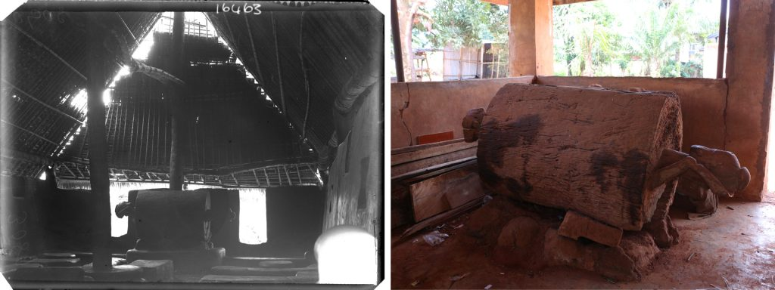
Ikoro drum
Northcote Thomas’s photograph of the ikoro drum in the obu in Nibo, 1911 (NWT 3089a; RAI 400.16463). This would be sounded to warn the community of attack. Right: the ikoro drum today. (Photograph by George Agbo). https://re-entanglements.net/conflict/

Slide 10
Igbo speech (1910)
Eye bi na agbo nele ali ona uhiena ono gwuo so mhi ne. Omo ovhe lasa ne na now li vho, ogbo kho oshie yele asha kha sha
In the olden days or in the present, which one is the better to live in? We can see in the old days, a child is not allowed to go out anywhere. Now one can go everywhere. Everywhere is safe.
https://re-entanglements.net/wp-content/uploads/2020/08/NWT_302_Okpekpe.mp3

Slide 11
Answer the following question in as much detail as you can. Try to mention at least 3 ways in which these communities resisted.
In which ways did the Igbo Communities respond to the trade in enslaved African people?

Slide 12



