Slide 1
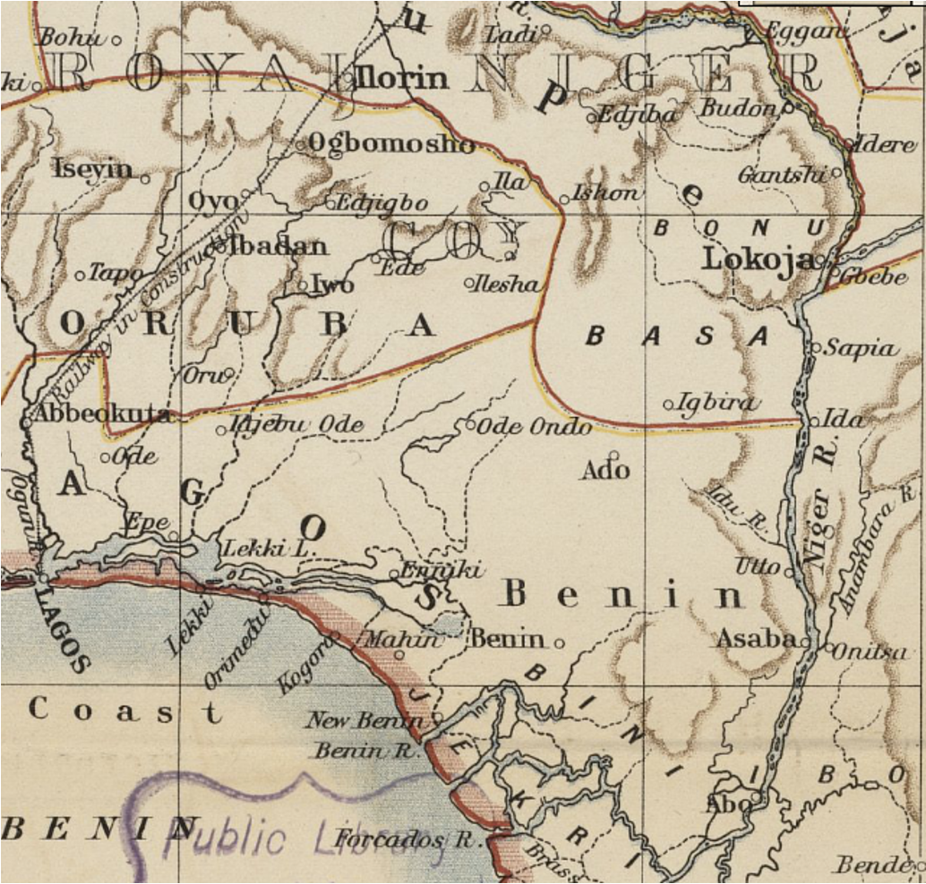
What influenced the development of West Africa in the late 18th Century?

Slide 2
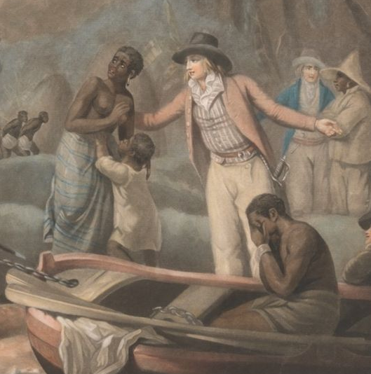
How did the trade in enslaved African people impact West African social, political, and economic conditions?
Lesson 2
John Raphael Smith, 1752–1812, The Slave Trade, 1791. Yale Center for British Art, B1978.43.283.

Slide 3

Starter Task – Cops and Robbers
Copy the following T-Chart into your jotter. Using recall, make a list of the different aspects of West African societies you can remember from the first lesson. You must link it to: politics, economy, and society.
Cops | Robbers
Some African states were centralised, whilst others were decentralised.

Slide 4

Starter Task – Cops and Robbers
Now, you must ‘steal’ answers from your classmates. Leave your jotter at your desk and circulate the class to look at different answers. Fill in the robbers column with any new answers:
Cops | Robbers
Some African states were centralised, whilst others were decentralised.

Slide 5
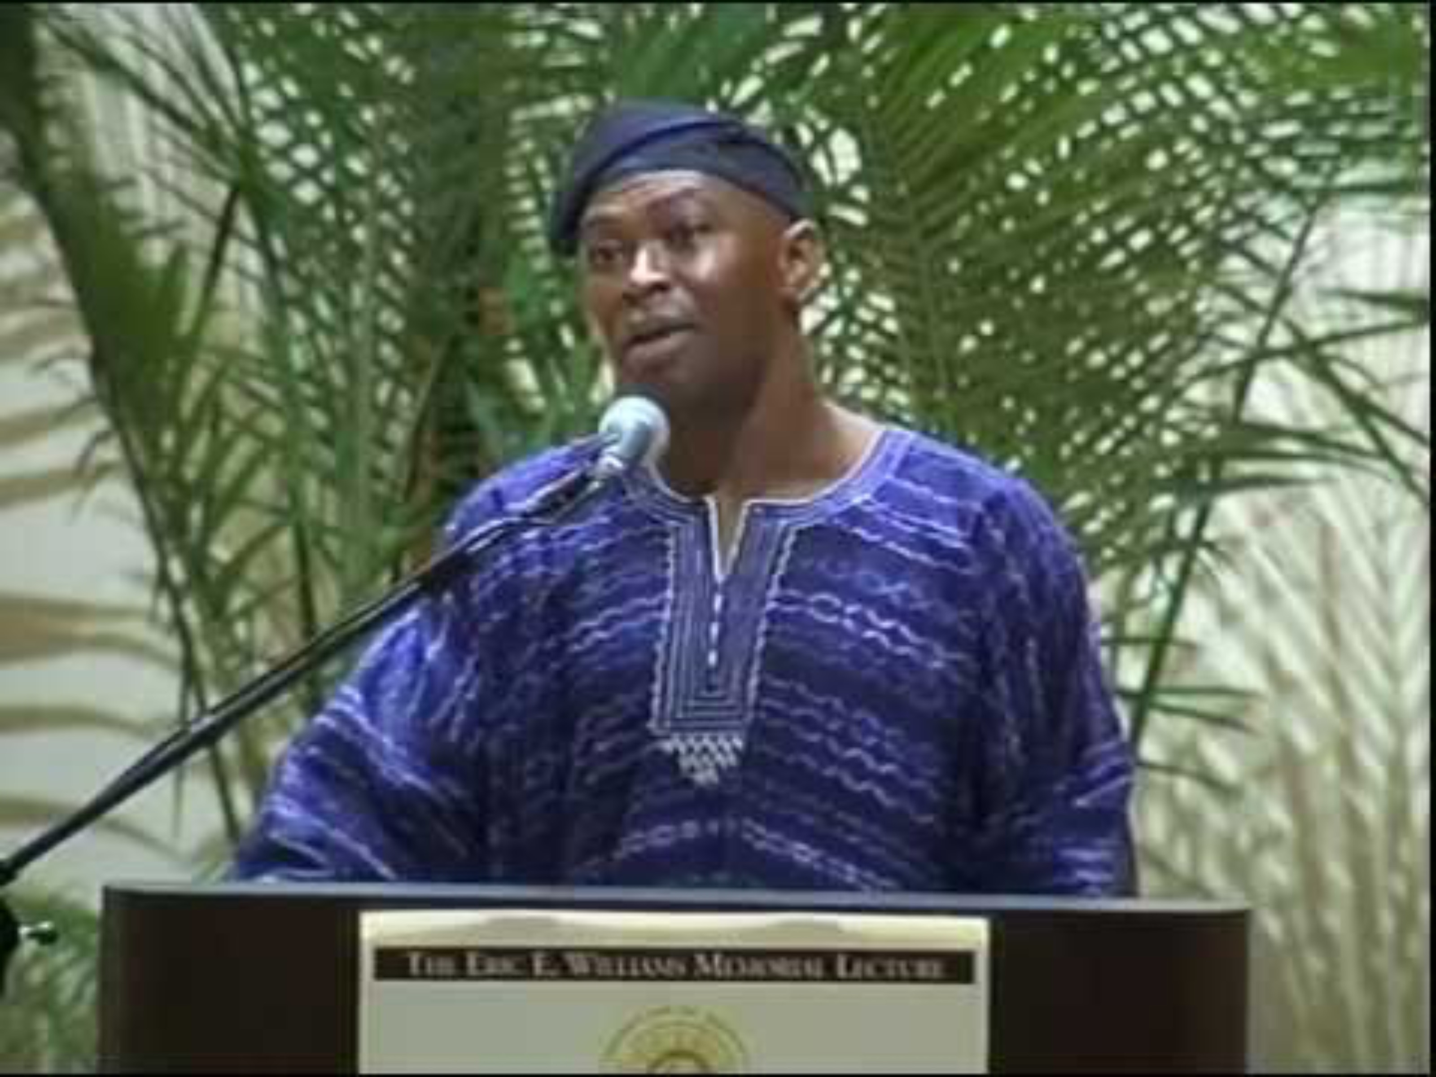
Notes:
Prof Jospeh Inikori, Emancipation, the African Atlantic and the Long Road to Freedom

Slide 6
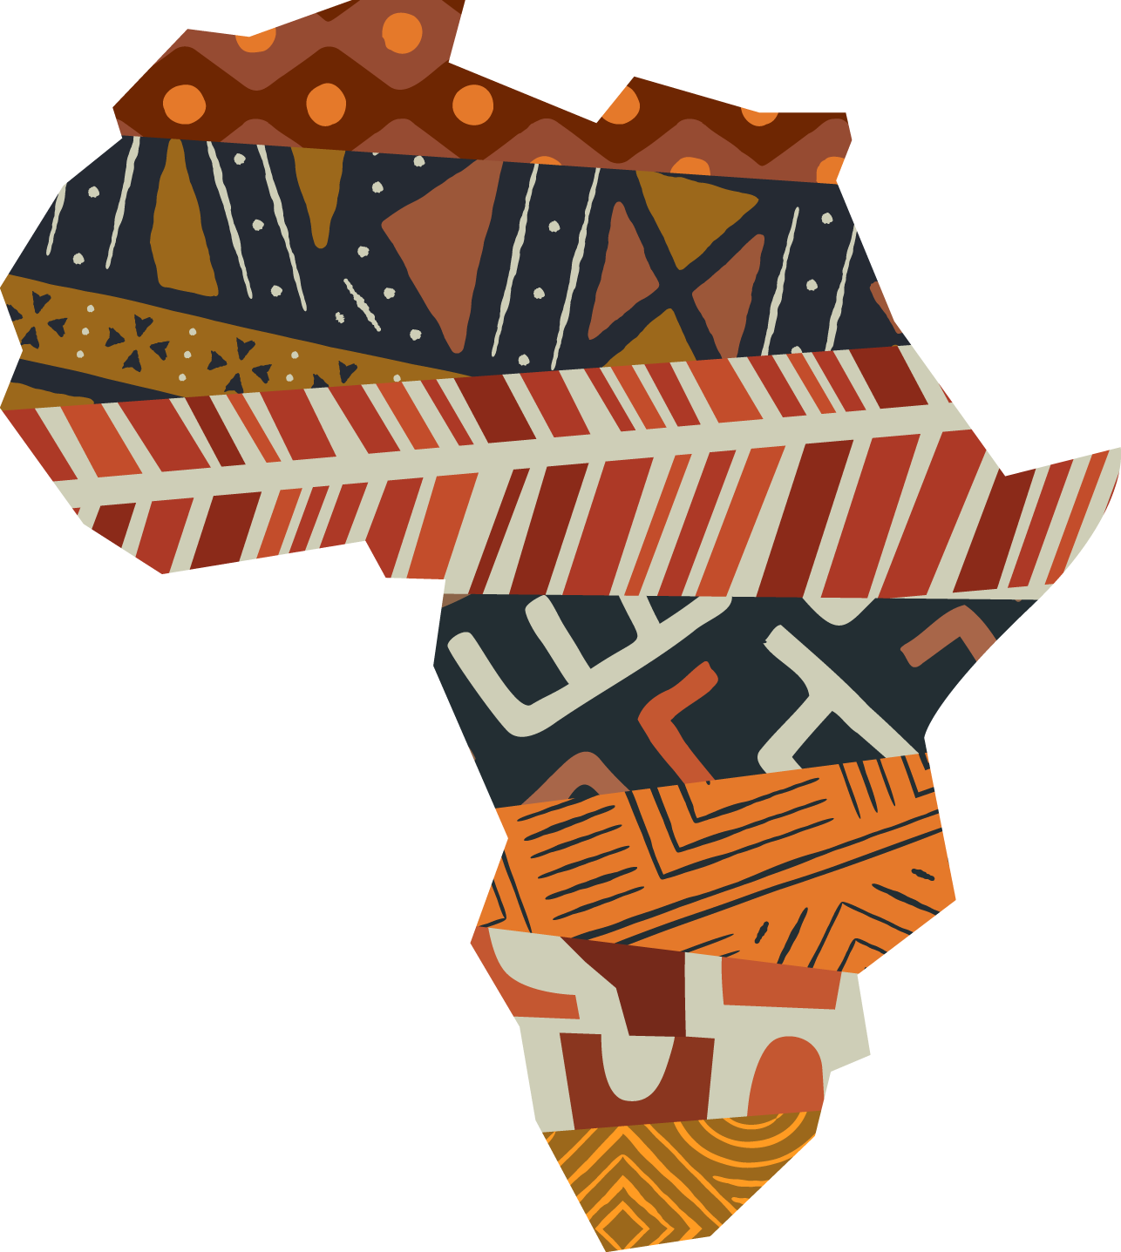
Impacts on Africa
The slave trade had an overwhelmingly negative impact on Africa and its social, economic, and political development.
Through the removal of an estimated 12 million people, the impacts of the slave trade are still felt in the continent today.

Slide 7




Economic impact
Prof. Adu-Boahen pointed out elites benefited the most from the trade in enslaved African people:
“Since the slave trade.. was a monopoly of the Kings and their military leaders and advisers, the bulk of the income went to them”
Professor Albert Adu Boahen

Slide 8

You have been given a Story, Source, Scholarship task on the impact of the slave trade on Africa. We will complete the story section together.
Read each paragraph, highlighting key words and phrases.
Title each paragraph in the left-hand column.
Summarise each paragraph in the right-hand column (2-3 bullet points).
We will do the first paragraph together.

Slide 9
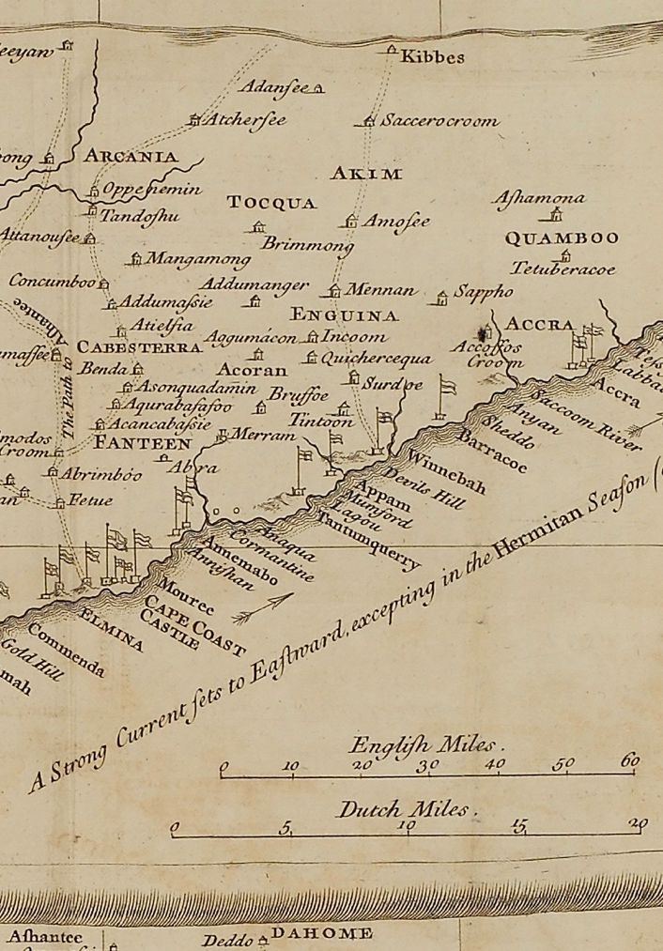


Look at the Source section of your worksheet
Analyse the map of the European forts on the West African coast. Using your own knowledge, explain how these forts would have been connected to slave trading and how they would have impacted local communities. Answer the questions below the map.

Slide 10


Now look at the Scholarship section of your worksheet.
Read the extract from Babacar M’Baye’s article and answer the questions that follow.

Slide 11
In your reading, it says that the slave trade impacted gender roles.
How would this impact the role of women in African societies?
Think: Write down your answer to the following question.
Pair: Discuss your answers with a partner.
Share: Discuss the different answers as a class.

Slide 12
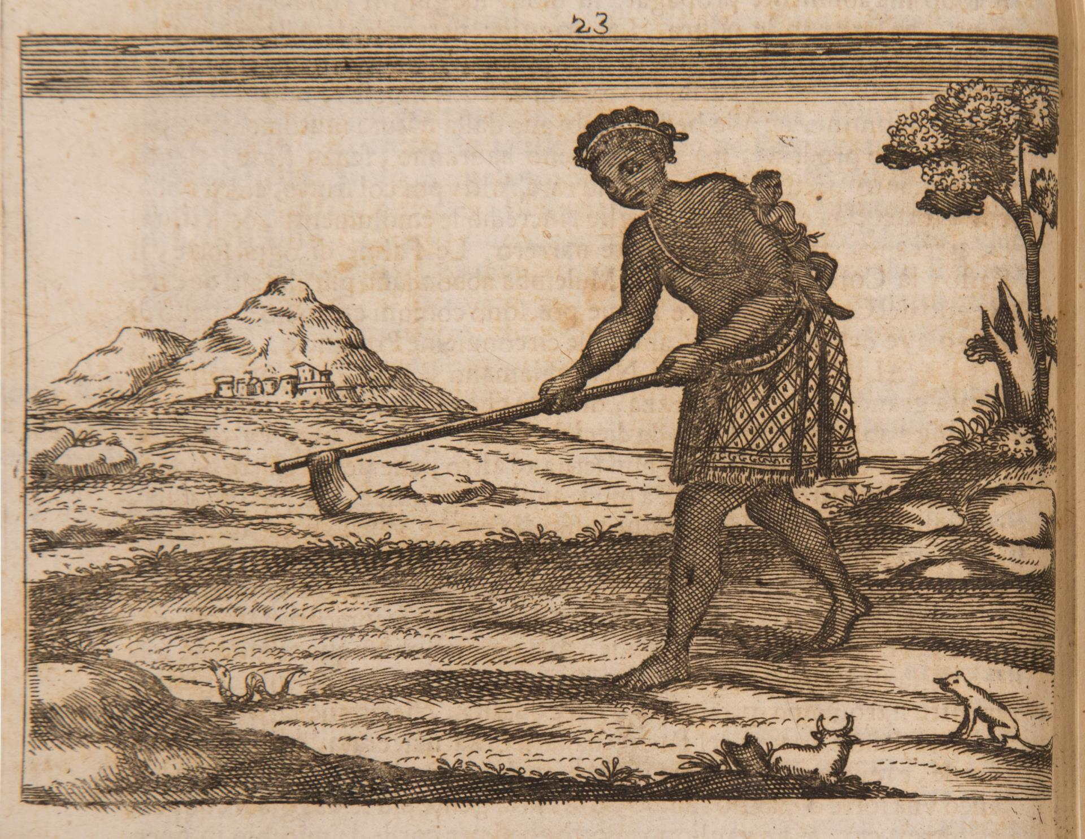
Impact on Gender Roles
The loss of men saw women take on their roles in society.
Women ended up performing the majority of agricultural work, as well as fishing and hunting. Their inexperience led to less protein in the diets of communities.
“Woman Hoeing,” engraving by Fortunato da Alemandini , Istorica Descrittione De’ Tre Regni Congo, Matamba, et Angola, 1687. Jamestown-Yorktown Foundation, JYF2002.20.

Slide 13
Impacts on Africa
You have 14 cards that describe different impacts of the slave trade on African societies.
Organise them under the following headings:
Political impacts.
Economic impacts.
Social impacts.

Slide 14
Plenary: Summarising sentences
In 3 sentences, summarise your learning from today's lesson. Use the following sentence stems:
West African politics were impacted by the slave trade because…
The economy of West African societies was impacted by the slave trade because…
The social circumstances of West African societies were impacted by the slave trade because…

Slide 15



