Slide 1
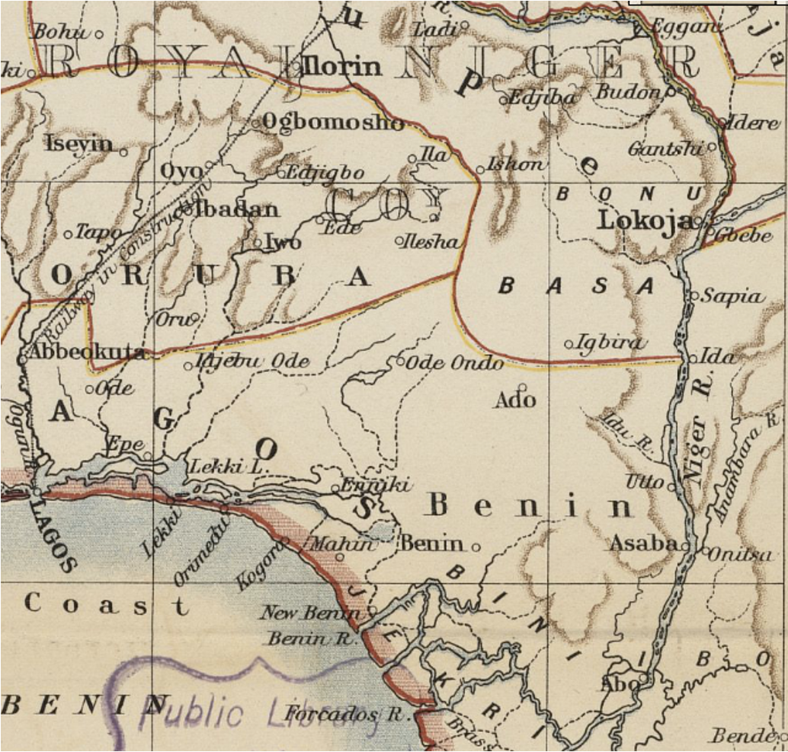
What influenced the development of West Africa in the late 18th Century?

Slide 2

Describe different ways in which Igbo communities resisted the trade in enslaved African people.
4 Marks

Slide 3
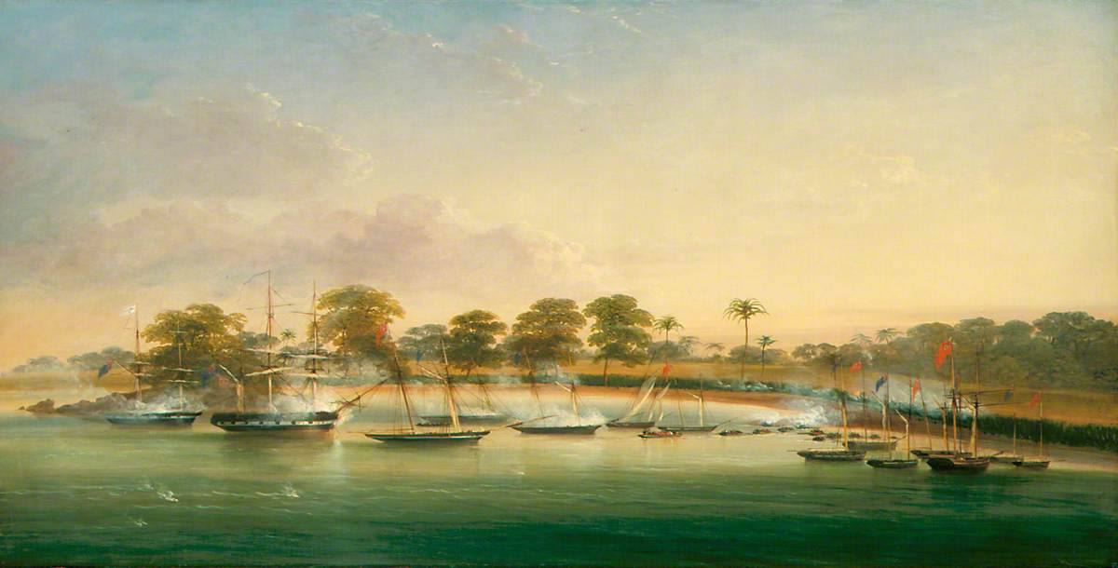
Why did Lagos become such an important port for the trade in enslaved African people?
Lesson 4
James George Philp, British Men o' War Attacked by the King of Lagos, 1851.
Government Art Collection.

Slide 4
We will learn…
About the different reasons why Lagos became one of the most important Slave Trade ports in West Africa.
How each of these factors impacted Lagos’ importance in West Africa.
We will be successful if we can…
Gather, organise and summarise information from secondary sources.
Describe 2 factors that affected the development of Lagos as a slaving port.
Explain the reasons why these factors impacted Lagos’ importance as a port.

Slide 5
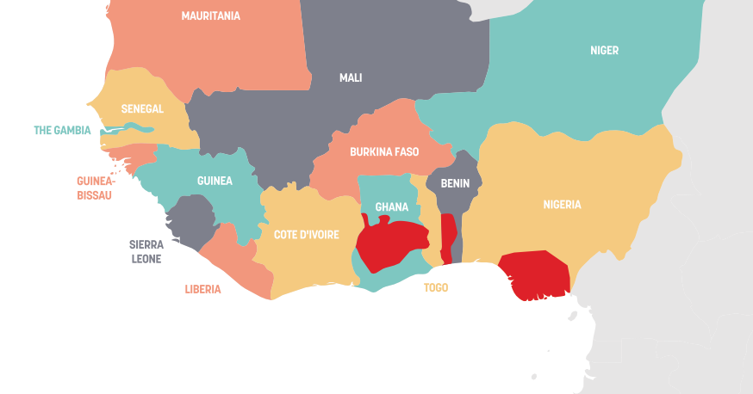
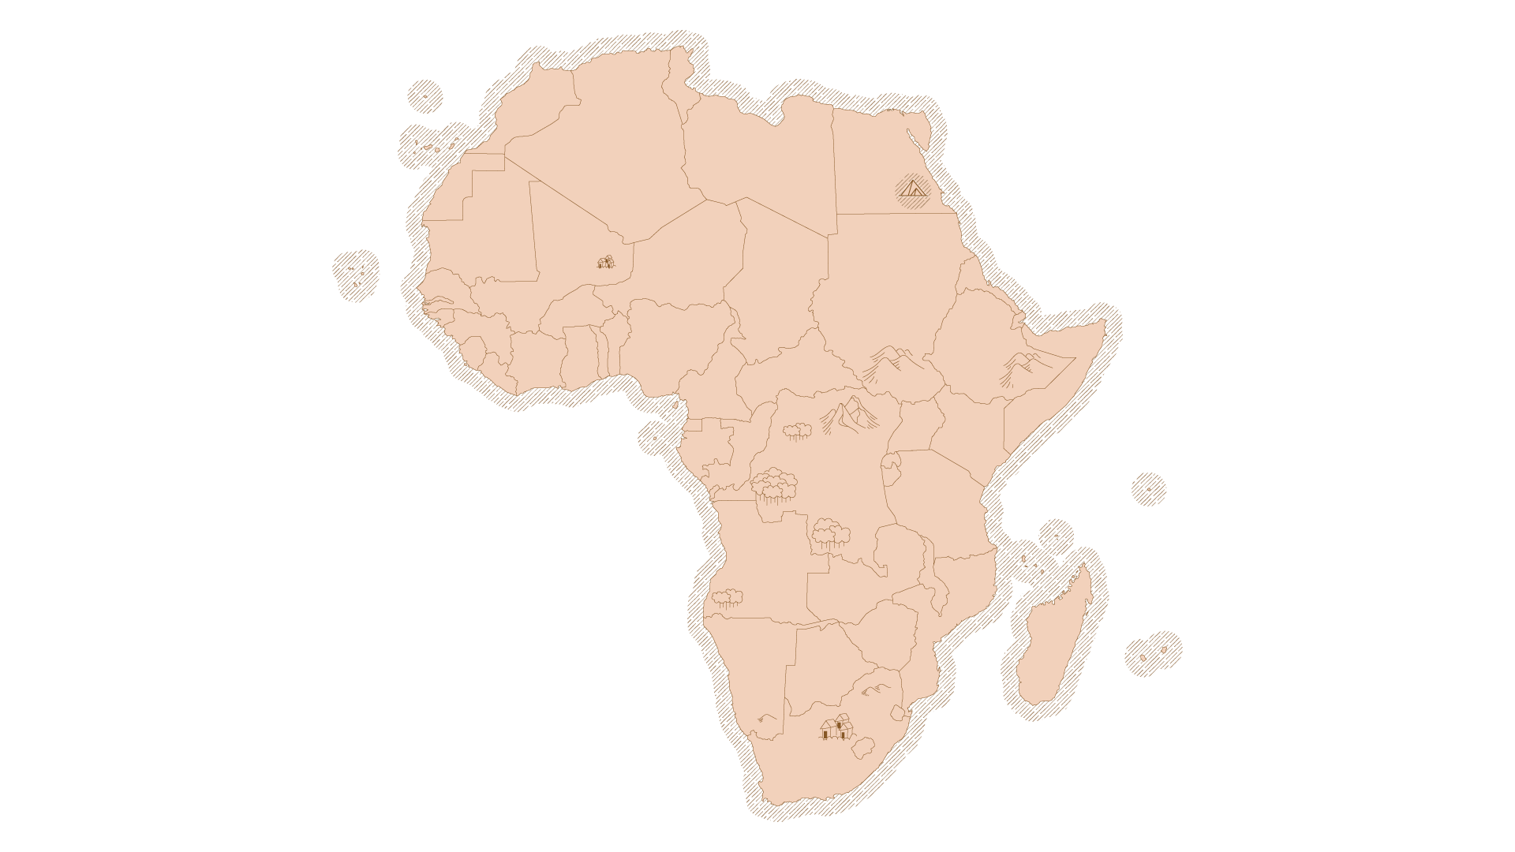

Lagos: A Bit of Context
LAGOS

Slide 6
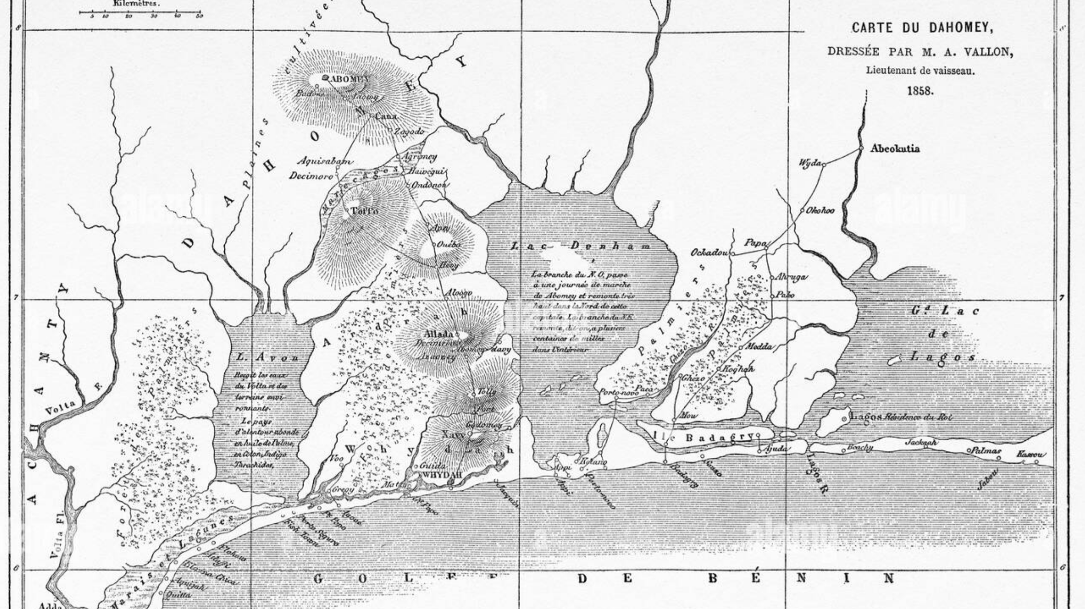

Slide 7
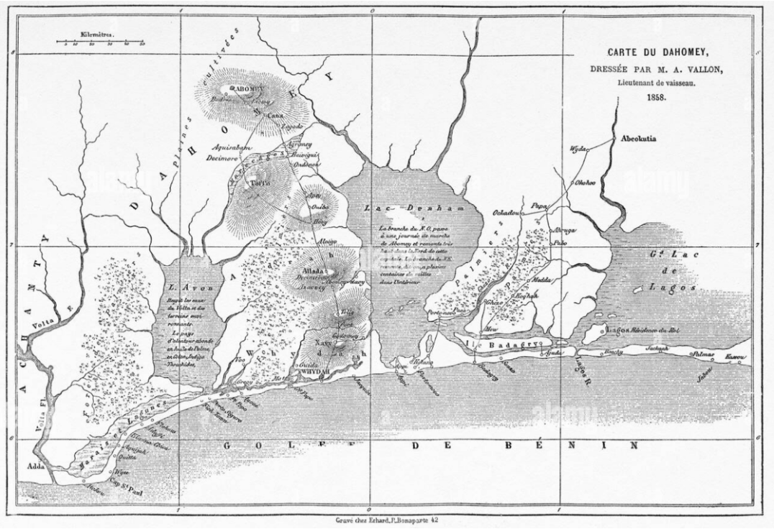
Introduction
From the River Volta to the Niger Delta there is a coastal lagoon system which linked to interior through rivers. It also served the coastal trading system.
Lagos occupies a central position within the lagoon system between the kingdoms of Allada, and later Dahomey, to the west and the Yoruba kingdom of Ijebu and Kingdom of Benin to the east.
Notes:
this pendant was found in a 1938 excavation, a similar object is in the Nigerian Museum in Lagos. Facial scarification similar to t9th-10th century: Igbo-Ukwu becomes an urban centre with a highly-developed bronze casting tradition. See, eg https://www.britishmuseum.org/collection/object/E_Af1956-15-1 hat of the casting is particularly associated with the ichi title taken by Igbo men of status (Equiano’s father is described as having this scarification).

Slide 8
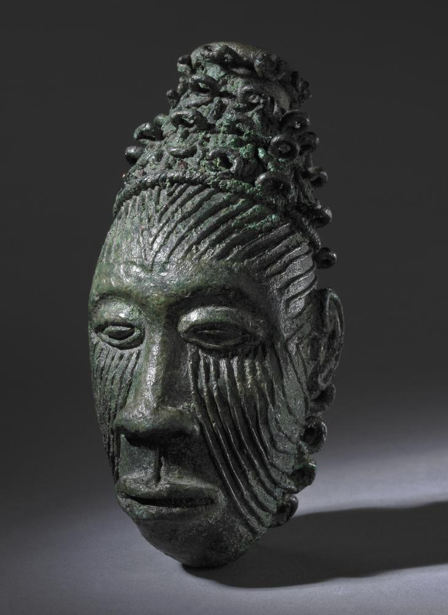
Early History of Lagos
Original inhabitants of Lagos were the Awori Yoruba who moved there down the River Ogun Iseri.
By mid-16th century Benin had sent war canoes to establish a military fort in Lagos.
In the late seventeenth century, the present dynasty of Obas (Kings) of Lagos was founded.
Still little-known by Europeans.
Notes:
this pendant was found in a 1938 excavation, a similar object is in the Nigerian Museum in Lagos. Facial scarification similar to t9th-10th century: Igbo-Ukwu becomes an urban centre with a highly-developed bronze casting tradition. See, eg https://www.britishmuseum.org/collection/object/E_Af1956-15-1 hat of the casting is particularly associated with the ichi title taken by Igbo men of status (Equiano’s father is described as having this scarification).

Slide 9

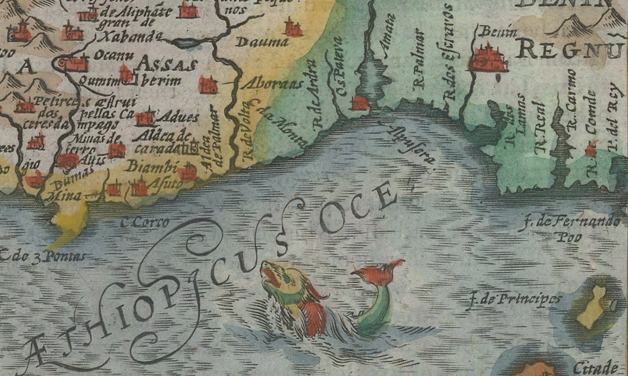
Can you locate Lagos?
Hendrik Hondius, " Africae nova tabula”, 1638. Boston Public Library
Notes:
https://collections.leventhalmap.org/search/commonwealth:7h149z97c

Slide 10

Timeline of Lagos
Read the information on your timeline sheet and highlight any key moments you think that helped Lagos to become a powerful port.
1508
1680s
the biggest towne of al[l] the Coast
1897
“very small”
Obas of Benin banned the sale of men into the transatlantic slave trade
1485
1765
Slave ship Betty
Notes:
Link to timeline: https://cdn.knightlab.com/libs/timeline3/latest/embed/index.html?source=1bfN_lmHn_9wV_GskGTqFtrNNnlDz2OfOif4YGvBwTAo&font=Default&lang=en&initial_zoom=2&height=650

Slide 11


Using Slave Voyages
Use the Scan Code to visit the Slave Voyages website and search:
Voyage ID: 91049 on the Database.
Extension: Why do you think it took until the late eighteenth century for Lagos to rise to its prominent position? What impacts do you think the slave trade had in the area?
Notes:
Link to timeline: https://cdn.knightlab.com/libs/timeline3/latest/embed/index.html?source=1bfN_lmHn_9wV_GskGTqFtrNNnlDz2OfOif4YGvBwTAo&font=Default&lang=en&initial_zoom=2&height=650

Slide 12
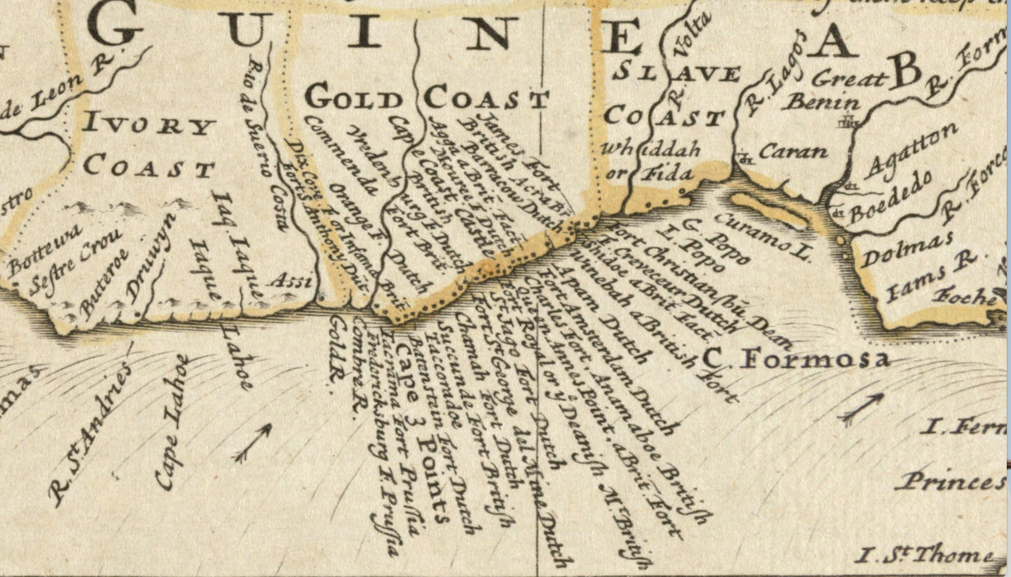
Can you locate Lagos?
Herman Moll, "This map of Africa”, 1732. Boston Public Library

Slide 13



What was the relationship between the trade in enslaved Africans and the growth of Lagos?
Read the extract by historian Kristin Mann.
“To answer this question it is necessary to know how the slave trade was conducted, who profited from it, and what those who benefited did with their new income."
It covers a variety of reasons why Lagos became an important port during the 19th century.

Slide 14



Using different colours, highlight what you consider important information that could have affected Lagos’ growing power.
Summarise your highlighted information by organising (writing) it in one of these 3 categories:
Trade
Environment
Political Situation
Environment
Factors
Trade
POLITICS

Slide 15
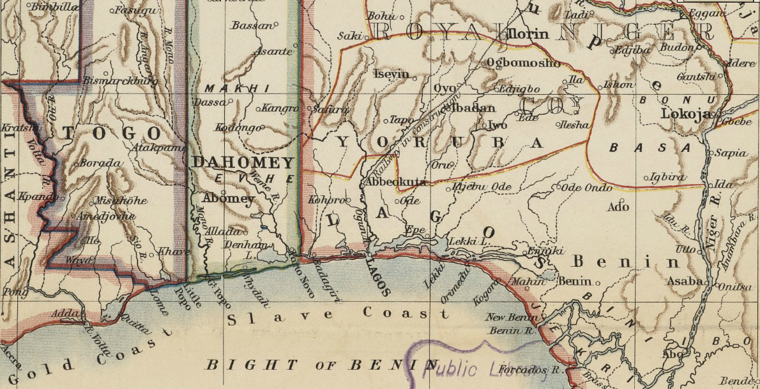
Can you find Lagos now?
"Map to Illustrate the Question of the Niger”, Detail showing Lagos, Nigeria, 1898

Slide 16


Plenary
Answer the following question in as much detail as you want. You need to describe at least 2 reasons why Lagos became such an important port.
How did Lagos become such an important Port for the Slave Trade?
Extension: In your own words, why were these factors important in making Lagos such a powerful port?

Slide 17



