Slide 1
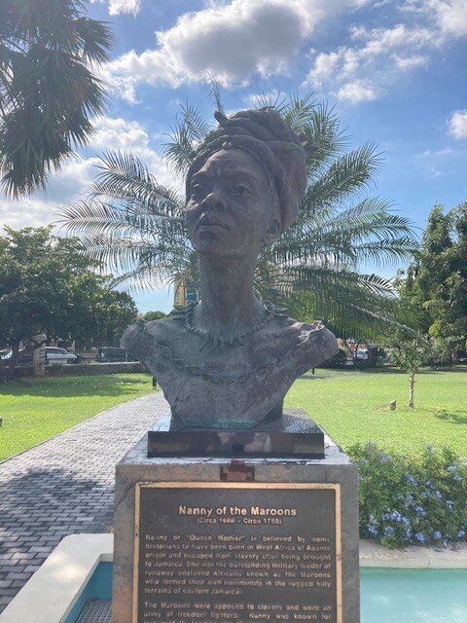
How do historians reconstruct hidden stories of resistance in the Caribbean?
A bust of Jamaican National Heroine, the Right Excellent Nanny of the Maroons, at the Blue and John Crow Mountains National Park. wikicommons

Slide 2

What do we mean by “resistance”?
Resistance was anything that disrupted the efficiency of the plantation system, or gave enslaved people control over their own lives.
Enslaved women had opportunities to disrupt and to take control, and they used these opportunities.

Slide 3
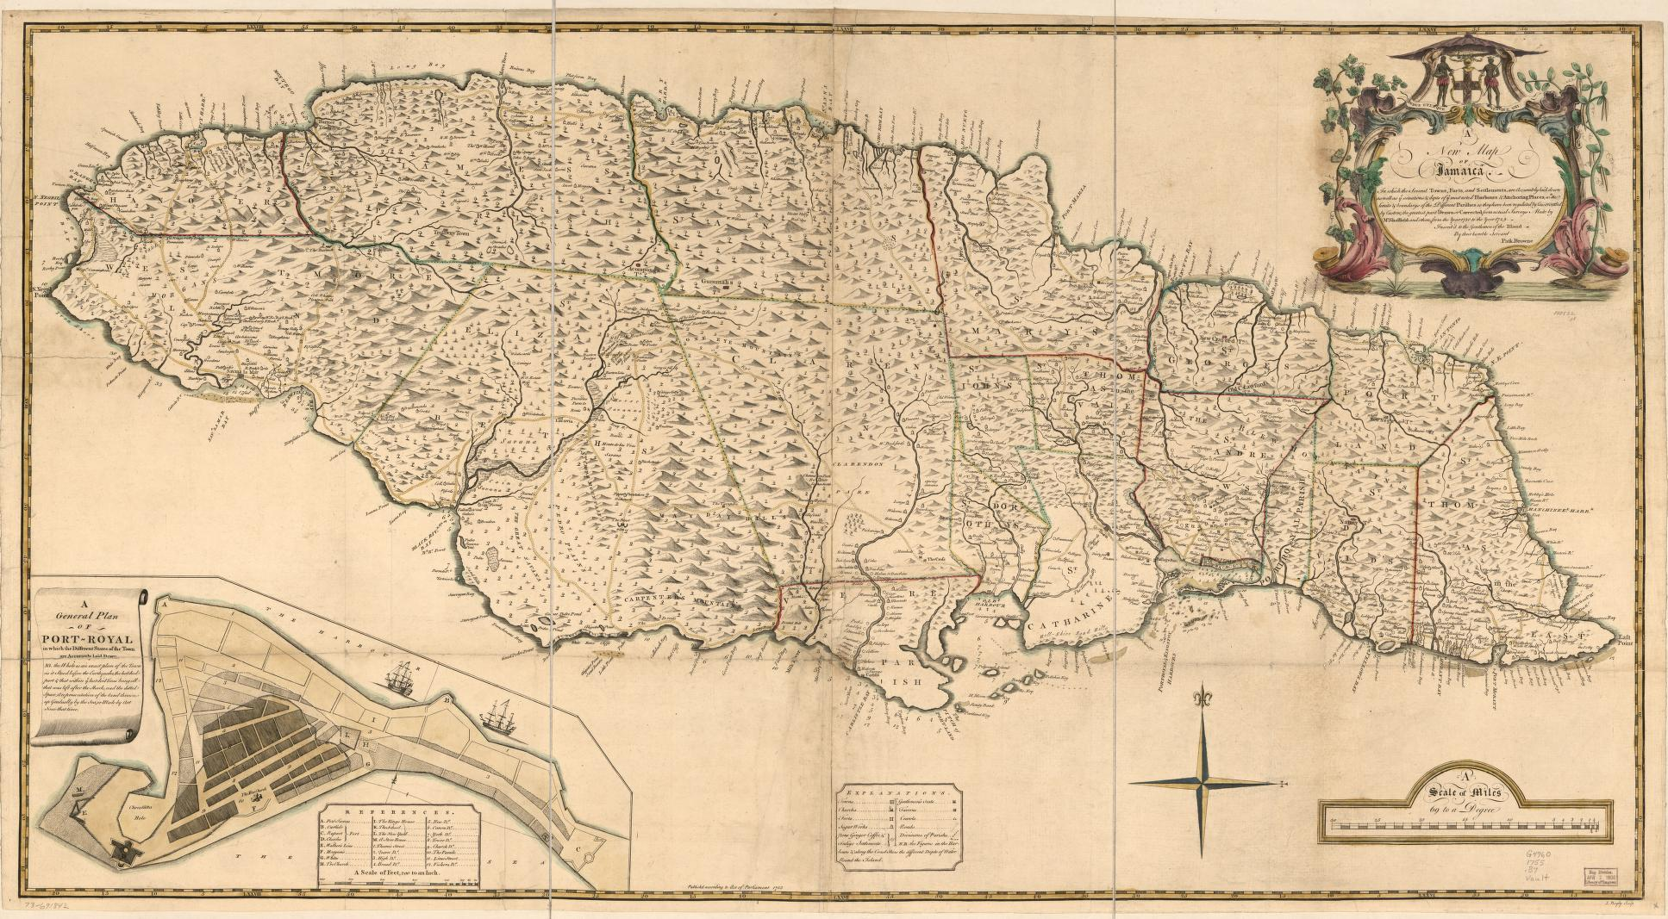


18th Century Jamaica
The sources that we are going to explore come from Jamaica in the 18th century.
A new map of Jamaica (1755), Library of Congress https://www.loc.gov/item/73691842/.
Notes:
Browne, P., Sheffield, A. 1. C. & Bayly, J. (1755) A new map of Jamaica; in which the several towns, forts, and settlements, are accurately laid down as well as ye situations & depts. of ye most noted harbours & anchoring places. [London?] [Map] Retrieved from the Library of Congress, https://www.loc.gov/item/73691842/.
This map is a great source as on the website you can zoom in and the key shows where sugar plantations, forts, roads are – good potential digital activity for pupils to explore and consider the opportunities for resistance/difficulties of resistance using the map, but I haven’t included as too much for one lesson…

Slide 4
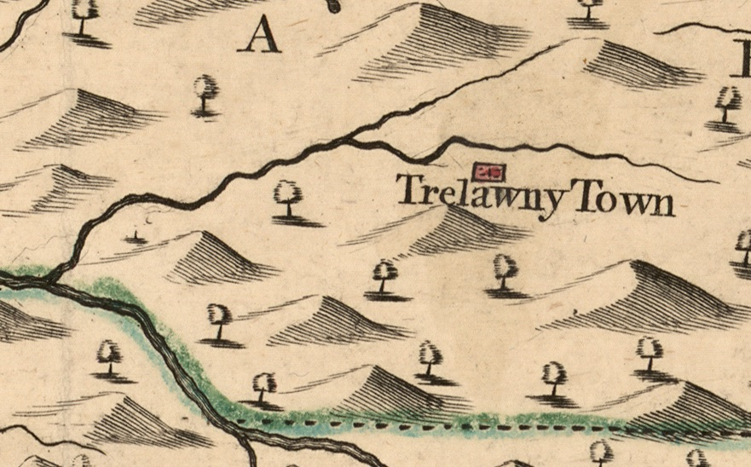
Resistance in Jamaica
Jamaica was a British colony at this time and experienced a number of wars and rebellions led by the Maroons and by enslaved people on plantations.
The mountains on the island allowed the Maroons to carry out guerilla campaigns against the British troops.
However, Jamaica also had busy, bustling towns such as Kingston, which allowed for a different kind of resistance to emerge.
The trade routes and market towns allowed enslaved people to hide in plain sight.
Notes:
The largest maroon village was Trelawny Town. Until a peace
treaty was signed in 1738 between the British official Colonel John Guthrie and the Trelawny Town
leader, Captain Cudjoe, the rebels were a source of fear and apprehension among the colonial
plantocracy, especially around Cockpit Country. After the Second Maroon War of 1795-96 many of
the Trelawny inhabitants were deported. See, https://www.rgs.org/media/hewfck3r/themaroonsofjamaica.pdf

Slide 5
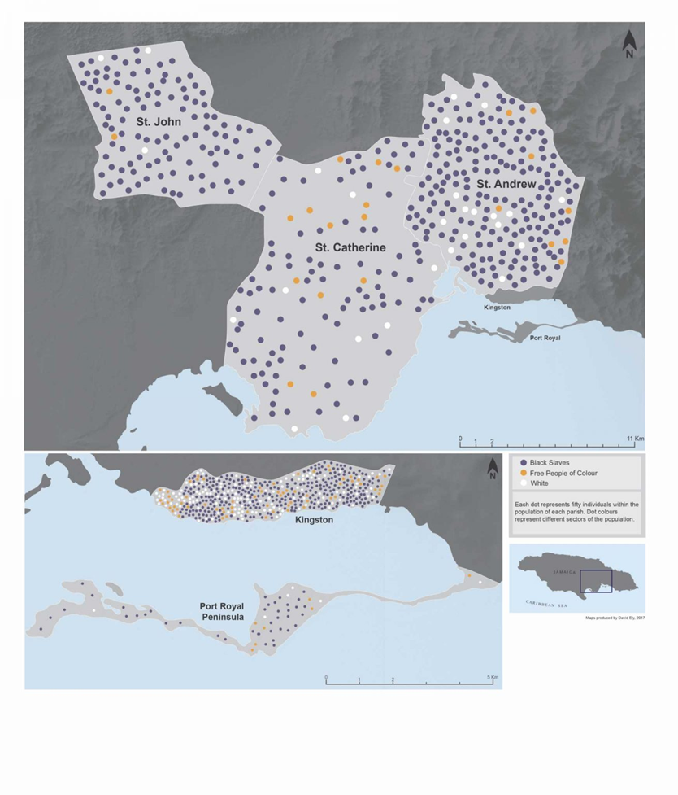

18th Century Kingston
Port towns like Kingston were busy, bustling places, populated by:
Enslaved people (dark blue dots)
Free people of Colour (orange dots)
White people (white dots)
Each dot represents 50 people.
Map derived from Simon Newman, ‘Hidden in Plain Sight: Escaped slaves in late Eighteenth and Early Nineteenth Century Jamaica’, William and Mary Quarterly (2018).
Do you think that this would make it easier or more difficult for enslaved people to escape to the towns? Why?
Notes:
Source of map = https://oireader.wm.edu/open_wmq/hidden-in-plain-sight/hidden-in-plain-sight-escaped-slaves-in-late-eighteenth-and-early-nineteenth-century-jamaica/

Slide 6
What do historical sources tell us about the resistance of women on plantations?
Lesson 1

Slide 7
To use historical sources to investigate the role of women in resistance on plantations in the Caribbean.
By the end of this lesson, you should be able to:
Extract information about the resistance of women from historical sources
Describe methods used by women to resist enslavement
Assess the value of historical sources in helping us to understand the role of women in resistance

Slide 8

Think, pair, share:
What do we already know about the experiences of women who were enslaved?
What roles did women typically have on plantations?
Why do you think reconstructing the resistance of women on plantations may be difficult for historians?
You have one minute to note your ideas before sharing with your partner.
Notes:
Based on prior learning, learners may be able to give examples of men and women being separated on Middle Passage, abuse and sexual exploitation, may have idea of men and women having different roles, men in fields, women in domestic sphere – starter would allow this misconception to be corrected to ensure pupils understand range of roles women had on plantations.

Slide 9
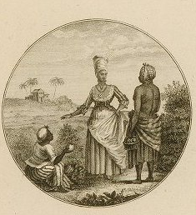
Experiences of Enslaved Women on Plantations
Enslaved women carried out many different roles on plantations.
They worked in the fields alongside men, planting and harvesting sugar cane.
They also carried out domestic tasks such as cooking, cleaning, laundry, sewing, childcare and nursing.
Women would also often grow food.
Nicolas Ponce (1746-1831), Recueil de vues des lieux principaux de la colonie françoise de Saint-Domingue. Paris, Chez M. Moreau de Saint-Méry, 1791. John Carter Brown Library.

Slide 10
Language
We are going to use primary sources in this lesson. These sources were written by enslavers, and the language reflects the racist attitudes that were held by this group of people at the time.
We do not use the terms that you will read today. They were used to label people as different and inferior, with no basis in fact.
Notes:
This warning should come one or more days in advance of the lesson, and directly before the use of the primary sources. See the guidance in Unlocking Perspectives published by the Understanding Slavery Initiative http://archive.understandingslavery.com/images/pdfs/USI-handbook.pdf

Slide 11
Task 1: Runaway Ads
Part One
Each member of your team has been issued with two runaway ads that were published in newspapers in Jamaica in the 18th century.
Read through your sources carefully and answer the questions next to the source.
Part Two
Starting with person A, rotate around the table and share what you have learned from your sources.
Part Three
As a team, you will now discuss your sources and share your information to help you to complete the summary table.
Notes:
wonder if we are asking too much from the class here. I think my preference would be to give two sources to each table and then have the whole tables share with other tables. I think in a mixed ability classroom, asking an individual pupil to work with two sources in challenging language, against the clock is too much. Better to have multiple copies of the same two sources available to each member of a table (and have four tables working simultaneously). The class can then use the table to share their insights as a class.

Slide 12
Women and Resistance - Summary of Runaway Ads.
 | What do these sources tell us about women who escaped from slavery? | What do these sources tell us about how women survived and avoided capture?
Group A
Group B
Group C
Group D

Slide 13
Key definitions
Plantain: a tropical plant grown in the Caribbean that can be eaten. Looks like a banana.
Coromantee: enslaved African people from the Akan region of the west coast.
Eboe: enslaved African people from Benin, a variation of Igbo.
Mandingo: enslaved African people from a region of western Africa.
Creole: a person of African descent who was born in the Caribbean.
Maroon: a person of African descent who escaped slavery and formed or joined a free and often secluded settlement.
Pistole: a Spanish gold coin.
Half-Joe: a Portuguese gold coin.
Subscriber: the person who has placed the ad; usually the plantation owner.
Mulatto: a term used to describe a person with one parent who is black and one parent who is white. Offensive language.
Higgling: selling goods, bartering or haggling to agree on a price.
Wench: an offensive way to describe a women, suggesting that she is lower class.
Notes:
Should there be a shared glossary for these lessons with agreed definitions? I have looked to keep simple. These would be printed for learners to use while working with the sources, or on the screen as they complete the task.

Slide 14
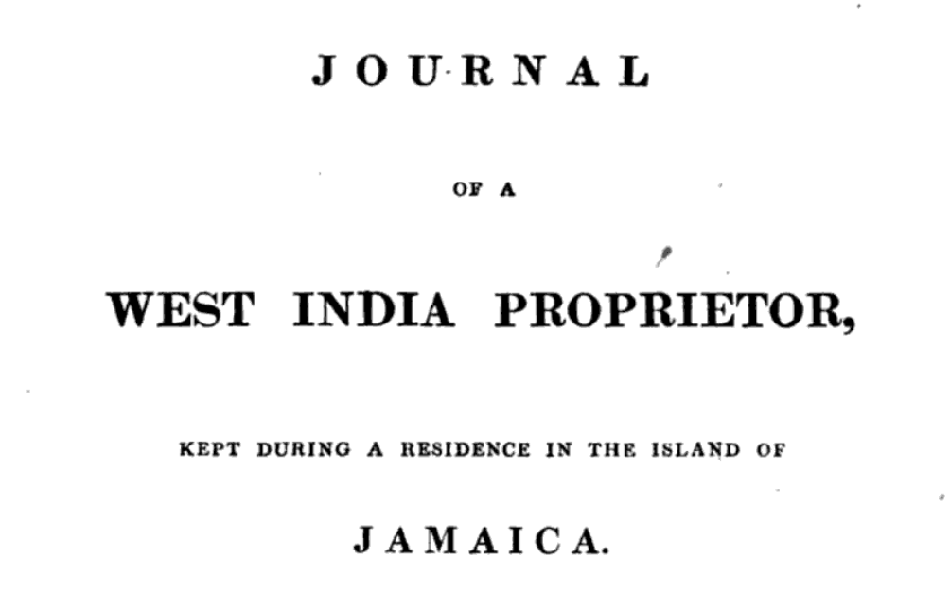

Task 2: Women and resistance
Women also had opportunities on plantations to resist in other ways.
Read the source carefully and answer the questions:
1. Describe in your own words what the source is telling us about this young girl’s actions.
2. Who does the author of the source think was mainly responsible for this act? Why?
3. What impact do you think these actions would have had on plantations and plantation owners?
Notes:
Matthew Gregory Lewis (1775–1818) Gothic horror novelist and dramatist, author of 1796 The Monk. He also worked as a diplomat, politician and an estate owner in Jamaica. Lewis inherited slave plantations in Jamaica and spent time on them in the early nineteenth century. He supported the abolition of the slave trade but his racism and self-interest made it impossible for him to imagine how his slaves could survive without benevolent proprietors like him, so he opposed their emancipation.

Slide 15

Plenary: Circles of Certainty…
What do we know about women and resistance from examining these sources?
The sources
don’t tell us …
The sources
suggest that …
We know from the sources that…
Notes:
Matthew Gregory Lewis (1775–1818) Gothic horror novelist and dramatist, author of 1796 The Monk. He also worked as a diplomat, politician and an estate owner in Jamaica. Lewis inherited slave plantations in Jamaica and spent time on them in the early nineteenth century. He supported the abolition of the slave trade but his racism and self-interest made it impossible for him to imagine how his slaves could survive without benevolent proprietors like him, so he opposed their emancipation.

Slide 16

