Slide 1
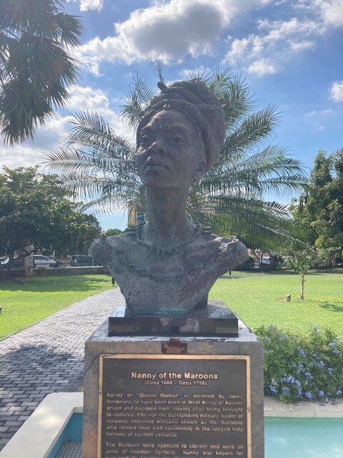
How do historians reconstruct hidden stories of resistance in the Caribbean?
A bust of Jamaican National Heroine, the Right Excellent Nanny of the Maroons, at the Blue and John Crow Mountains National Park. wikicommons

Slide 2

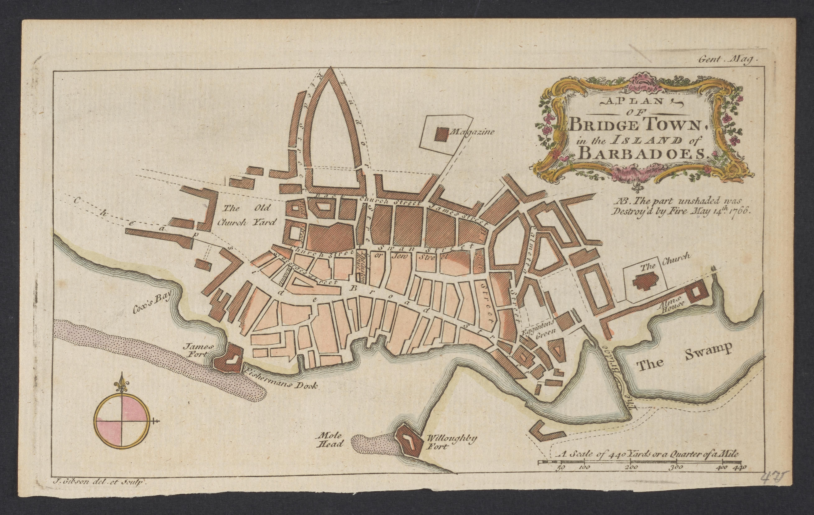
Look closely at Source A, a street map of Bridgetown in Barbados.
What can this map tell us about life in Barbados in the 18th century?
1 point per fact. How many points can you score?
For a bonus point, see if you can locate Palmetto Street.

Slide 3

Urban Resistance by children
Lesson 2

Slide 4

Learning about:
Learning to:
read and understand a primary source
identify the way enslaved young people were described by their enslavers
evaluate whether young people’s acts of resistance challenged slavery
Do we undervalue acts of resistance by young people?

Slide 5
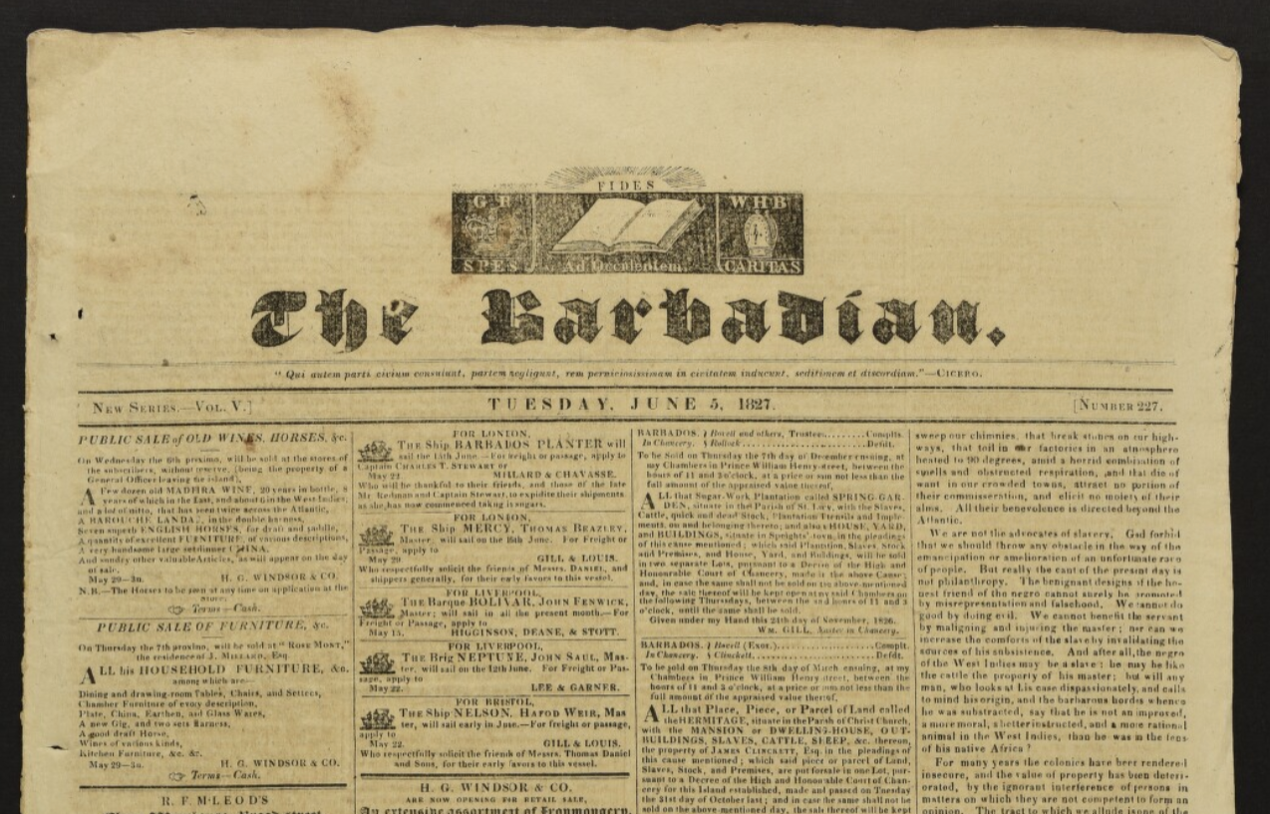
Source B is an excerpt a newspaper printed in Bridgetown, Barbados, between 1822-1861. This article is from June 5th, 1827.
Task 1: The Barbadian
Read Source B and underline any words you cannot confidently define.
The Barbadian, 05 Jun 1827, British Library, EAP1251/1/6/6/2.
https://eap.bl.uk/archive-file/EAP1251-1-6-6-2

Slide 6
Source B
"A premeditated, and most diabolical attempt was made yesterday by a black girl about twelve years of age, to produce a fire in a house in Palmeto Street ... This young criminal, who is said to be a vile thief, was confined in a closet (her master and mistress having gone to spend the day out of town), which she broke open, and then deliberately emptied the draws of her mistresses' wardrobe of various articles, and placed them on the bed; searched her masters room for some gunpowder, laid it under the bed, drew the counterpane down to the side of the bedstead, procured fire, and applied to the powder. It was a most providential circumstance that an opposite neighbour saw the flash and the smoke issuing from the house; he and other neighbours rushed in and speedily extinguished the fire. The wicked incendiary jumped out of a window, but was caught, and we hope will be brought to trial. We have thus has a narrow escape of being involved in a most awful conflagration, for the house in which the horrid attempt was made in a central, and very crowded part of the town...If there should be any relaxation in the attention and vigilance of the associated Fire-Companies, we trust that this merciful escape from a tremendous fire will operate as a warning...we hope that if any merchant is so thoughtless of his own, and of his neighbours, safety and so contemptuously neglectful of the law, as to keep any large quantity of gunpowder in his store, he will attend to this warning, and think seriously of the awful consequences which may result from his neglect."
Notes:
There is perhaps need for some careful handling here of the fact that in discussing arson/fire-starting we are talking about acts that could have led to significant death and destruction, including of enslaved people, although in this case the girl was apprehended first. Had there been a massive fire in Bridgetown, it would have hurt people fairly indiscriminately. There is an ethical issue here in that (in my view anyway) a straightforward celebration of such resistance is not sufficient—we have to also engage with the fact that slavery created a dynamic in which violence against enslaved people was commonplace, and in which it was very hard for them to contest this without using some violence themselves.

Slide 7
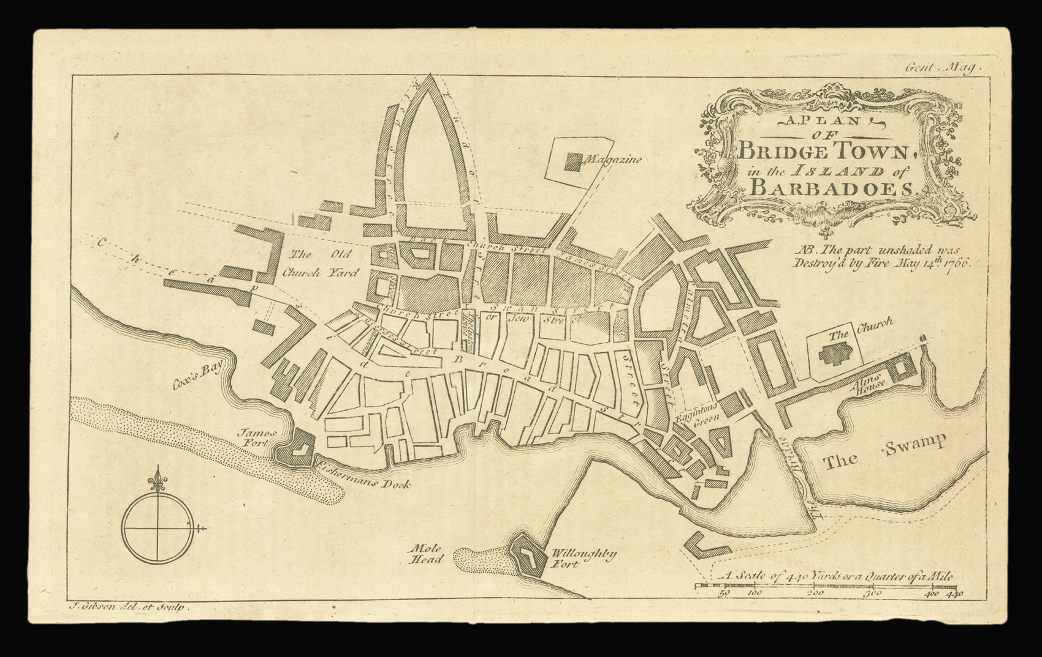
Vocabulary
Premeditated: Planned beforehand.
Diabolical: Devilish.
Vile: Repulsive.
Confined: Restricted within a small space.
Counterpane: Bedspread (duvet/quilt).
Providential: Fortunate, lucky.
Extinguished: Put out.
Incendiary: Fire-starter.
Conflagration: Huge fire.
Vigilance: Watchfulness.
Contemptuously: Scornfully.

Slide 8
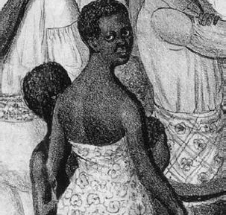
Task 2: Think, Pair, Share
Read Source B again.
1. Highlight words that describe the twelve-year-old girl.
2. Discuss with your partner:
How is the girl characterised?
Why do you think she is characterised in this way?
The three girls (Kag’ne, Mar’gru, and Te’me), detail of a lithograph by John Childs, c. 1839

Slide 9
Recap
Did this story surprise you?
Why do you think that is?
What did you imagine resistance would look like? Who did you imagine?
Notes:
How are they to make a judgement on this?
Who is ‘we’?
What evidence do they have about how ‘we’ value acts of resistance?

Slide 10
Task 3: Do we undervalue acts of resistance by young people?
To answer this question we need to consider the acts of the girl in Palmetto Street.
Create a table of two columns. In the left column write down acts of resistance. In the right column explain how this can be considered an effective act of resistance.
ACT OF RESISTANCE | HOW THIS CHALLENGED SLAVERY
Broke the closet open | No longer confined. Not controlled by her enslavers.
Emptied the wardrobe of the mistresses’ clothes

Slide 11
Acts and Impacts of Resistance
ACT OF RESISTANCE | HOW THIS CHALLENGED SLAVERY
Broke the closet open | No longer confined. Not controlled by her enslavers.
Emptied the wardrobe of the mistresses’ clothes | Possibly some personal antagonism. Cost of replacing the clothes.
Set fire to the house | Damage to the property. Potential damage to the whole town if the fire had spread.
Frightened the neighbour | Psychological impact of threat to personal safety. What if this happens again. Instills fear in the community
Prompted a review of the fire-service | Takes up time and resources of the planters, which could otherwise be spent on agriculture.
Engages the judicial system | Time and effort and money of the Barbadian government required. Also brings under scrutiny the choices of the enslavers.

Slide 12
Plenary
Look again at the map of Bridgetown, Barbados.
Now answer the question, and give a reason:
Do we undervalue the acts of resistance of young people?
Notes:
In particular, note that a significant portion of Bridgetown was destroyed by fire in 1766. This suggests that the town’s buildings were a) rather flammable and b) sufficiently compact that the fire could spread. Accordingly, the act of resistance of the young girl, though foiled, was potentially massive.

Slide 13

Conclusions
The city of Bridgetown’s coat of arms (created in 1960) refer to the fact that a significant portion of Bridgetown was destroyed by fire in 1766. The city’s motto can be translated as “out of the past fires we rise again to the light"
This suggests that the town’s buildings were a) flammable and b) sufficiently compact that the fire could spread.
The act of resistance of the young girl, though foiled, was potentially massive.

Slide 14



