Slide 1

Too small to make a difference?
Notes:
https://slaverylawpower.org/barbados-slave-code/

Slide 2
How did children rebel against enslavement?

Slide 3
In many ways, children can make their own choices about their lives and can help create change for themselves and others…
Notes:
Individual response / Pair and Share / Class discussion

Slide 4



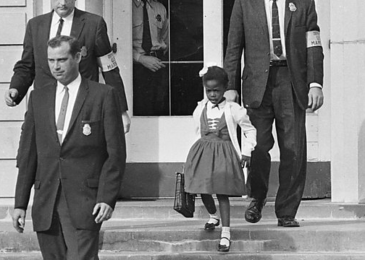




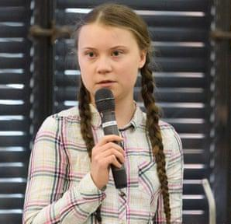
Children as change makers
“One child, one teacher, one book and one pen can change the world” Malala
In 1960 Ruby Bridges became one of the first black children to attend a formerly all-white school, aged just 6 years old.
“We children are doing this to wake the adults up. We children are doing this for you to put your differences aside and start acting as you would in a crisis. We children are doing this because we want our hopes and dreams back.”
Greta Thunberg
Notes:
Images from:
Greta Thunberg's speeches to be rushed out as a book | Publishing | The Guardian
BBC World Service - Witness History, Ruby Bridges Attends an all-White School
Malala Yousafzai Turns 18: What Comes Next for the World’s Most Famous Teenager? | Vogue

Slide 5








“Listen, you little …
Think Pair Share
I’m BIG,
YOU’RE LITTLE;
I’M RIGHT, you’re wrong,
and there’s NOTHING
you can do about it.”
What choices can you, as a child, make in your own life?
What things are not up to you?
Mr Wormwood (Matilda’s Dad)
“Though she be but little, she is fierce.”
William Shakespeare

Slide 6
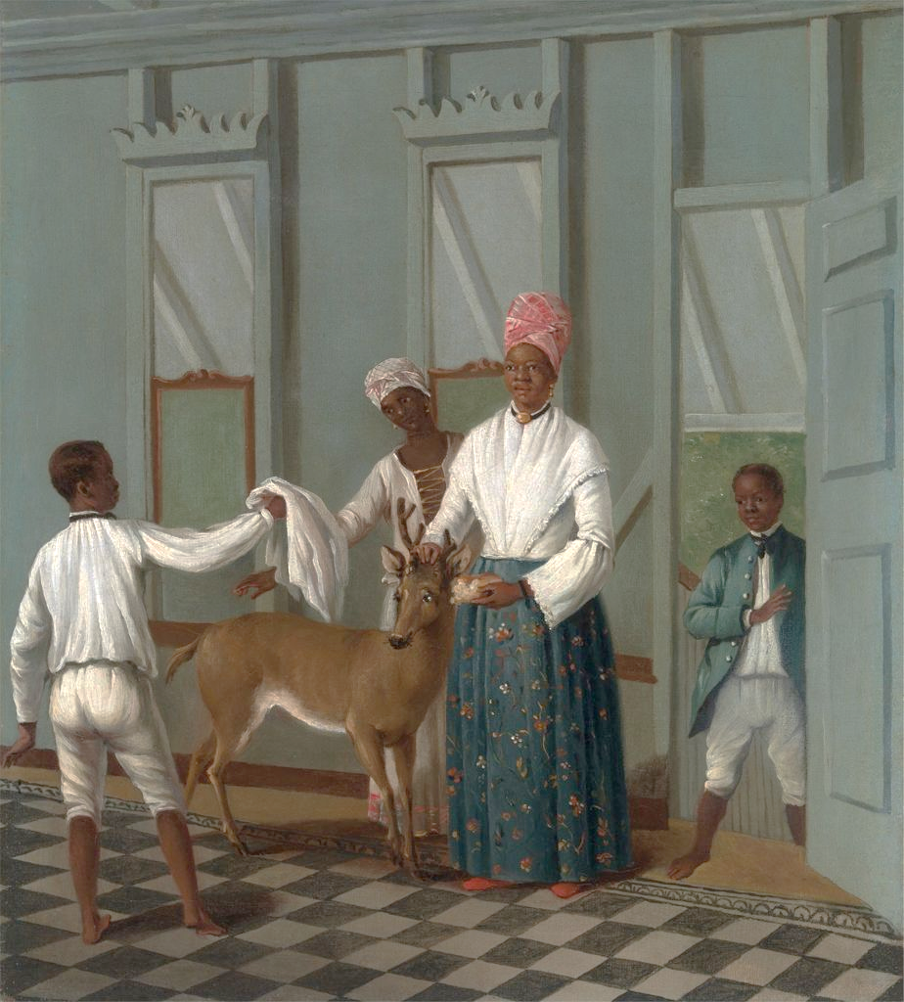


As a child enslaved on a plantation in the Caribbean,
your power to make decisions would have been very different.
In what ways do you think?
Little decisions
Big decisions
Notes:
Montpelier estate, Jamaica by James Hakewill. Image reference HAKE5 as shown on www.slaveryimages.org, sponsored by the Virginia Foundation for the Humanities and the University of Virginia Library. Courtesy of authors Jerome S Handler and Michael L Tuite Jr. from https://www.liverpoolmuseums.org.uk/archaeologyofslavery/slavery-caribbean

Slide 7



Child Labour
Enslaved children, like enslaved adults, were legally considered the property of their enslavers and were not treated like people free to make their own choices. Children were made to work on the plantation for long hours doing work that was tiring and dangerous and they could be punished if the enslavers were not satisfied with their work.
Here are some of the jobs children would have done indoors or outdoors on the plantation:
What do you think these jobs might have involved?
TASK: With a partner, create some interview questions you would ask an enslaved child about their work.
WEEDING THE SUGAR CANE
CUTTING GRASS FOR ANIMALS & FEEDING THEM
MAIDS
HERDING CATTLE
COLLECTING SUGAR CANE LEAVES (BAGASSE)
DRESSERS
KITCHEN ASSISTANTS
VALETS

Slide 8
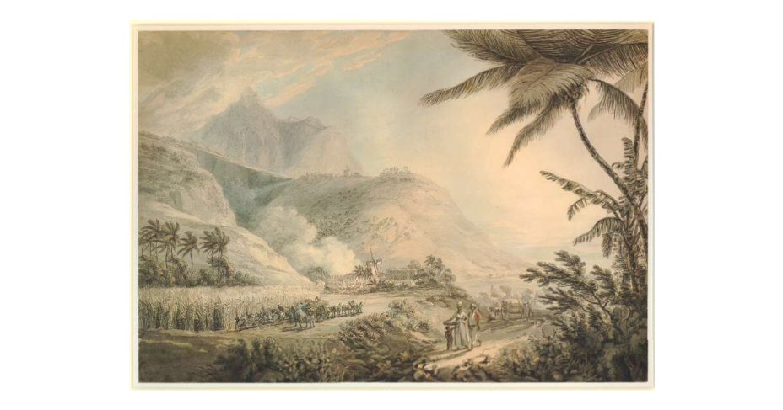

Child Labour
Children were made to work on the plantation for long hours doing work that was tiring and dangerous and they could be punished with violence by the enslavers without reason.
Notes:
Parham Hill House and sugar plantation, Antigua, drawn by Thomas Hearne, 1779, from The British Museum collection, drawing | British Museum

Slide 9

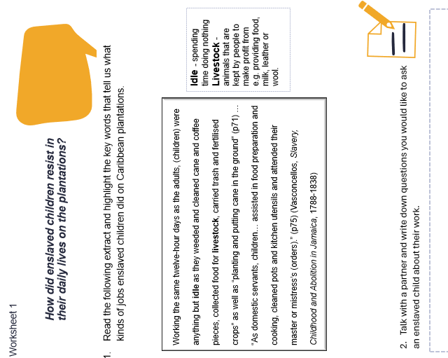
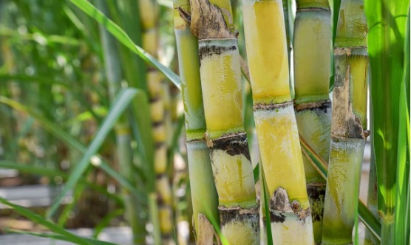


Read what historian Colleen Vasconcellos writes
about the work children did on plantations (worksheet 1).
  What jobs can you see mentioned?
  Highlight or underline them.
Notes:
Growing Sugarcane: How to Plant and Care For This Sweet Treat (morningchores.com)

Slide 10








“Working the same twelve-hour days as the adults, (children) were anything but idle as they weeded and cleaned cane and coffee pieces, collected food for livestock, carried trash and fertilised crops” as well as “planting and putting cane in the ground” (p71) …
“As domestic servants, children… assisted in food preparation and cooking, cleaned pots and kitchen utensils and attended their master or mistress’s (orders).” (p75)
It wasn’t only in the kitchen where children worked in the household. They also worked as maids or valets to their enslavers.
Spending time
doing nothing.
IDLE
Animals that are kept by people to make profit from e.g. providing food, milk, leather or wool.
LIVESTOCK
A male servant of a wealthy man.
VALET
THINK ABOUT THE LENGTH OF THIS WORKING DAY–THIS IS DOUBLE YOUR SCHOOL DAY!
(Vasconcellos, Slavery, Childhood
and Abolition in Jamaica, 1788-1838)
What do you think these jobs might have involved?

Slide 11



What would you like to know?
With a partner, create some interview questions you would like to ask an enslaved child about their work.

Slide 12
Everyday acts of resistance
Despite having little control over their lives, enslaved children found ways in which they could covertly resist their enslavers’ orders to improve their daily lives or gain an element of freedom.
Here are some of the ways that children resisted:
Think about the dangers of being caught in a rebellious act.
Think about the ways in which these acts of resistance could have improved an enslaved person’s life or disrupted the enslaver and therefore justify the dangers.
BREAKING TOOLS OR MACHINERY
PRETENDING NOT TO UNDERSTAND TASKS
ARSON
DISRUPTING BUSINESS
TAKING A LONG TIME TO DO TASKS
DAMAGING PROPERTY
POSIONING FOOD
THEFT OF FOOD OR SMALL ITEMS
Notes:
Covertly: resistance in a hidden way

Slide 13

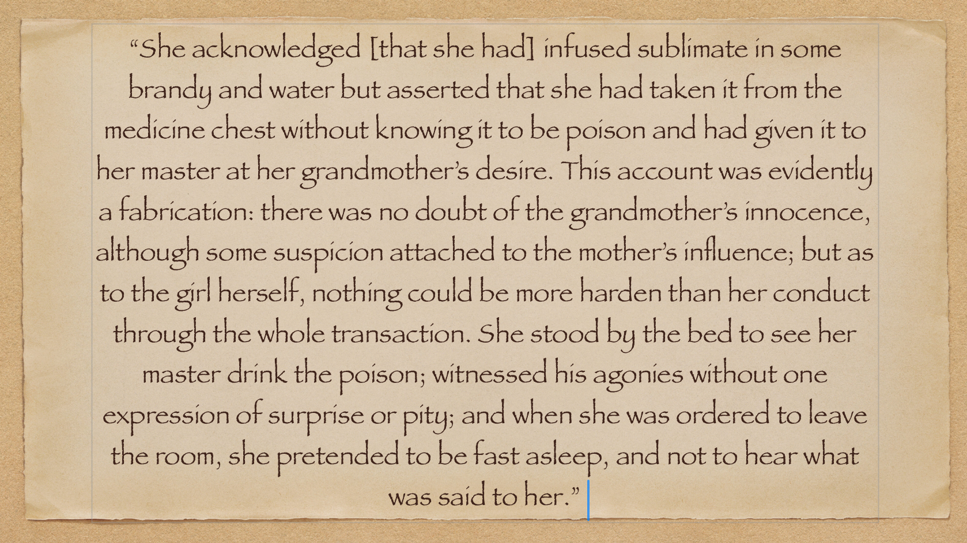
Primary source
A Primary Source is a source of information that was written at the time the events happened by someone who was living through this point in history.
See Worksheet 3 and answer the questions…
An entry from the diary of Matthew Lewis, a plantation owner in 1834

Slide 14

One sided primary source
Can you think of any reasons that slave owners might want to make those they kept enslaved look badly behaved and themselves look wronged?
Remember that when you only hear one side of a story this can be unfair and hide the truth. The same is true of events in history.
The white enslavers in the Caribbean were more powerful and wealthy than the enslaved black population.
Often, enslaved people were not taught or allowed to read or write and their voices were silenced. The historical texts that survive were almost all written by white slave owners.
Enslavers were writing for their own reasons. It is important that we think about the point of view of a writer before we believe everything that they say.
Become a historical detective who looks for clues to the truth and remembers the perspectives of enslaved children which may have been forgotten or not written about – ask yourself why might an enslaved child have done this?

Slide 15
Runaway Ads
Ran away, from ISAAC RODOGUES PENHA on Thursday the 30th of January last, a small creole boy named MONDAY, the two middle fingers of his right hand are contracted, occasioned by being burnt, has large navel, had on when he went away a check shirt, without any breeches, as he could not wear them on account of a whipping, he had a few days before.
He took with him a large Spanish grey horse and went through knock Patrick in company with a Spanish … fellow who calls himself MARTIN who is a known rogue for stealing horses. It is supposed he has incited the boy to go with him, that he may sell him and the horse;
… The said Martin has changed the boy’s name to TOM.”
See Worksheet 4 and answer the questions…
Jamaica Mercury, East Kingston, 2 July 1779
Citation: Chambers, Douglas B., “Jamaica Runaway Slaves: 18th Century” (2013). Documenting Runaway Slaves. Paper 2.
Notes:
https://dloc.com/AA00021144/00001/pdf

Slide 16
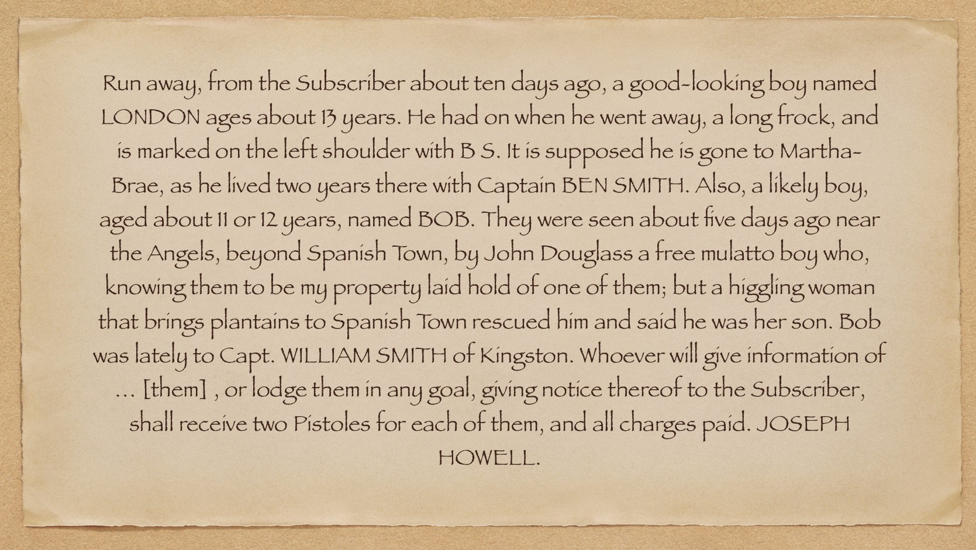
Runaway Ads
Jamaica Mercury, East Kingston, 2 July 1779
Citation: Chambers, Douglas B., “Jamaica Runaway Slaves: 18th Century” (2013). Documenting Runaway Slaves. Paper 2.
Notes:
https://dloc.com/AA00021144/00001/pdf

Slide 17

Runaway adverts
Maroon communities – these were communities of former enslaved who escaped to secluded areas like mountains.
They had their own culture, trade, government and defence.
Escaping from a plantation by running away was another means of rebelling that children sometimes chose. This could have been temporary, such as truanting from work or leaving the plantation for a short time or could have been making a permanent escape or trying to join a maroon community.
The Primary Sources that give us clues about the enslaved children’s experiences of escape are Newspaper Articles known as ‘Runaway ads’.
Discuss with your partner if/why you think this different word choice is important.
Today many people prefer to call children and adults who ran away from slavery ‘freedom seekers’ rather than ‘runaways’.

Slide 18

Discuss these questions with your partner and be ready to share your ideas with the class:-
Why do you think Joseph Howell offers a reward for the return of the enslaved boys?
What can we work out about the personalities and characters of London, Bob and the woman who sells plantains?

Slide 19


Independent reading of runaway ads
Advice and support
Imagine you could help escaping slaves by giving them advice or helping them find support from others, using ideas from the sources we have read. Write on a post-it note some advice you might give to the enslaved child.
Stick your
post-it on the board when you are done!
Notes:
I intend to choose 2 or 3 more of these ads and let children work together as a group/pair to extract information from these (highlighting key words and note-taking) and present what they have learned to the class. – Not completed this yet.

Slide 20



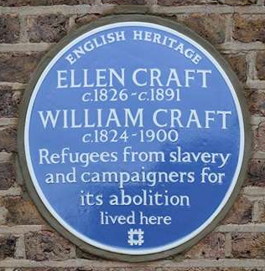



Challenge: Memorial design
Design a memorial that commemorates the courage and efforts of enslaved children who resisted their enslavement. It should be respectful and centre the lives of children like those we have learned about, whose voices have for so long been forgotten.
Think about:
WORDS
IMAGES
WHAT KIND OF MEMORIAL?
Plaque?
Statue?
Something else?
Notes:
Image: https://www.english-heritage.org.uk/visit/blue-plaques/ellen-and-william-craft/
Are there any Blue plaques for children in the UK? See https://www.bbc.co.uk/news/articles/c1m5v04dm55o

Slide 21

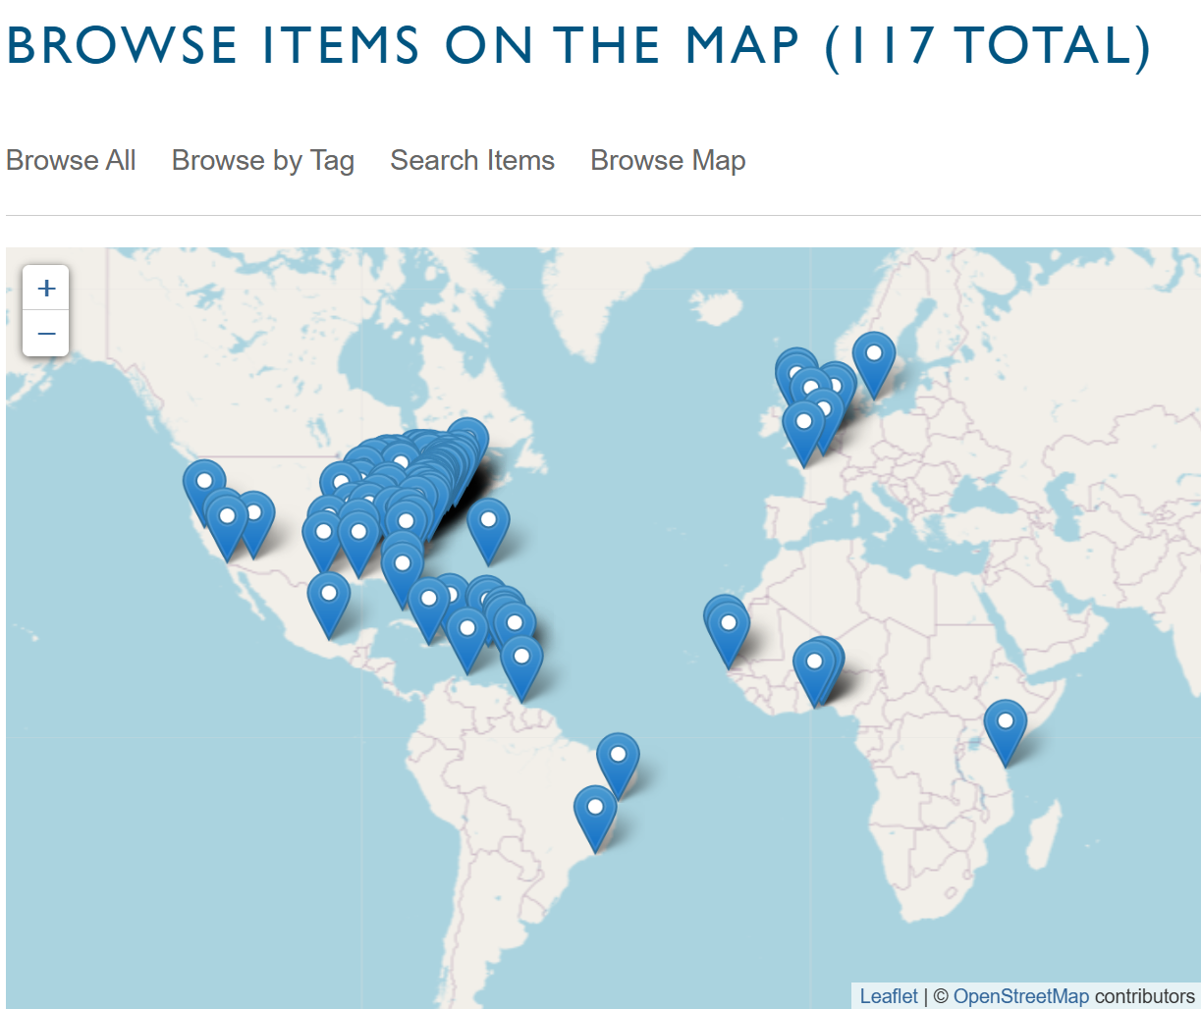
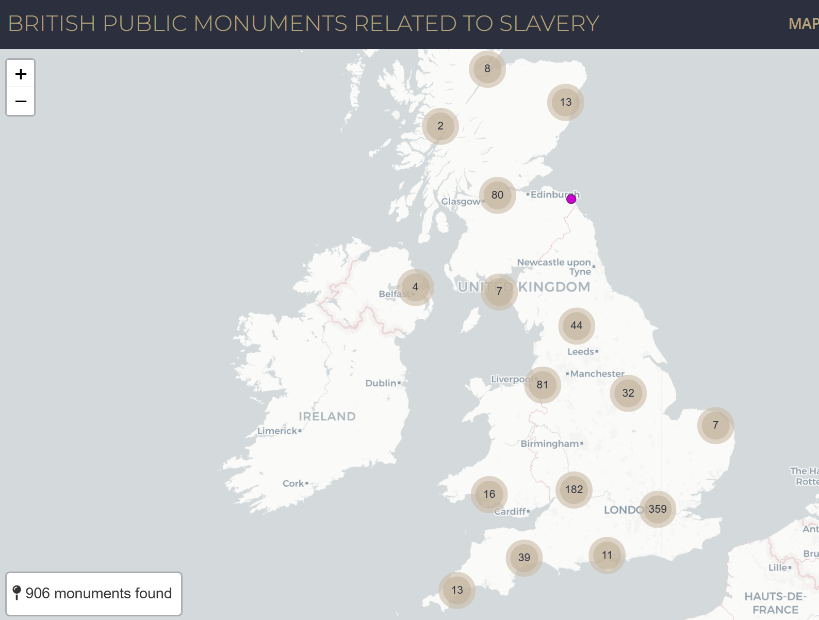
Memorials to Enslavement
(World monuments Database)
(British monuments Database)
Notes:
www.slaverymonuments.org/
https://britishmonumentsrelatedtoslavery.net/

Slide 22



Slide 23
“Working the same twelve-hour days as the adults, (children) were anything but idle as they weeded and cleaned cane and coffee pieces, collected food for livestock, carried trash and fertilised crops” as well as “planting and putting cane in the ground” (p71) …
“As domestic servants, children… assisted in food preparation and cooking, cleaned pots and kitchen utensils and attended their master or mistress’s (orders).” (p75)
It wasn’t only in the kitchen where children worked in the household. They also worked as maids or valets to their enslavers.
Spending time
doing nothing.
IDLE
Animals that are kept by people to make profit from e.g. providing food, milk, leather or wool.
LIVESTOCK
A male servant of a wealthy man.
VALET
THINK ABOUT THE LENGTH OF THIS WORKING DAY–THIS IS DOUBLE YOUR SCHOOL DAY!
(Vasconcellos, Slavery, Childhood
and Abolition in Jamaica, 1788-1838)
What do you think these jobs might have involved?

Slide 24
How did enslaved children resist in their daily lives on the plantations?
Idle - spending time doing nothing
Livestock - animals that are kept by people to make profit from e.g. providing food, milk, leather or wool.
____________________________________________________________________________________________________________________________
.
___________________________________________________________________________________________________________________________
.
____________________________________________________________________________________________________________________________
Working the same twelve-hour days as the adults, (children) were anything but idle as they weeded and cleaned cane and coffee pieces, collected food for livestock, carried trash and fertilised crops” as well as “planting and putting cane in the ground” (p71) … “As domestic servants, children… assisted in food preparation and cooking, cleaned pots and kitchen utensils and attended their master or mistress’s (orders).” (p75) (Vasconcellos, Slavery, Childhood and Abolition in Jamaica, 1788-1838)
2. Talk with a partner and write down questions you would like to ask
an enslaved child about their work.
Read the following extract and highlight the key words that tell us what kinds of jobs enslaved children did on Caribbean plantations.
Worksheet 1

Slide 25

How did enslaved children resist in their daily lives on the plantations?
ARSON
TAKING A LONG TIME TO DO TASKS
TASK: Think about the different types of covert resistance that enslaved children used.
1. Cut the actions out and place them on the line.
2. When placing them down think about the level of RISK of getting caught and the level of DISRUPTiON to the enslavers.
Lowest ----------to ---------- highest
risk to the enslaved child
Worksheet 2
Highest ----------to ---------- lowest
potential to disrupt slavery

Slide 26

Worksheet 2
BREAKING TOOLS OR MACHINERY
PRETENDING NOT TO UNDERSTAND TASKS
ARSON
DISRUPTING BUSINESS
TAKING A LONG TIME TO DO TASKS
DAMAGING PROPERTY
POSIONING FOOD
THEFT OF FOOD OR SMALL ITEMS

Slide 27
How did enslaved children resist in their daily lives on the plantations?
Primary source
A Primary Source is a source of information that was written at the time the events happened by someone who was living through this point in history.
“She acknowledged [that she had] infused sublimate in some brandy and water but asserted that she had taken it from the medicine chest without knowing it to be poison and had given it to her master at her grandmother’s desire. This account was evidently a fabrication: there was no doubt of the grandmother’s innocence, although some suspicion attached to the mother’s influence; but as to the girl herself, nothing could be more harden to her conduct through the whole transaction. She stood by the bed to see her master drink the poison; witnessed his agonies without one expression of surprise or pity; and when she was ordered to leave the room, she pretended to be fast asleep, and not to hear what was said to her.”
Sublimate – a toxic chemical that would poison someone
Fabrication – a lie
Harden – pitiless or unfeeling
An entry from the diary of Matthew Lewis, a plantation owner in 1834
Worksheet 3
See Worksheet 2 and answer the questions…

Slide 28
How did enslaved children resist in their daily lives on the plantations?
Primary source
Questions:
What had the child done to the slave owner?
____________________________________________________________________________________________________________________________________
2. How do you think she had the opportunity to take the poison from the medicine chest?
______________________________________________________________________________________________________________________________________________________
3. How does Mattew Gregory Lewis try to suggest that the girl was guilty of doing wrong?
______________________________________________________________________________________________________________________________________________________________________________________________________________________________
“She acknowledged [that she had] infused sublimate in some brandy and water but asserted that she had taken it from the medicine chest without knowing it to be poison and had given it to her master at her grandmother’s desire. This account was evidently a fabrication: there was no doubt of the grandmother’s innocence, although some suspicion attached to the mother’s influence; but as to the girl herself, to hear what was said to her.”
An entry from the diary of Matthew Lewis, a plantation owner in 1834
4. Look at the information we have about the writer of this text:
“An entry from the diary of Matthew Lewis, a plantation owner in 1834”
A plantation owner was a person who owned a plantation and its enslaved people, so he was an enslaver himself.
How does this make you feel about the information in the text?
Why do we need to treat this primary source with care?
Worksheet 3
See Worksheet 2 and answer the questions…

Slide 29
How did enslaved children resist in their daily lives on the plantations?
Primary source
A Primary Source is a source of information that was written at the time the events happened by someone who was living through this point in history.
creole – someone born in the British Caribbean
incited – persuaded or encouraged
breeches – trousers
Ran away, from ISAAC RODOGUES PENHA on Thursday the 30th of January last, a small creole boy named MONDAY, the two middle fingers of his right hand are contracted, occasioned by being burnt, has large navel, had on when he went away a check shirt, without any breeches, as he could not wear them on account of a whipping, he had a few days before. He took with him a large Spanish grey horse and went through knock Patrick in company with a Spanish … fellow who calls himself MARTIN who is a known rogue for stealing horses. It is supposed he has incited the boy to go with him, that he may sell him and the horse; … The said Martin has changed the boy’s name to TOM.”
: Newspaper Runaway advertisement
Cornwall Chronicle, Santa Cruz, St. Elizabeth, 4 February 1777
Worksheet 3
See Worksheet 2 and answer the questions…

Slide 30
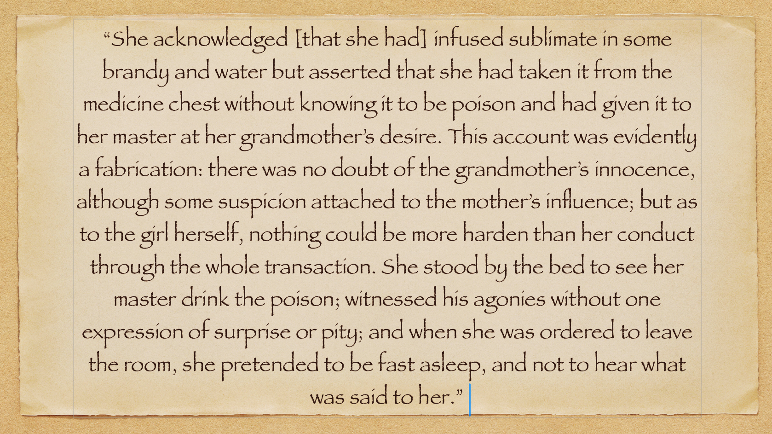
How did enslaved children resist in their daily lives on the plantations?
Primary source
Questions:
Why do you think Monday/Tom ran away?
____________________________________________________________________________________________________________________________________
2. Why might Martin have changed the boy’s name?
______________________________________________________________________________________________________________________________________________________
3. Think about life for an enslaved boy on a Caribbean island - what risks did the boy face?
____________________________________________________________________________________________________________________________________________________________________________________________________________________________________
Newspaper: Jamaica Mercury,
Date: 2 July 1779
Worksheet 4

Slide 31
Challenge: Memorial design
Design a memorial that commemorates the courage and efforts of enslaved children who resisted their enslavement. It should be respectful and centre the lives of children like those we have learned about, whose voices have for so long been forgotten or ignored.
Think about:
WORDS
IMAGES
WHAT KIND OF MEMORIAL?
Plaque?
Statue?
Something else?
Notes:
https://www.gov.uk/government/news/national-expansion-of-blue-plaques-schemes

