Slide 1



What do children’s sweets have to do with the fight against slavery?
Notes:
https://slaverylawpower.org/barbados-slave-code/

Slide 2

Understanding the role of children in the abolitionist movement.
I can identify main ways in which children participated in the abolitionist movement.

Slide 3


Choose a sweet from the jar and explain why you chose it.
OR
Can you think of a time when a grown-up let you choose something for yourself?

Slide 4



How did it feel to have the freedom to choose your sweet?
How does having the ability to make choices make you feel?
OR
What did you choose?
How did it feel?
Were you happy with your decision?
Notes:
Encourage pupils to think about how having agency in small decisions, can make a difference in their lives.
Activity: teaches about the concept of agency but also encourages pupils to reflect on the importance of having the freedom to make choices in their own lives.

Slide 5
Britain’s Caribbean Islands: A Difficult History
A long time ago, from 1600 to 1833, Britain controlled some islands in the Caribbean. These islands were very hot and perfect for growing crops like sugar and tobacco. Unfortunately, the hard work of farming these crops was mostly done by enslaved Black people. Their lives were often controlled by white people from Britain.
Abolitionists were people who worked very hard to end slavery. They believed that slavery was wrong for many reasons, and they fought to make sure that enslaved people could have their freedom.

Slide 6





The abolition movement was a big effort by lots of people who wanted to stop slavery. Slavery was when some people were forced to work for no pay, treated very badly and not allowed to be free.
“
THE ABOLITIONIST MOVEMENT
People did all sorts of things to end slavery. Some wrote letters and books to tell others why slavery was bad. Others boycotted sugar, signed petitions and even played abolitionist board games.
The abolition movement was all about standing up for what’s right and making sure everyone is treated fairly with respect, no matter where they came from or what they look like.
.
/
Notes:
(https://www.genome.gov/about-genomics/fact-sheets/Genetics-vs-Genomics)
https://www.theoriesofrace.com/1

Slide 7


The abolition of the slave trade in Britain
Watch the video about the abolition of the slave trade
Notes:
https://www.bbc.co.uk/bitesize/articles/zn7rbqt#zbnyf82

Slide 8
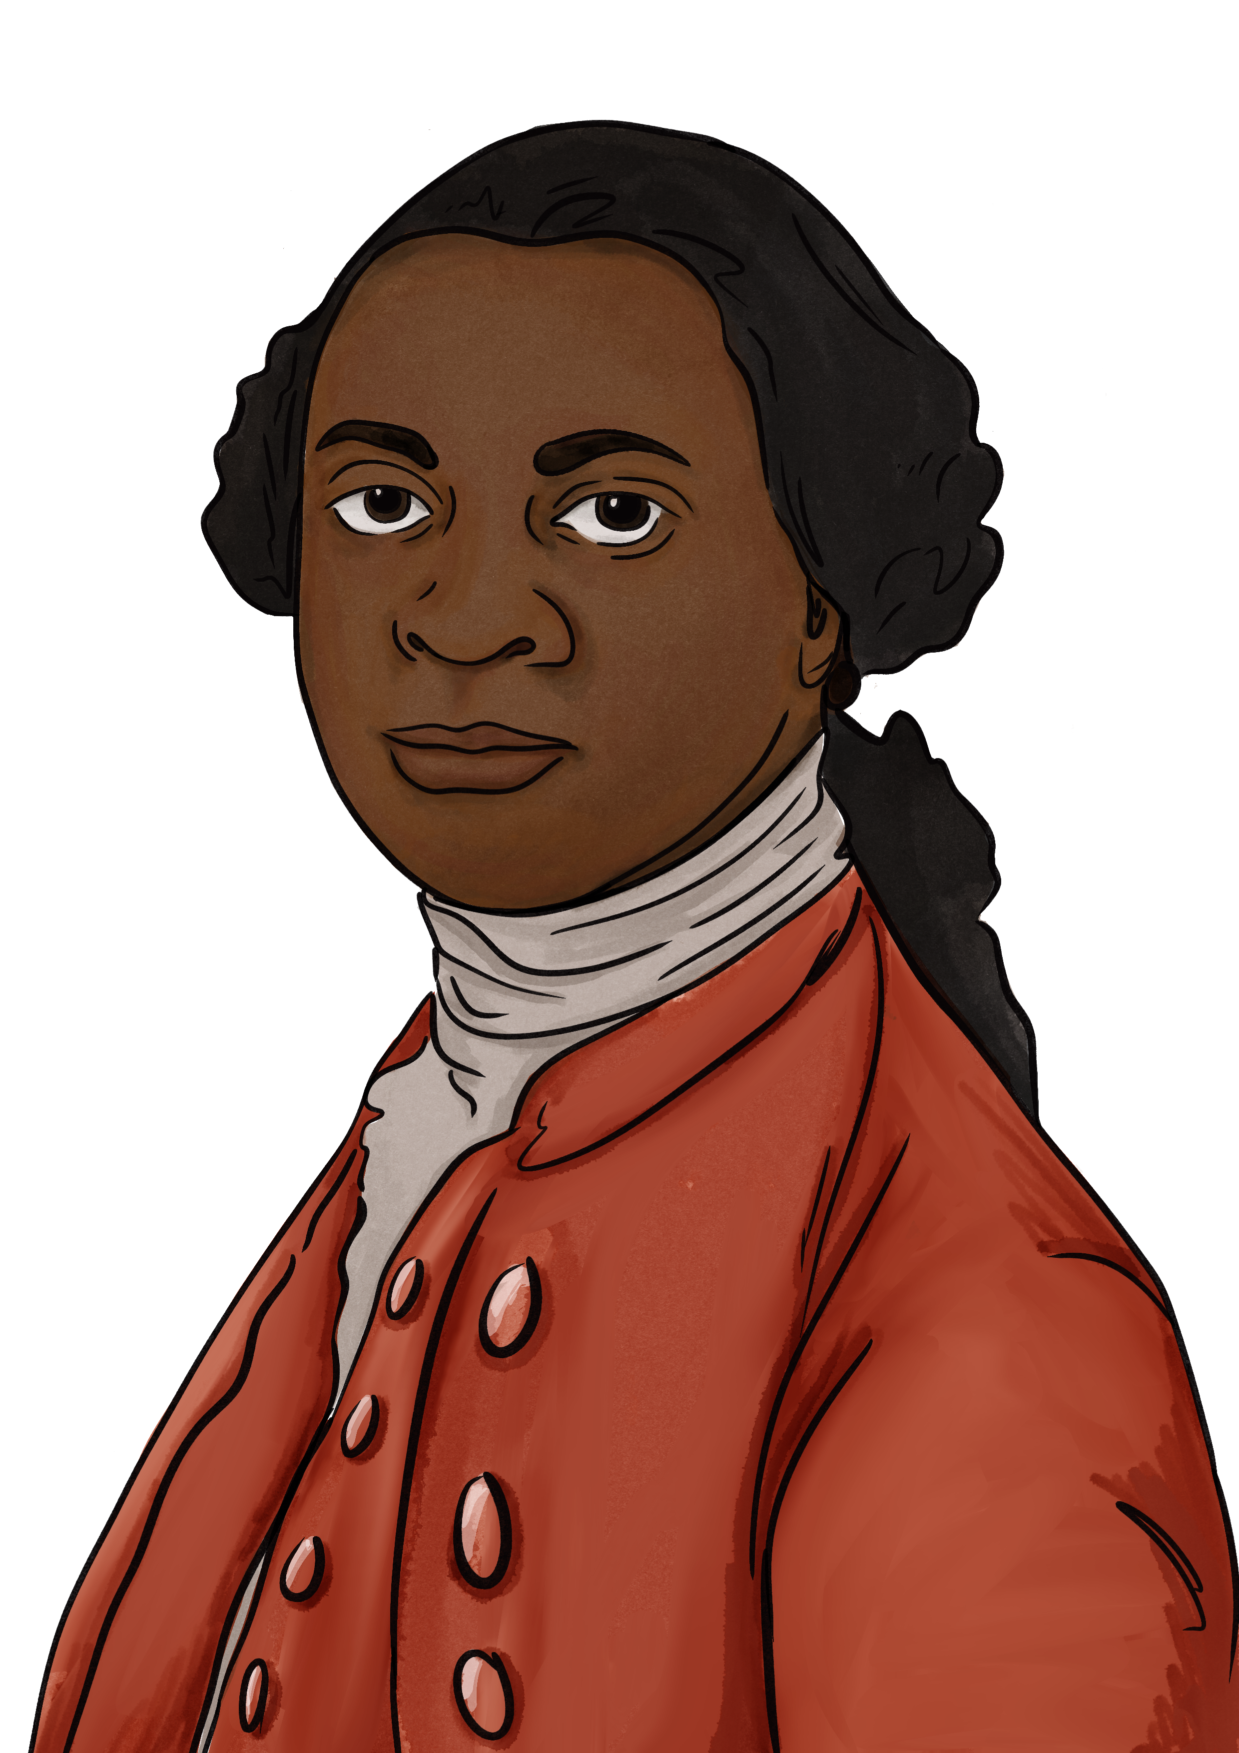

Abolitionists
Equiano, also known as Gustava Vassa, was born in West Africa and enslaved as a child. After buying his own freedom, he became an important abolitionist in Britain.
His autobiography, “The Interesting Narrative of the Life of Olaudah Equiano,” published in 1789, played a vital role in showing the atrocities of slavery and was significant to helping the abolitionist cause.
Notes:
Drescher (1990) - https://doi.org/10.1215/9780822382379-014
Image - https://www.google.com/url?sa=i&url=https%3A%2F%2Fcapmin.org%2Fwilberforce-on-perseverance-in-office%2F&psig=AOvVaw0UQXF44sKpH4Md3L_TSdu5&ust=1721930427069000&source=images&cd=vfe&opi=89978449&ved=0CBAQjRxqFwoTCPjvkO6gwIcDFQAAAAAdAAAAABAE

Slide 9

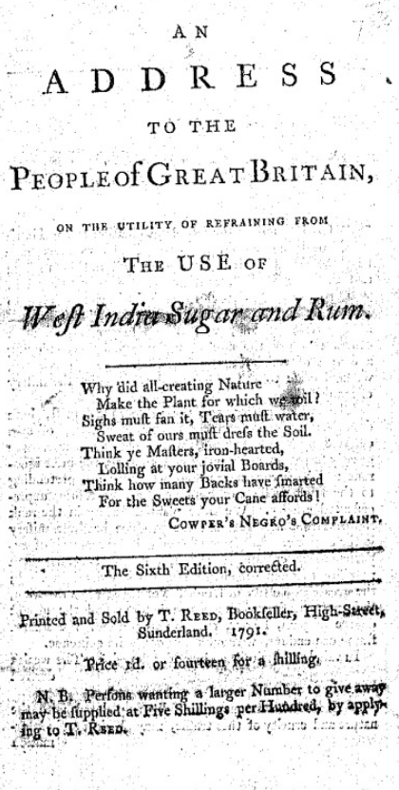
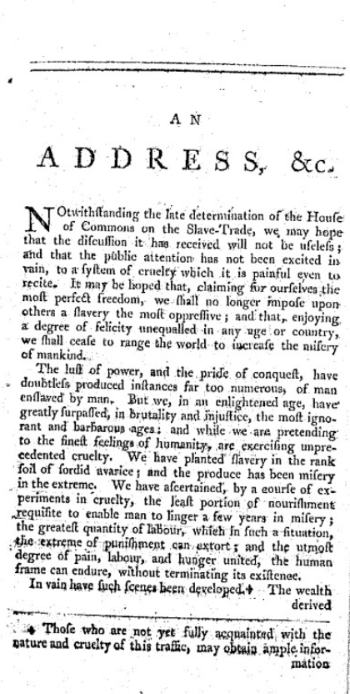

William Fox’s Address
William Fox’s Address to the People of Great Britain, on the Propriety of Refraining from the Use if West India Sugar and Rum, 1791.
This was a very popular pamphlet and appealed to adults and children at the time. It encouraged them to abstain from sugar.
In one instance, it was noted, a 10-year-old boy, wouldn’t take sugar –
“…since he read Fox’s tract.”
Notes:
https://brycchancarey.com/abolition/williamfox.htm

Slide 10


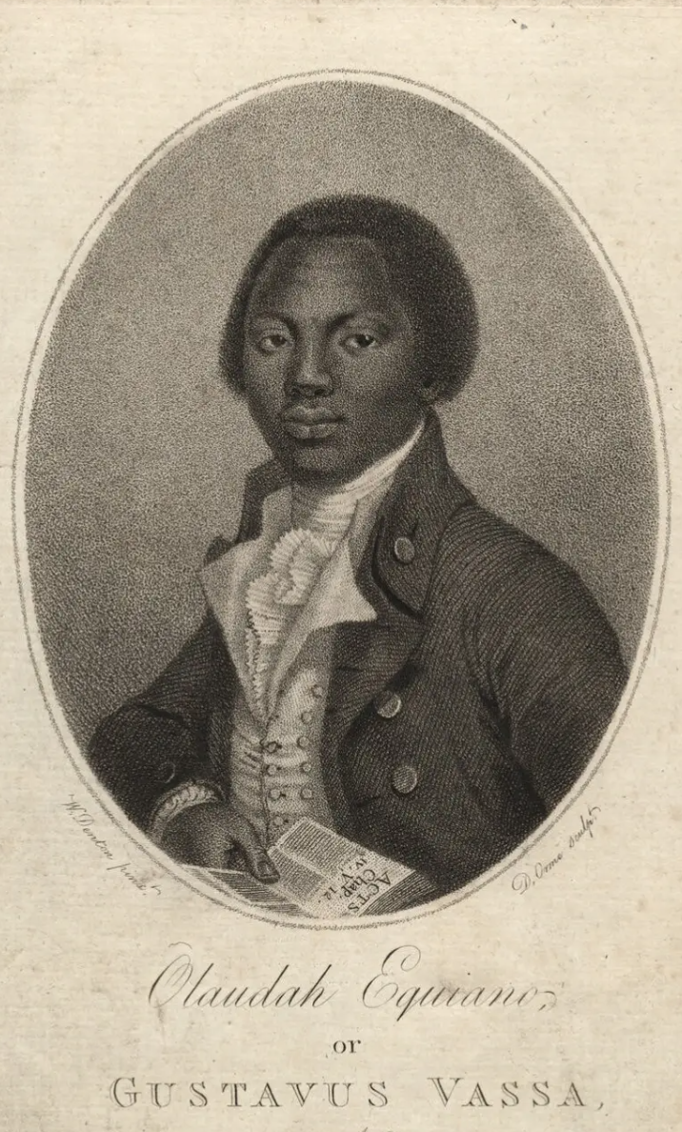
Excerpt from the diary of Katherine Plymley
“He dined at my Brothers, the little people, immediately went to him, offered their hands & behaved in their pretty friendly way.
Whilst my sister was out of the room, he gave Panton one of the little pamphlets against the use of sugar. When Ann return’d & Panton said, see what this gentleman has given me, she told him what warm friends they were to the abolition, & that they had long left off sugar.
He gave Panton one of his memoirs & wrote his name in it himself & desired him to remember him.
He asked Panton if he should like to travel. Panton— said he did not know – Should he like to go to Africa – Yes – Will you go with me – just as my Papa pleases – Josepha on being asked made the same answer & he made many professions of the care he would take of them.
Ann, Mrs. Plymley and the little people were much pleased with him.”

Slide 11

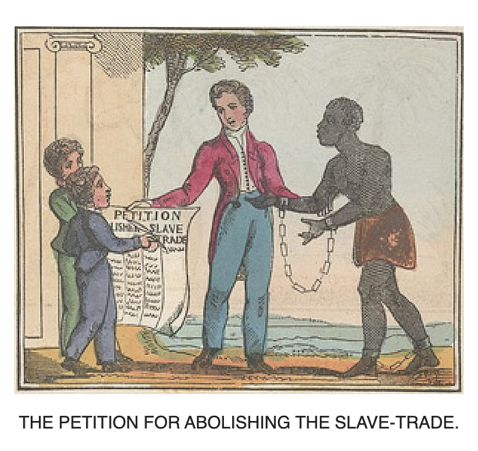
Historical Case Studies
Read – How Children Joined the Fight to Abolish Slavery by Dr Ryan Hanley, Kathryn Gleadle.
Read – excerpt from diary of Katherine Plymley.
Discuss the roles of children in the abolition movement.

Slide 12

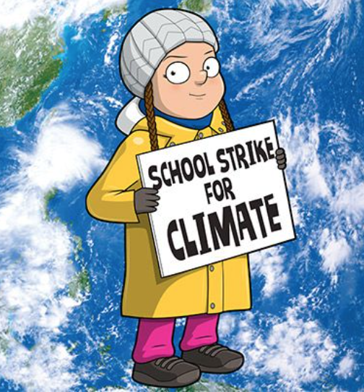


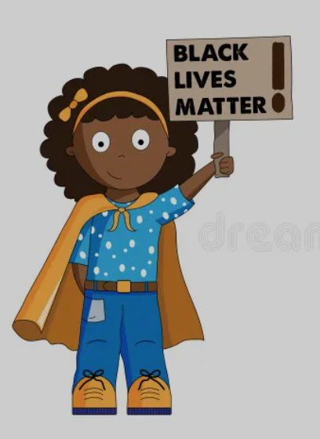
Children’s involvement in current
social movements
How have children been involved in today’s social movements?

Slide 13
Explore creative ways in which children contribute to the fight against the slave trade.
I can explain how children used sweets as a tool to raise awareness and funds for anti-slavery efforts.

Slide 14

Boycotts – 1790s & 1820s
One of first examples of mass consumer protest. It encouraged people not to buy sugar and goods produced from the enslaved in the West Indies.
At the end of 1791, 300,000 families boycotted sugar and sales fell significantly.
This number rose again in later boycotts (1820)*.
It was observed that children were particularly active in the boycotts of sugar produced by
enslaved people.
Ester Copley
claimed that –
“In some instances, children, having heard the sufferings endured by Africans in cultivating sweet cane, (…) resolutely abstained from it, and introduced into whole families the system of abstinence.”
A HISTORY OF THE SLAVE TRADE
AND ITS ABOLITION, 1839
Notes:
*Also when women’s leadership in the abolitionist movement picked up force

Slide 15
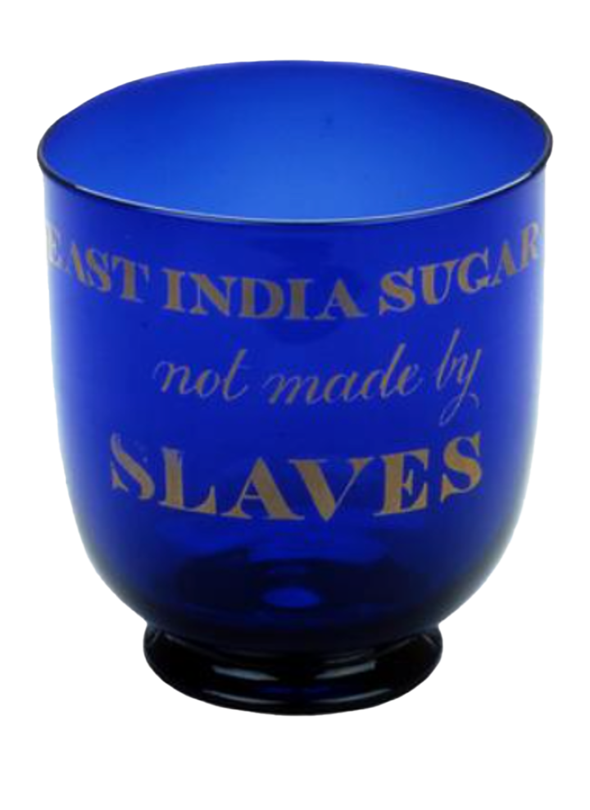


Sugar bowls
During the boycotts as many as 300,000 people abstained from sugar.
These sugar bowls were mass produced to encourage people to not buy from West Indies, but other parts of the world.
Notes:
We would not say ‘slaves’ today because that is not what they were or how these people would want to self-identify
We use ‘enslaved’ to show this was done to these people against their will

Slide 16


Role-play
Read – Georgian children boycotted sugar to protest against slavery and support abolitionists.
Enact a community sugar boycott.
Notes:
https://news-archive.exeter.ac.uk/2021/april/title_853263_en.html

Slide 17


Creative Project
1
2
Pupils to create posters or pamphlets that could be used during the abolitionist movement to raise awareness about the sugar boycott.
Include an additional section in the project that explains how these actions helped the cause.

Slide 18
Reflect on the significance of small actions in creating social change
I can demonstrate understanding of the impact of children’s involvement on the abolitionist cause.
I can reflect on the importance of collective action, no matter how small, in advocating for social justice.

Slide 19
Small actions in creating social change
HISTORICAL MOVEMENTS
CONTEMPORARY MOVEMENTS
Publishing Pamphlets: Abolitionists like William Lloyd Garrison published pamphlets and newspapers that spread anti-slavery ideas, raising awareness and gathering support for the cause.
Underground Railroad: Individuals like Harriet Tubman helped enslaved people escape to freedom one by one, contributing to the weakening of the slavery system.
Petitioning: People signed petitions against slavery, which were sent to lawmakers, showing widespread public support for abolition.
Social Media Campaigns: Activists use hashtags and online campaigns to spread awareness about issues like climate change and racial justice. Greta Thunberg started with a small school strike that grew into a global climate movement.
Community Cleanups: Local environmental groups organize small-scale cleanups that lead to larger initiatives for environmental protection.
Letters to Leaders: Young people write letters to politicians advocating for changes in laws and policies, contributing to significant legislative actions.

Slide 20
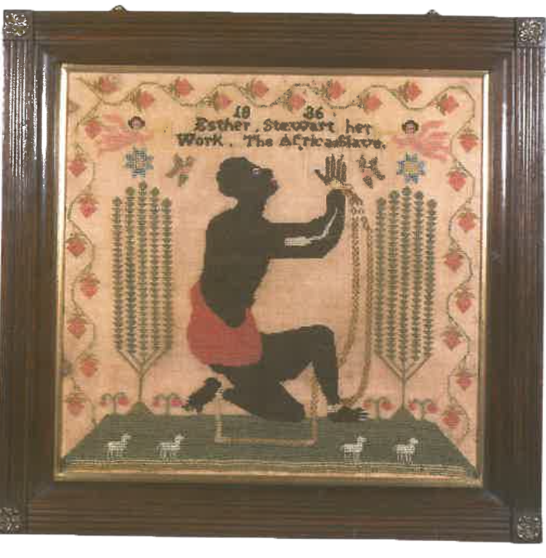
Women and children’s involvement
“The African Slave,” signed “Esther Stewart” and dated 1836. Worked in coloured wools, this rare sampler shows a kneeling slave, chained hand and foot.
A perfect example of the anti-slavery movement in Britain.
Notes:
Discussion point: Although this imagery of Africans was trying to create a ‘positive good’ – the end of slavery
What aspects of the image might also fuel anti-Black racism?

Slide 21
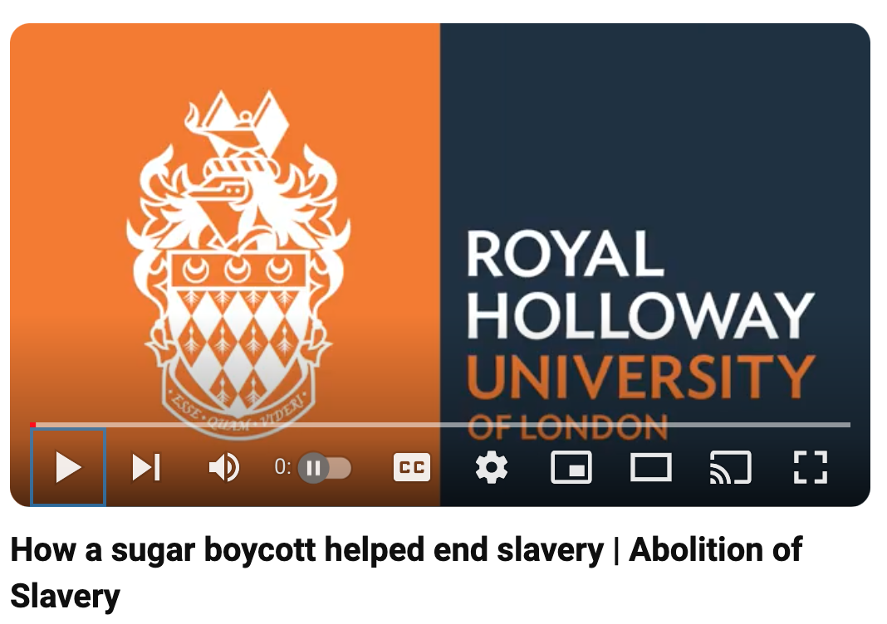

Women and children’s involvement
Notes:
https://youtu.be/5NimHtuA-6o?si=eHXXErQw-M23IM33

Slide 22

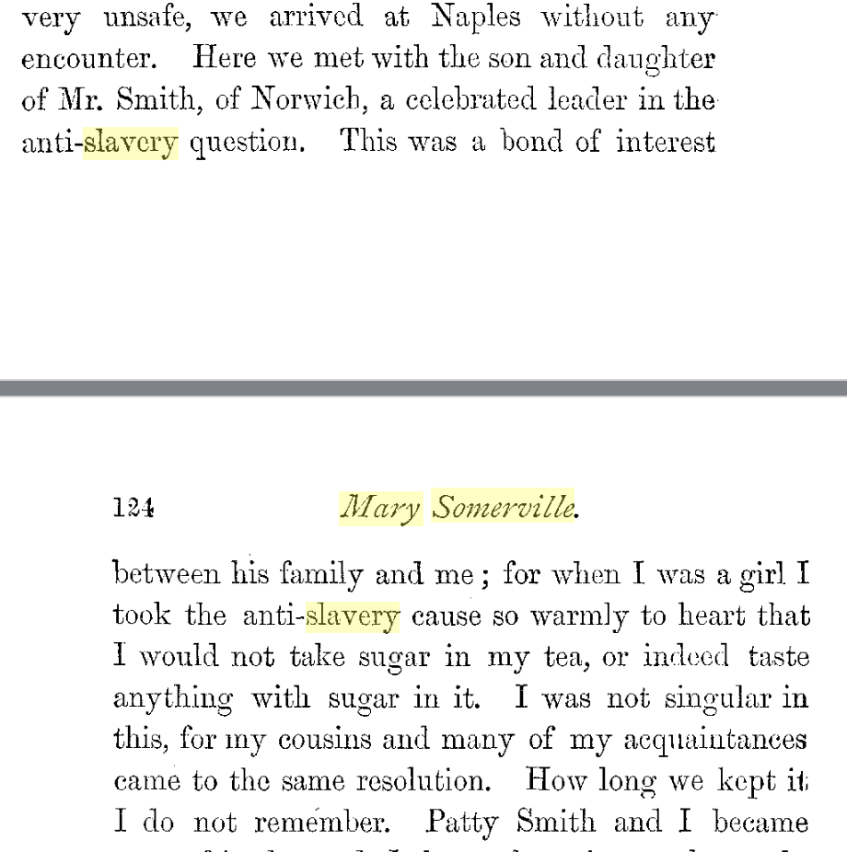

Women and children’s involvement
Personal Recollections, from Early Life to Old Age, of Mary Somerville
With Selections from Her Correspondence
By Mary Somerville, Martha Charters Somerville · 1874
Notes:
https://www.google.co.uk/books/edition/Personal_Recollections_from_Early_Life_t/qfXVUCYKF1sC?hl=en&gbpv=1&dq=Mary+Somerville+%22slavery%22&pg=PA124&printsec=frontcover

Slide 23
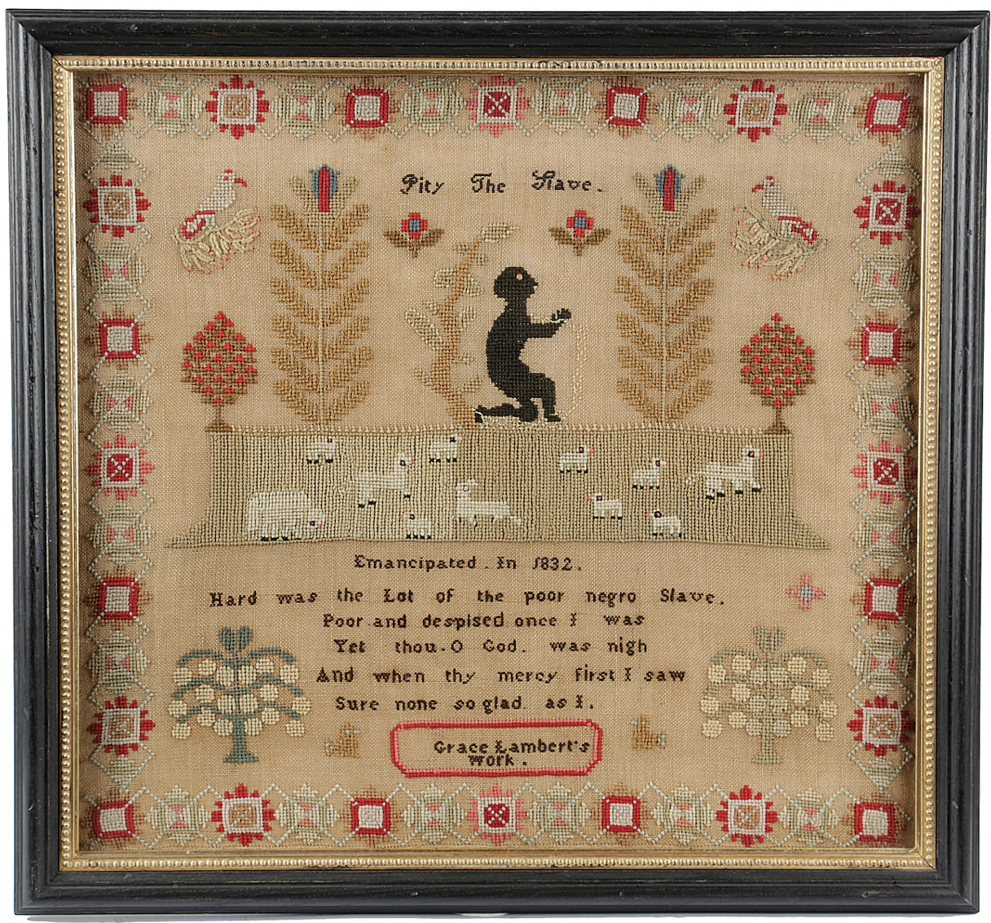


Analyse the primary source using the handout provided.

Slide 24

Write a short essay or journal entry on a small action you can take to address a current social issue.

Slide 25



Slide 26
Primary Source Analysis
What is it? (E.g. letter, newspaper, report.
What was used to make it?)
Who made it? (E.g. authorship, famous person, require more research?)
When and where is it created?
What does it tell you?
What does it not tell you that might be important to also know?
Why was it created?

Slide 27
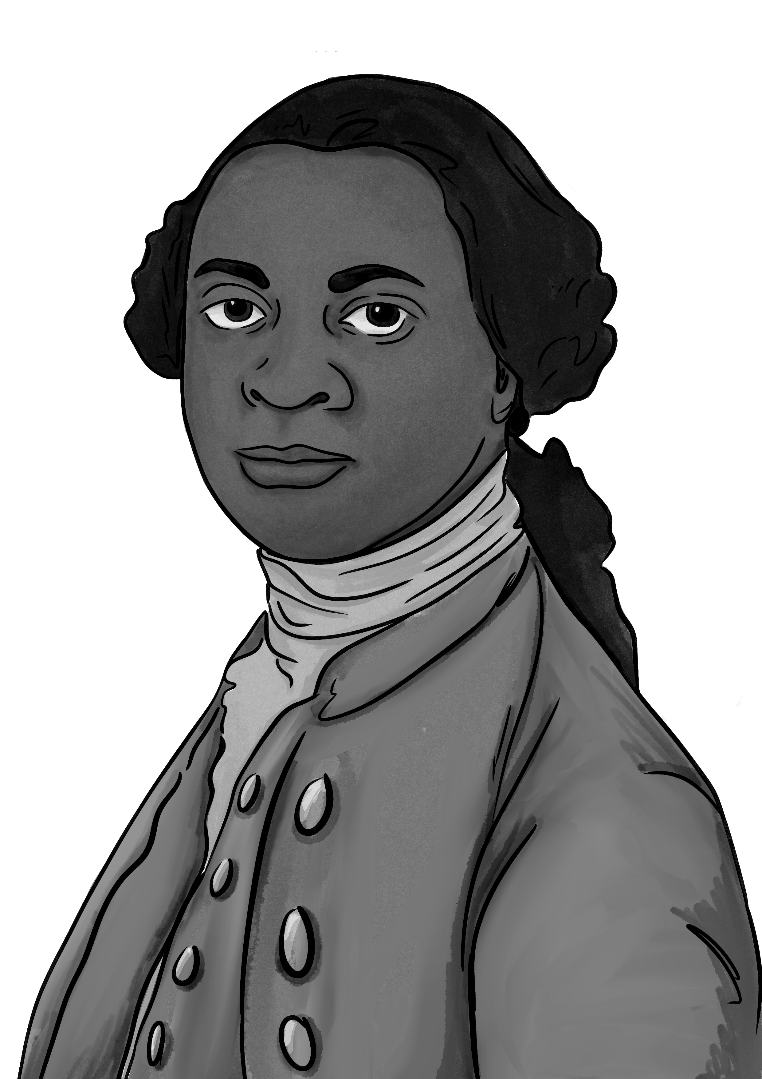
Excerpt from the diary of Katherine Plymley
He asked Panton if he should like to travel.
Panton said he did not know – Should he like to go to Africa?
– Yes –
-Will you go with me –
- just as my Papa pleases –
Josepha on being asked made the same answer
and he (Equiano) made many professions of the care he would take of them.
Ann, Mrs. Plymley and the little people were much pleased with him.
Equiano’s visit to the Plymley household in 1793
Mr Vasa [Equiano] had been on a visit to Mr Leighdon in Shrewsbury & was not, he said, willing to leave the county without seeing my Brother, to whom he had been introduced in London.
My Brother had then purchased of him the memories of his life [The Interesting Narrative] written by himself; & I believe his business at this time was to get introduced wherever he could, & to dispose of them…
…had my brother been at home, he would have done all he could for him, & did endeavour to see him afterwards in Shrewsbury but he was gone. He dined at my Brothers, the little people*, immediately went to him, offered their hands & behaved in their pretty friendly way.
Whilst my sister was out of the room he gave Panton one of the little pamphlets against the use of sugar. When Ann return’d & Panton said, see what this gentleman has given me, she told him what warm friends they were to the abolition, & that they had long left off sugar. He gave Panton one of his memoirs & wrote his name in it himself, & desired him to remember him.
.
Notes:
*’though they had not been accustomed to blacks’ this phrase has been removed from the diary extract above for reasons of teaching sensitively. It is suggested teachers think carefully about their own classroom contexts when considering how to handle out of date racial terms

